Slide 1
MULLARD SPACE SCIENCE LABORATORY
The Influence of Sudden Commencements on the Rate of Change of the Surface Magnetic Field in the UK
Andy Smith¹, Mervyn Freeman², Jonathan Rae¹, Colin Forsyth¹
Credit: NASA
¹ Mullard Space Science Laboratory, University College London, Dorking, UK
² British Antarctic Survey, Cambridge, UK
19 November 2019

Slide 2
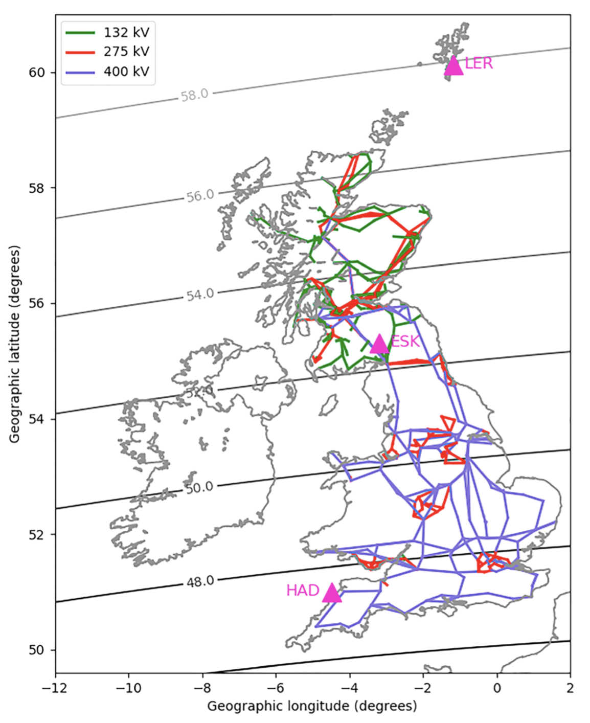
Definitions and Data
Geomagnetically Induced Currents (GICs) can disrupt or damage power transformers. The magnitude of GICs depends on:
The rate of change of the field [e.g. Viljanen et al., 2001].
The local subsurface conductivity [e.g. Beggan et al., 2015].
Geometry of power network [e.g. Thomson et al., 2005].
21 years worth of data used (1996 – 2016), from three UK magnetometer stations.
We define the rate of change:
Large values of R are typically associated with higher latitudes [e.g. Viljanen et al., 2006].
R > several hundred nTmin⁻¹ is of a worrying level.
Approximately 50% of large R in the UK are associated with substorm expansion and recovery phases [Freeman et al., 2019].
LER
ESK
HAD
Freeman et al., 2019

Slide 3
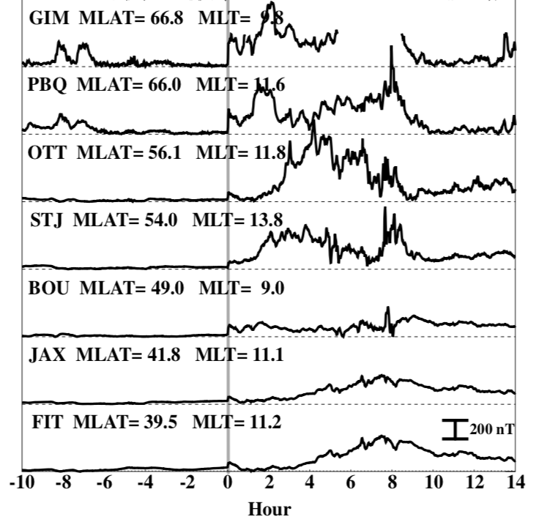
Sudden Commencements
Sudden Commencements (SCs) represent a significant source of GICs at mid latitudes [e.g. Kappenman et al., 2003; Marshall et al., 2012].
SCs are rapid increases in the strength of magnetopause currents following the impact of a solar wind pressure pulse [Araki, 1977; 1994].
Signature is observed globally, though the magnitude is latitude dependent [Fiori et al., 2014].
SCs may be followed by further magnetospheric activity [Chree, 1925; Curto et al., 2007].
We use a catalogue compiled by Ebre Observatory, identifying 380 SCs between 1996 and 2016.
Fiori et al., 2014

Slide 4
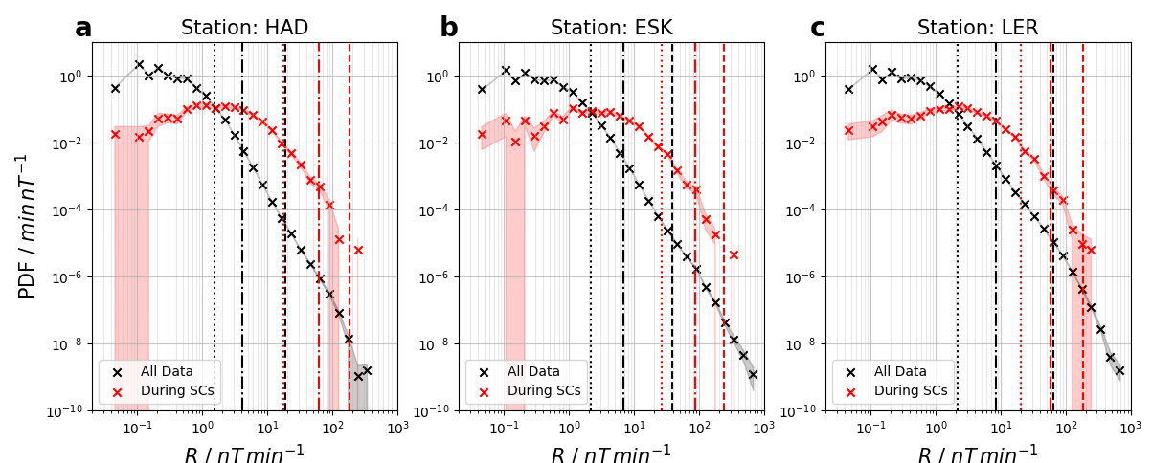
R During SCs
PDFs intersect at around the 90th percentile (~1nTmin⁻¹)
90th, 99th and 99.97th percentiles marked
Percentiles are largest at the middle (ESK) station
Increasing Latitude
Smith et al., 2019

Slide 5
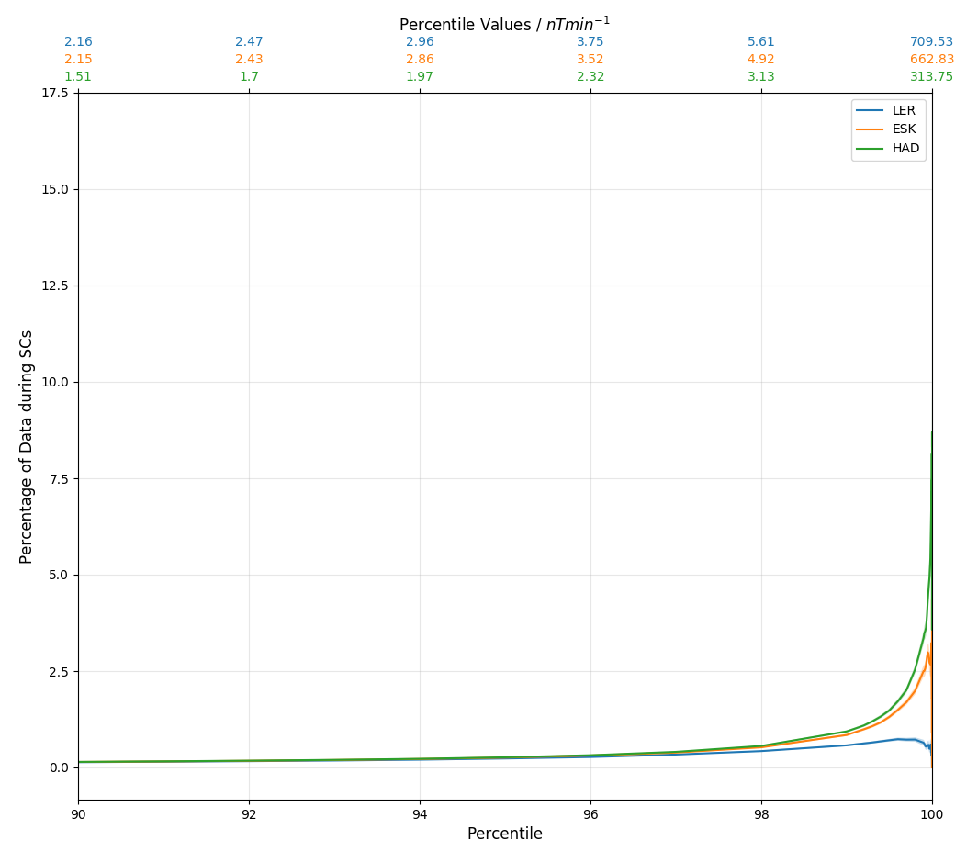
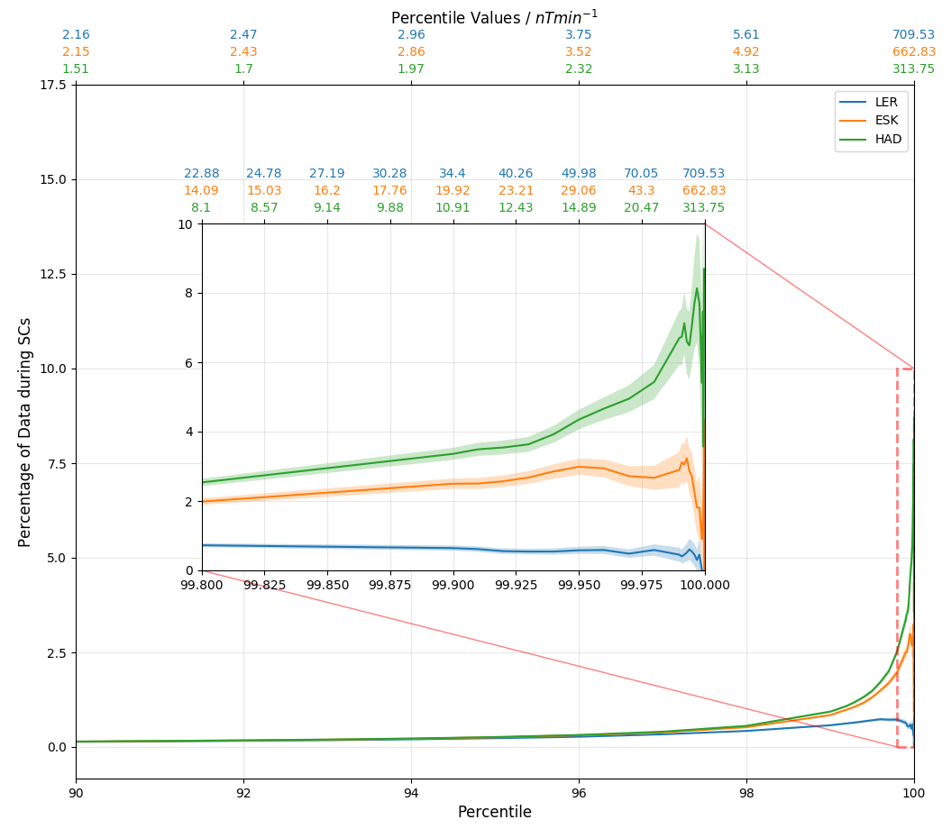
R During SCs
We can evaluate the fraction of R that is attributable to SCs.
Total data: 11x10⁶ minutes
SCs: 1900 minutes
Overall Fraction = 0.0002%
However, they may contribute more at higher percentiles, and this could be more significant at lower latitudes.
Above the very high percentiles the fraction of data related to SCs becomes non-negligible, but still small.
Smith et al., 2019

Slide 6
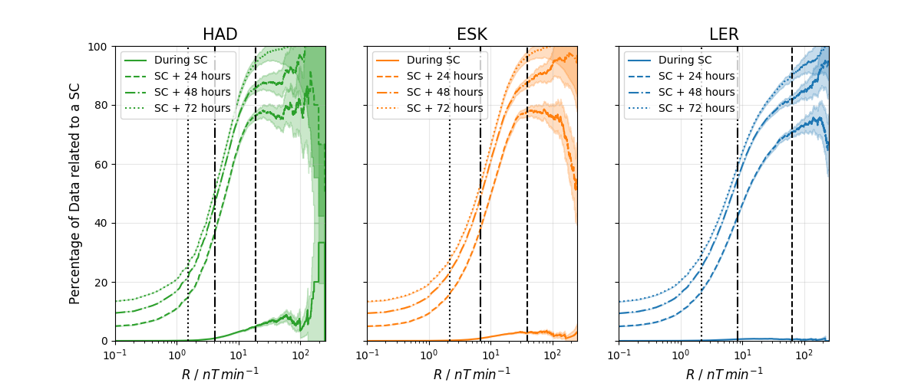
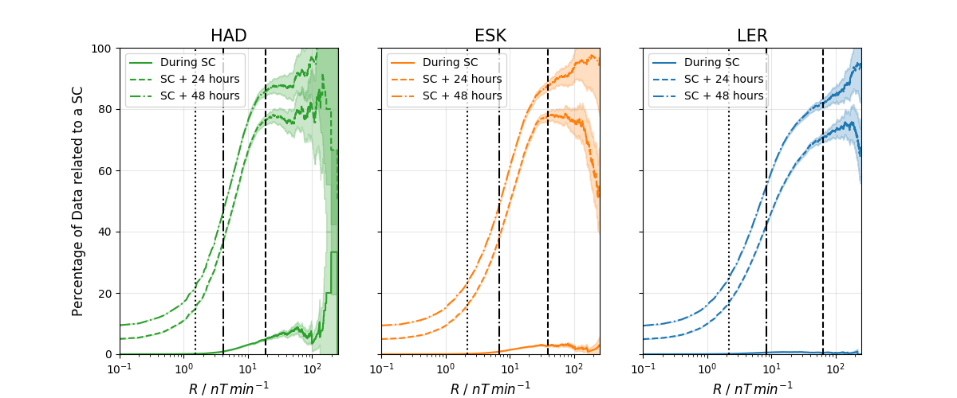
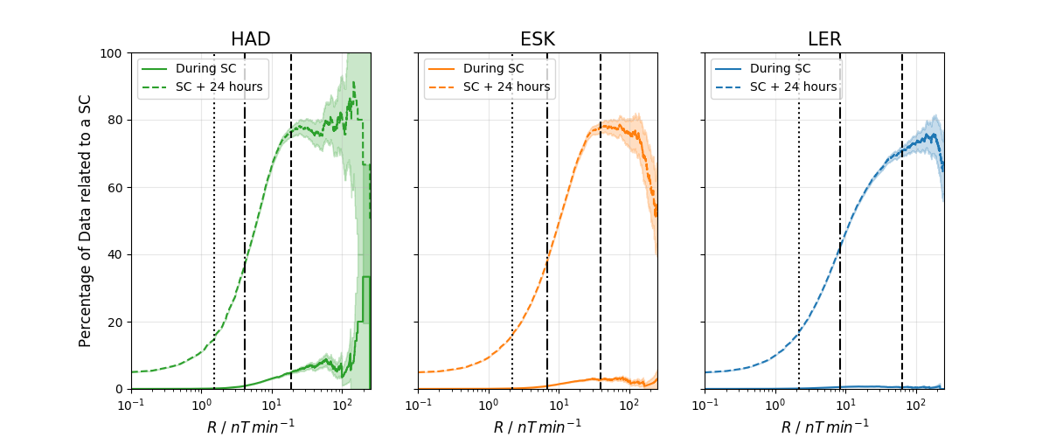
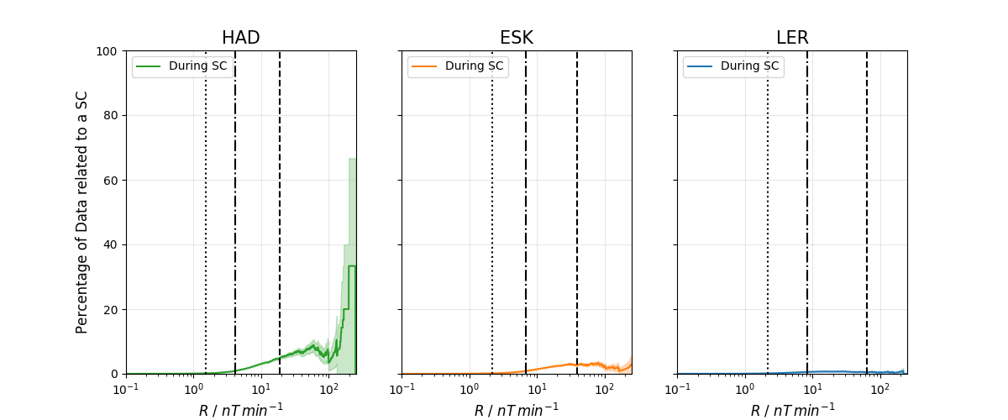
R Following SCs
Smith et al., 2019
90% of data above the 99.97th percentile occurs within three days of a SC.
All R > 200 nTmin⁻¹ occur within three days of an SC

Slide 7
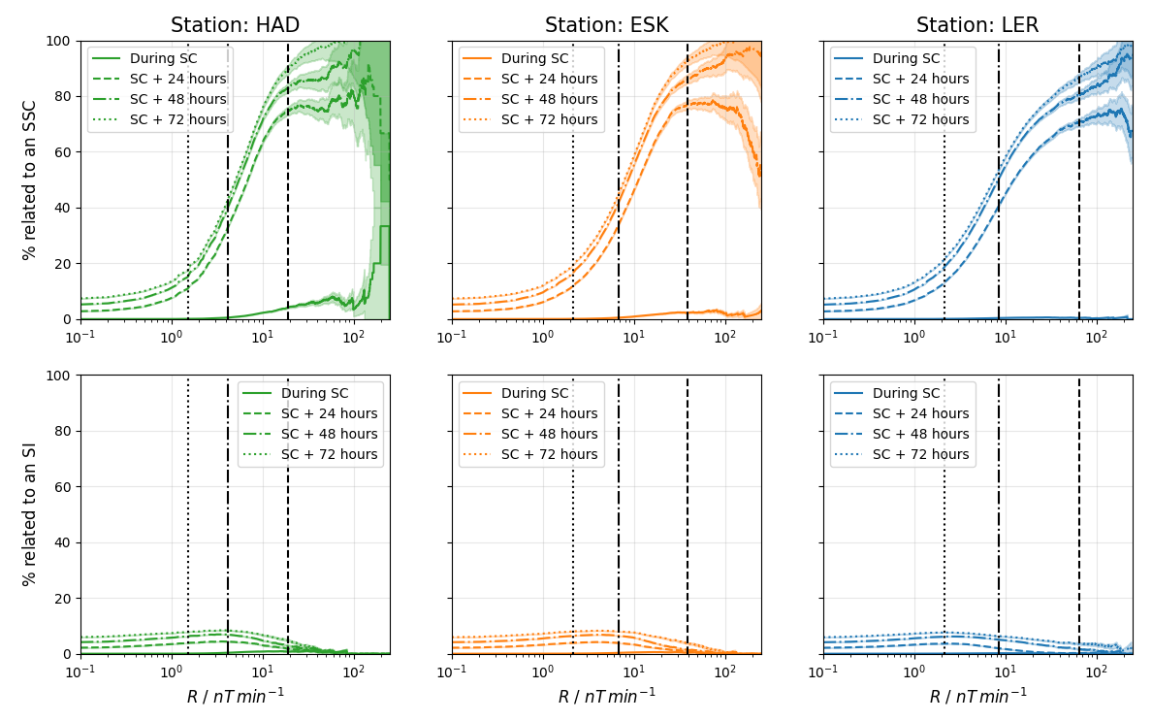
R Following SCs
If followed by a magnetospheric storm the SC is classified as a Sudden Storm Commencement (SSC). Total.= 215/380 SCs.
If not, then it can be classified as a Sudden Impulse (SI). Total = 165/380.
Smith et al., 2019

Slide 8
Summary
Rate of change of the surface magnetic field (R) in the UK is enhanced during SCs.
The percentiles of R are largest at the middle station (latitudinally).
Only small fraction of the largest R is attributable to SCs (< 8%).
Greater than 90% of extreme R occurs within three days of an SC.
Only SSCs lead to this enhancement, SIs have smaller impacts both initially and in the following days.
If you can forecast SCs (e.g. using heliospheric tracking from L5, or at L1) then you can predict the broad 3 day intervals within which the UK is likely to see the largest R.
Smith et al., 2019; Space Weather; DOI: 10.1029/2019SW002281
andy.w.smith@ucl.ac.uk

