Slide 1
Preliminary investigation of the possibility of GIC development in Greece
Adamantia Zoe Boutsi ^{(1,2)}, Georgios Balasis ⁽¹⁾, and Ioannis A. Daglis ^{(2,1)}
¹IAASARS, National Observatory of Athens, Greece
²Department of Physics, National and Kapodistrian University of Athens, Greece
Objective
Method
Data
Conclusions

Slide 2
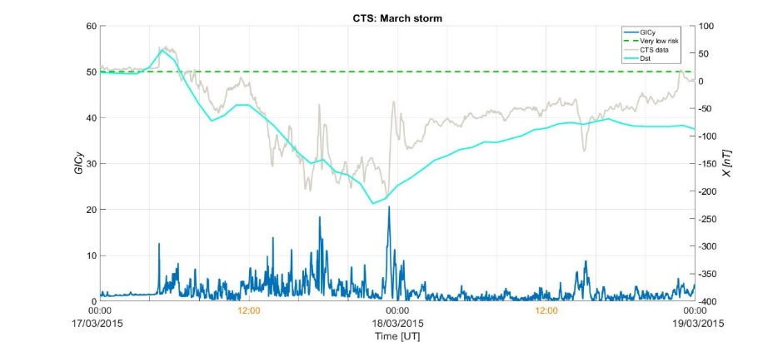
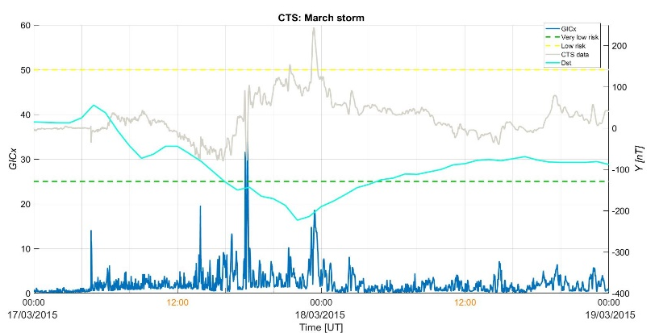
Analysis
1st step
We reproduce the results of the GIC index by Tozzi et al. (2019) for Italy during the 2015 St. Patrick’s storm.
Methodology
2/7

Slide 3
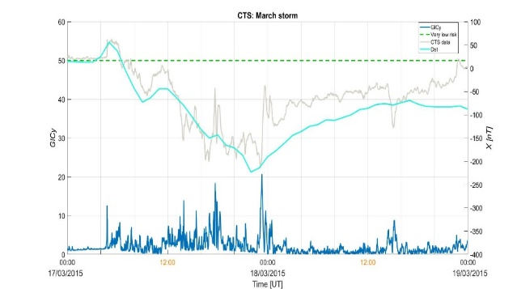
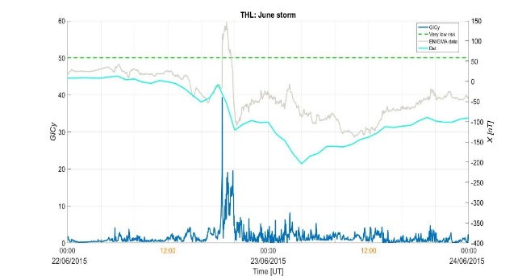
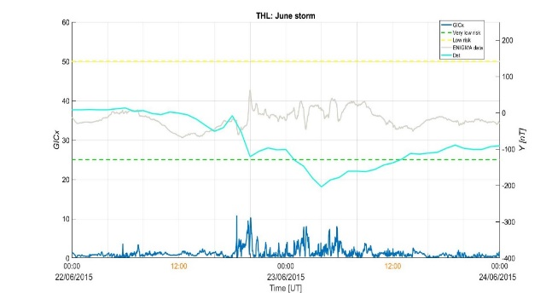
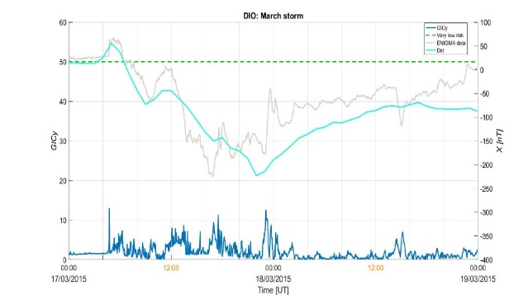
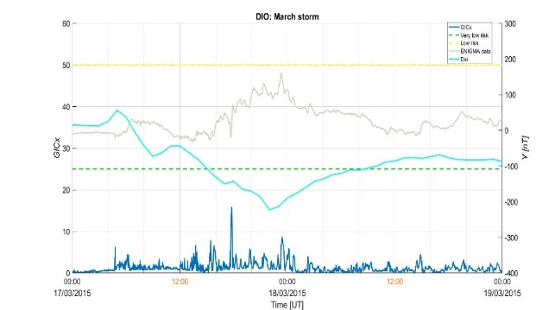
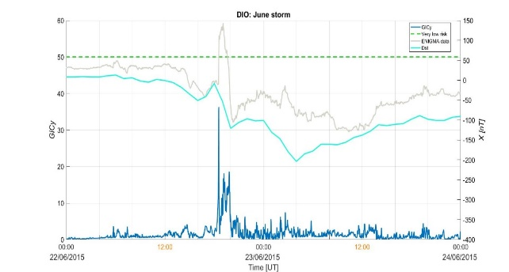
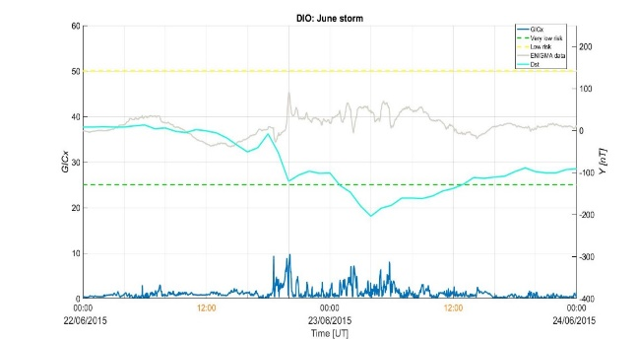
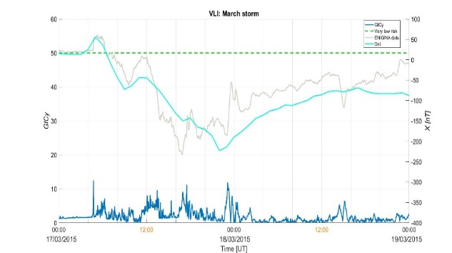
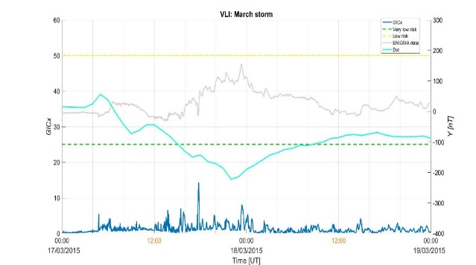
Analysis
2nd step
We calculate the GIC index for Greece during the St Patrick's and June 2015 storms.
Magnetic storm of 17 March 2015 (Dst = -223 nT)
Magnetic storm of 23 June 2015 (Dst = -204 nT)
data
4/7
Notes:
Apply the same methodology to ENIGMA data for the 17 March 2015 storm (available data were provided for DIO and VLI stations), and for the 23 June 2015 storm (available data were provided for THL and DIO stations), since those were the most intense storms of solar cycle 24.

Slide 4
Definition of GIC index
Remove linear trend from geomagnetic field time series
Apply the following formulas (Marshall et al., 2011) using moving windows of 1440 points, each:
${GIC}_{x}\left(t\right)= \left|{FFT\left\{Y\left(f\right)Z(F)\right\}}^{−1}\right|$
${GIC}_{y}\left(t\right)= \left|{FFT\left\{X\left(f\right)Z(F)\right\}}^{−1}\right|$
$Z\left(f\right)= e^{iπ/4}\sqrt{f/{f_{N}}}$ (filter function)
$f$: variable frequency
$f_{N}$: Nyquist frequency ($f_{N}$=8.3 mHz for sampling rate: 1 value/min)
Return to “Objective”
3/7

Slide 5
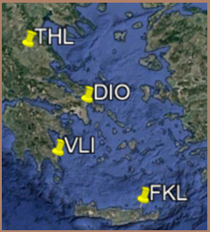
Data
5/7

Slide 6
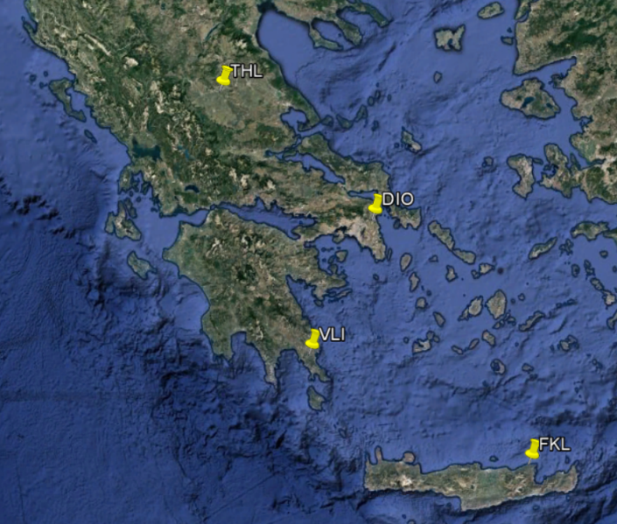
Data
ENIGMA Magnetometer Network http://enigma.space.noa.gr/:
Station | Latitude (°N) | Longitude (°E) | Sampling frequency
Klokotos (THL) | 39.565 | 22.014 | 5 Hz
Dionysos (DIO) | 38.078 | 23.933 | 1 Hz
Velies (VLI) | 36.718 | 22.947 | 1 Hz
Finokalia (FIN) | 35.338 | 25.670 | 10 Hz
Conclusions
6/7

Slide 7
Remarks
GIC index is a proxy of the geoelectric field and is estimated straightforwardly from magnetic field data.
GIC index provides a first estimation of the risk level due to geomagnetically induced currents around the area of the magnetic station / observatory.
Our results show that the higher the geographic latitude of the magnetic station / observatory, the higher the GIC index values that are calculated.
At a first glance, during the storms of March and June 2015 Greece did not seem to be much affected by geomagnetically induced currents.
However, it should be noted that the present GIC index is calculated without taking into account the geolectrical structure of the area that the station is located (i.e., the electrical conductivity of the subsurface), which might seriously affect the development of GIC.
7/7

