Slide 1
Ralph Zander & Christian Dratwa, 16.11.2019
Radiation aspects of space weather
in the airline business

Slide 2
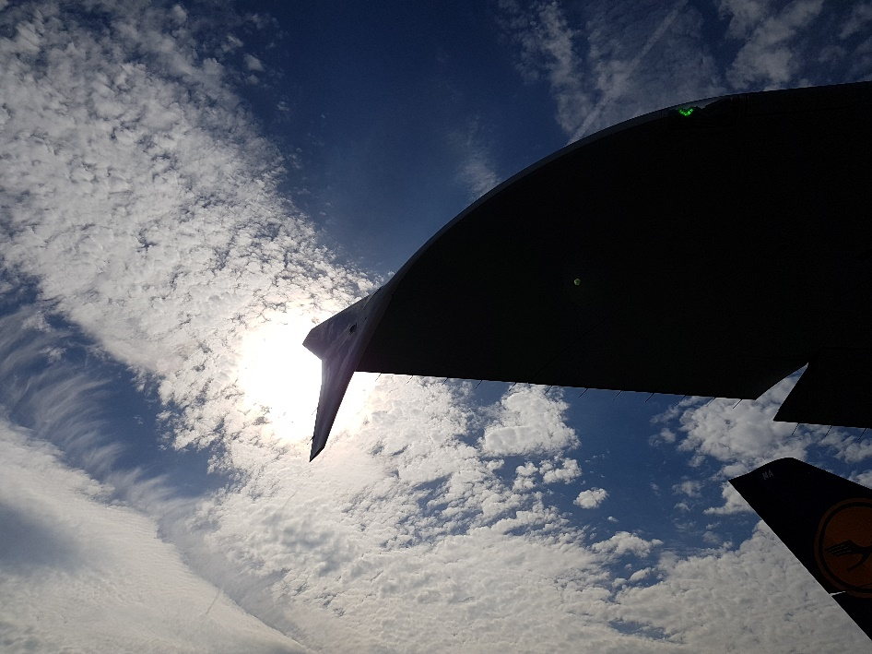
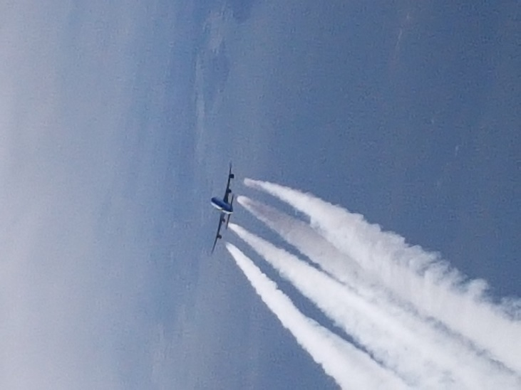
Radiation aspects of space weather in the airline business
What you can expect from this talk
Short introduction of „Vereinigung Cockpit“ and our work
Problems we face today
Who is affected in what way
Possible countermeasures
Your questions, short discussion
Aviation pictures
Intro, Ralph Zander, VC, 1.11.2019

Slide 3
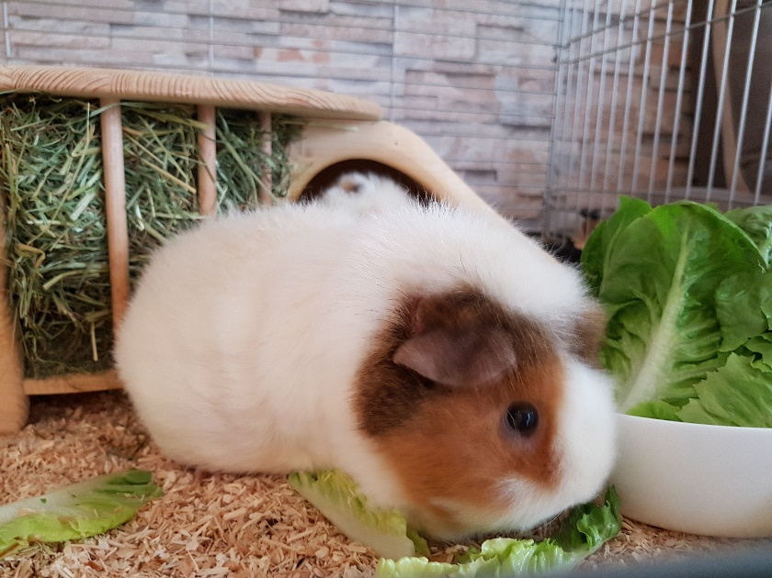
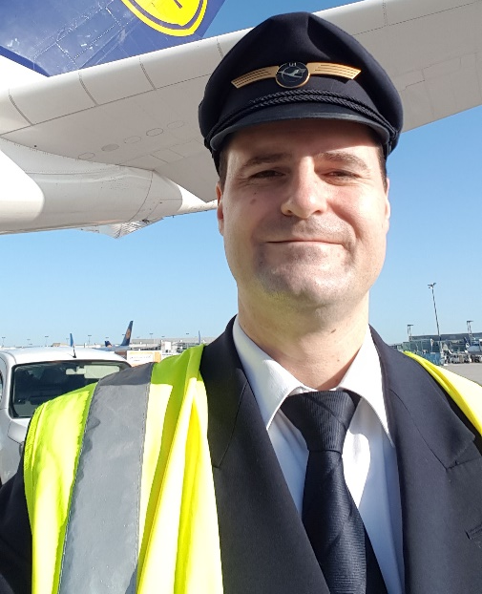
Radiation aspects of space weather in the airline business
„Vereinigung Cockpit“ – WHO WE ARE AND WHAT WE DO
Vereinigung Cockpit is the german airline pilots association, part of ECA (European Cockpit Association)
Different units, taking care of the interests of pilots; e.g. air traffic services, flight health, radiation
Who is presenting this talk
Intro, Ralph Zander, VC, 16.11.2019

Slide 4
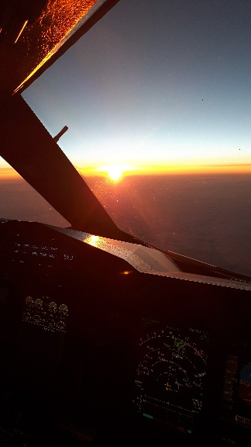
Radiation aspects of space weather in the airline business
ProblemS we face today
1)
Reasons
Is occupational radiation exposure an issue at all?
The Federal Office for Radiation Protection (BfS) figures for Germany in 2017
Monitored occupationally exposed persons: 447,787 thereof air crew: 44,763 (10%)
Collective dose: 117 Sv thereof air crew collective dose: 93 Sv (79,6%)
The vast majority of exposed workers receives only a minor portion of the dose. Among radiation protection experts, aviation generally serves as the bad example in terms of exposure.
Lack of knowledge (Crews, Operators, Legislators)
Increasing pressure by economy
Increasing flight hours for crews (optimized rostering)
Flightroutes optimized by economical factors
Lack of countermeasures against imminent dangers (in flight)
No measurement equipemnt on board
No space weather reports to crews
1)
The Federal Office for Radiation Protection (BfS), figures for Germany in 2017
Problem, Ralph Zander, VC, 16.11.2019

Slide 5
Radiation aspects of space weather in the airline business
Who is affected in what way
Flight Crew
Communication/Navigation: HF com, GPS distortion
Health: UV radiation & ionizing radiation
Denial or overcautious, Lack of knowledge
Who is affected, Ralph Zander, VC, 16.11.2019

Slide 6
Radiation aspects of space weather in the airline business
Who is affected in what way
Cabin Crew
Health: ionizing radiation
Lack of knowledge
Common perception: We can‘t do anything against radiation
Who is affected, Ralph Zander, VC, 16.11.2019

Slide 7
Radiation aspects of space weather in the airline business
Who is affected in what way
Passengers
Lack of knowledge
Frequent flyers
Influence on pregnancy (ionizing radiation)?
Who is affected, Ralph Zander, VC, 16.11.2019

Slide 8
Radiation aspects of space weather in the airline business
Who is affected in what way
Operators, Crew scheduling, Flightplanning
Denial of risks
Lack of training
Economic pressure
Who is affected, Ralph Zander, VC, 16.11.2019

Slide 9
Radiation aspects of space weather in the airline business
Who is affected in what way
Legislators
Lack of detailed information
Economic interests
Who is affected, Ralph Zander, VC, 16.11.2019
Picture By Saeima - 12.Saeimas deputātu svinīgais solījums, CC BY-SA 2.0, https://commons.wikimedia.org/w/index.php?curid=36631259

Slide 10
Radiation aspects of space weather in the airline business
Possible countermeasures
Smart rostering of crews, educate the crew scheduling staff
Adaption of flight routes/altitudes and taking space weather into account during flight planning, educate dispatch staff
Air traffic control needs to be involved in space weather anomaly procedures
Passenger awareness should be raised, they can build economic pressure on airlines
Operators need to be shown the advantages of educated crews and an action plan
Legislators need an up to date legal framework and installment in airlines
Science should provide methods and equipment for calculating, measuring and forecasting
Countermeasures, Ralph Zander, VC, 16.11.2019

Slide 11
Let‘s hear your questions!
Thank you for your attention

