Slide 1
Radiation monitoring hosted payloads: ICARE_NG2
S. Bourdarie, J. Carron, L. N’Guyen, R. Ecoffet, P. Bourdoux, D. Falguere, M. Ruffenach, P. Caron, J. Luntama, M. Heil

Slide 2
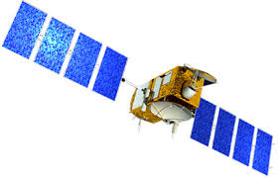
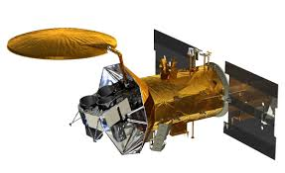
Introduction
ICARE-NG2 is the present version of the ICARE instrument
Environment measurements (proton and electron fluxes)
Technological board “MEX”, i.e. TID and DDD drifts, SEE records (optional)
Includes connections for an optional external sensor (RS422 serial link, and +5V)
CARMEN is a mission name for space environment hosted payloads
CARMEN-1 : ICARE-NG + 3 micro-debris detectors (SODAD) on SAC-D
CARMEN-2 : ICARE-NG, associated with LPT from JAXA on JASON-2
CARMEN-3 : ICARE-NG + AMBRE (plasma detector) + LPT, on JASON-3
CARMEN-4 : ICARE-NG on E7C
JASON-2
SAC-D

Slide 3
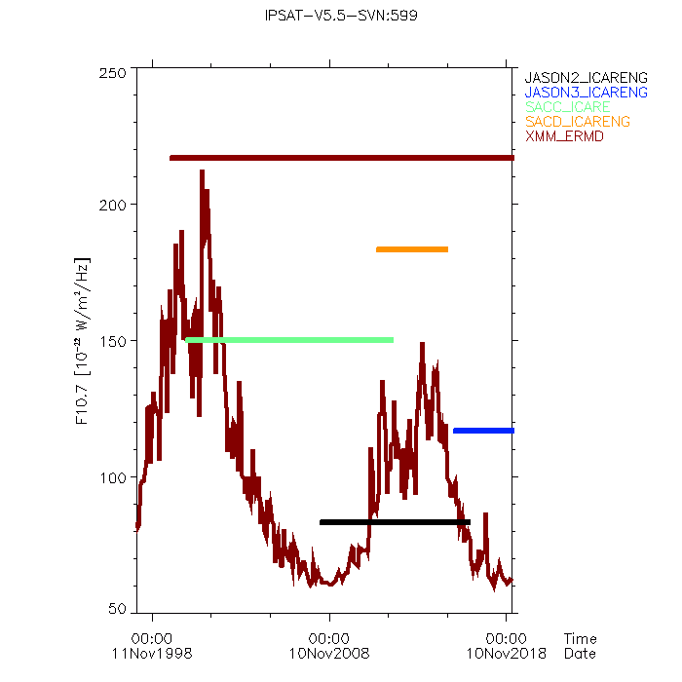
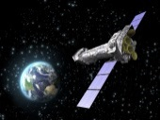
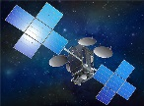
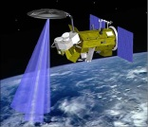
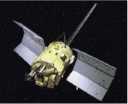
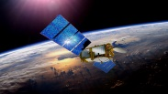
Introduction
20 years of space environment and effects measurements
XMM
E7C
SAC-D
SAC-C
Jason-3
Jason-2

Slide 4
ICARE-NG2 : The payload
 | CARMEN-5 characteristics
Size (mm) | ̴ 218 x 148 x 105
Housing material | Alu 6082 T651
Surface finishing | Surtec 650 and PUK black paint
Sensors | 2×telescopes (stack of 2 diodes) and one single diode
Mass | ̴ 4,18Kg
Power | 6W typ (10W with MEX ON)
Power supply interface | 100V regulated power bus
Interface links with spacecraft | CAN bus
Operating temperature range | -35°C to +66°C
Lifetime | 8 years
(256 or 128) channels ×5
2 coincidences
2 anti-coincidences
1 single

Slide 5
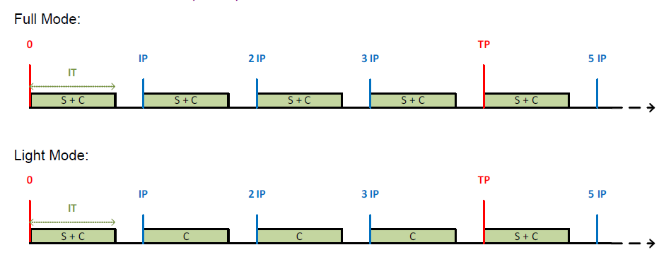
ICARE-NG2 : The payload
ICARE-NG2 can accomodate any TM budget (i.e. strong constraint in EOR phase)
IT = Integration time (250 ms – 62 s < IP-2)
IP = Integration period (8s, 16s, 32s, 64s)
TP = Telemetry period (8s, 16s, 32s, 64s, 128s or 256s)
M = Mode (Full or Light)
Can be set by TC
S=640 bytes and C=20 bytes

Slide 6
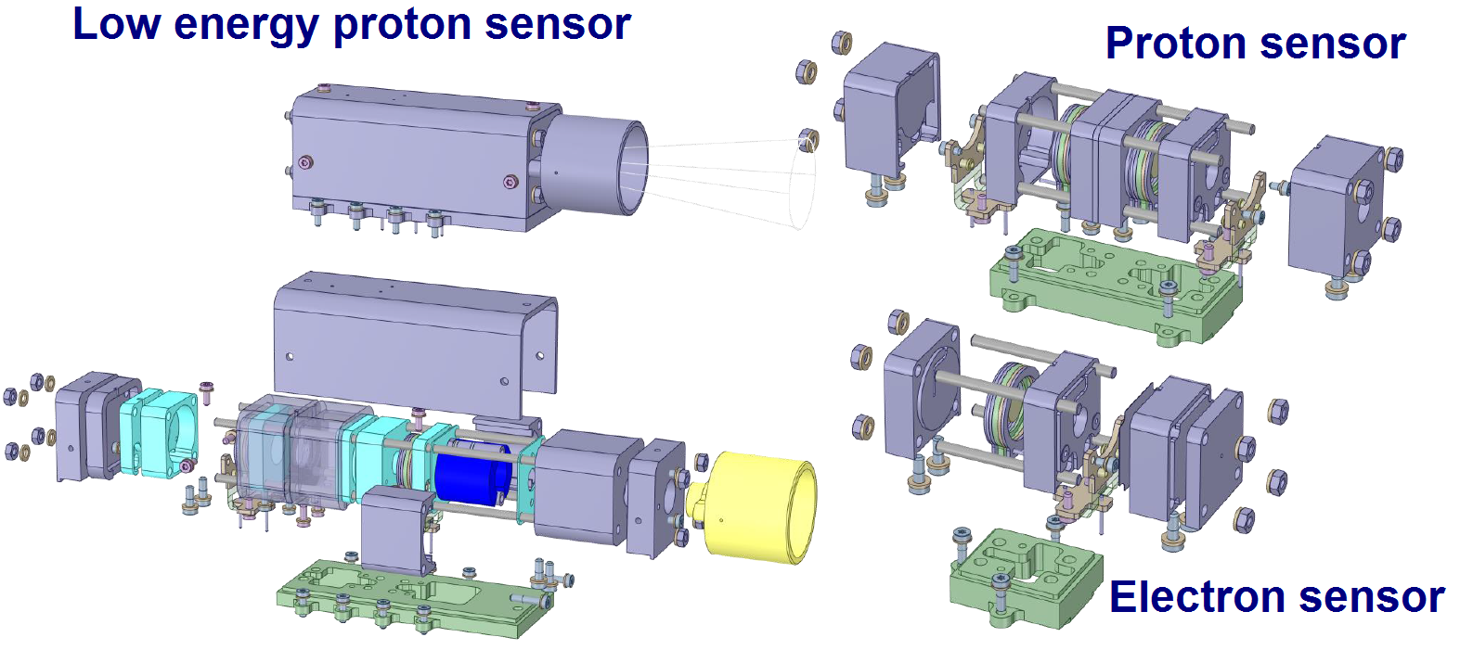
ICARE-NG2: The sensors
A or C
B

Slide 7
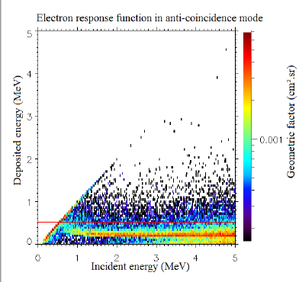
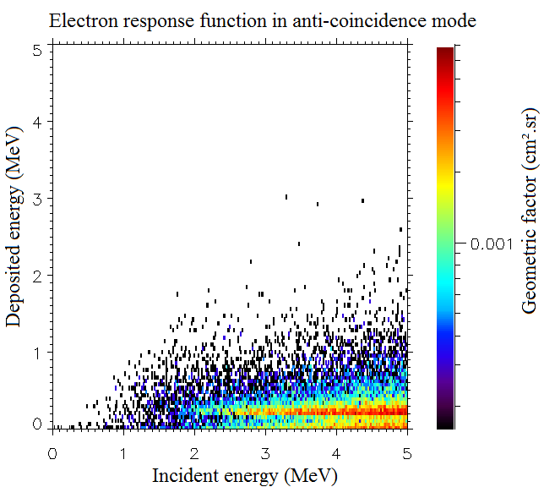
ICARE-NG: The sensors
Without magnet
With magnet

Slide 8
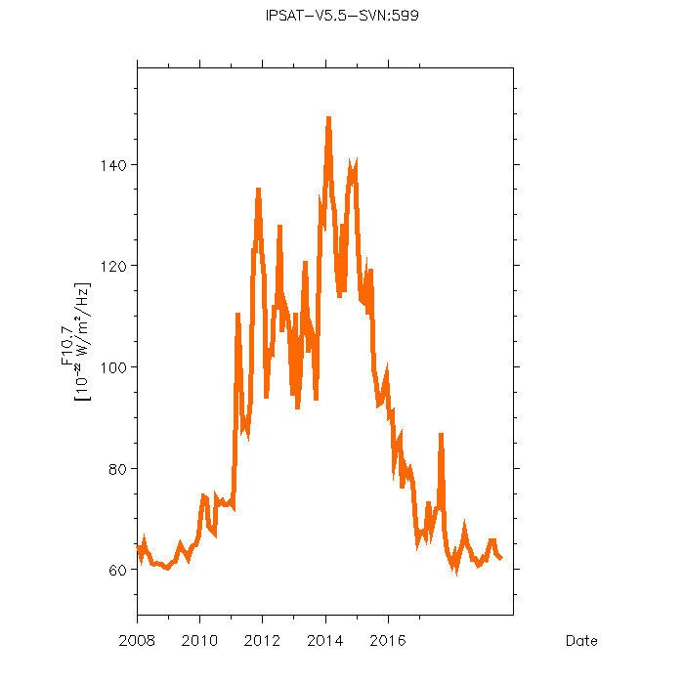
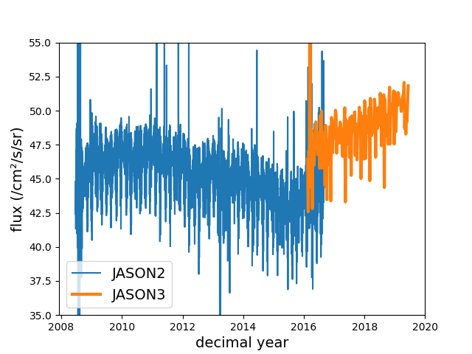
ICARE-NG: Examples
Protons
> 93 MeV
6.3%

Slide 9
ICARE-NG: Examples
2009 2011 2013 2015 2017 2019

Slide 10
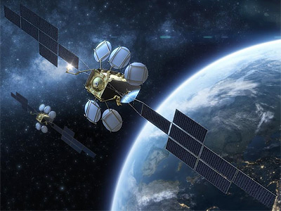
ICARE-NG2: Future missions
HotBird F2 (Eutelsat)
Manufacturer: ADS
Ariane launch in 2021
EOR + GEO
CAN bus + 100V
Proton energy
coverage
Electron energy
coverage
2 ICARE-NG2 will be delivered to ESA part of SSA program
- Baseline: CAN bus + 100V
- Flight opportunities TBD

