Slide 1
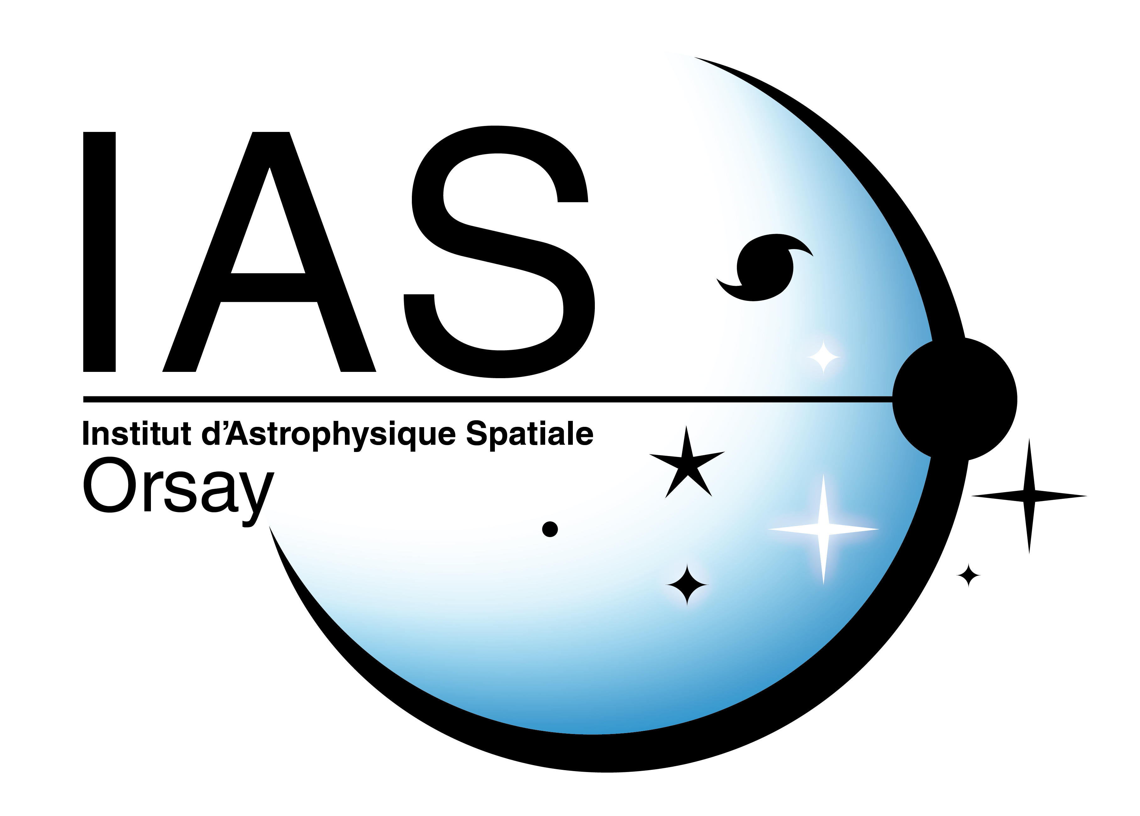
Assessing the predictability of the geomagnetic activity with information theoretical tools
Guillerme BERNOUX¹, Antoine BRUNET¹,
Miho JANVIER², Éric BUCHLIN²
Thursday, November 21, 2019
ESWW 16, Liège
ONERA / DPHY, Université de Toulouse, Toulouse – France
Institut d’Astrophysique Spatiale, CNRS, Univ. Paris-Sud, Université Paris-Saclay 91405 Orsay CEDEX – France

Slide 2
Objectives / Problems
Context: multiple-hours ahead forecast of geomagnetic indices (Kp, Dst, etc.) with Neural Networks
Idea: Use solar imaging to improve Deep-Learning-based forecasts (increase time window)
But…
High-dimensional data
We know (physically) that solar activity is connected to the dynamics of the geomagnetosphere…
…but can we show (with a metric) that geomagnetic indices are “correlated” to solar imaging ?
If so, could this metric be used for feature selection?
Select only a smaller set of pixels?
Ranking the wavelengths?
Notes:
In order to improve time window -> look directly at the origin of the solar wind i.e. use solar imaging
Problems : images are high dimensional data which means problems to store the data, to process the data, and long computation times, i.e. if we want to run several tests it takes a long time
+ we know that the sun is at the origin of the solar wind etc., but can we statistically correlate the fluctuation of the values of the pixels to the a geomag index ? If yes, can we use this metric for feature selection ?

Slide 3
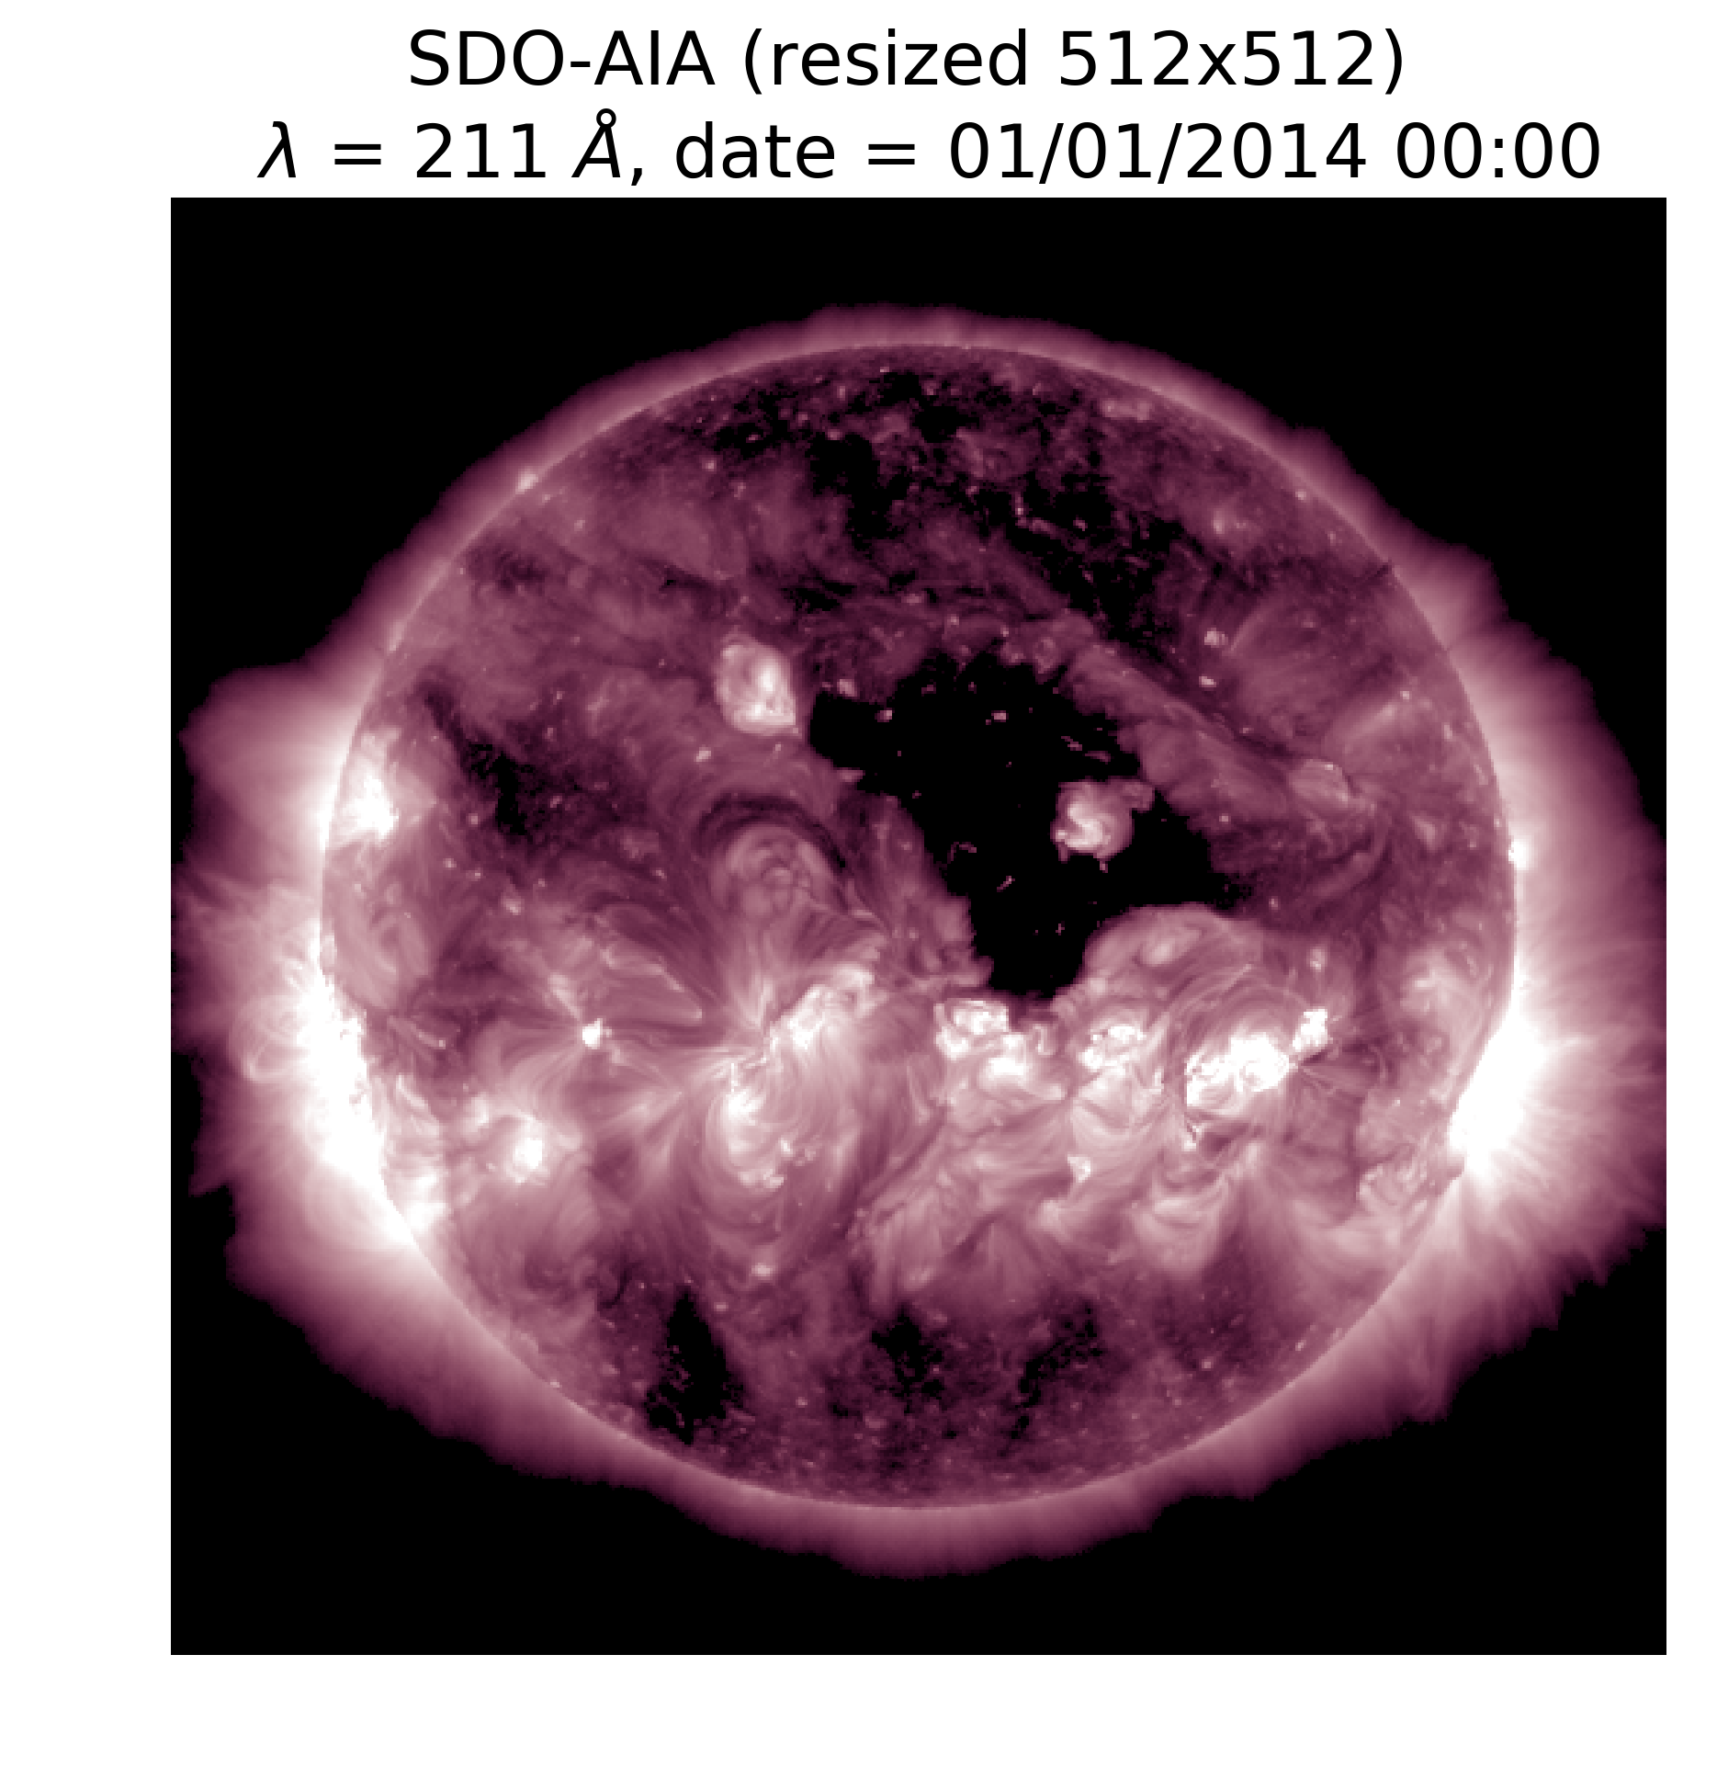
Datasets
Geomagnetic indices and solar wind parameters :
Low-resolution (1h) OMNI data (Kp, …)
Solar imaging:
« ML-READY » SDO-AIA data from (Galvez et al., 2019)[2]
10 wavelengths (7 EUV + 2 UV + 450 nm)
Time range : 2010 – 2018
6.5 TBs (→ 270 GBs in 128x128 resolution)
[2] Galvez, Richard, David F. Fouhey, Meng Jin, Alexandre Szenicer, Andrés Muñoz-Jaramillo, Mark C. M. Cheung, Paul J. Wright, et al. “A Machine-Learning Data Set Prepared from the NASA Solar Dynamics Observatory Mission.” The Astrophysical Journal Supplement Series 242, no. 1 (May 2019): 7.
Notes:
For solar imaging, we used SDO AIA pictures transformed to be ML-Ready
This data was made available earlier this year
What they did : correct instrument degradation, realign all images (surface and orientation), discard corrupt data, resize pictures, Python-ready
What I did in addition : resize (128*128), increase time-step (6min -> 1h)

Slide 4
Methods Information theorotical tools
Chosen metric: Mutual Information [3]
$$MI\left(X,Y\right)=H\left(X\right)+H\left(Y\right)−H\left(X,Y\right)$$
Where $H\left(X\right)=−\int{p\left(x\right)\log{p\left(x\right)}}dx$ is the Shannon Entropy of a source X
(= amount of information contained in the source)
$MI\left(X,Y\right)=$reduction of uncertainty that the knowledge of X gives on Y
$MI\left(X,Y\right)≥0$
$MI\left(X,Y\right)=0 ⇔$ X and Y are independent
“Generalized correlation” : $GenCorr\left(X,Y\right)= \sqrt{1−e^{−2∗MI(X,Y)}} ∈[0,1]$ [4]
Already used in Space Weather (see e.g. [5])
[3] Thomas M. Cover, Joy A. Thomas. Elements Of Information Theory 2nd Ed, 2006.
[4] Tsonis, A. A. “Probing the Linearity and Nonlinearity in the Transitions of the Atmospheric Circulation.” Nonlinear Processes in Geophysics 8, no. 6 (2001): 341–45.
[5] Johnson, Jay R., and Simon Wing. “Chapter 3 - An Information-Theoretical Approach to Space Weather.” In Machine Learning Techniques for Space Weather, edited by Enrico Camporeale, Simon Wing, and Jay R. Johnson, 45–69. Elsevier, 2018. https://doi.org/10.1016/B978-0-12-811788-0.00003-2.

Slide 5
Results with OMNI data
→ Before using it with SDO-AIA, see what we get with solar wind parameters
Solar wind parameters
(By, Bz, Vsw, n, P, and combinations)
(multivariate) linear correlation
Compare
Kp index
Mutual Information
compare
Feed LSTM to nowcast
→ Nowcast accuracy

Slide 6
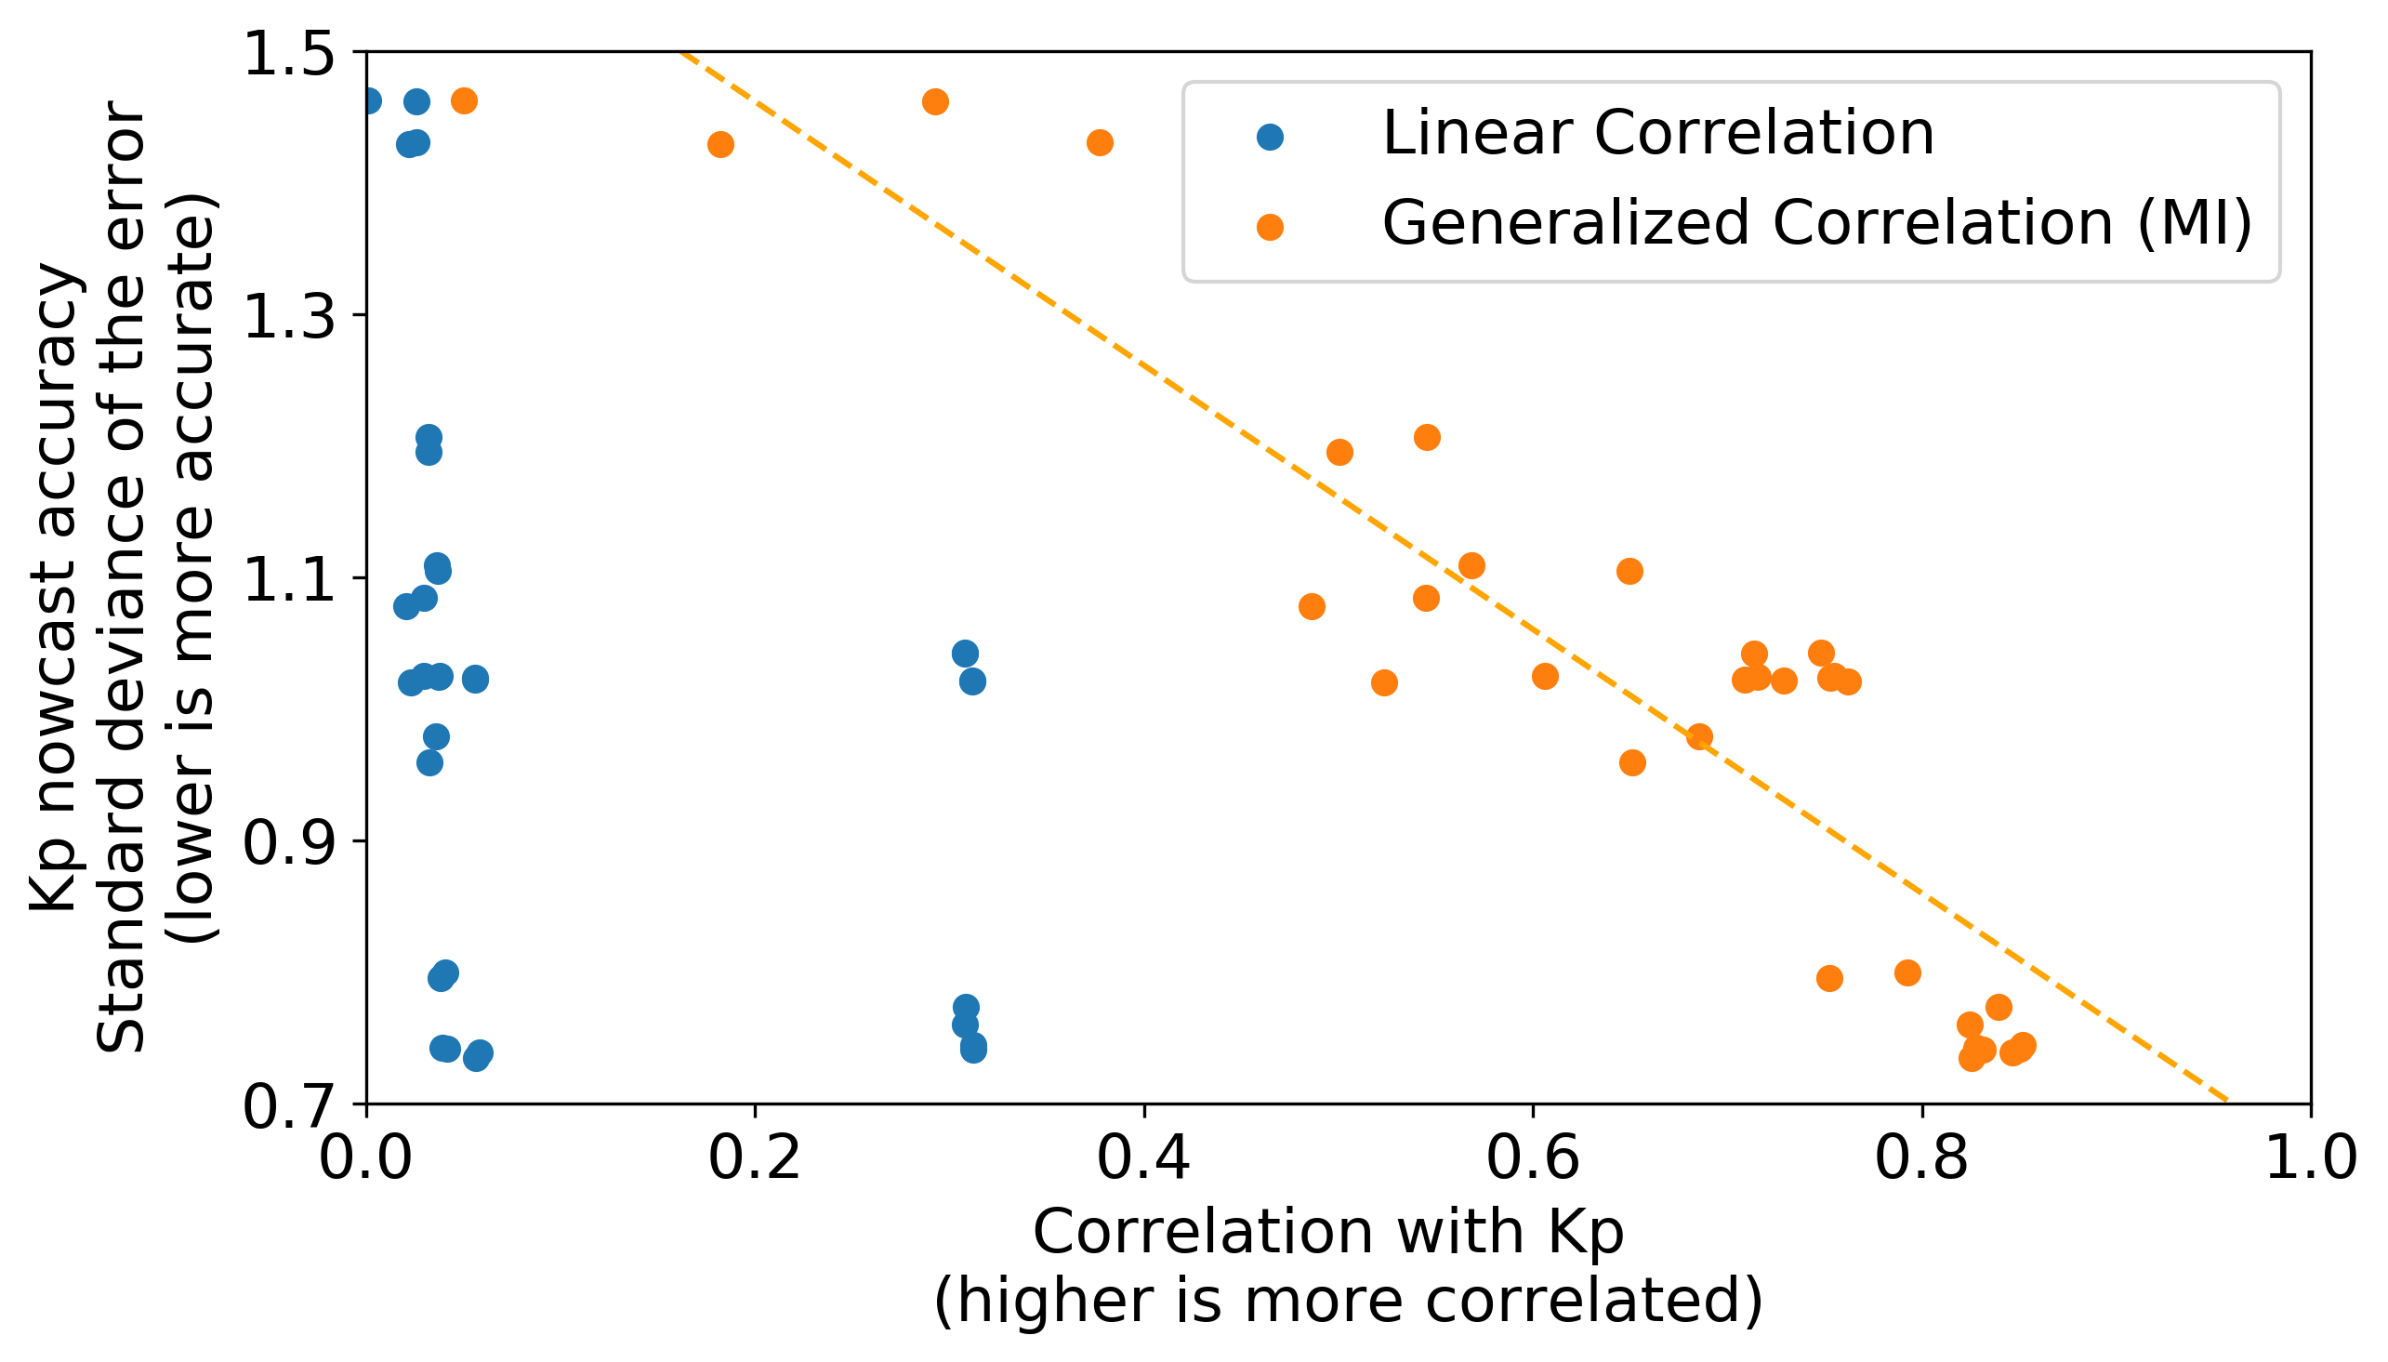
Results with OMNI data
Figure: Comparison between the linear and the generalized (MI-based) correlations between solar wind parameters and Kp and the forecasting accuracy of Kp using the same solar wind parameters as inputs
R = 0.91
➔ MI is able to detect (high-order) correlations between solar wind parameters and Kp
MI could indeed be used for feature selection (ranking the inputs) when using solar wind parameters as inputs for our neural network
What about with solar imaging ?

Slide 7
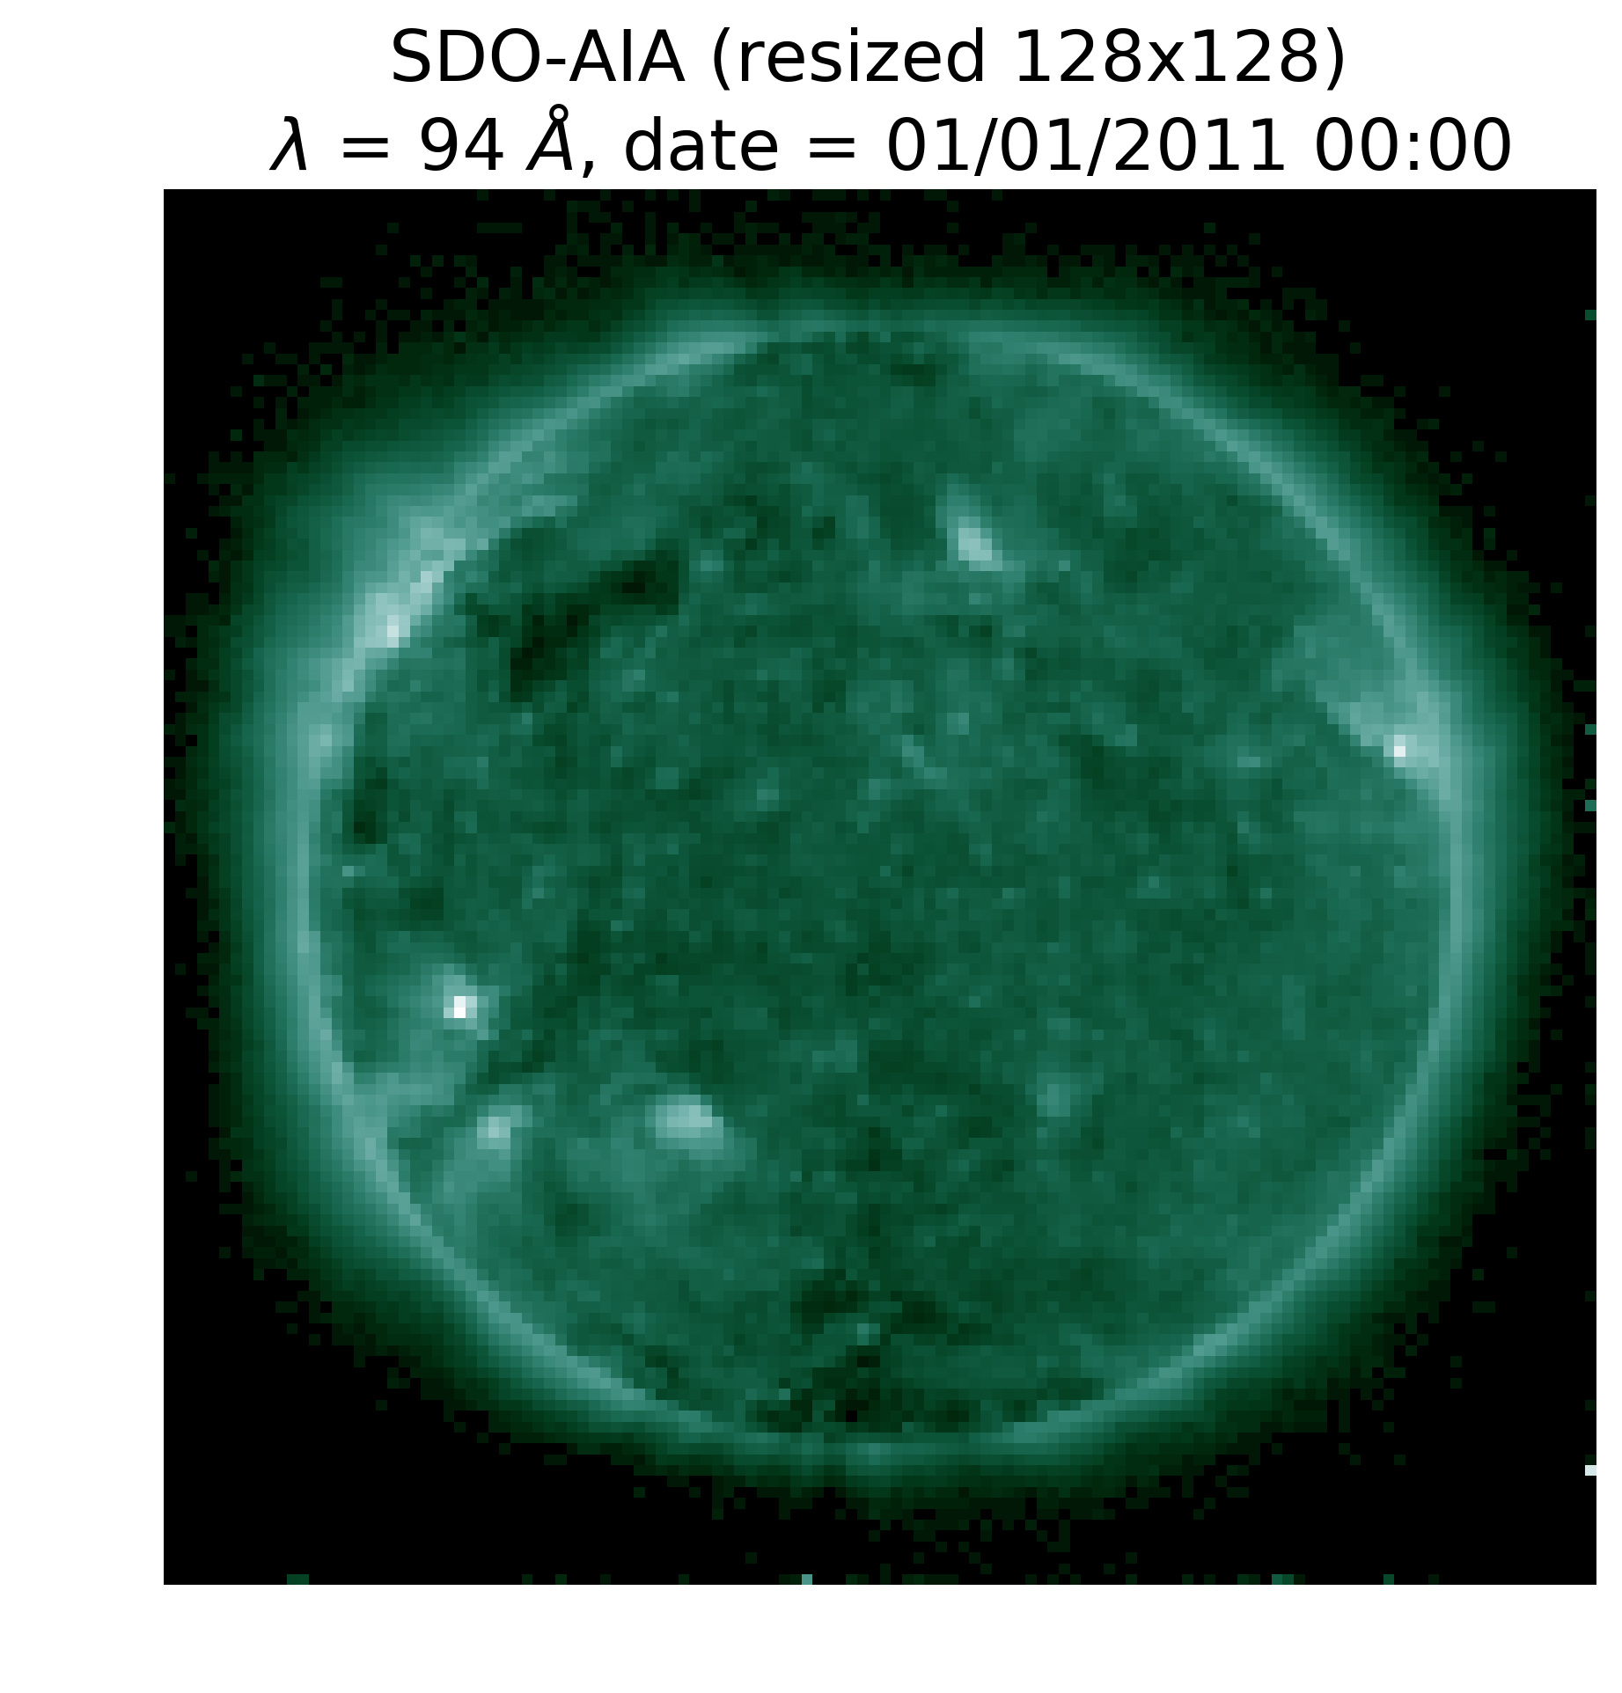
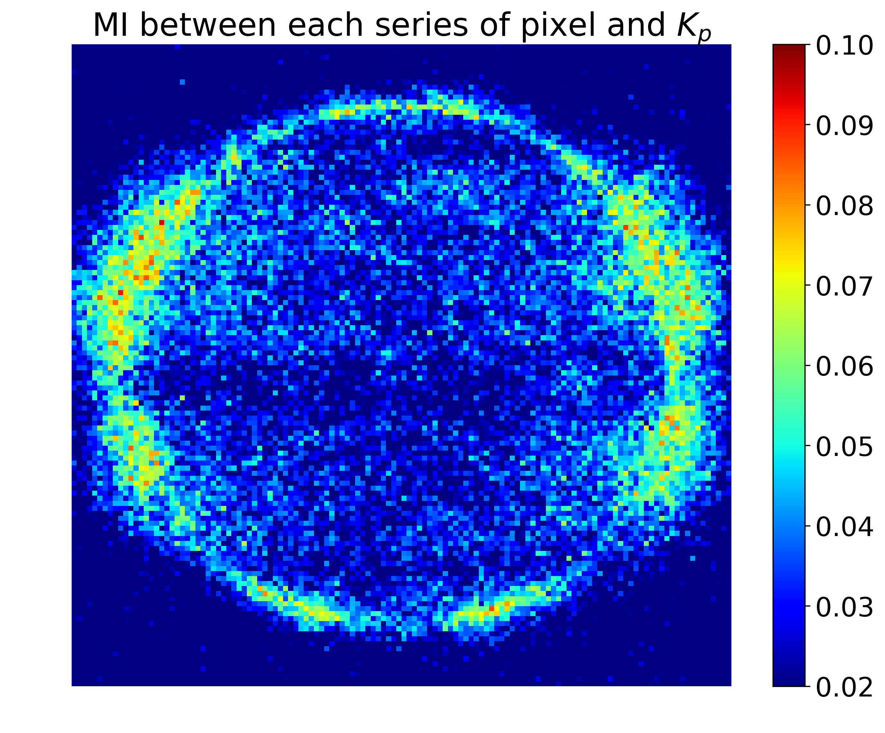
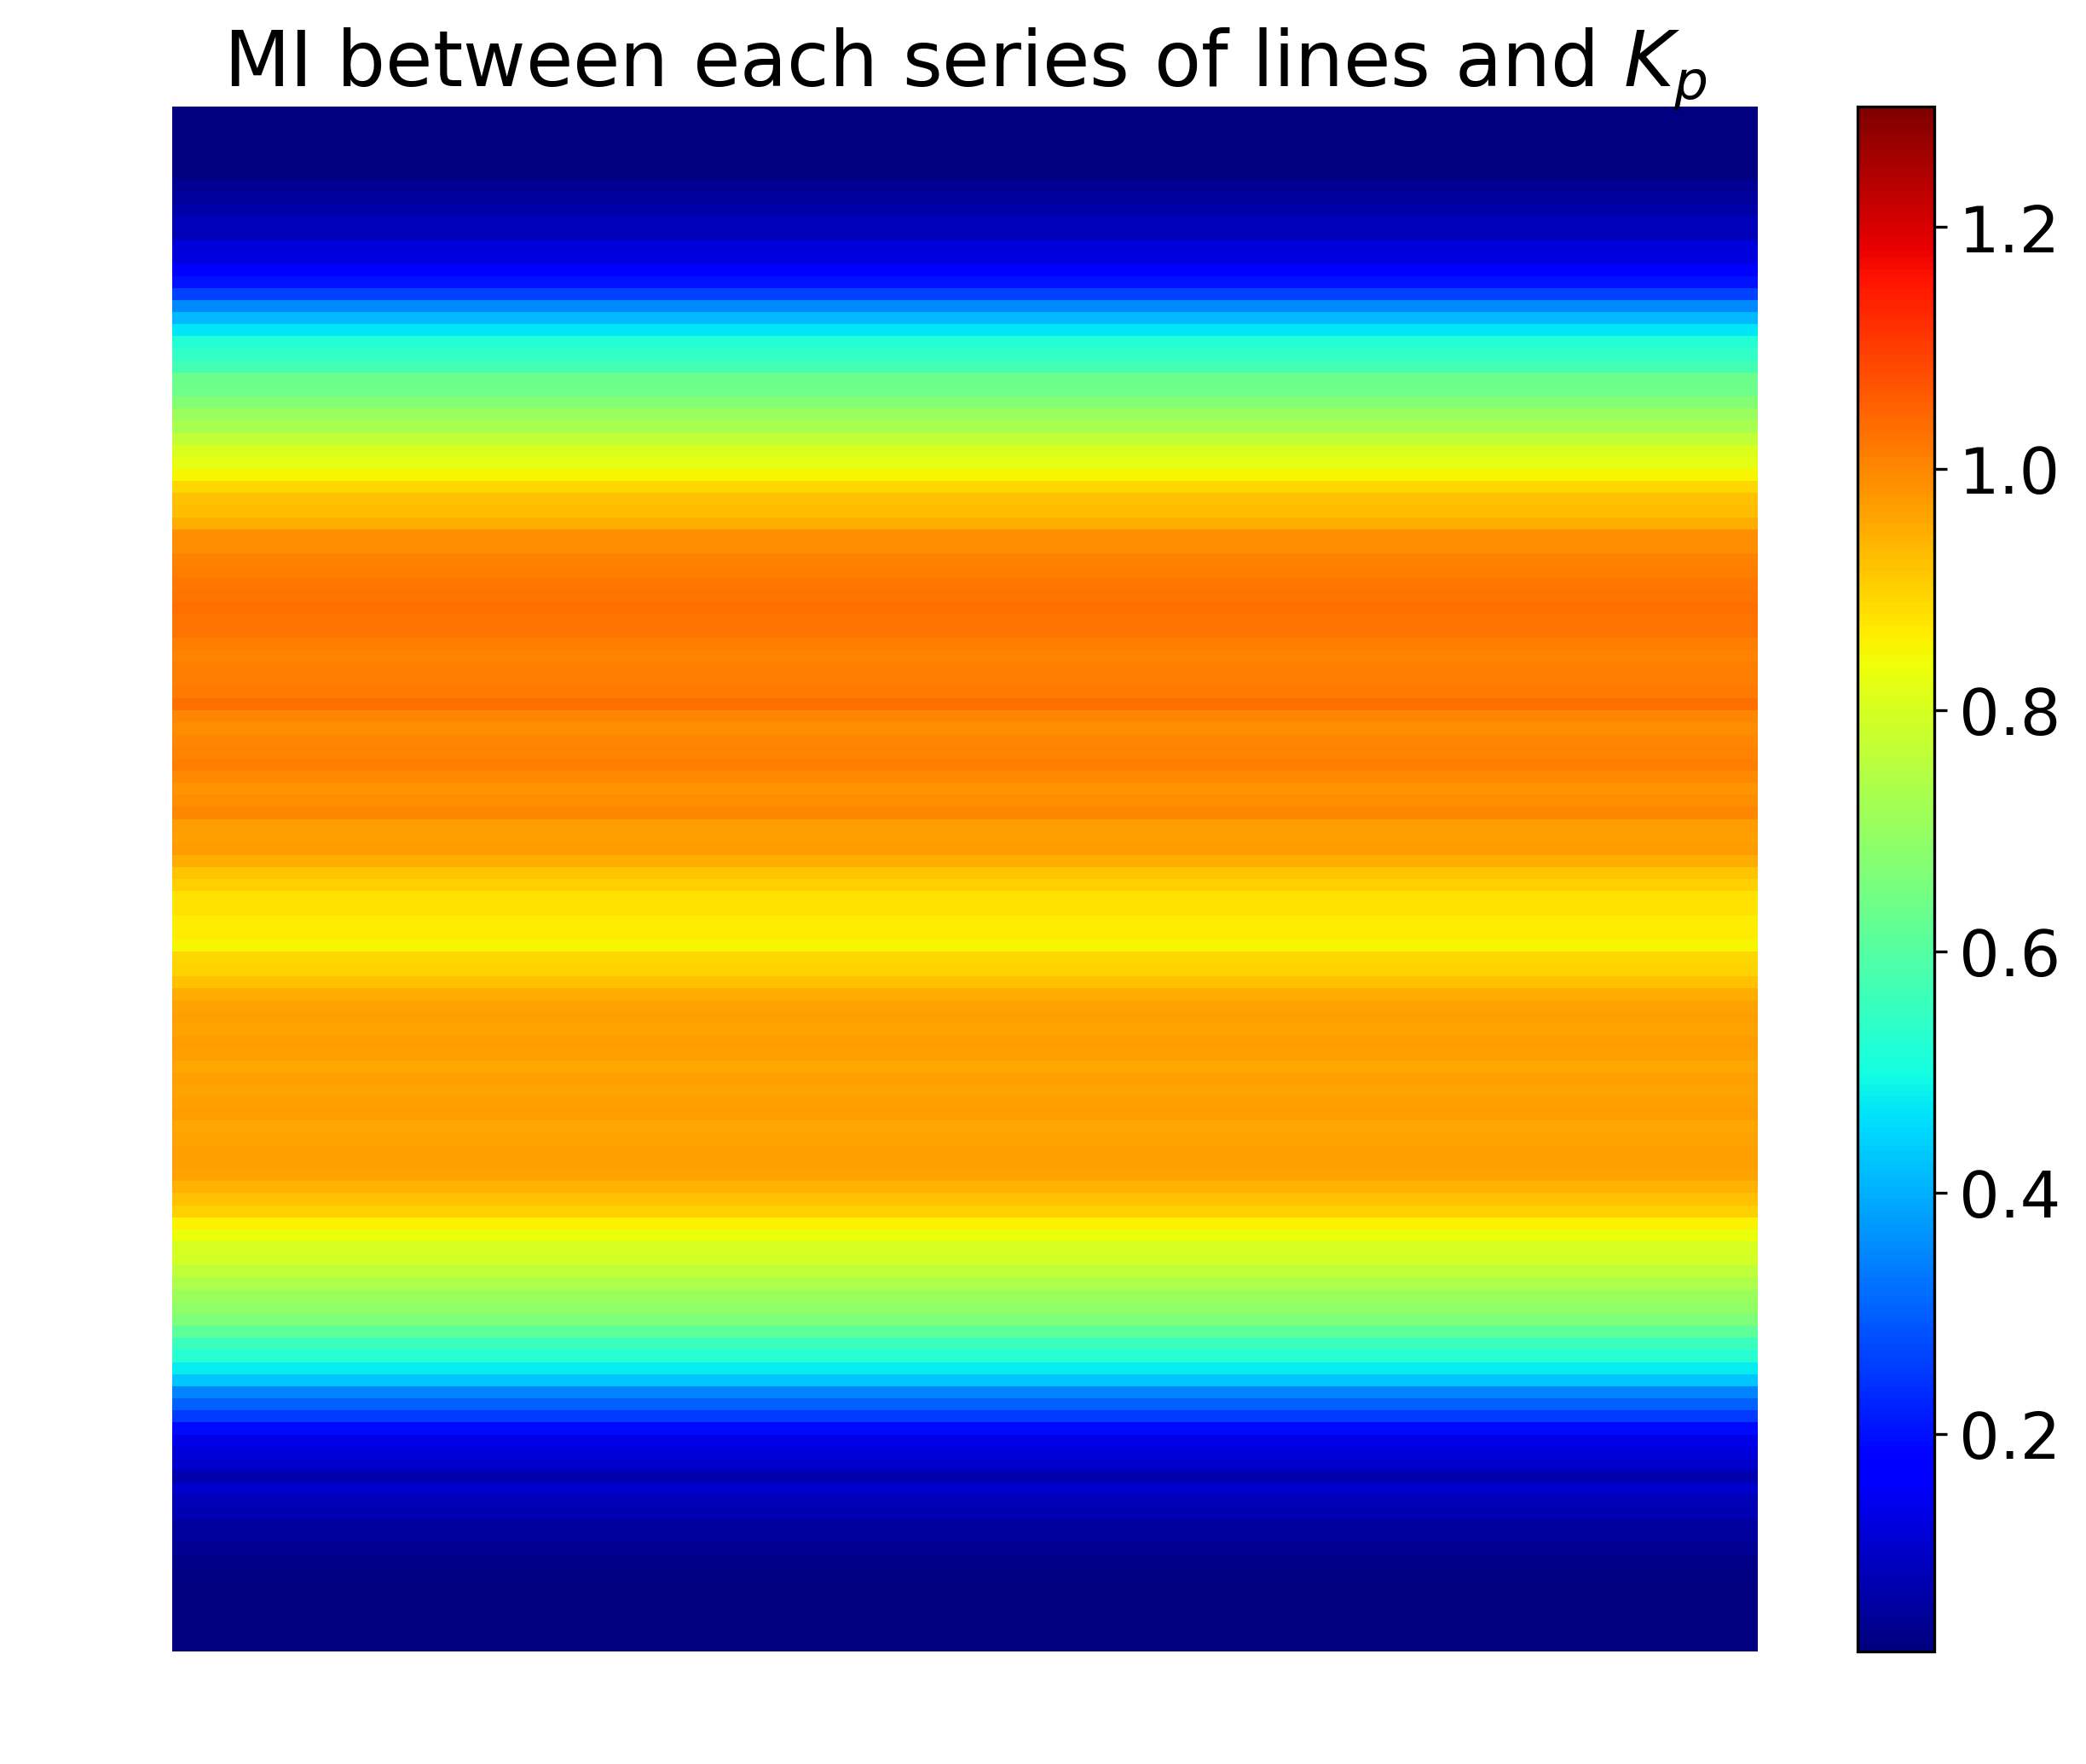
Results with SDO-AIA data
Example: λ = 94 Å ; Year = 2011

Slide 8
Results with SDO-AIA data
Figure: Mutual Information values between each time-series of lines and Kp, per year and per wavelength
There are dependencies between SDO-AIA and Kp
Differences between areas on each image
Differences between wavelengths
Differences between years (solar cycle)
Accuracy of the estimated MI values ?
Results obtained without time-lag
Cannot really discard an area of the images

Slide 9
Conclusions
Mutual Information is indeed a good predictability estimator…
…at least when dealing with low-dimensional time-series
Mutual Information detects dependencies between SDO-AIA images and Kp
Mutual Information does not seem to be a great metric for feature selection when using solar imaging…
…but it confirms raw physical intuitions on which wavelengths to use
Next steps / Future work:
Consolidate physical explanations of the results
Use SDO-HMI data
Create and tune an adequate NN that uses solar imaging as input and cross-validate with our current results

Slide 10
Thank you for your attention
Contact:
Guillerme.Bernoux@onera.fr

Slide 12
Appendix

Slide 13
Appendix
Source : nasa.gov

Slide 14
Results with OMNI data
→ Before using it with SDO-AIA, see what we get with SW parameters
Subset | Linear pred. with Kp | Generalized corr. (MI in nats) with Kp | Kp nowcast error STD
By | 0.026 | 0.29 (0.04) | 1.46
Bz | 0.021 | 0.49 (0.13) | 1.08
Vsw | 0.036 | 0.57 (0.20) | 1.11
… | … | … | …
By, Bz | 0.029 | 0.54 (0.18) | 1.08
By, Vsw | 0.037 | 0.65 (0.27) | 1.10
… | … | … | …
By, Vsw, ρsw, P | 0.312 | 0.76 (0.43) | 1.02
Bz, Vsw, ρsw, P | 0.312 | 0.83 (0.59) | 0.74
By, Bz, Vsw, ρsw, P | 0.312 | 0.85 (0.65) | 0.74
White noise | 0.001 | 0.05 (0.001) | 1.46

Slide 15
Results with SDO-AIA data
Other idea: compute MI between full images (reduced by PCA) and Kp and select successively the wavelengths that add the highest MI (goal: avoid redundancies)
Figure: Mutual Information between each time-series of full SDO-AIA images (reduced by PCA, keeping 25 PCs) and Kp. Variance due to the estimator is plotted in dark blue.
Adding EUV wavelengths to other EUV wavelengths does not increase MI significantly (up to +0.04 nat for 211 Å when adding λ = 94 Å or 304 Å) →redundancies
Adding UV and visible wavelengths to EUV wavelengths increases MI
(up to +0.10 nat for 211 Å when adding λ = 1600 Å)

Slide 16
Appendix

Slide 17
Appendix
Figure: Mutual Information values between each time-series of columns and Kp, per year and per wavelength

Slide 18
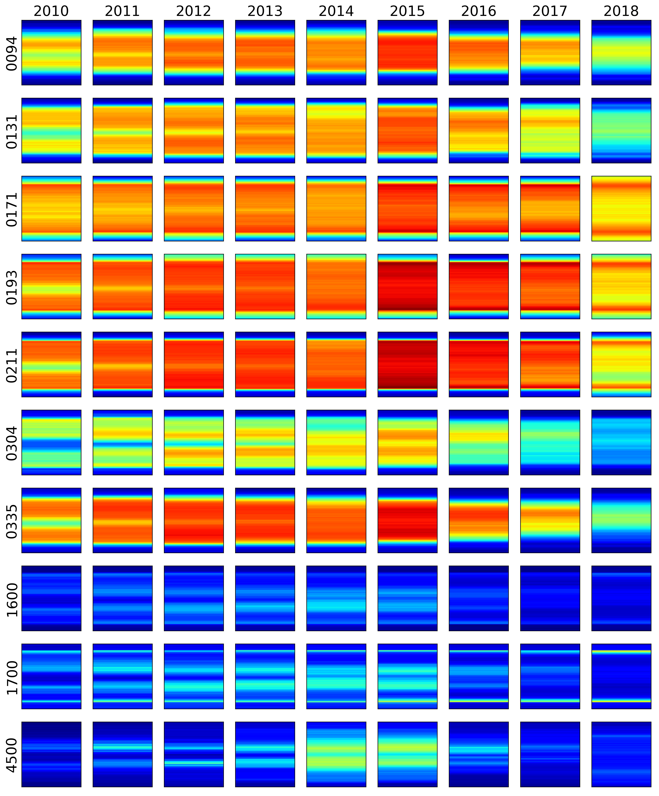
Appendix
Lag = 0 days
Lag = 5 days

Slide 19
Appendix

