Slide 1
supervised machine learning for flare prediction: the impact of features and of the training set generation process on the forecasting performances
michele piana
the MIDA group
dipartimento di matematica università di genova
CNR – SPIN genova
ESWW16, liege, november 21 2019

Slide 2
the context
space weather forecasting using machine learning:
focus on flares
feature-based, supervised machine learning
SDO/HMI magnetograms as input data; GOES data for labelling
main messages:
data preparation matters
information hidden in active regions is (highly) redundant
binary, deterministic prediction is still a dream

Slide 3
data, features and labels
data:
SHARP data products in the SDO/HMI database (2D images of continuum intensity, the full three-component magnetic field vector, and the line-of-sight component of each photospheric HARP)
time range: from 2012 September 14 to 2016 April 30
24 hour sampling
features:
property extraction algorithms (credit: FLARECAST) led to 167 feautures
flare association:
each SHARP AR is associated to either a GOES solar flare with class C1 and above (C1+) or a GOES solar flare with class M1 and above (M1+)
flare association leads to four more features (peak magnitude, time difference with start time, time difference with peak time, time difference with end time)

Slide 4
data preparation
four training sets are generated, corresponding to four issuing times (00:00 UT, 06:00 UT, 12:00 UT, 18:00 UT)
focus on ARs rather then feature vectors:
2/3 ARs randomly extracted from the set of all ARs belonging to a specific issuing time
the 171-dimension feature vectors belonging to the extracted ARs are labelled whether a C1+ flare occurred in the next 24 hours
the test set is made of the feature vectors belonging to the remaining 1/3 ARs
training/test set generation is randomly repeated 100 times to enable statistical analysis

Slide 5
prediction and feature ranking
machine learning methods (credit: FLARECAST):
hybrid LASSO
random forest
other supervised considered (SVC, logit)
optimization: unsupervised fuzzy clustering (benvenuto, piana, campi, massone; ApJ; 2018)
feature ranking:
both ML methods compute relative importance associated to each feature
recursive feature elimination:
train the classifier
compute the importance for each feature
remove the feature with smallest importance and begin again

Slide 6
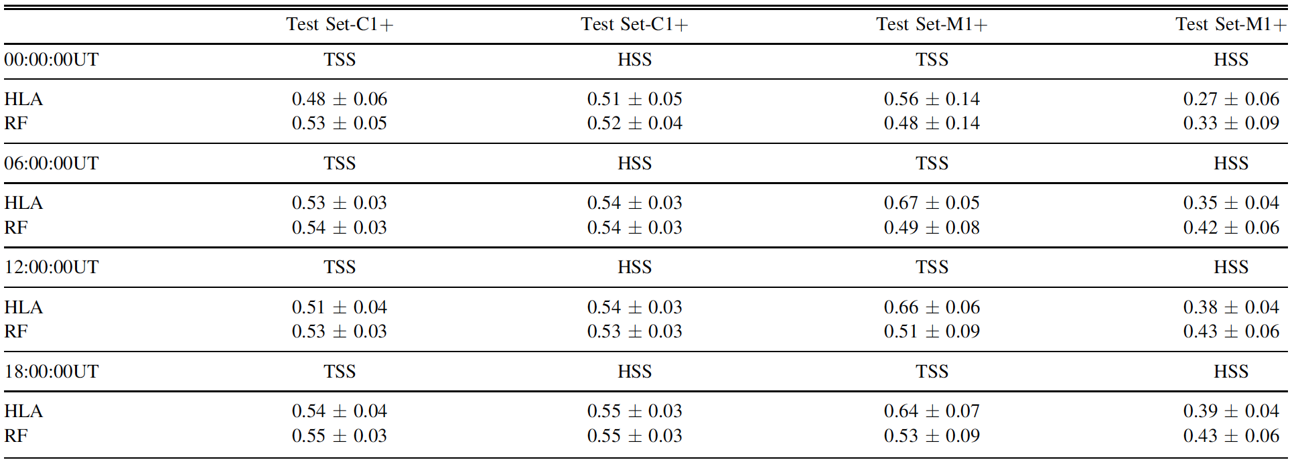
results: about training and scores (campi, benvenuto, massone, bloomfield, geourgoulis, piana; ApJ; 2019)
training
according to
active regions
training
according to
features

Slide 7
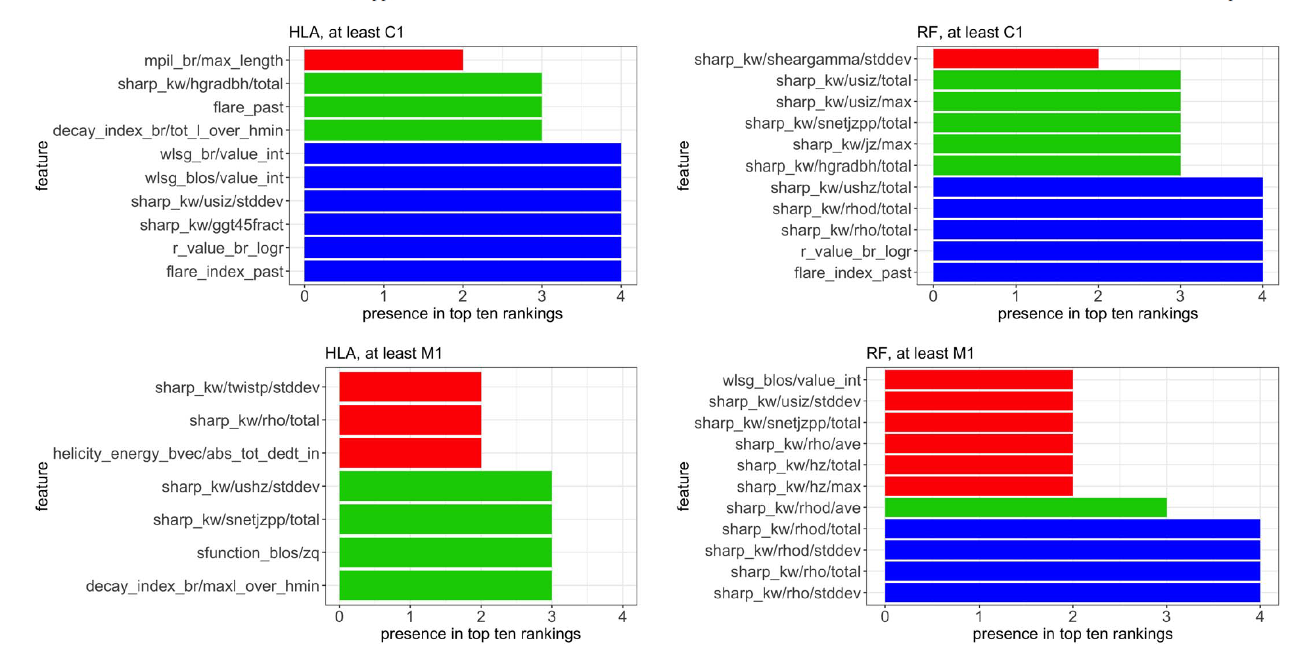
results: top-ten (campi, benvenuto, massone, bloomfield, geourgoulis, piana; ApJ; 2019)
number of times each feature is selected in the top-10 rankings,
on average over the 100 random realizations of the test set, for all issuing times

Slide 8
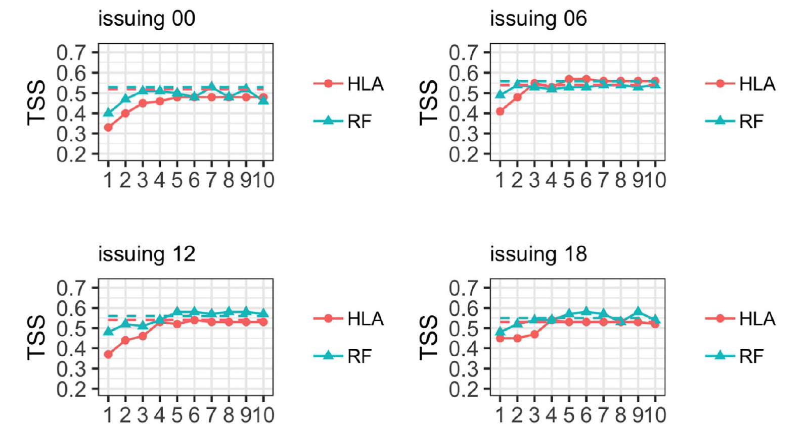
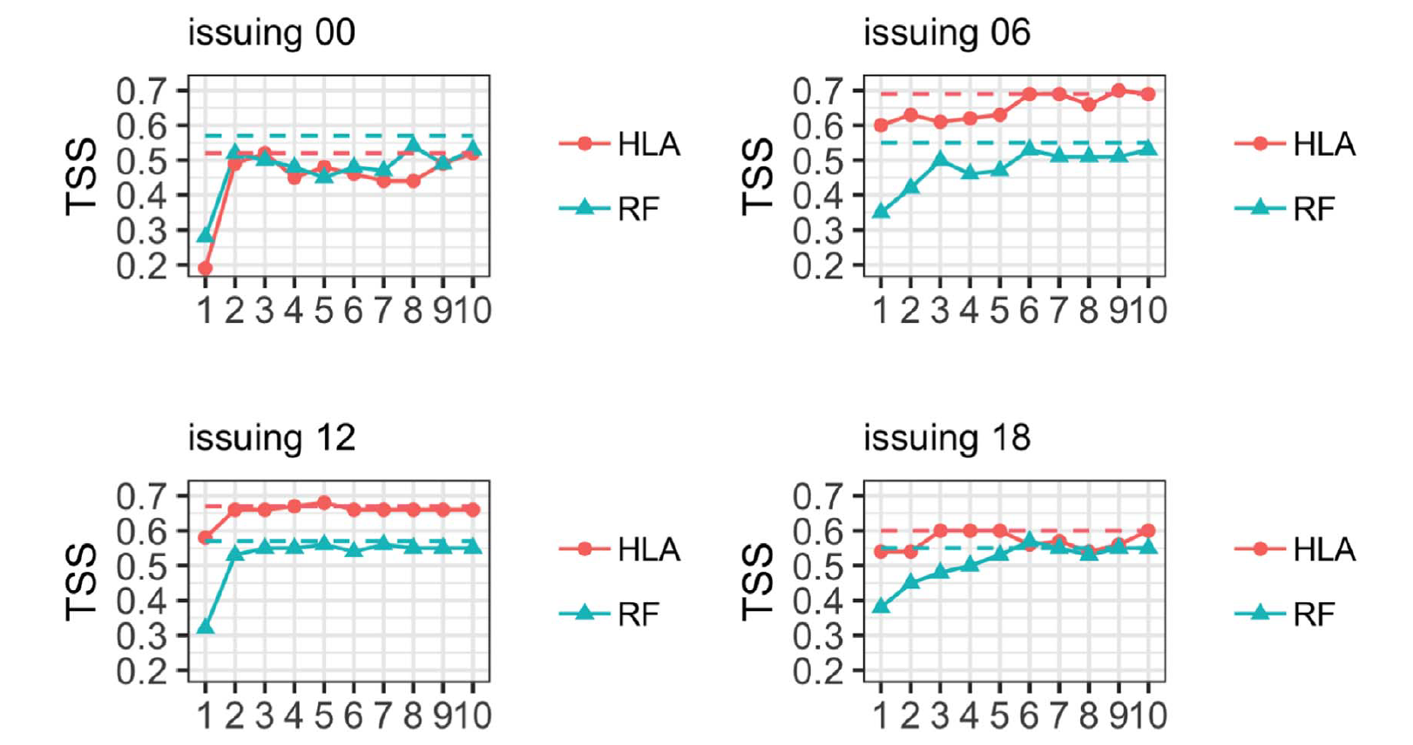
results: redundancy of information (campi, benvenuto, massone, bloomfield, geourgoulis, piana; ApJ; 2019)
TSS scores obtained by using just the 10 top-ten features added one at a time

Slide 9
conclusions
main messages:
data preparation matters
information hidden in active regions is (highly) redundant
binary, deterministic prediction is still a dream
in progress:
systematic analysis of the top-ten features in the ranking (robustness with respect to method, issuing time, training set)
comparison with deep learning
exploring the connections between machine learning and numerical models

