Slide 1
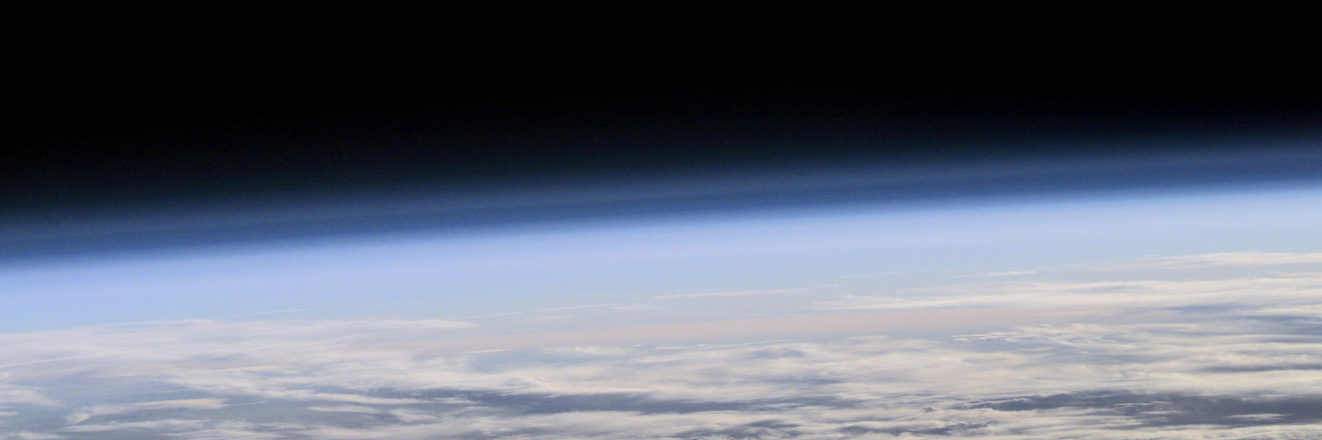


Magnetopause and solar wind pressure
Magnetopause position and solar wind pressure: Going beyond a statistical relation
J. De Keyser¹, M. Bandic², G. Verbanac²
1 Royal Belgian Institute for Space Aeronomy (BIRA-IASB), Brussels, Belgium
2 University of Zagreb, Croatia
ROYAL BELGIAN INSTITUTE FOR SPACE AERONOMY

Slide 2
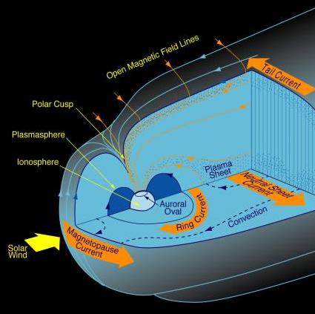
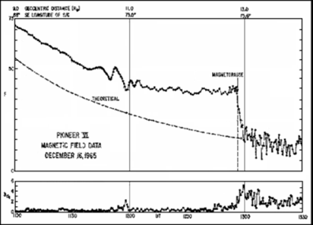
The magnetopause
The first spacecraft that left the magnetosphere already detected the transition between the geomagnetic field and the interplanetary field: That transition is tends to be sharp when the interplanetary magnetic field (IMF) is weak, more variable, and has a different orientation.
Ness et al., JGR, 1966

Slide 3
The magnetospheric boundary
In a closed magnetosphere, one defines
the magnetopause current layer as the tangential discontinuity boundary between IMF and geomagnetic field;
the magnetopause plasma boundary as the barrier between the magnetosheath and magnetospheric plasma.
Both are co-located.
In an open magnetosphere model,
the magnetopause current layer tends to be a rotational discontinuity;
a boundary layer is formed by some magnetosheath plasma leaking through;
whose inner boundary is a tangential discontinuity.
MP
MP IB

Slide 4
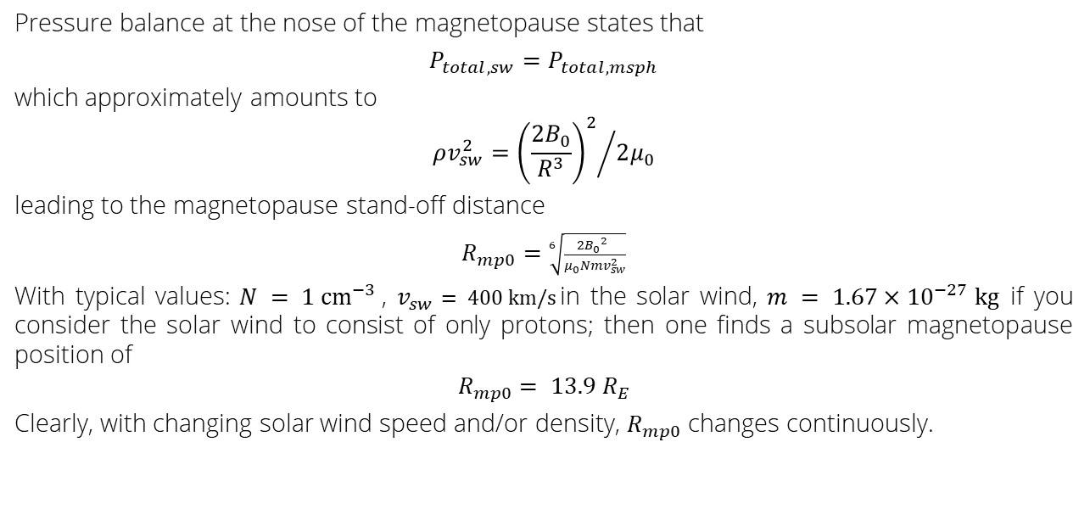
Magnetopause stand-off distance
Pressure balance at the nose of the magnetopause states that
$P_{total, sw}=$ $P_{total, msph}$
which approximately amounts to
$$ρv_{sw}^{2}={{\left(\frac{2B_{0}}{R^{3}}\right)}^{2}}/{2μ_{0}}$$
leading to the magnetopause stand-off distance
$R_{mp0}=$ $\sqrt[6]{\frac{2{B_{0}}^{2} }{μ_{0}Nmv_{sw}^{2}}}$
With typical values: $N = 1 {cm}^{−3}$, $v_{sw}= 400 km/s$in the solar wind, $m = 1.67×{10}^{−27} kg$if you consider the solar wind to consist of only protons; then one finds a subsolar magnetopause position of
$$R_{mp0}= 13.9 R_{E}$$
Clearly, with changing solar wind speed and/or density, $R_{mp0}$ changes continuously.

Slide 5
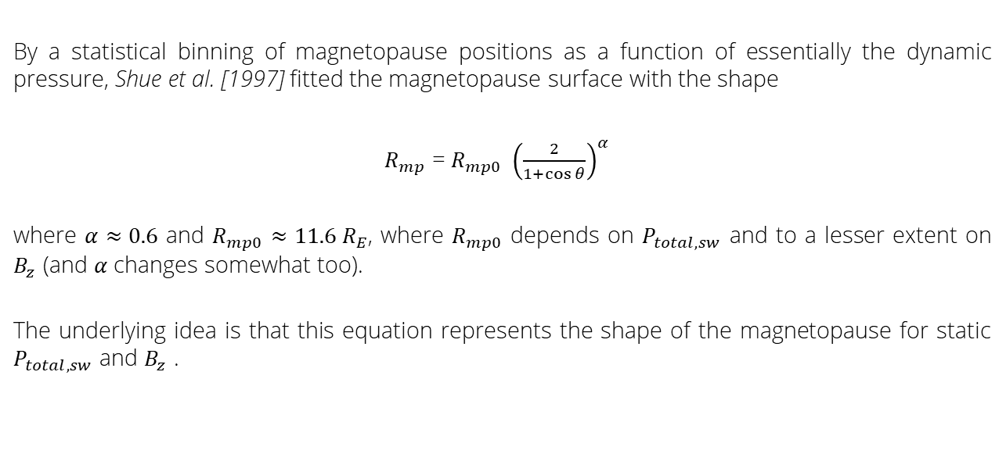
Magnetopause surface shape
By a statistical binning of magnetopause positions as a function of essentially the dynamic pressure, Shue et al. [1997] fitted the magnetopause surface with the shape
$R_{mp}$ = $R_{mp0} { {\left(\frac{2}{1+\cos{θ}}\right)}_{}^{α} }_{ }$
where $α≈0.6$ and $R_{mp0}$ $≈11.6 R_{E}$, where $R_{mp0}$ depends on $P_{total, sw}$ and to a lesser extent on $B_{z}$ (and $α$ changes somewhat too).
The underlying idea is that this equation represents the shape of the magnetopause for static $P_{total, sw}$ and $B_{z}$ .
Petrinec – Lockheed Martin

Slide 6
Problems
There are fundamental problems with this approach.
1. The conditions are rarely static.
Magnetopause motion combines with tailward magnetosheath flow to create surface waves.
Upon compression, plasma wave speeds (Alfvén speed) inside the magnetosphere are faster than inside the magnetosheath, producing a bulge running ahead of the surface wave.
2. Even if the conditions are static, the magnetopause can move.
Surface wave motion may result from, e.g. the Kelvin-Helmholz instability, even when there is no pressure variation.
Petrinec – Lockheed Martin

Slide 7
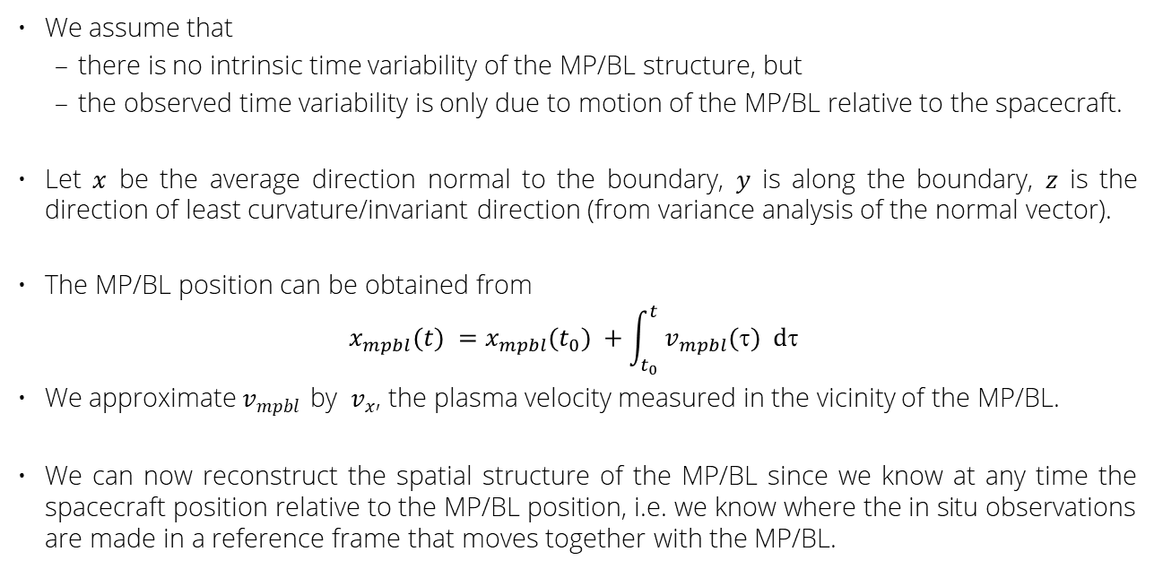
Magnetospheric boundary reconstruction
We assume that
  there is no intrinsic time variability of the MP/BL structure, but
  the observed time variability is only due to motion of the MP/BL relative to the spacecraft.
Let $x$ be the average direction normal to the boundary, $y$ is along the boundary, $z$ is the direction of least curvature/invariant direction (from variance analysis of the normal vector).
The MP/BL position can be obtained from
$$x_{mpbl}(t) =x_{mpbl}(t_{0}) +\int_{t_{0}}^{t}{{ v}_{mpbl}(τ) dτ}$$
We approximate${ v}_{mpbl}$ by ${ v}_{x}$, the plasma velocity measured in the vicinity of the MP/BL.
We can now reconstruct the spatial structure of the MP/BL since we know at any time the spacecraft position relative to the MP/BL position, i.e. we know where the in situ observations are made in a reference frame that moves together with the MP/BL.

Slide 8
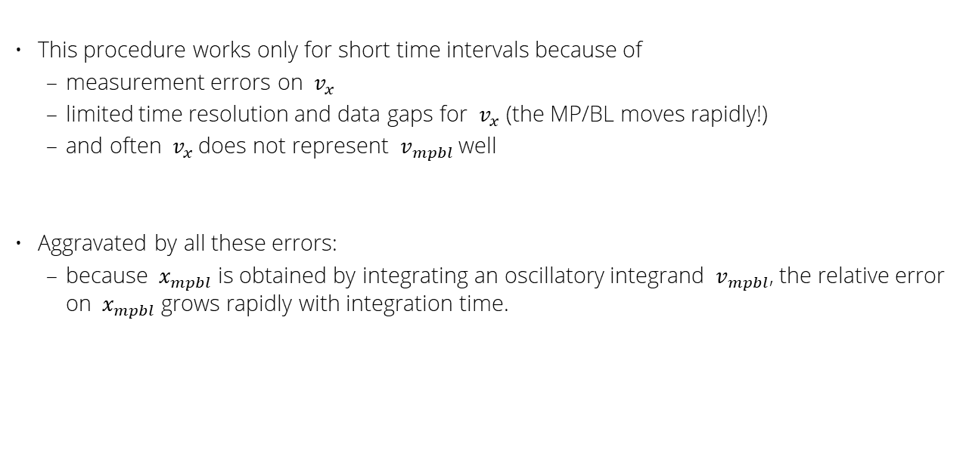
Difficulties
This procedure works only for short time intervals because of
  measurement errors on ${ v}_{x}$
  limited time resolution and data gaps for ${ v}_{x}$ (the MP/BL moves rapidly!)
  and often ${ v}_{x}$does not represent ${ v}_{mpbl}$ well
Aggravated by all these errors:
  because ${ x}_{mpbl}$ is obtained by integrating an oscillatory integrand ${ v}_{mpbl}$, the relative error on ${ x}_{mpbl}$grows rapidly with integration time.

Slide 9
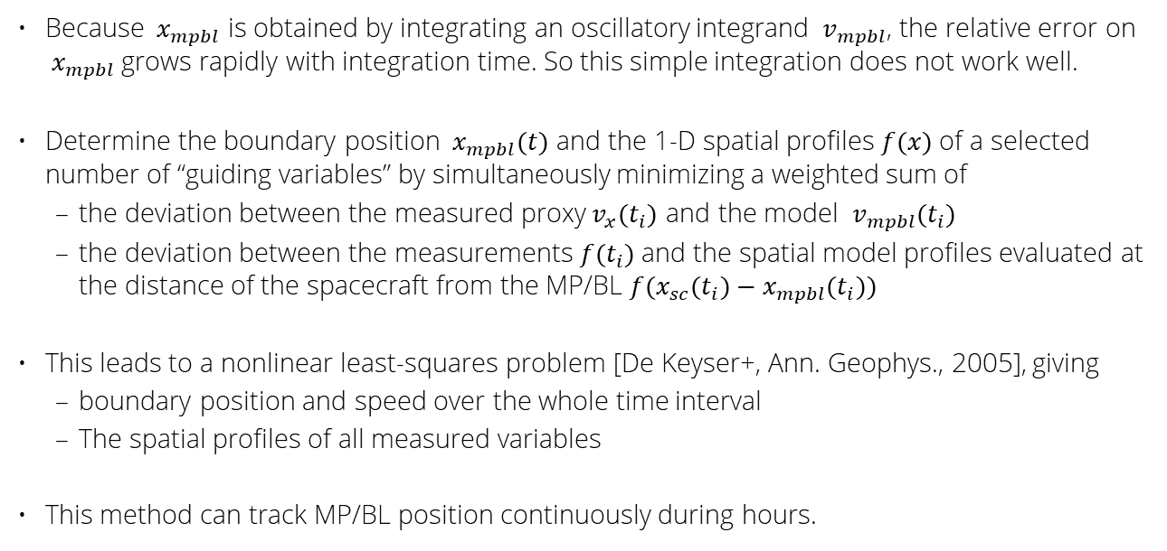
Advanced approach
  Because ${ x}_{mpbl}$ is obtained by integrating an oscillatory integrand ${ v}_{mpbl}$, the relative error on ${ x}_{mpbl}$grows rapidly with integration time. So this simple integration does not work well.
Determine the boundary position ${ x}_{mpbl}(t)$ and the 1-D spatial profiles $f(x)$of a selected number of “guiding variables” by simultaneously minimizing a weighted sum of
  the deviation between the measured proxy${ v}_{x}(t_{i})$ and the model ${ v}_{mpbl}(t_{i})$
  the deviation between the measurements $f(t_{i})$and the spatial model profiles evaluated at the distance of the spacecraft from the MP/BL $f(x_{sc}(t_{i})−x_{mpbl}(t_{i}))$
This leads to a nonlinear least-squares problem [De Keyser+, Ann. Geophys., 2005], giving
  boundary position and speed over the whole time interval
  The spatial profiles of all measured variables
This method can track MP/BL position continuously during hours.

Slide 10
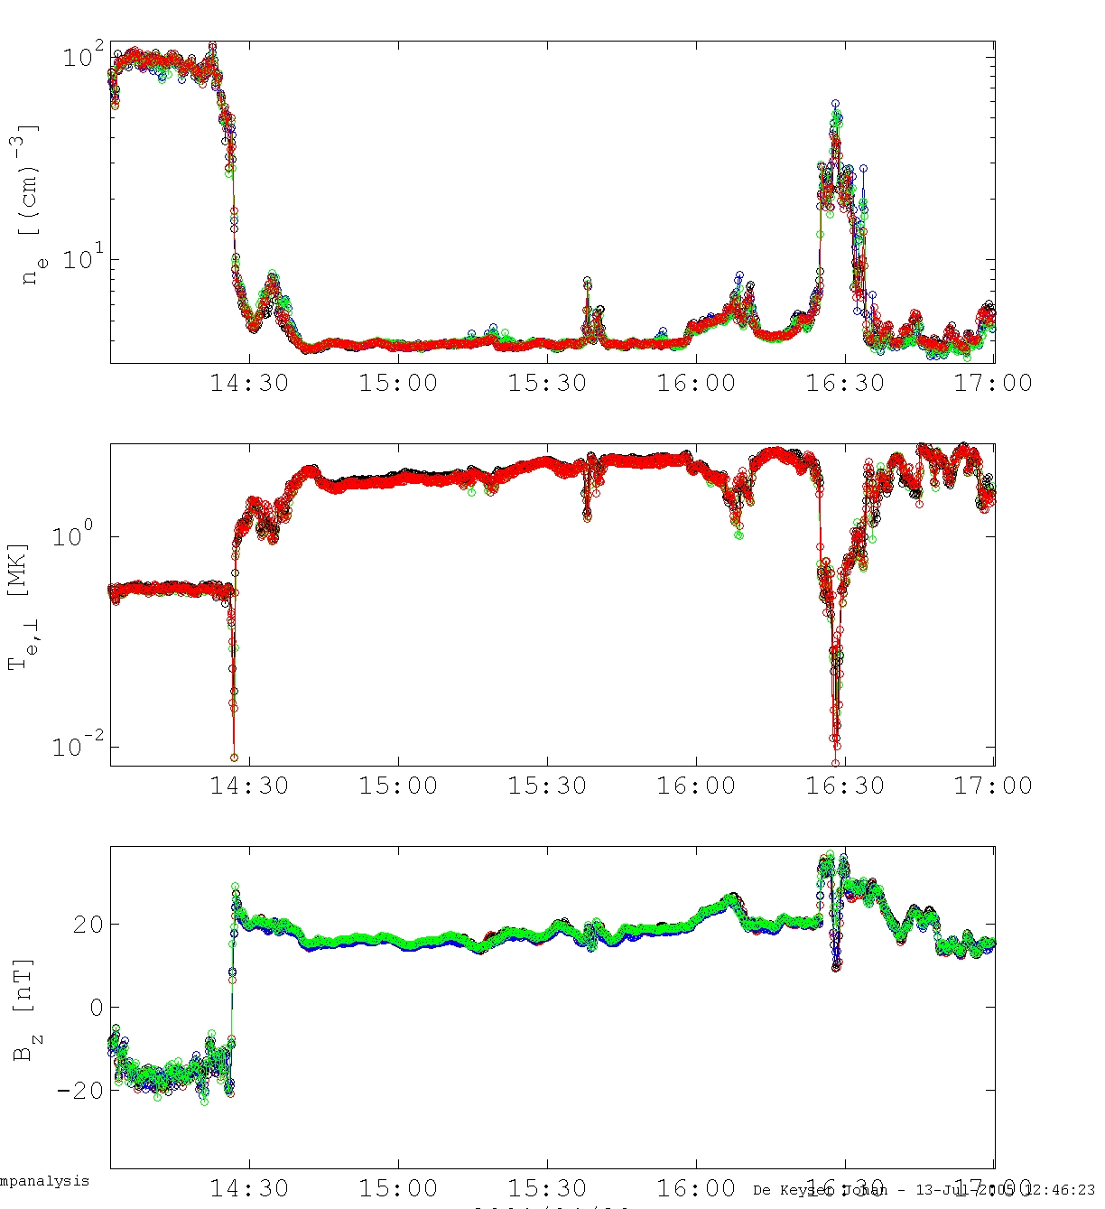
Example: direct solar wind control
April 23, 2001 : Inbound MP/BL pass, 15 s resolution data; all sc see essentially the same thing (standard Cluster color coding is used)

Slide 11
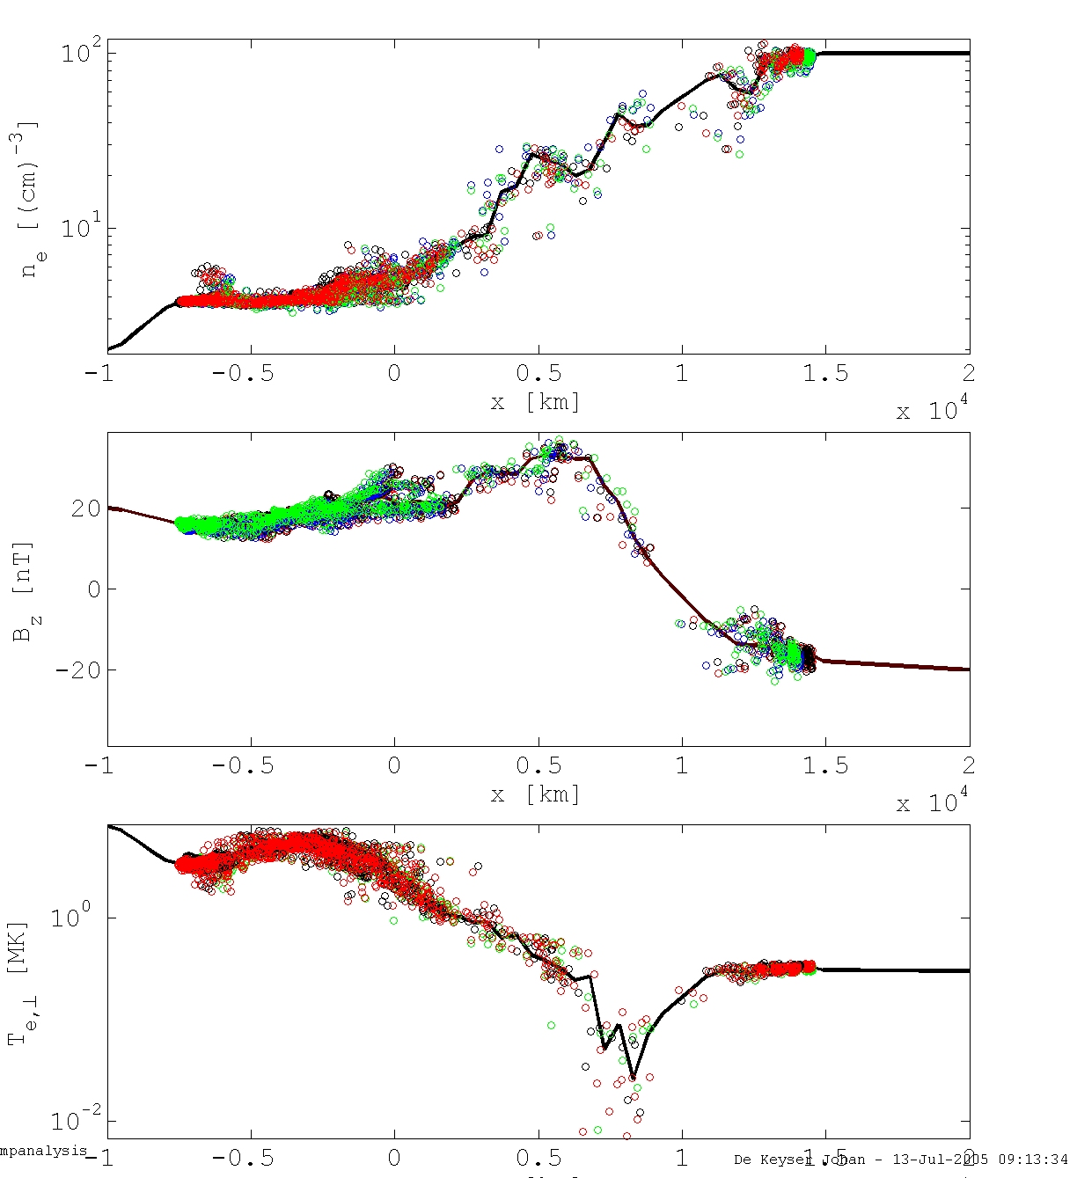
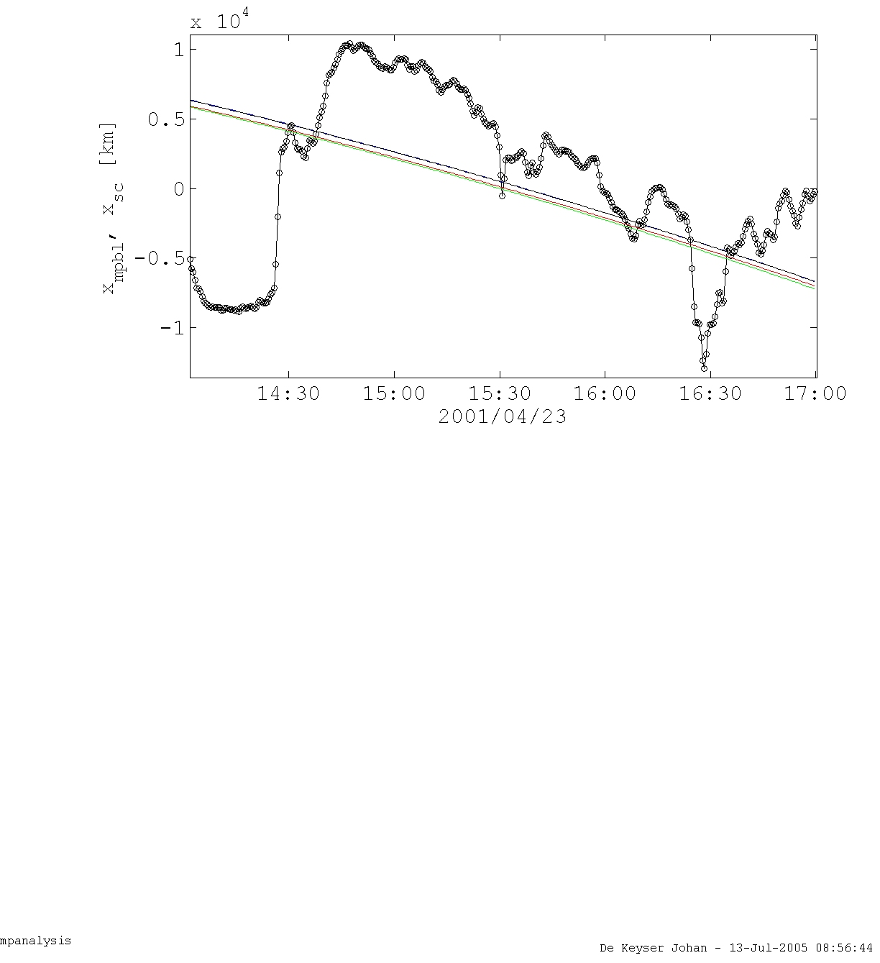

Reconstruction with ∆t = 30 s, using vx from CIS/HIA on C1 and C3, with ne, Te⊥ (PEACE) and Bz (FGM) as guiding variables, giving rather little weight to ${ v}_{x}$

Slide 12
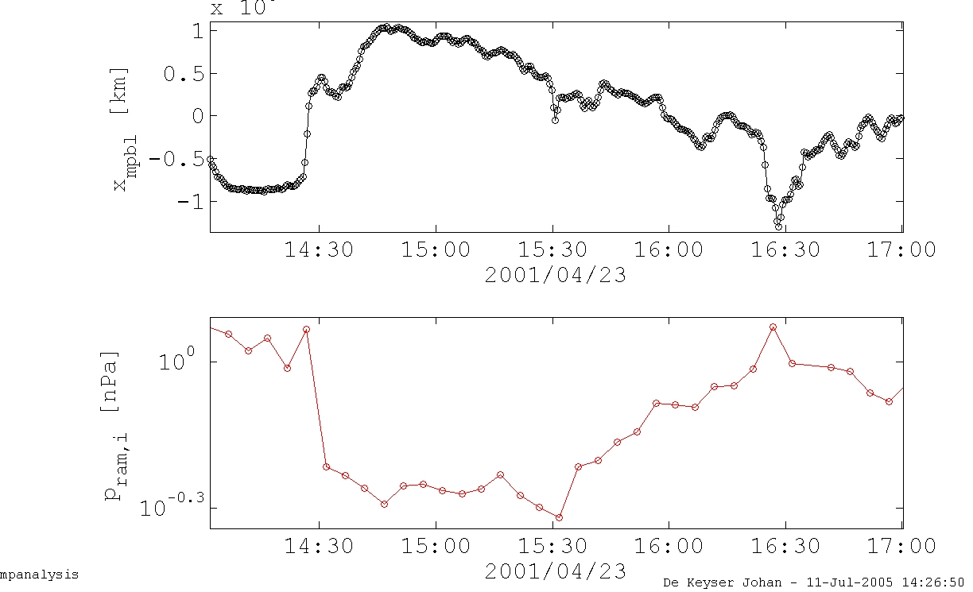
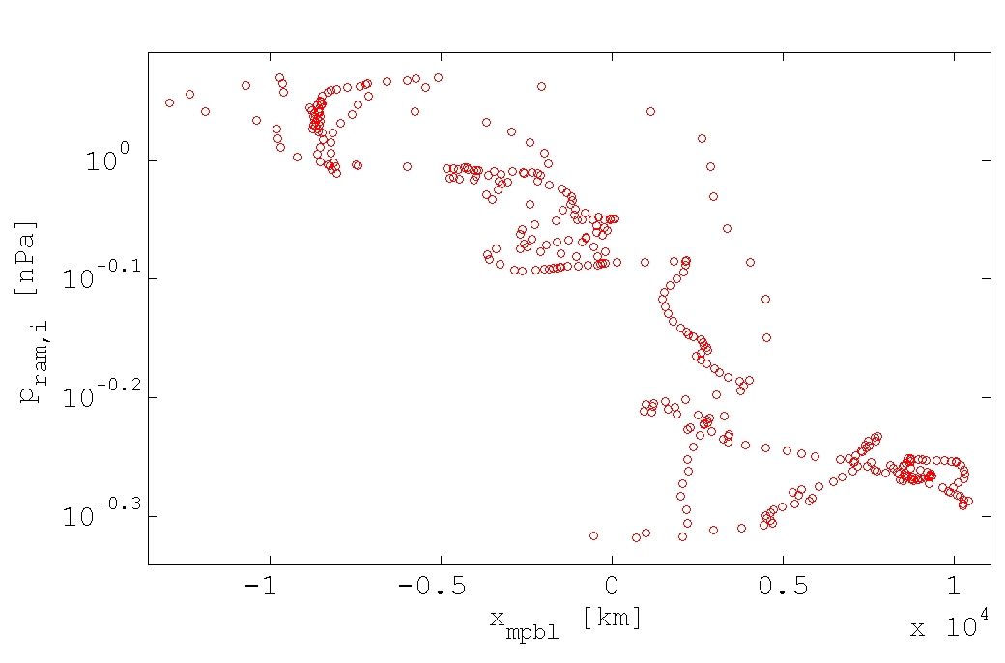
Using ACE/SWEPAM data at L1 with a SW propagation time of 5200 s, we find a clear anti-correlation between MP/BL position and ram pressure on the 5 minute timescale.

Slide 13
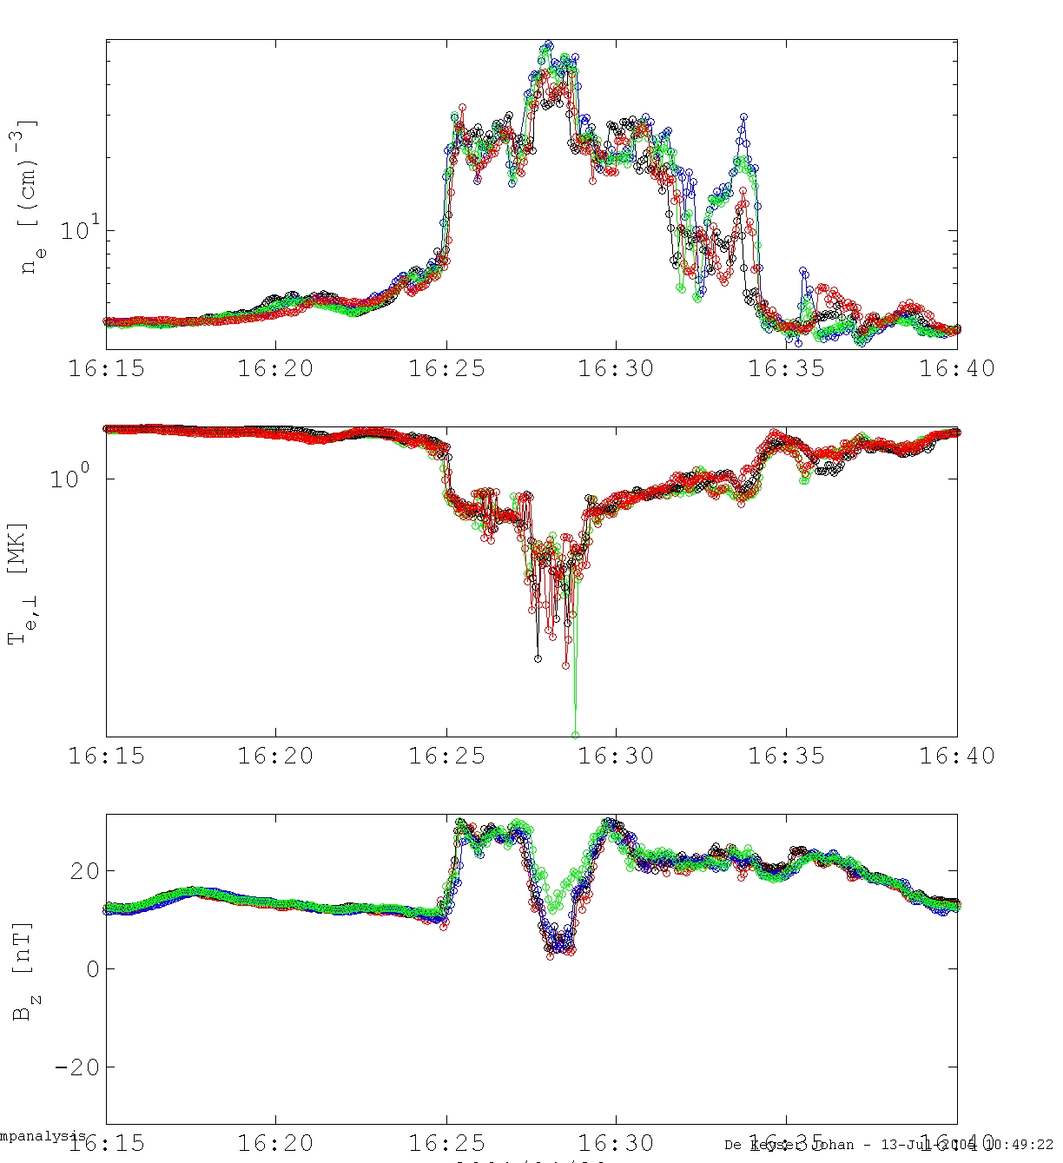
Example: substructure
Same event : end of inbound pass, 4 s resolution data : differences between the sc show up

Slide 14

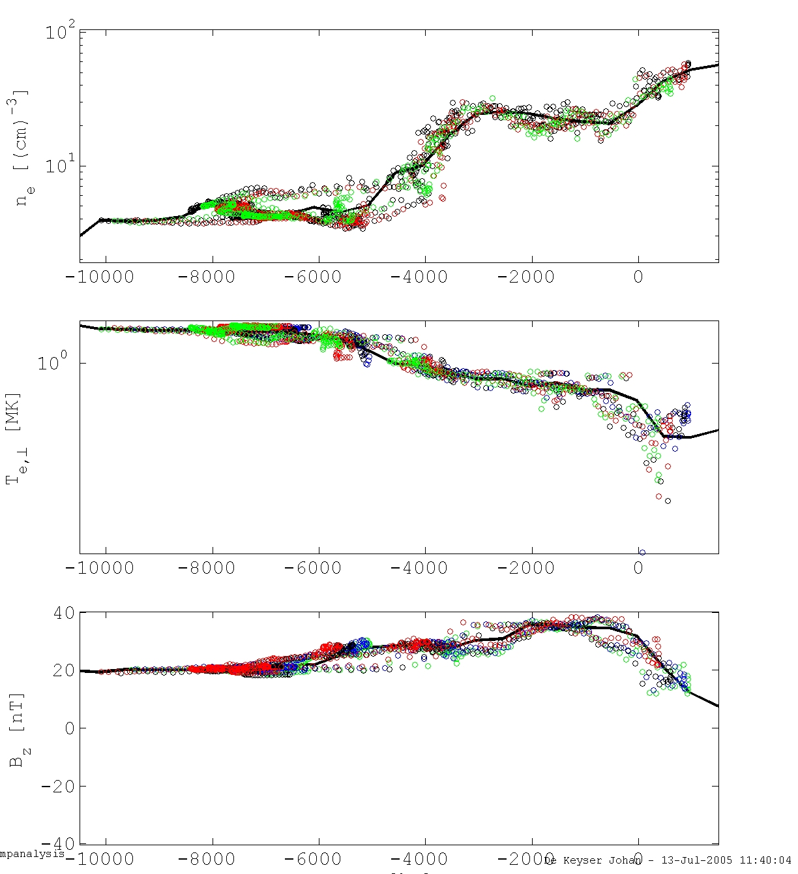
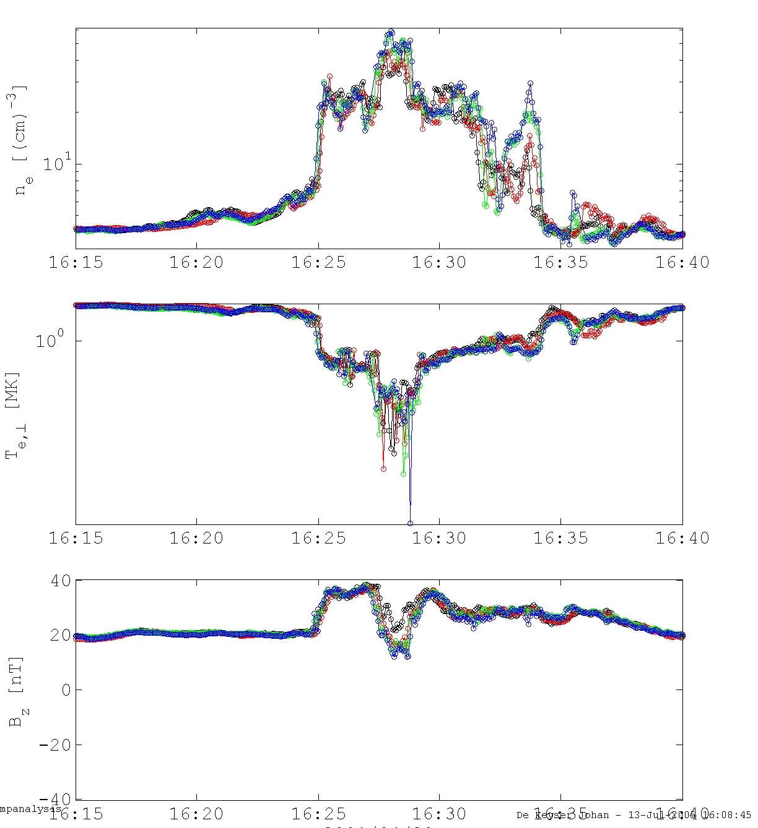
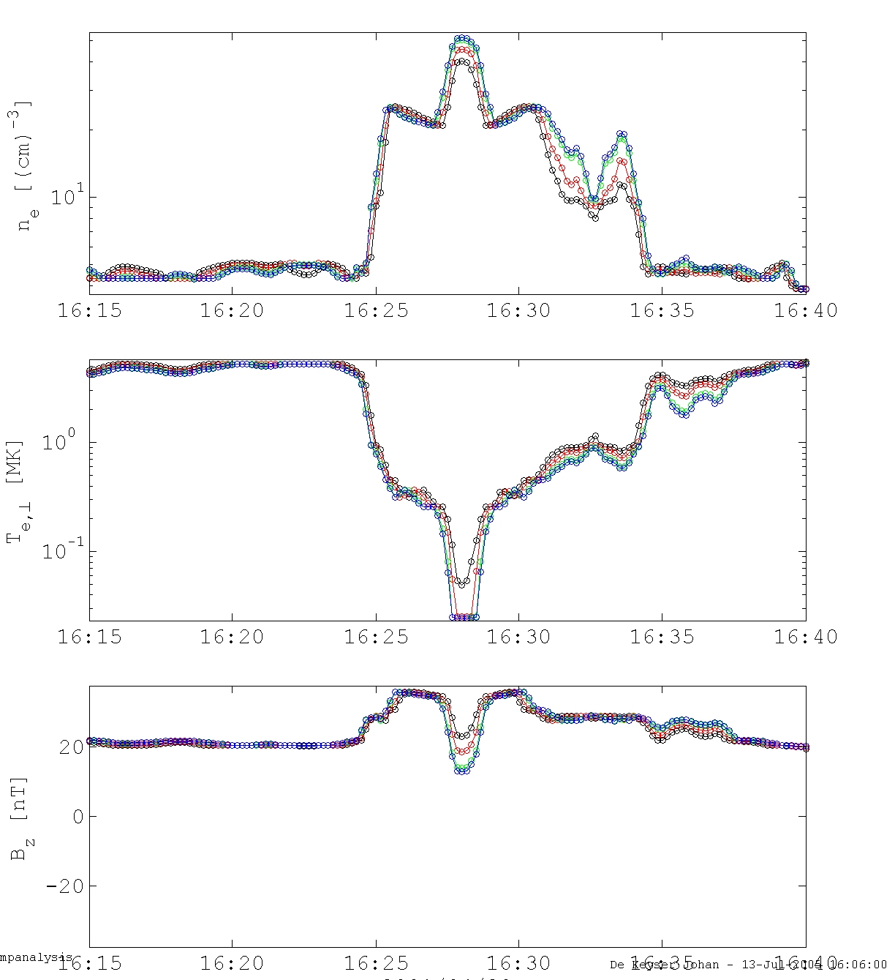
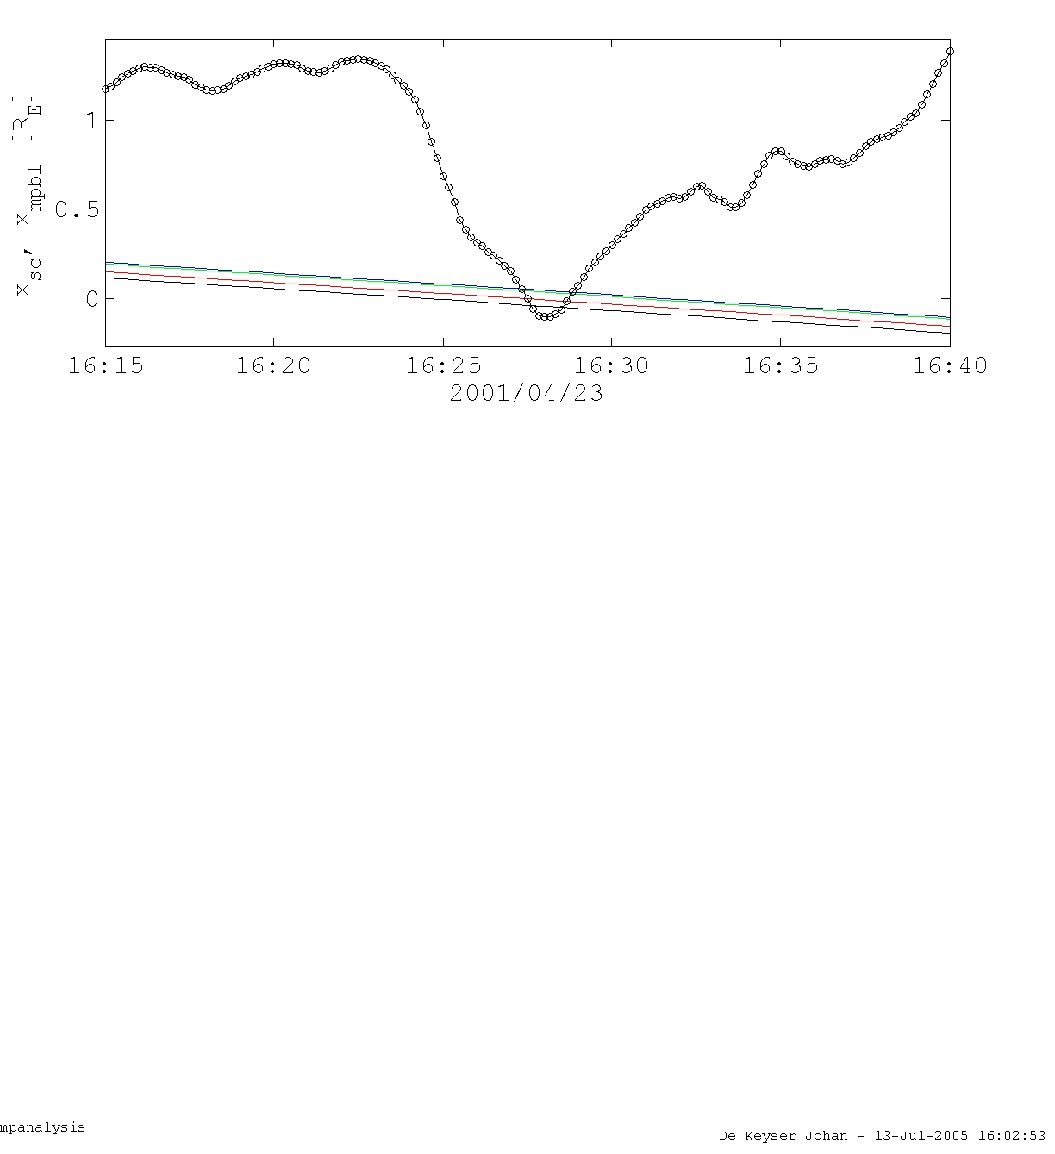
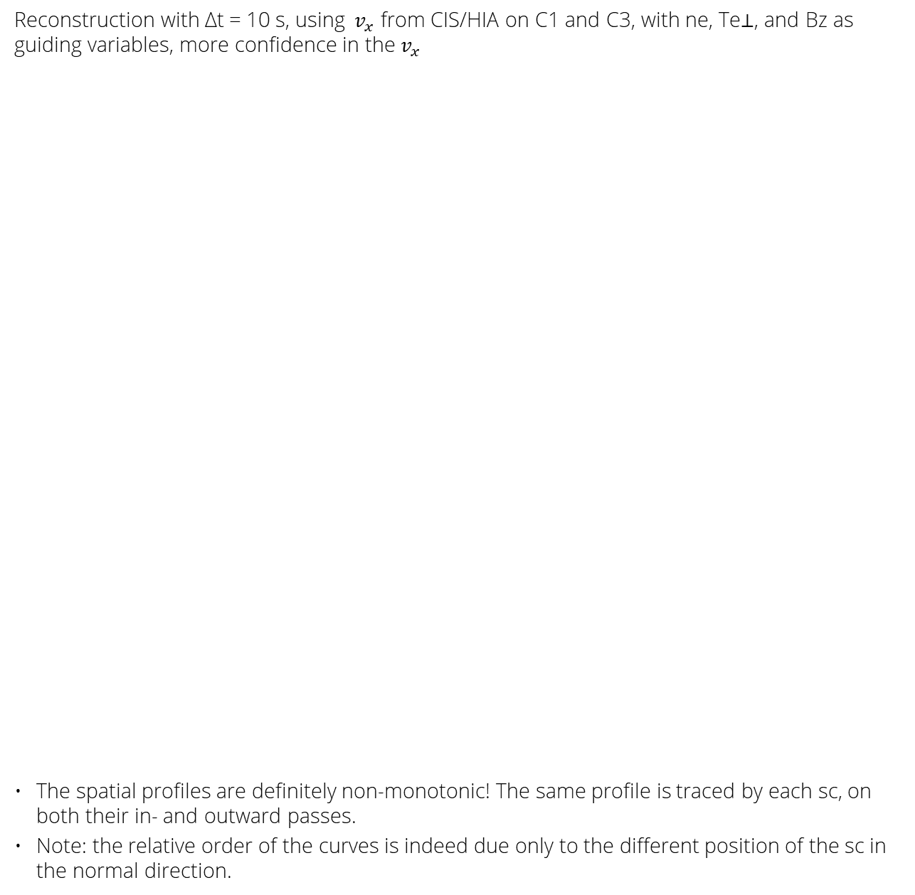
Reconstruction with ∆t = 10 s, using ${ v}_{x}$ from CIS/HIA on C1 and C3, with ne, Te⊥, and Bz as guiding variables, more confidence in the $v_{x}$
The spatial profiles are definitely non-monotonic! The same profile is traced by each sc, on both their in- and outward passes.
Note: the relative order of the curves is indeed due only to the different position of the sc in the normal direction.

Slide 15
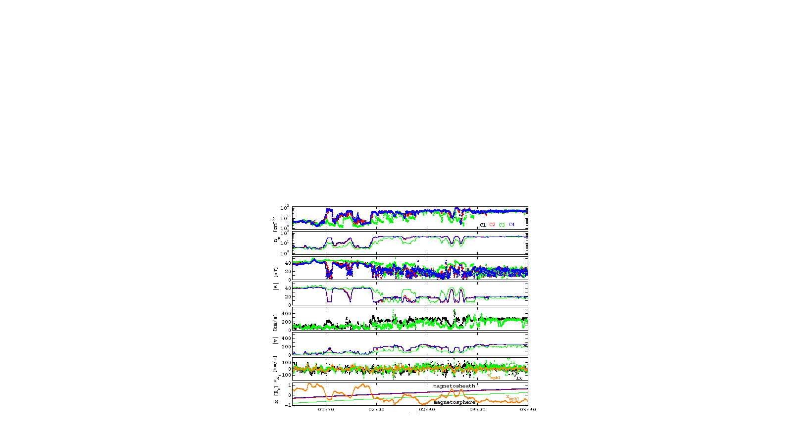
Example: long-duration tracking
June 11, 2001 : Outbound MP/BL pass, ∆t = 20 s, using vx from C1 and C3, with ne and Bz as guiding variables; C1, C2, C4 close together, C3 inward, which explains the relative ordering, the partial crossings through the MP, …

Slide 16
Conclusions
Empirical reconstruction brings a vast amount of multi-spacecraft and multi-instrument data together in a common context to obtain a global picture of the MP/BL.
In doing so, it is found that
  Much of the observed time variability at the MP/BL can be ascribed to boundary motion.
  MP crossing order and relative values of densities, temperatures, etc. are due to the different distances of the spacecraft from the MP/BL.
  The 30 s averaged boundary speed distribution has a variance of about 20 km/s, but may go up to 100 km/s. Boundary acceleration can be significant, as found with local analysis techniques.
  Boundary structure in the form of a density plateau is observed: formation mechanism ?
  Correlation between MP/BL position and solar wind ram pressure in a deterministic (rather than statistical) sense shows direct solar wind pressure control of the magnetopause position, for some events at least.

Slide 17
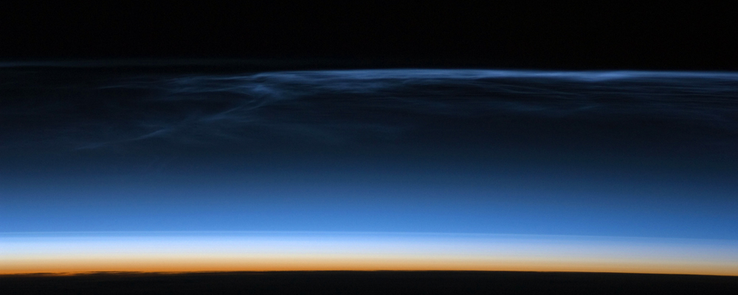

thank you!
more info?
www.aeronomie.be
Johan.DeKeyser@aeronomie.be

