Slide 1
Magnetic local time asymmetries in precipitating electron and proton populations with and without substorm activity
O.S. Yakovchuk^{1,2} and J.M. Wissing¹
¹Institute of Environmental Systems Research, University of Osnabrück, Germany
²Skobeltsyn Institute of Nuclear Physics, Lomonosov Moscow State University, Russia
ESWW2019
18.11. – 22.11.2019
Notes:
1
1

Slide 2
Outline
Goal :
AISstorm: Atmospheric Ionisation model during Substorm
Data sets:
Particle data
Coordinate system
SML index and derived substorm onsets
Isolated substorms and no substorm periods
Results:
Precipitation map
Particle flux at high latitudes
Auroral oval asymmetry
Kp-dependence
Summary
Notes:
2
2

Slide 3
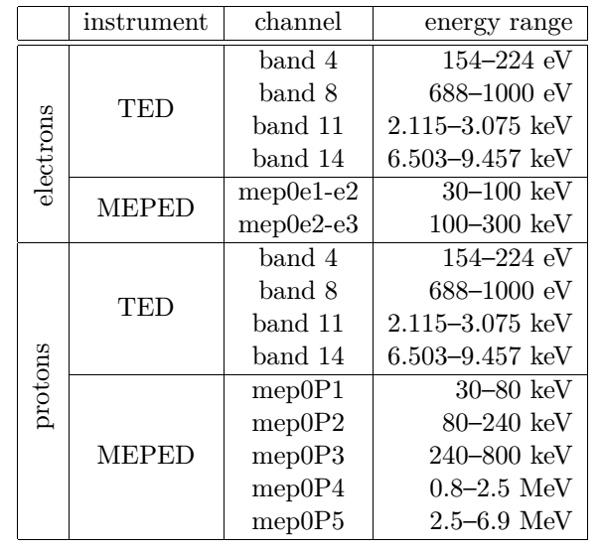
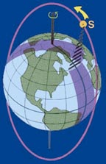
Data sets Time period: 2001 – 2008
POES:
Sun-synchronous orbit
altitude 820 km
100 minutes
98,5⁰ inclination
16 s average fluxes
Channels and nominal energy ranges from the POES & METOP satellites

Slide 4
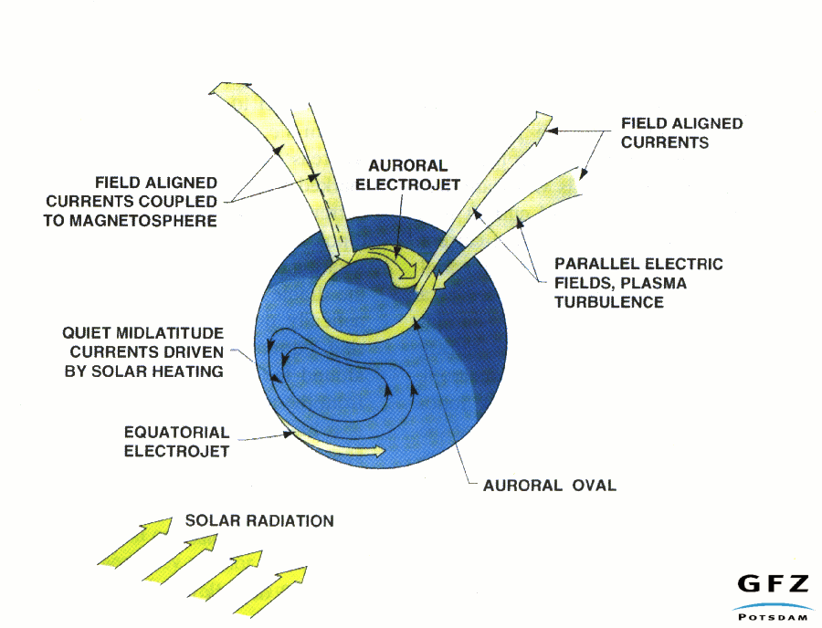
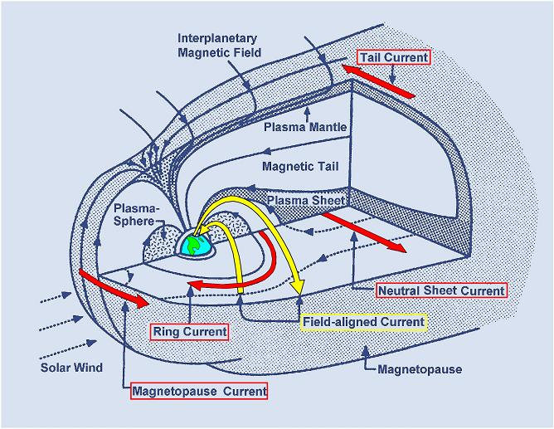
Coordinate System
Geographic longitude hides daytime-dependence
Solution: longitude replaced by local time

Slide 5
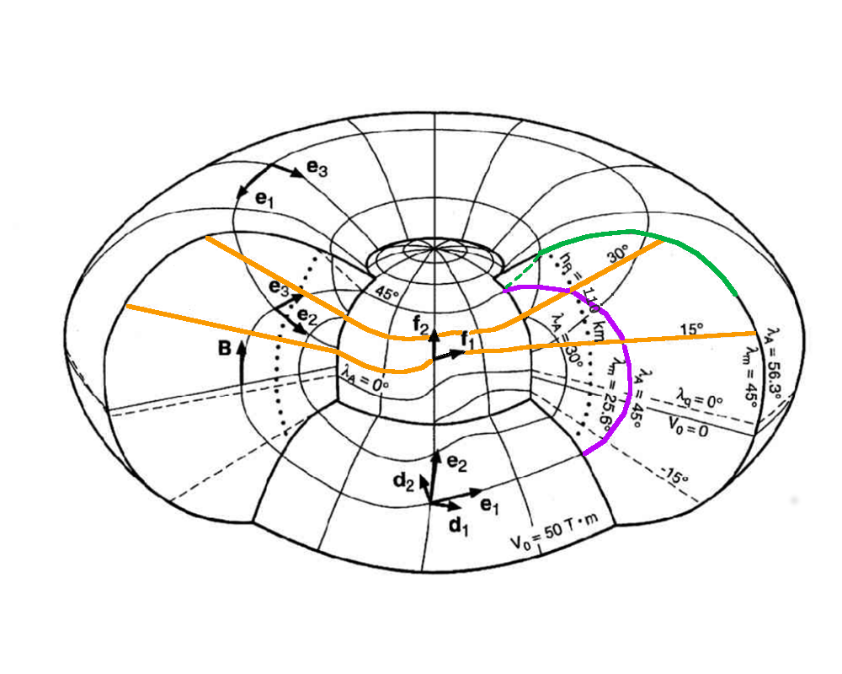
Coordinate System
Latitude:
Longitude: along identified IGRF longitude line
(International Geomagnetic Reference Field)
Quasi-dipole (QD)
represent magnetic field on the ground, expands radial outward
APEX is defined by the point where magnetic field line hits the ground surface, and constant along the same field line
Modified APEX
same as APEX, but for user defined surface height (for ex. 110 km)
(A.D. Richmond, 1994)
Particles precipitate along magnetic field line.
-> in modified APEX coordinate measurements and location where particles are stopped by the atmosphere (110km) are at the same latitude.

Slide 6
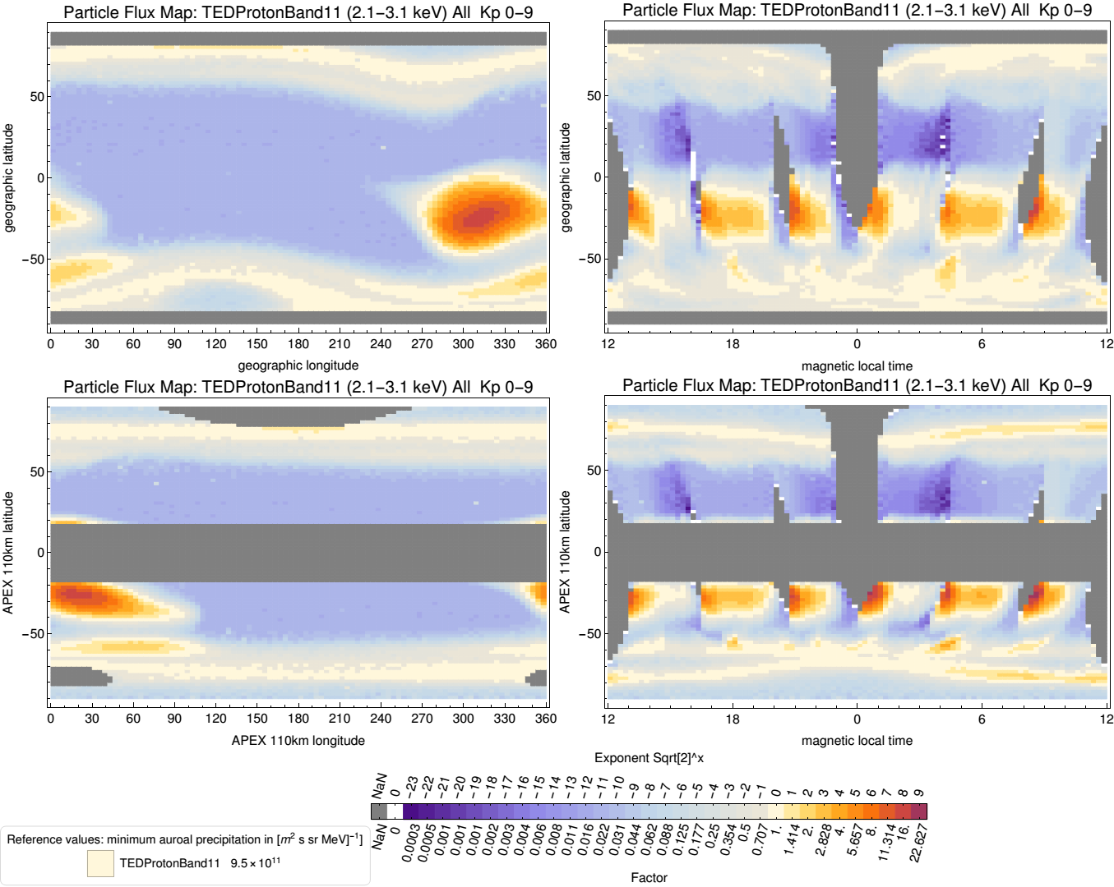
Particle flux in the TED proton band 11 in:
vs. Longitude
vs. MLT
Geographic
coordinates
Modified APEX 110 km
coordinates
Long resolution:
3,75⁰ or 15 min MLT
The color scale marks the minimum flux in the auroral oval in beige. The neighboring color indicates that the flux is a factor √2 apart (the neighbour after that a factor 2).

Slide 7
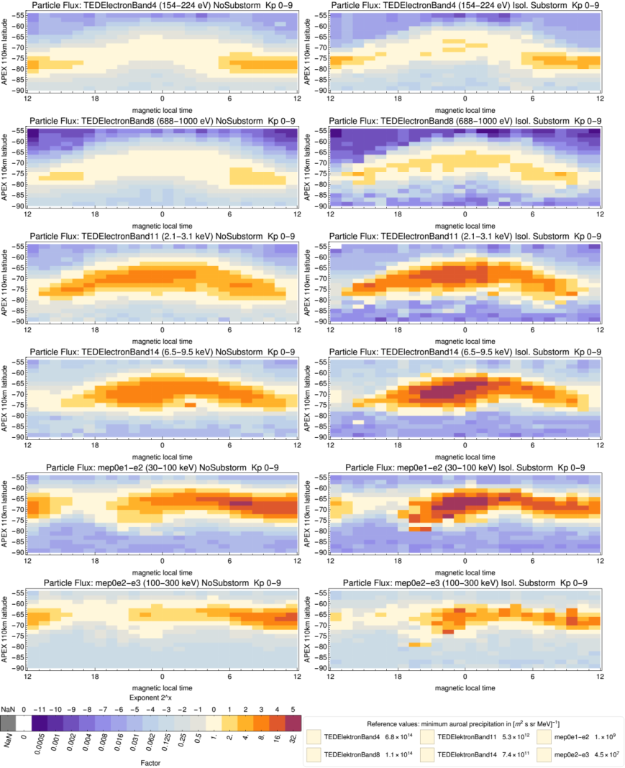
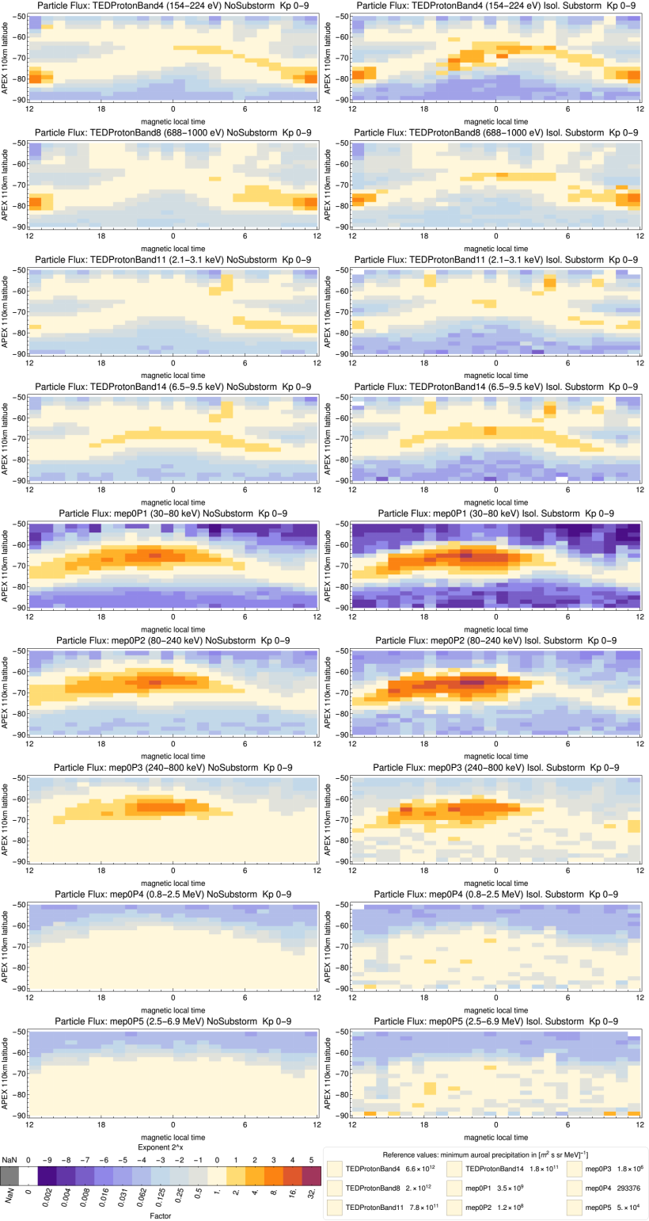
Electron
Proton
No substorm
Isolated
No substorm
Isolated
Isolated
Energy
Fluxes at high latitudes on the
southern hemisphere
Substorms mostly increase particle precipitation in the night-sector by about factor 2–4 but can also reduce it in the day-sector

Slide 8
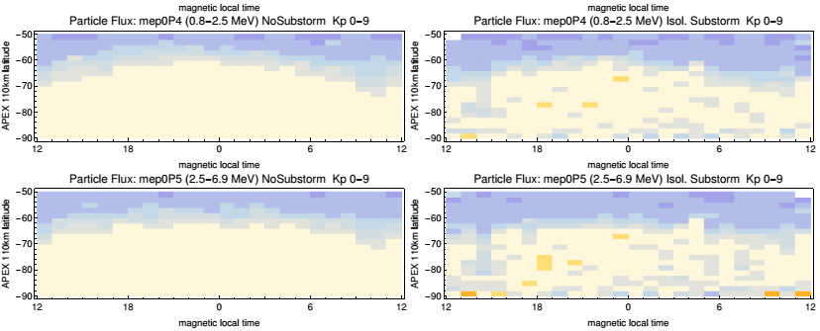
Proton fluxes at high latitudes on the southern hemisphere
The two highest energy channels do not show MLT variations
Particle precipitation is limited to SPE. Since these particles enter the ionosphere via open field lines there is no latitudinal focusing but a homogeneous precipitation within the polar cap.

Slide 9
Electron
Proton
No substorm
Isolated
No substorm
Isolated
Energy
Low energetic
Fluxes at high latitudes on the southern hemisphere

Slide 10
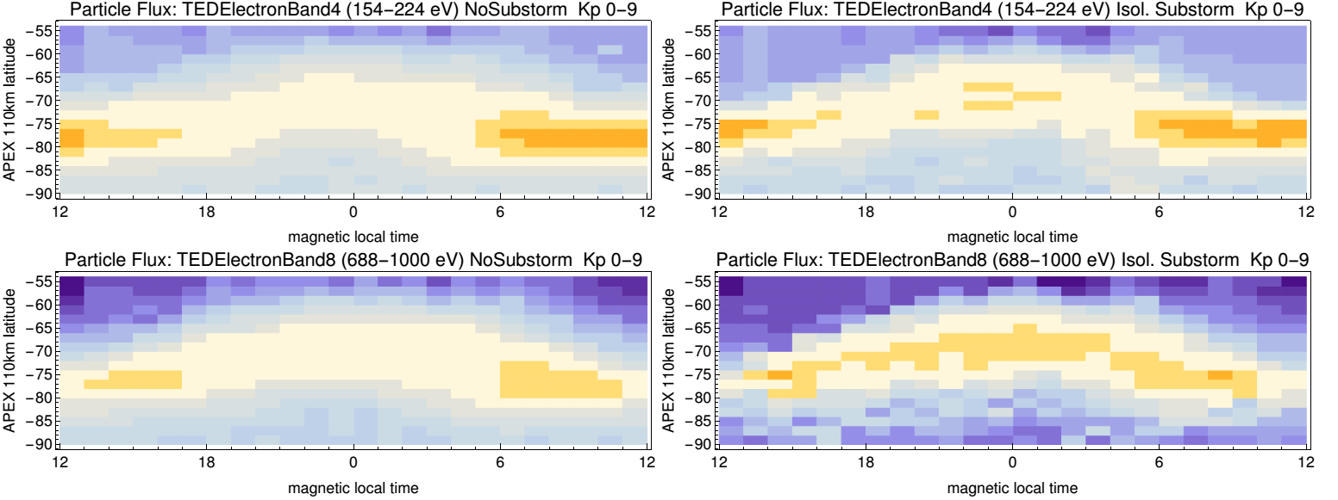
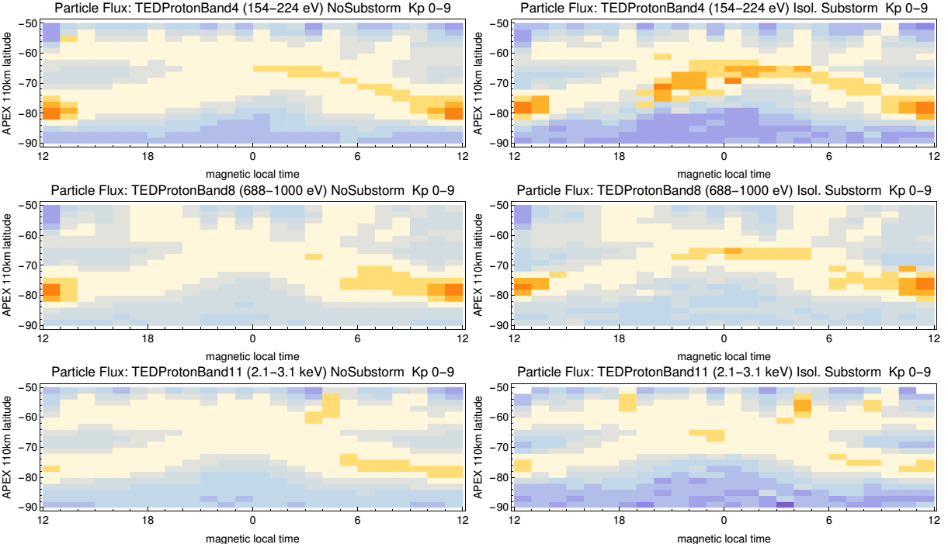
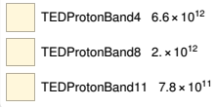
No substorm
Isolated
Low energetic fluxes at high latitudes on the southern hemisphere
Electron
A second oval structure
is an artifact of the MLT-binning
The maximum flux in the auroral oval appears in the day sector.
No-substorms
Source: poleward edge of the cusp- periods with northward IMF
Proton
Isolated substorms the particle flux is shifted by 2 degrees to the equator.
Source: the equatorward edge of the cusp - corresponding region in periods of southward IMF
(Sandholt+,1998;
Newell & Meng,1992)

Slide 11
Electron
Proton
No substorm
Isolated
No substorm
Isolated
Isolated
Energy
High energetic
Fluxes at high latitudes on the southern hemisphere

Slide 12
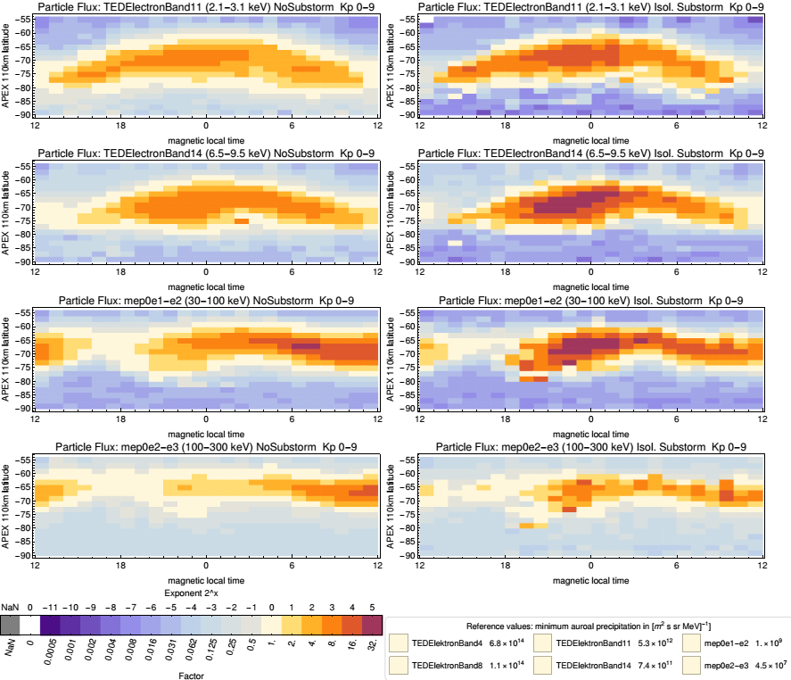
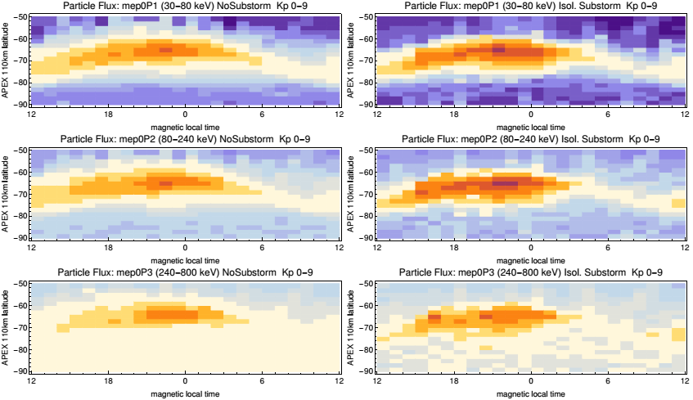
High energetic fluxes at high latitudes on the southern hemisphere
Electron
Proton
No substorm
Isolated substorm
No substorm
Isolated substorm
The high electron channels (above >2 keV) show a displacement of the main particle flux with MLT from midnight (TEDelectron band 11) via morning sector (mep0e1-e2) to day sector (mep0e2-e3).
Reason: electrons drift eastwards – precipitation in the morning
Concerning protons, between TED proton band 14 and the following channels (mep0P1 to mep0P3) the main particle flux shifts from midnight to the evening sector.
Reason: protons drift westward, and precipitate in the evening sector.

Slide 13
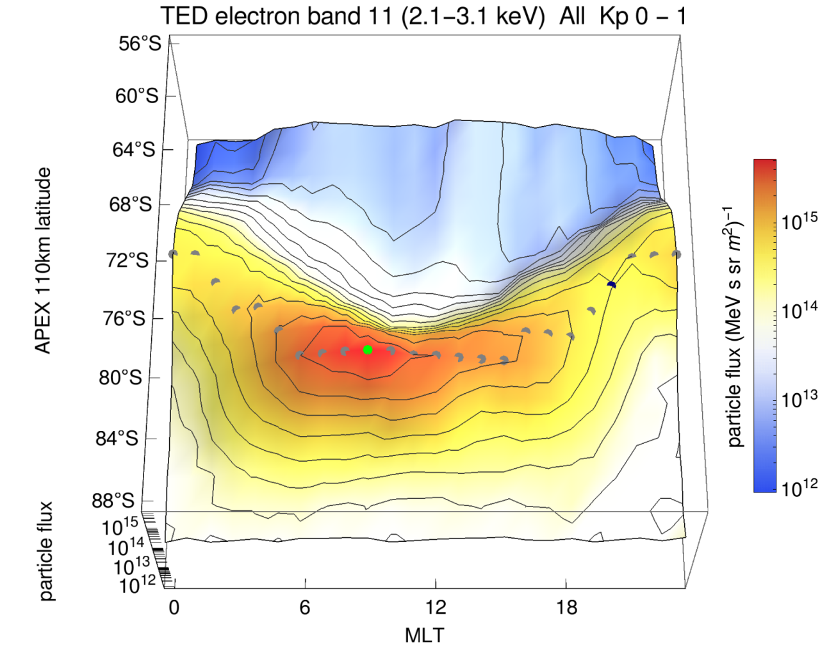
Auroral oval identification algorithm
The gray dots represent the position of the auroral oval.
Maximum flux for each MLT-bin within the typical auroral latitude range – preliminary auroral oval.
The green (9 MLT) and black (20 MLT) indicate maximum and minimum of the auroral oval, respectively

Slide 14
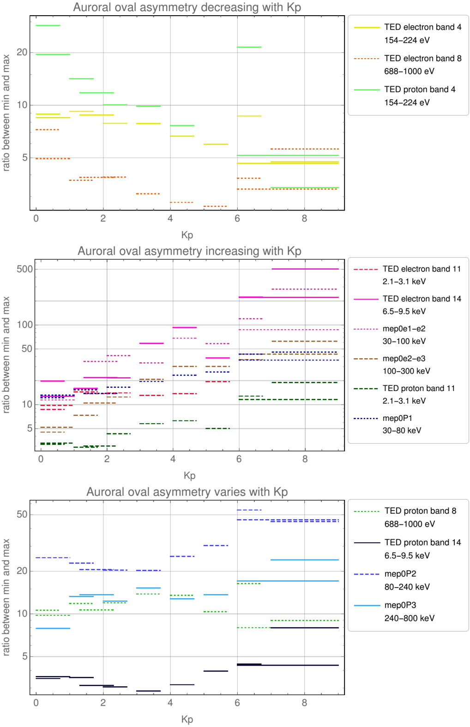
Dependence of the auroral oval asymmetry with Kp
negative correlation
Channels dominated by dayside precipitation Nightside substorm activity at high Kp declines asymmetry
positive correlation
High geomagnetic disturbance should be linked with enhanced acceleration, scattering and substorm processes that increase asymmetry.

Slide 15
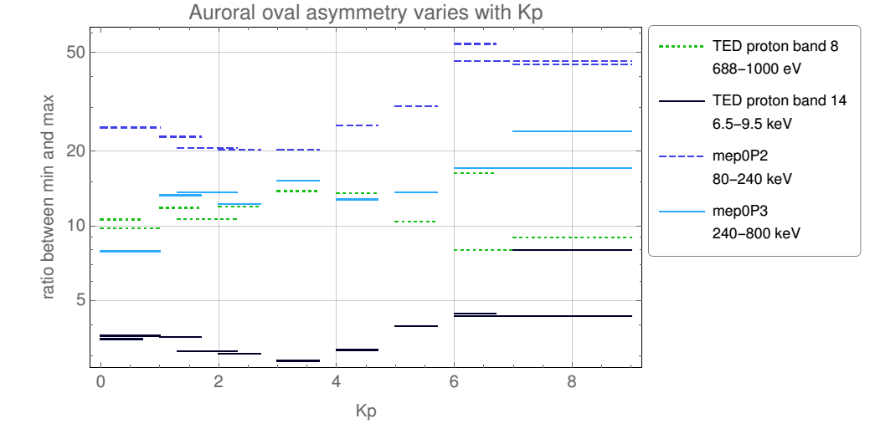
Dependence of the auroral oval asymmetry with Kp
no clear correlation
For higher proton channels the Kp-dependence is ambiguous, but in general the asymmetry is significantly smaller than in the electron channels.
Reason: the channels are influenced by both dayside and substorm precipitation

Slide 16
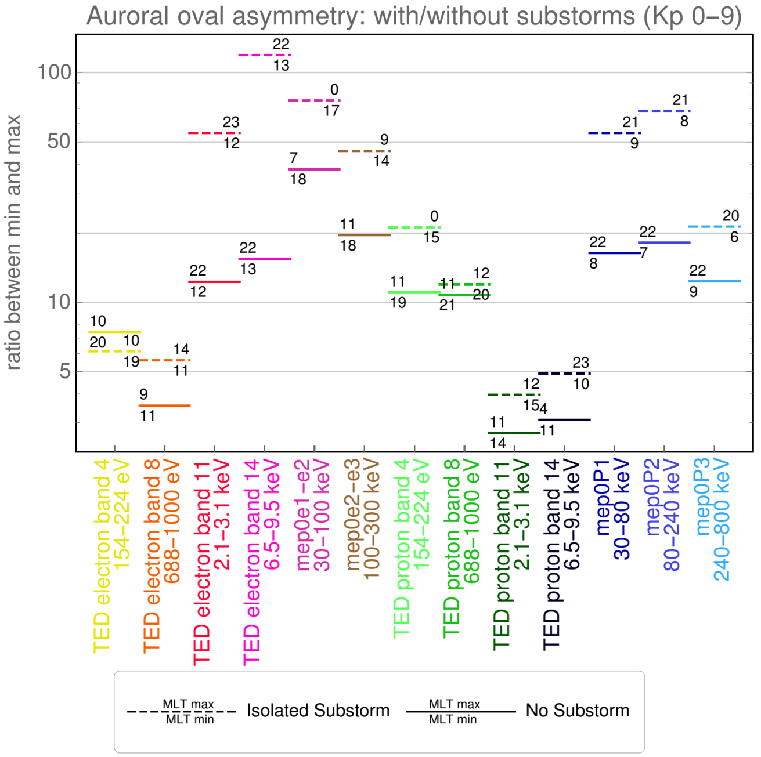
The auroral asymmetry is shown as ratio between max and min auroral oval flux
The number above a specific ratio states the MLT where the maximum is detected while the number below that ratio indicates the MLT of the minimum

Slide 17
The auroral asymmetry is shown as ratio between max and min auroral oval flux
Maximum flux on the dayside
Asymmetry is small sometimes decreasing during substorms
Maximum flux around midnight.
Asymmetry increasing, peaking at typical substorm energies
Decreasing asymmetry and substorm depenence for higher energies
The number above a specific ratio states the MLT where the maximum is detected while the number below that ratio indicates the MLT of the minimum

Slide 18
Summary
The MLT distribution of electron (0.15–300 keV) and proton (0.15–6900 keV) flux/precipitation into the atmosphere based on NOAA POES and METOP satellite data during 2001–2008 in combination with different substorm activity was described.
Substorms mostly increase particle precipitation in the night sector by about factor 2–4, but can also reduce it in the day sector.
During substorms the maximum low energy electron flux is shifted by 2 degrees to the equator
MLT dependence can be assigned to particles entering the magnetosphere at the cusp region and magnetospheric particles in combination with energy-specific drifts
The maximum flux asymmetry ratio depends on particle energy, decreasing with Kp for low energetic particles and increasing with Kp for higher energy electrons, while high energy protons show a more complex dependency.
accepted to Annales Geophysicae, 2019

Slide 19
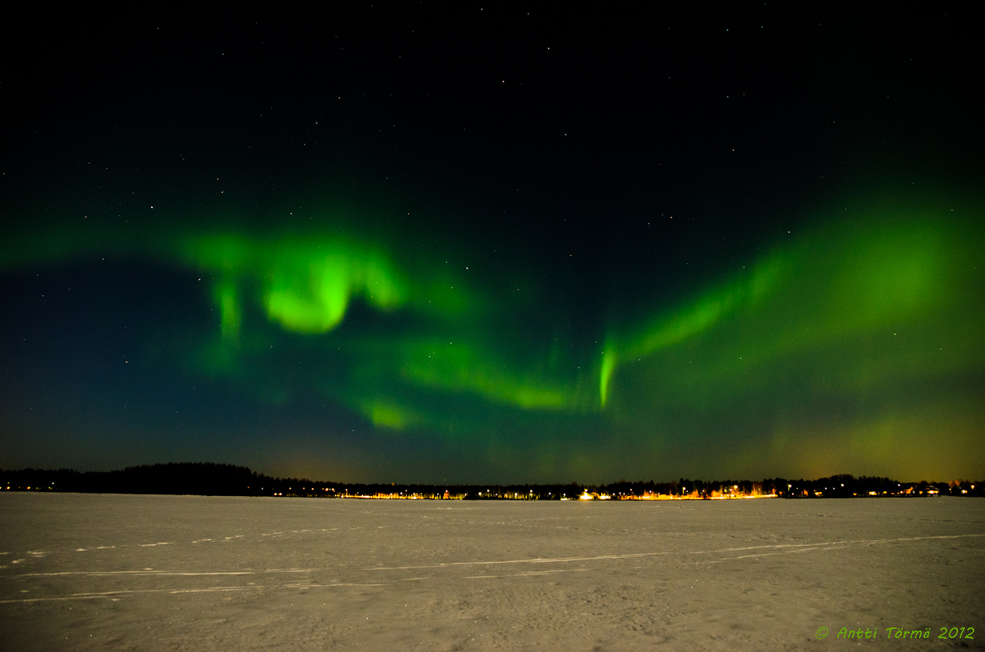
Thank you for your time!
07.03.2012 Kuivasjärvi lake near
University of Oulu

Slide 20
AISstorm
Geomagnetic data Kp, SML
Particle measurements from satellites
Statistical analysis
Spatial particle precipitation/spectrum
GEANT 4
Spatial ionisation pattern

Slide 21
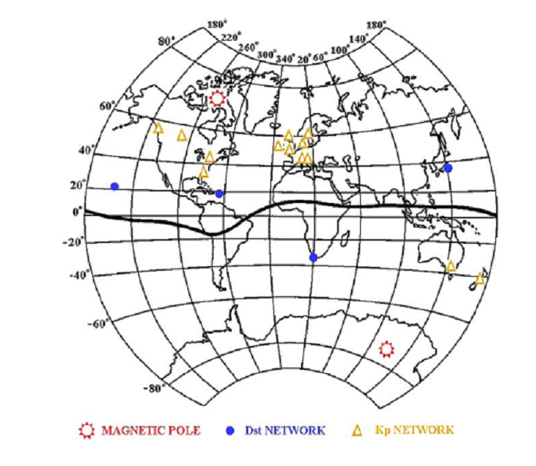
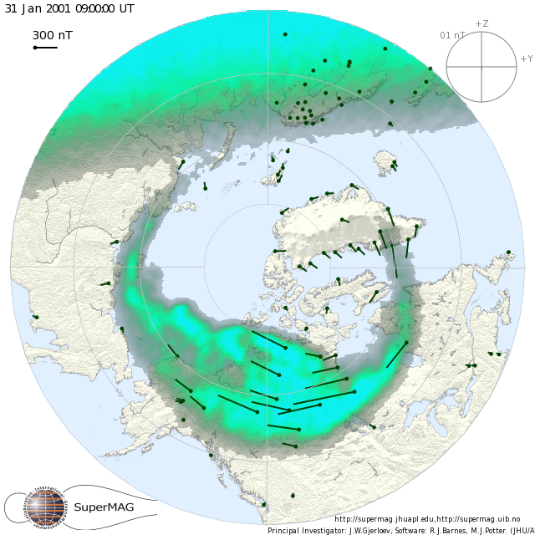
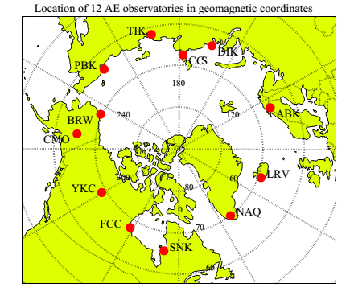
Geomagnetic indices
Kp index (Bartels et al., 1939)
10-13 stations mid-latitudes (44°-60°)
sensitive to several current systems
Dst index (Sugiura , 1964)
4 stations low-latitudes (20°-30°)
is mainly due to the ring current
AE index (Davis and Sugiura, 1966)
10-13 hight-latitudes (61.7°-70°)
the auroral electrojet
AE = AU- AL
SME index (Newell & Gjerloev, 2011)
SuperMAG
>100 hight-latitudes stations (+40° -80°)
SME = SMU-SML
SML as a substorm onset

Slide 22
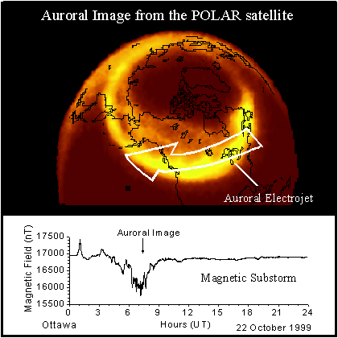
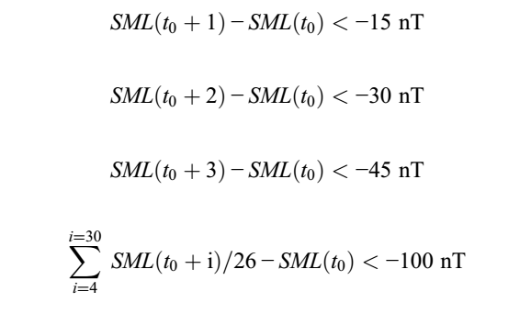
Isolated substorms and no substorm periods
Period 2001–2008
The substorm onset (t₀) -SML index
(spaceweather.gc.ca)
no-substorm periods: 90%
without any substorms
isolated substorms: 2%
at least 3 h separation between onsets
(Newell & Gjerloev, 2011)

Slide 23
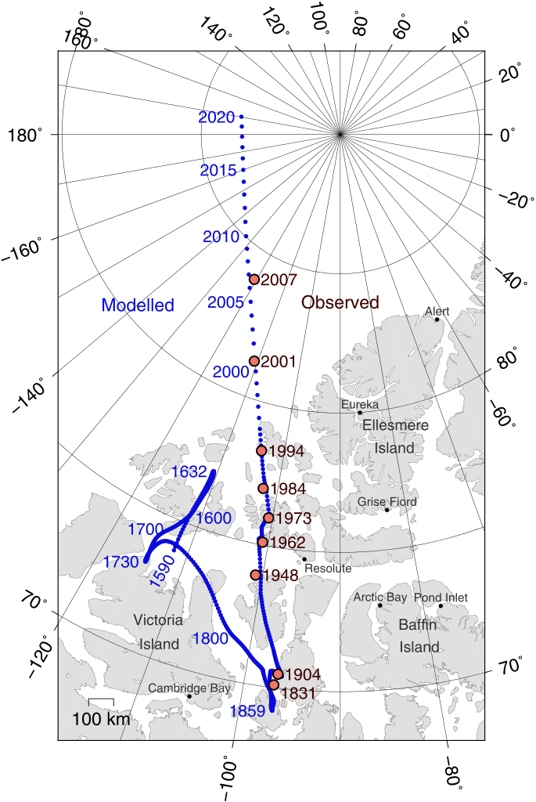
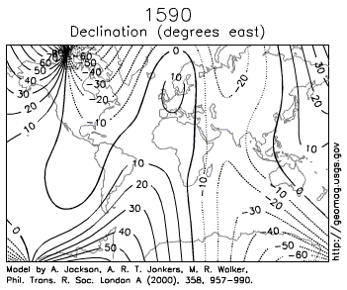
Magnetic coordinate System
But: magnetic field (coordinates) changes with time
Modelled pole position taken from the National Geophysical Data Center, "Wandering of the Geomagnetic Poles “.
Variability of the poles has to be included!

