Slide 1
What is happening with the Sun – and ionospheric response
Jan Laštovička
Institute of Atmospheric Physics CAS, Prague, Czech Republic jla@ufa.cas.cz

Slide 2
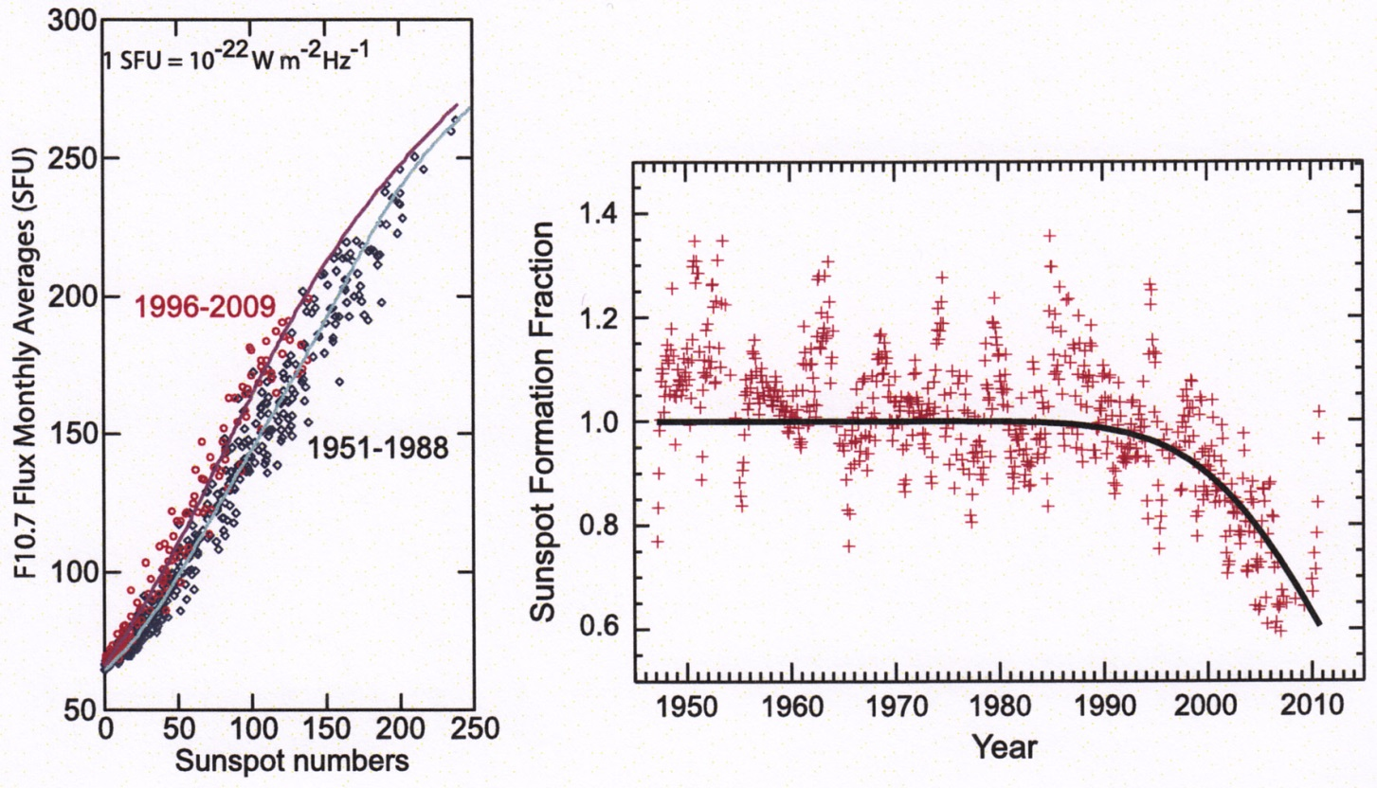
Something is happening with the Sun
Left panel: F10.7 plotted vs. sunspot numbers. Relationship between them has changed significantly during solar cycle 23. Right panel: The sunspot formation fraction parameter changed remarkably during solar cycle 23. Balogh et al. (2014).
Compared to previous solar cycles, the Sun has changed its behavior in cycles 23 and early 24 (present).
The relationships among solar proxies F10.7, Mg II and Fα (solar H Lyman alpha flux) also changed to some extent.

Slide 3
Ionospheric response to solar activity
Elias et al. (2014) studied long-term trends in f_{o}F2 and found some changes of trends during the solar cycle 23, which they attributed to changes in the solar EUV-F10.7 relationship. Laštovička et al. (2016) investigated the behavior of long-term trends in foE - the results are consistent with the results of older papers only after dividing the whole analyzed interval into parts with different solar activity dependences of foE.
Data:
Ionospheric critical frequencies foF2 and foE are analyzed. For foF2, the data of a north-south chain of European stations Juliusruh (54.6ºN, 13.4ºW), Pruhonice (49.98ºN, 14.55°E) and Rome (41.8ºN, 12.5ºE) are used. Data on foE at some stations have problems with long-term data quality; therefore we use the data of the two best European stations, Slough/Chilton (51.5ºN, 1.3ºW) and again Juliusruh located at high midlatitudes. Missing data in databases were partly filled in by data submitted directly from ionospheric stations. Remaining data gaps were filled in by data estimated from the behavior of other European stations. Larger data gaps occurred very rarely.
Solar proxies F10.7, Fα (solar H Lyman-alpha flux) and Mg II (core-to-wing ratio) are used.

Slide 4
Ionospheric response to solar activity
Method:
The analysis is performed for noontime yearly average values. The yearly average value is the average from monthly medians, which are calculated from daily medians over 11-13 LT (noontime). Data are analyzed for the interval 1976-2014. Data are divided into two sub-periods 1976-1995 and 1996-2014 according to changes on the Sun; they are mostly analyzed separately.
I use simple equation (1):
X_{ion} = A + B * solar proxy
Since equation (1) describes the large majority of the total variance of ionospheric parameters (see Table 1), it is used in all further analyses.

Slide 5
Ionospheric response to solar activity
Table 1. The percentage of total variance of foF2 (Rome, Pruhonice, Juliusruh) and of foE (Juliusruh, Chilton) described by solar activity proxies via the simple equation (1). Mostly more than 95% of the total variance. * - data problems in 2011
1976-1995 1996-2014
F10.7 Fα F10.7 Fα Mg II
foF2 Rome 96% 96% 99% 99% 98% foF2 Pruh 98% 97% 99% 98% 98% foF2 Jul 98% 96% 99% 98% 97% foE Jul 99% 95% 88%* 87%* 88%* foE Chil 99% 96% 94% 93% 92%
96-99% of the total variance of yearly values is described by equation (1) for foF2. Table 1 also shows that 99% of the total variance of foE is described by F10.7 for 1976-1995 and it indicates some data problems for 1996-2014.

Slide 6
Ionospheric response to solar activity
All years
Period foF2 Rome foF2 Pruh foF2 Jul foE Jul foE Chil
F10.7 I 4.1±0.2 3.6±0.1 3.9±0.1 0.49±0.01 0.52±0.01 II 5.0±0.1 4.6±0.1 4.5±0.1 0.57±0.05 0.58±0.04 Fα I 2.68±0.13 2.36±0.10 2.56±0.12 0.313±0.017 0.334±0.016 II 3.08±0.08 2.81±0.09 2.74±0.09 0.352±0.033 0.354±0.024
Years of high solar activity (F10.7 > 152) removed
F10.7 I 5.0±0.2 4.1±0.2 4.4±0.2 0.46±0.03 0.50±0.03 II 5.3±0.1 4.8±0.2 4.6±0.2 0.53±0.08 0.56±0.06 Fα I 2.91±0.22 2.31±0.22 2.48±0.24 0.252±0.034 0.278±0.032 II 3.22±0.11 2.98±0.13 2.75±0.15 0.331±0.056 0.352±0.39
Only years 1989 and 1991 removed
F10.7 I 4.3±0.2 3.8±0.1 4.2±0.1 0.50±0.1 0.48±0.1
Table 2. Solar coefficients B (MHz/100s.f.u. for F10.7) and their standard errors from equation (1) for solar proxies F10.7 and Fα. Period I = 1976-1995, period II = 1996-2014.
For all years (top) the solar coefficients B are clearly larger in the second period 1996-2014 for all 5 datasets.

Slide 7
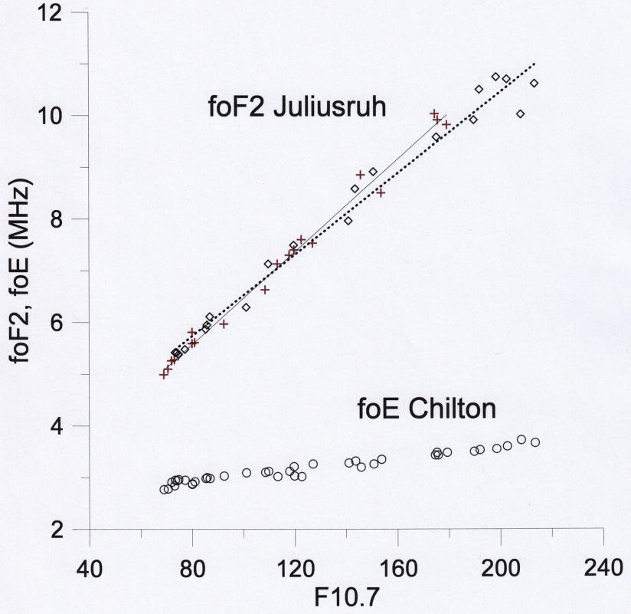
Ionospheric response to solar activity
However, there is an effect of saturation of the dependence of foF2 on solar proxies at high solar activity (e.g., Balan et al., 1994; Liu et al., 2006; Adeniy and Ikubani, 2013). It can affect the change of B from the first to the second period, because the first period contains more years with high solar activity. Figure shows that the effect of saturation does exist for foF2 but not for foE. The threshold value of F10.7 = 152 was chosen partly arbitrarily, mostly in line with values by Adeniyi and Ikubani (2013), while data by Liu et al. (2006) suggest a higher threshold. The threshold is rather low to be sure that all values affected by saturation are removed. Another version removes only 1989 and 2001 (substantial effect of saturation).
Dependence of foF2 (Juliusruh) and foE (Chilton) on solar activity (F10.7), 1976-2014. Empty squares, dotted line – foF2, 1976-1995. Red crosses, full line – foF2, 1996-2014.
Figure also illustrates a steeper dependence of foF2 on F10.7 in 1996-2014.

Slide 8
Ionospheric response to solar activity
All years
Period foF2 Rome foF2 Pruh foF2 Jul foE Jul foE Chil
F10.7 I 4.1±0.2 3.6±0.1 3.9±0.1 0.49±0.01 0.52±0.01 II 5.0±0.1 4.6±0.1 4.5±0.1 0.57±0.05 0.58±0.04 Fα I 2.68±0.13 2.36±0.10 2.56±0.12 0.313±0.017 0.334±0.016 II 3.08±0.08 2.81±0.09 2.74±0.09 0.352±0.033 0.354±0.024
Years of high solar activity (F10.7 > 152) removed
F10.7 I 5.0±0.2 4.1±0.2 4.4±0.2 0.46±0.03 0.50±0.03 II 5.3±0.1 4.8±0.2 4.6±0.2 0.53±0.08 0.56±0.06 Fα I 2.91±0.22 2.31±0.22 2.48±0.24 0.252±0.034 0.278±0.032 II 3.22±0.11 2.98±0.13 2.75±0.15 0.331±0.056 0.352±0.39
Only years 1989 and 1991 removed
F10.7 I 4.3±0.2 3.8±0.1 4.2±0.1 0.50±0.1 0.48±0.1
Removal of years with F10.7 > 152 removes 7 years from period I and 4 years from period II, which results in smaller but still existing difference between B in the periods I and II for foF2 with F10.7, and no significant impact on the inter-period difference with Fα. No effect on B for foE.
Removal of years 1989 and 1991 results in a slight reduction of the inter-period difference, which remains evident.

Slide 9
Ionospheric response to solar activity
For foF2 the B first decreases around the 11-year interval 1985 but 1984-1986 suffer with 5 years (maximum) of high solar activity, i.e. the decrease probably is not related to saturation effect. Then B is lowest in 1987-1994, just intervals affected by both years of the highest saturation effect 1989 and 1991. The period 1994-2004 contained four high solar activity years in each interval, thus the significant increase of B from 1994 to 1997 seems to be unrelated to an influence of saturation effect. Then the number of years of high solar activity decreases to 0 in 2008-2009.
B for foE – after quasi-stable evolution a large increase between years 2001 and 2005 statistically significant at 3σ level. The last three years are unreliable - large σ and much lower percentage – data problems.
Figure supports the stronger dependence on F10.7 for more recent years for both foF2 and foE.
Evolution of the 11-year-long sliding window parameter B (MHz/100s.f.u., F10.7) from equation (1) for foF2 from Juliusruh (black full line), Pruhonice (red full line) and Rome (green full line), and of 10xB for foE from Chilton (blue dashed line) and Juliusruh (brown dashed line) for intervals centered in years 1981-2009.

Slide 10
Conclusions
1. The dependence of both foF2 and foE on solar activity proxies is stronger in the period 1996-2014 than in 1976-1995. Thus the relationship between solar activity proxies and ionospheric parameters is not stable, which should be taken into account in ionospheric long-term trend and climatological studies as well as in modeling. This conclusion is valid for yearly average noontime values.
2. The yearly average values of ionospheric parameters are very dominantly controlled by solar activity represented by proxies.

Slide 11
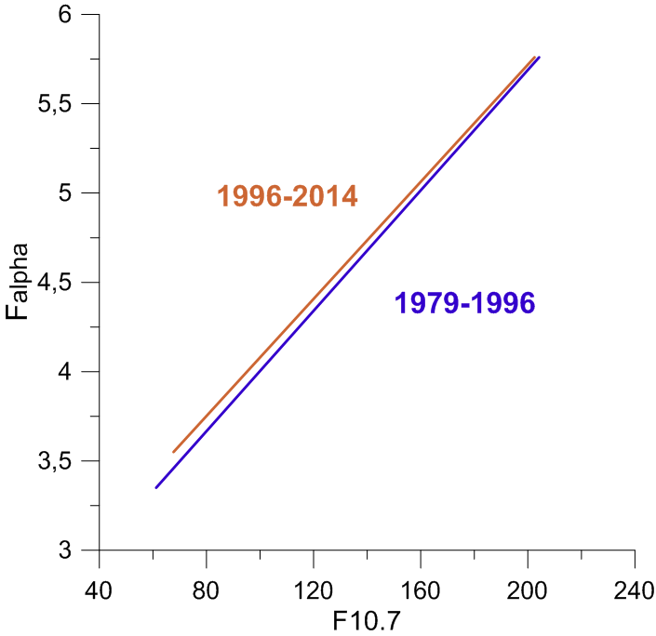
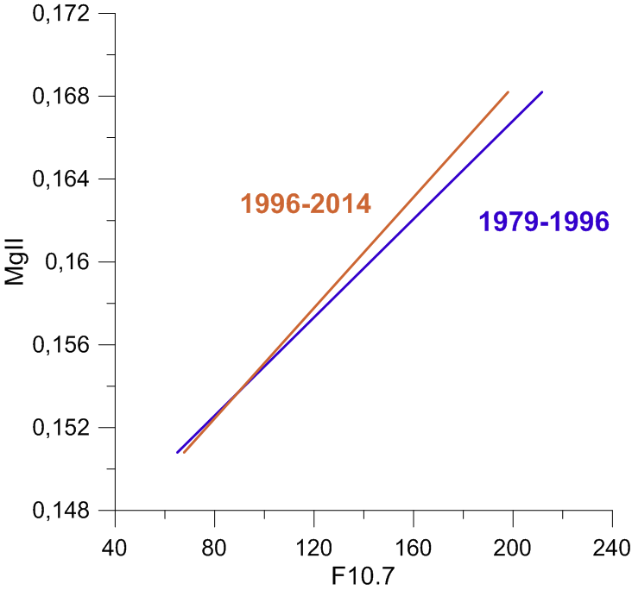
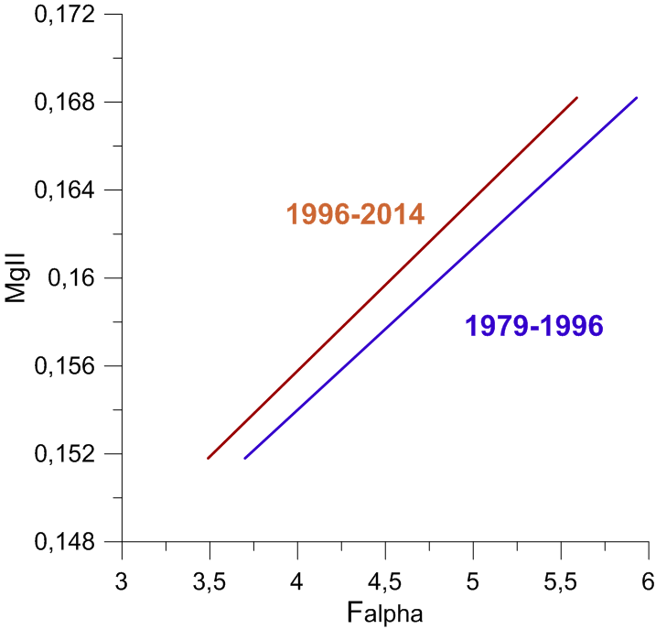
Something is happening with the Sun
The relation between the yearly average values of solar H-Lyman alpha flux (Falpha) and F10.7 - it changed little between 1979- 1995 and 1996-2014 (gaps in the Falpha data series were interpolated based on observed F10.7.
The relation between the yearly average values of Mg II index and F10.7. This relationship is steeper in 1996-2014 than in 1979- 1995.
The relation between the yearly average values of Mg II index and Falpha. This relation is evidently different in 1996-2014 compared with 1979-1995. The Mg II index values for fixed values of Falpha are remarkably larger in 1996- 2014 compared with 1979-1995.

