Slide 1
Highly Elliptical Orbits for services in Polar Regions: Increasing the mission lifetime by orbit optimisation L. Trichtchenko*, A. Trishchenko* and L. Garand** * Natural Resources Canada ** Environment and Climate Change Canada
ESWW, 2019, Session 15 - GNSS: How can the space weather community meet user requirements for navigation/communication at high latitudes?
Presentation at ESWW14, Liege, November 18-22, 2019

Slide 2
CONTENTS:
Motivation
Introduction
Orbits under consideration
Radiation environment reduction
5. Mission duration comparison
6. Results
7. References
Acknowledgements:
The use of the several space environment models and SPENVIS tool is acknowledged
Presentation at ESWW14, Liege, November 18-22, 2019

Slide 3
Motivation:
Stable communication for Arctic Regions:
satellites on Molniya orbit have been historically used for communication in high Arctic
other HEO orbits are being considered
Continuous observation of Arctic (Polar) Regions for weather forecasting and climate change monitoring:
HEO can provide good solution for operational mission with a long service life (~15 years)
WMO 2040 Global Observing Systems Vision: PART II: SPACE-BASED OBSERVING SYSTEM COMPONENT: Orbital scenarios: “… it will also include…highly elliptical orbits providing permanent coverage for the Polar regions;…”
What is required:
- Continuous stable communication
- Continuous Arctic observations with good spatial resolution;
- Maximum possible mission duration ( i.e. reduced total ionizing doze)
Presentation at ESWW14, Liege, November 18-22, 2019

Slide 4
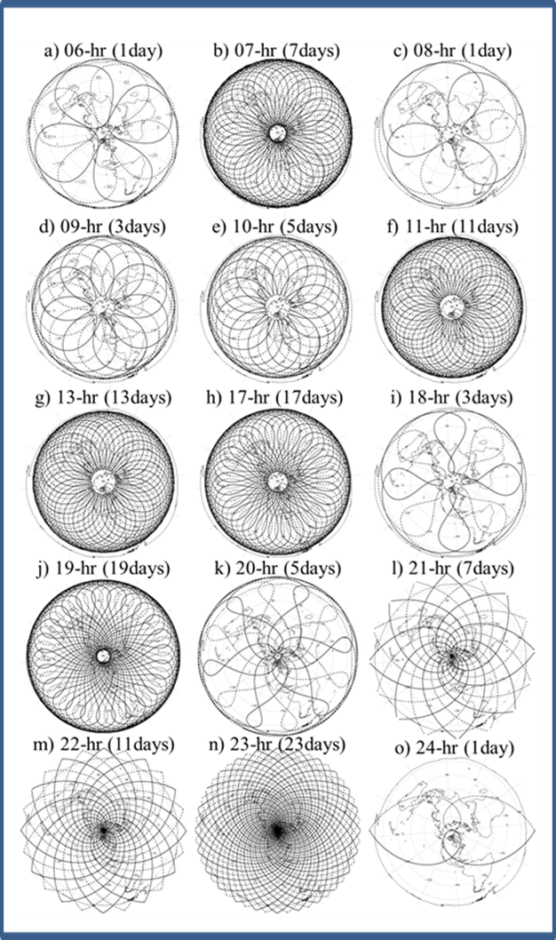
Introduction
Criteria for selection of Orbital Parameters
High eccentricity:
long dwelling time over the apogee/Arctic for continuous observations and communication services
b) Critical orbit inclination:
- minimizes orbit secular precession due to Earth’s gravitational field
c) Minimal apogee:
- closer to Earth, better image resolution
this requirement will be relaxed here by varying the eccentricity value
d) Reduced atmospheric drag and collision avoidance (Perigee >1000 km above surface)
e) Minimization of ionizing radiation
The whole range of suitable orbits were investigated in our previous publications, see references at the end of presentation.
Presentation at ESWW14, Liege, November 18-22, 2019

Slide 5
Orbits under consideration in current study:
Ground tracks in polar projection,
2 satellites, one repeat cycle
Presentation at ESWW14, Liege, November 18-22, 2019

Slide 6
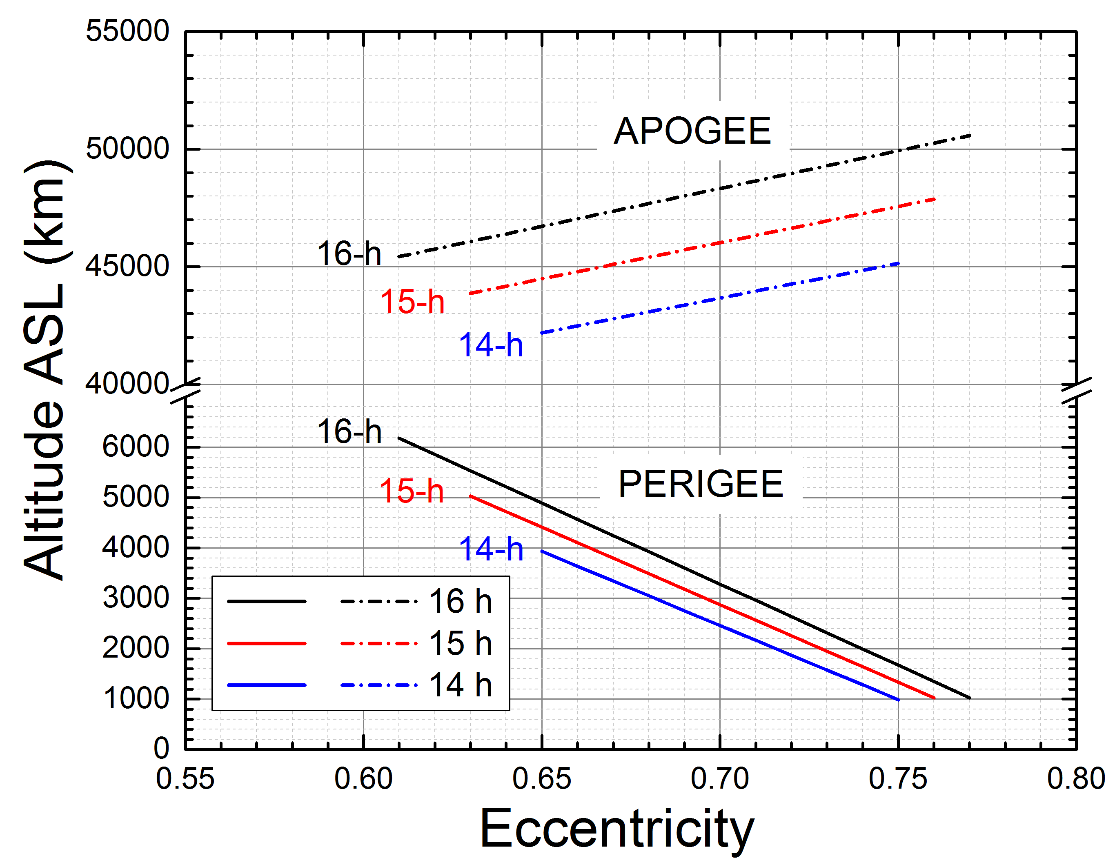
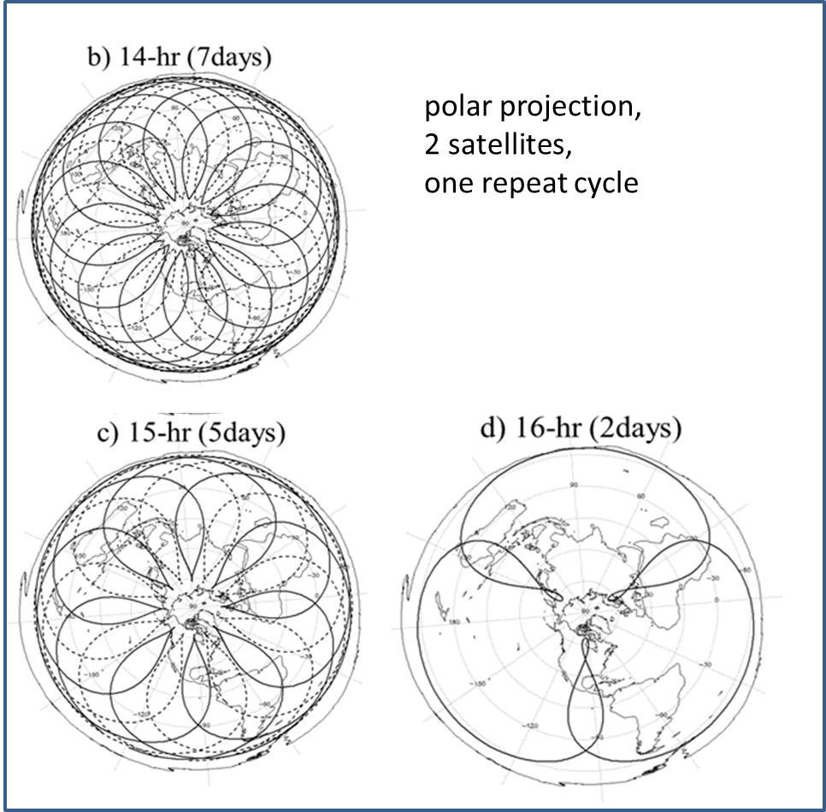
Orbits under consideration:
Relation between Altitude (Above Surface Level) and Eccentricity
(to achieve continuous Arctic coverage !)
Eccentricity= variable in this study
Presentation at ESWW14, Liege, November 18-22, 2019

Slide 7
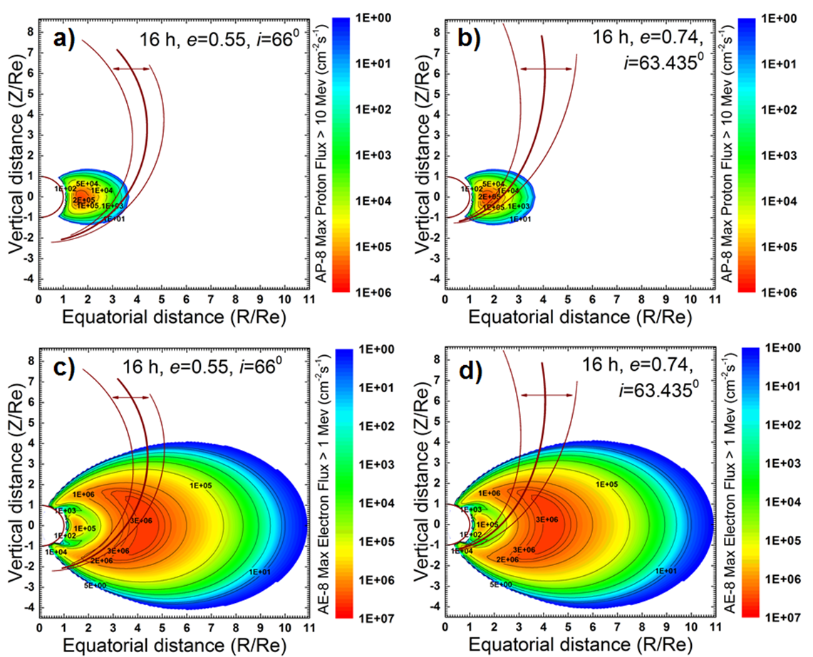
Radiation environment reduction (TID) due to changes in eccentricity:
“OLD” 16-hr orbit e=0.55
“NEW” 16-hr orbit e=0.74
Previous results on radiation environment assessment for a complete set of orbits (see Ref [3] for orbital parameters)
Reduces impacts of e-
Presentation at ESWW14, Liege, November 18-22, 2019

Slide 8
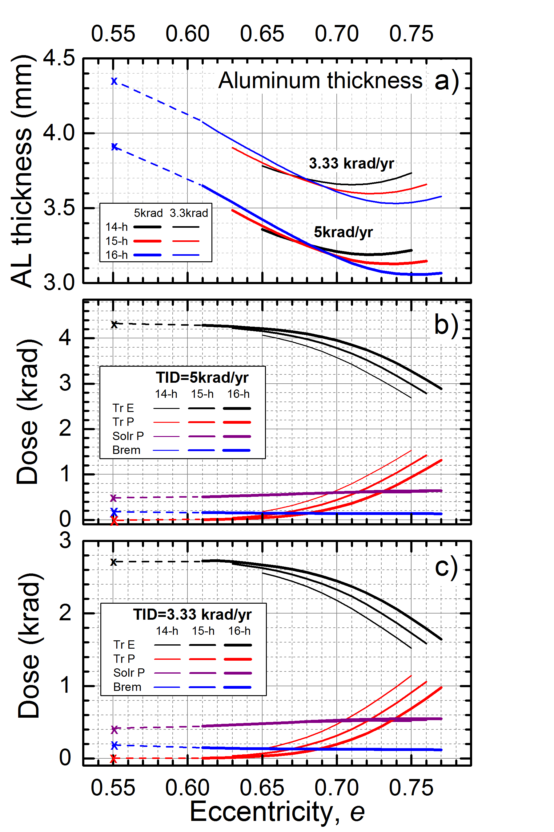
Radiation environment reduction (TID) for “new” orbits under considerations
TID and shielding for max 50 krad total mission dose (10 and 15 years duration)
Comparisons with “OLD” 16-hr orbit with e=0.55
Al thickness to keep Max TID = 50 krad
Aluminum thickness (mm) | Duration of “new” HEO missions | Duration of “old” 16-hr mission (yr) | Difference (yr)
3.19 | 14-h 10-year | 4.9 | 5.1
3.13 | 15-h 10-year | 4.6 | 5.4
3.06 | 16-h 10-year | 4.3 | 5.7
3.66 | 14-h 15-year | 7.8 | 7.2
3.60 | 15-h 15-year | 7.4 | 7.6
3.53 | 16-h 15-year | 6.9 | 8.1
Presentation at ESWW14, Liege, November 18-22, 2019

Slide 9
Results:
HEO orbits are the best suitable to achieve continuous Arctic communication and meteo/climate observation capacity
Among the set of HEO orbits, several were selected for more detailed analysis, i.e. with periods of 14-, 15- and 16- hr
The main purpose was to reduce the total ionizing dose (shielding thickness) by relaxing the apogee requirement (i.e. increasing eccentricity) for the HEO orbits at critical inclination
Assuming the total mission dose max= 50 krad,
required shielding was estimated for 10-and 15-year mission duration
Orbit optimization can reduce TID and increase mission lifetime for the same shielding by about factor of 2 relative to previously considered orbits
Acknowledgements
The use of the ESA's SPace ENVironment Information System (SPENVIS) publicly accessible at https://www.spenvis.oma.be is gratefully acknowledged
Presentation at ESWW14, Liege, November 18-22, 2019

Slide 10
References:
Trishchenko, A. P., Garand, L., Trichtchenko, L.D., 2011: Three-apogee 16-h highly elliptical orbit as optimal choice for continuous meteorological imaging of polar regions, J. Atmos. Oceanic Technol., 28, 1407–1422.
Trichtchenko, L.D., Nikitina, L.V. , Trishchenko, A.P. , Garand, L., 2014: Highly Elliptical Orbits for Arctic observations: Assessment of ionizing radiation, Advances in Space Research, 54, 2398- 2414 http://dx.doi.org/10.1016/j.asr.2014.09.012
Trishchenko, A.P., Trichtchenko, L.D., Garand, L., 2019: Highly Elliptical Orbits for Polar Regions With Reduced Total Ionizing Dose, Advances in Space Research,
63, 3761-3767, https://doi.org/10.1016/j.asr.2019.04.005
Presentation at ESWW14, Liege, November 18-22, 2019

Slide 11
EXTRA
Presentation at ESWW14, Liege, November 18-22, 2019

Slide 12
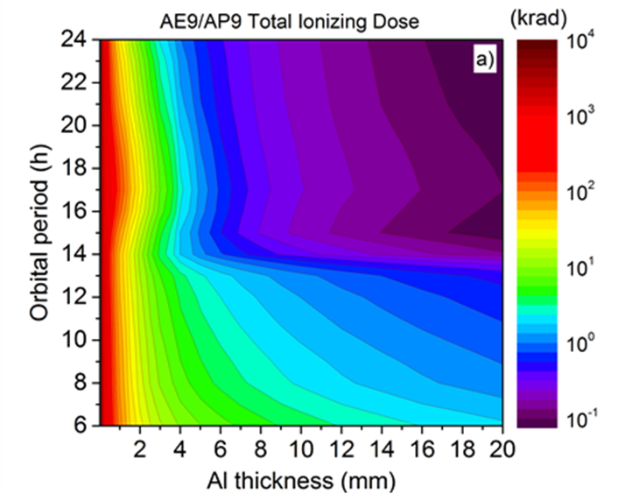
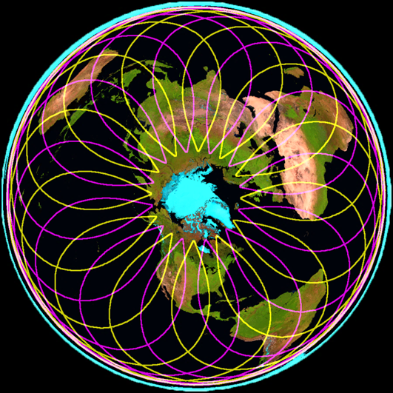
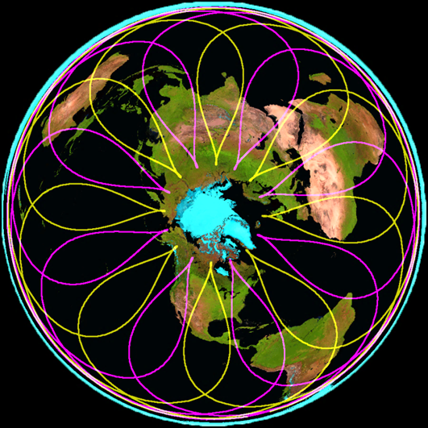
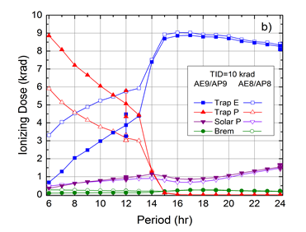
Summary: New candidate orbits for Arctic Observations are: 14-hr (top) and 15-hr (bottom).
Presentation at ESWW11, Liege, November 17-22, 2014

