Slide 1
An ionospheric index suitable for estimating the degree of ionospheric perturbations
Volker Wilken, Martin Kriegel, Norbert Jakowski
and Jens Berdermann

Slide 2
Outline
DIXSG method
Application of the DIXSG to ionospheric storms
Comparison with ROTI and AATR
Summary / conclusions

Slide 3
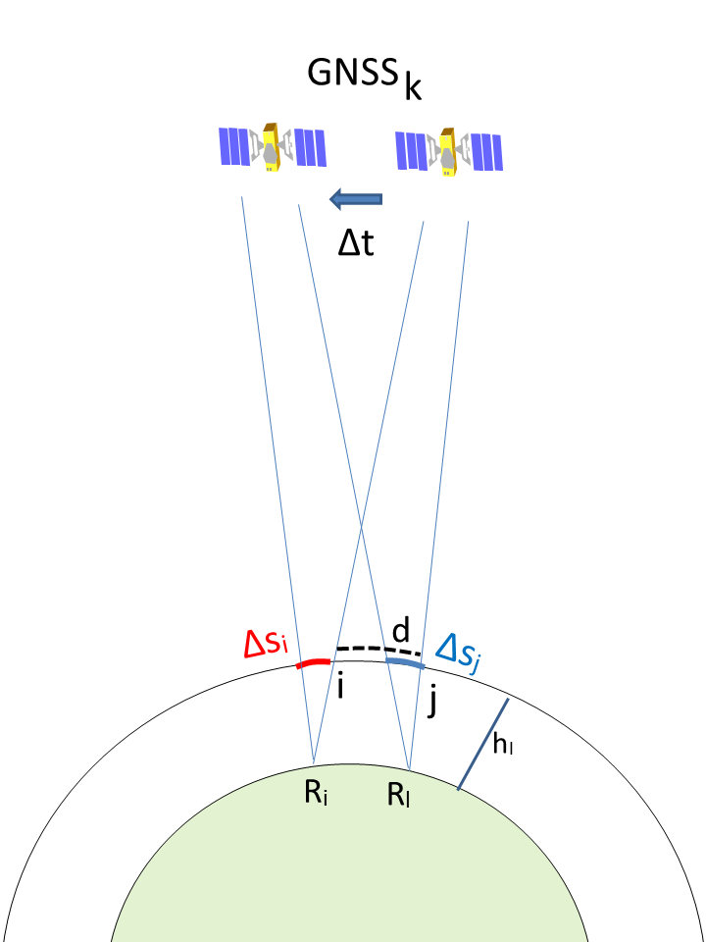
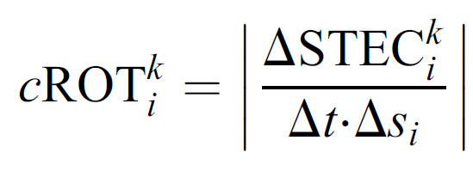
Disturbance Ionosphere Index Spatial Gradient (DIXSG)
Rate of TEC - ROT
Volker Wilken, Martin Kriegel, Norbert Jakowski, Jens Berdermann (2018) An ionospheric index suitable for estimating the degree of ionospheric perturbations, J. Space Weather Space Clim. 8 A19
DOI: 10.1051/swsc/2018008

Slide 4
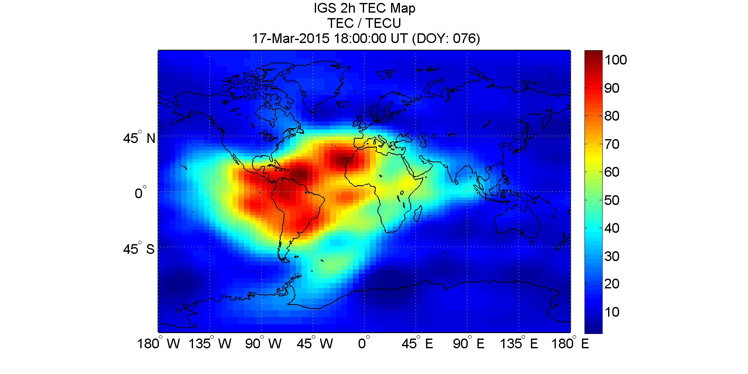
Application of the DIXSG to ionospheric storms

Slide 5
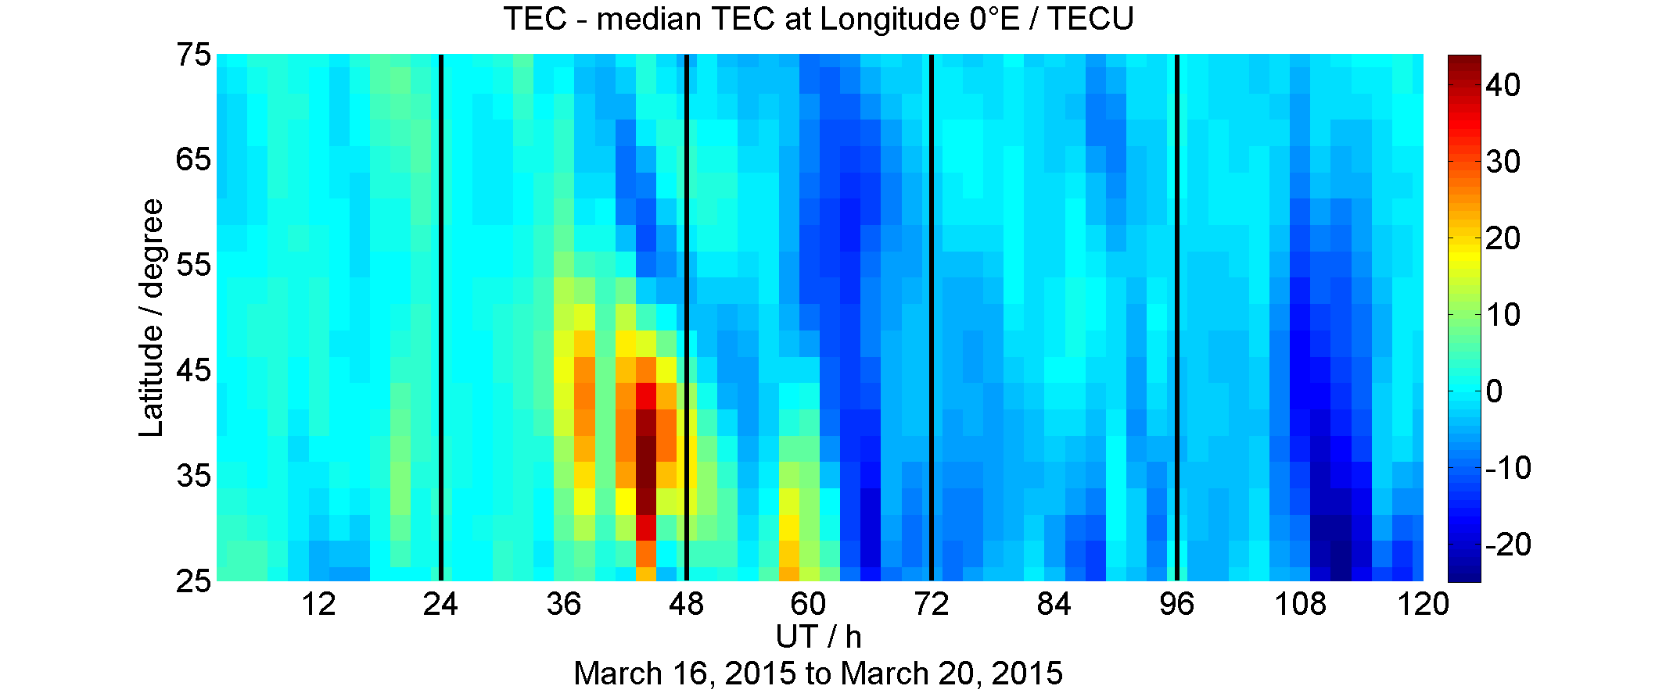
Application of the DIXSG to ionospheric storms
Storm pattern (percentage deviations from monthly medians) indicate storm enhanced ionization propagating towards low latitudes. Only single frequency GNSS users are interested in absolute TEC information.

Slide 6
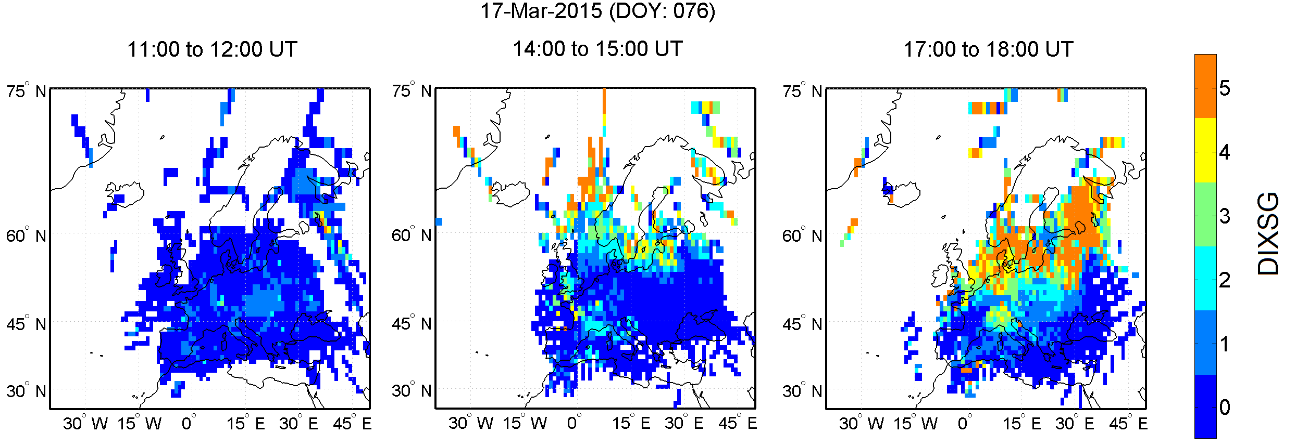
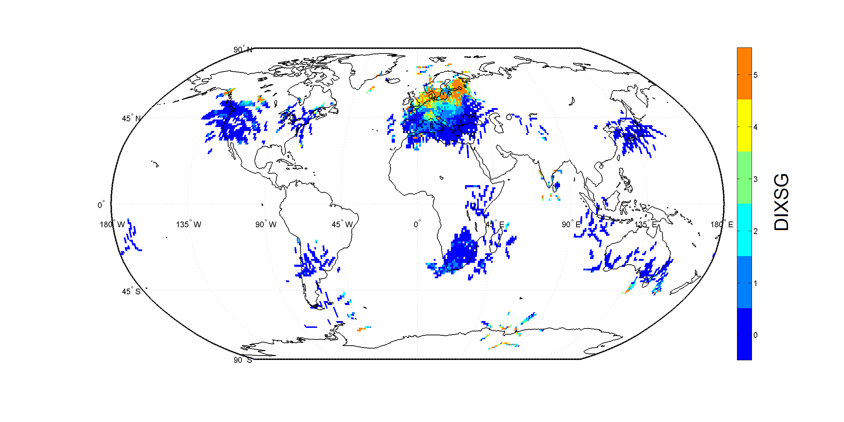
Application of the DIXSG to ionospheric storms
5 level scale of
perturbation
activity for
St. Patrick-storm.

Slide 7
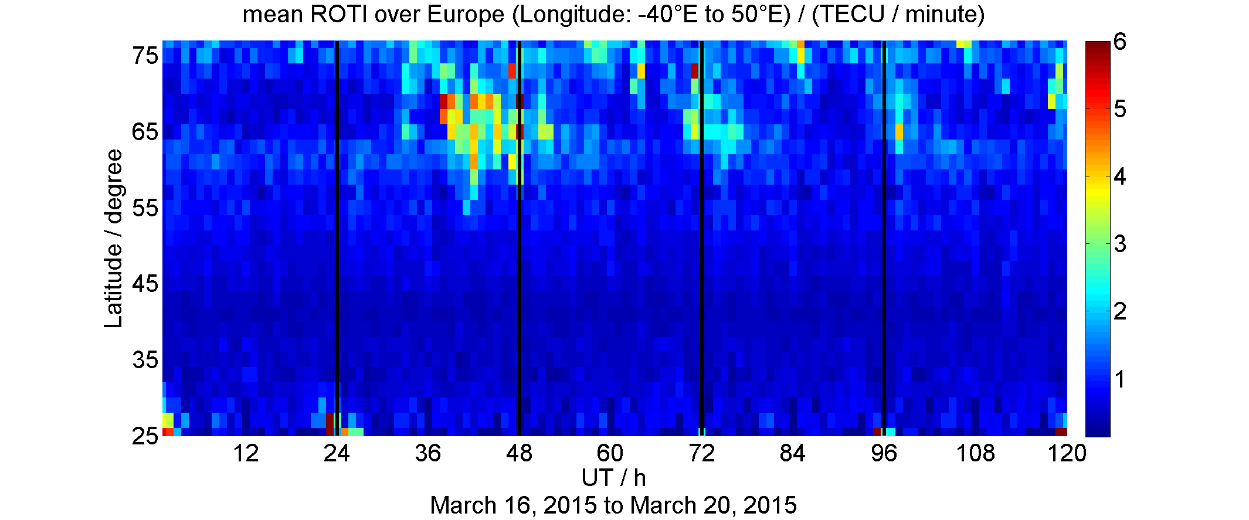
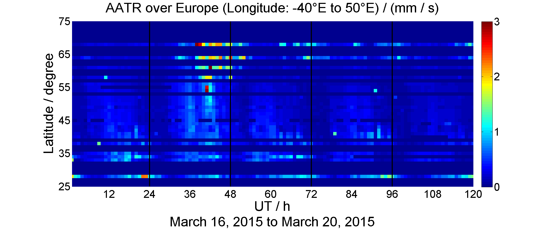
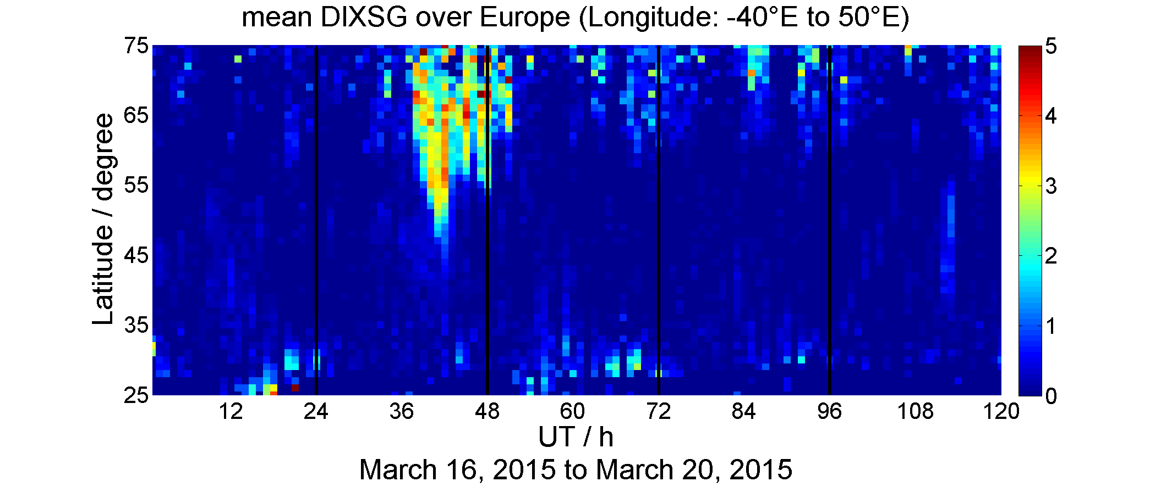
Application of the DIXSG to ionospheric storms - Comparison with ROTI and AATR
ROTI
AATR
DIXSG

Slide 8
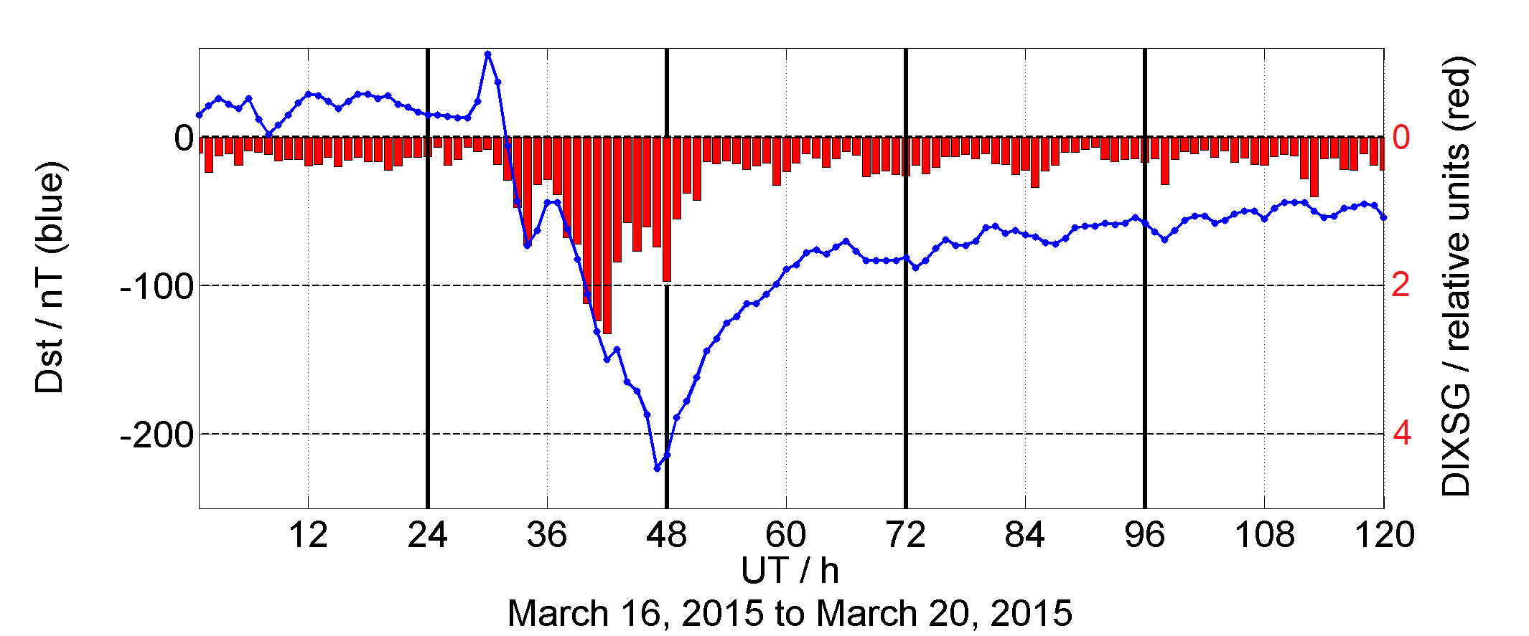
Application of the DIXSG to ionospheric storms

Slide 9
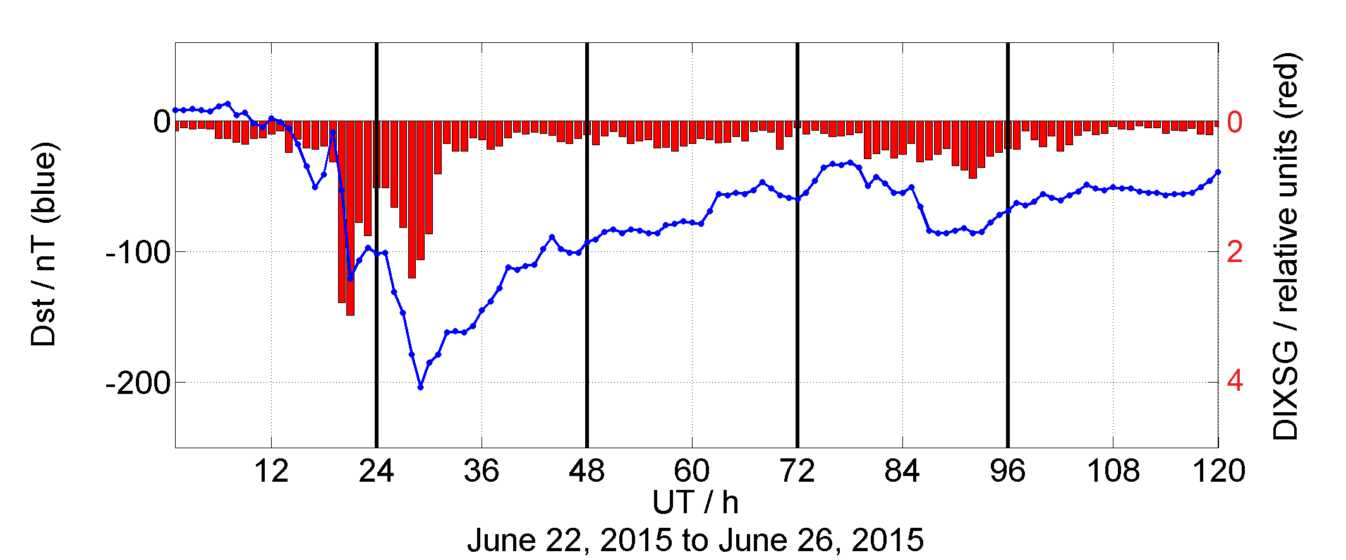
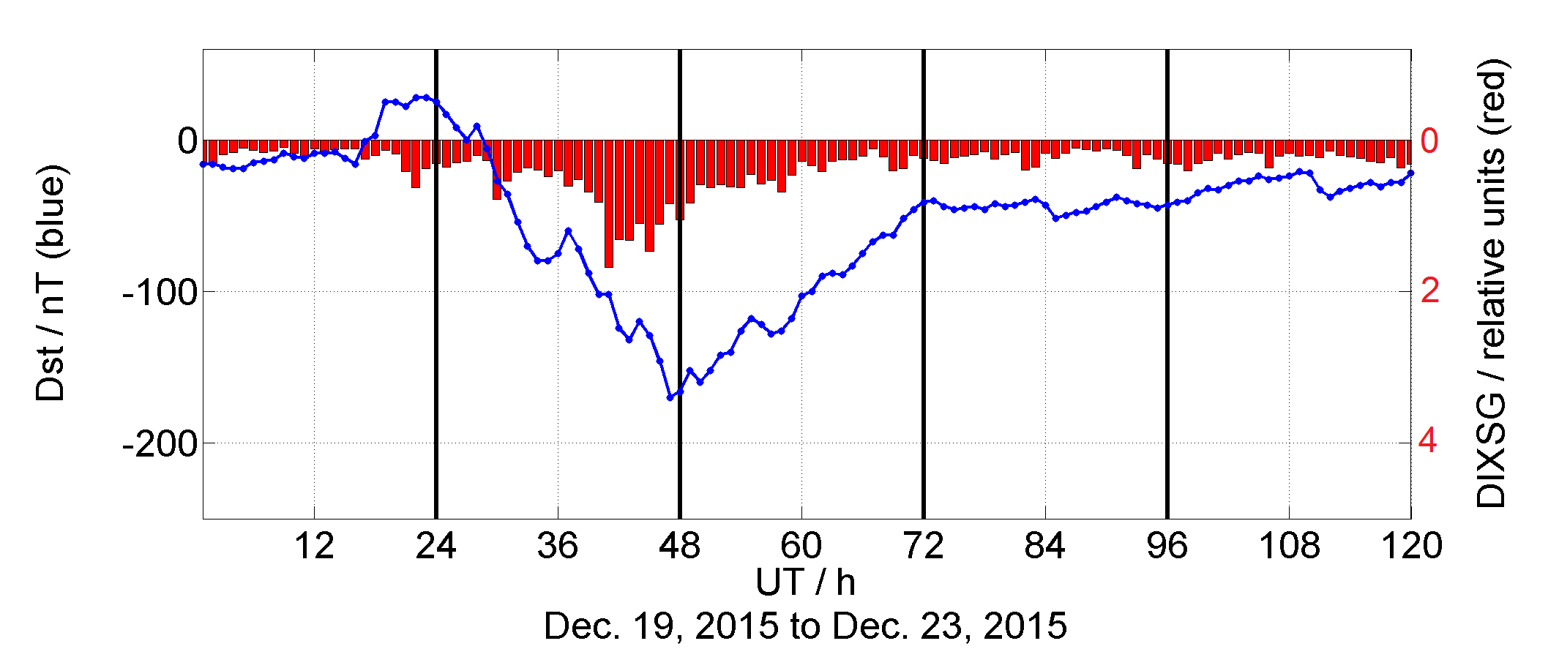
Application of the DIXSG to ionospheric storms

Slide 10
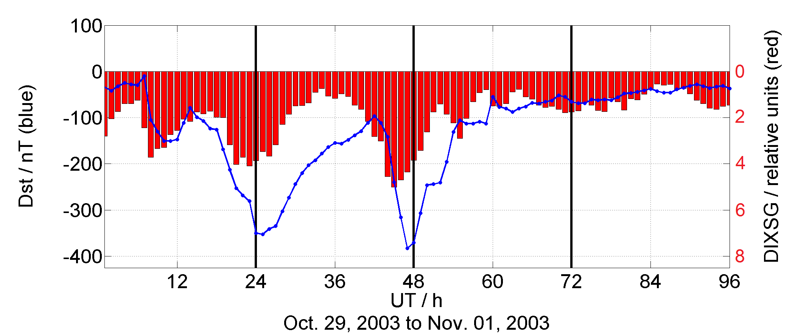
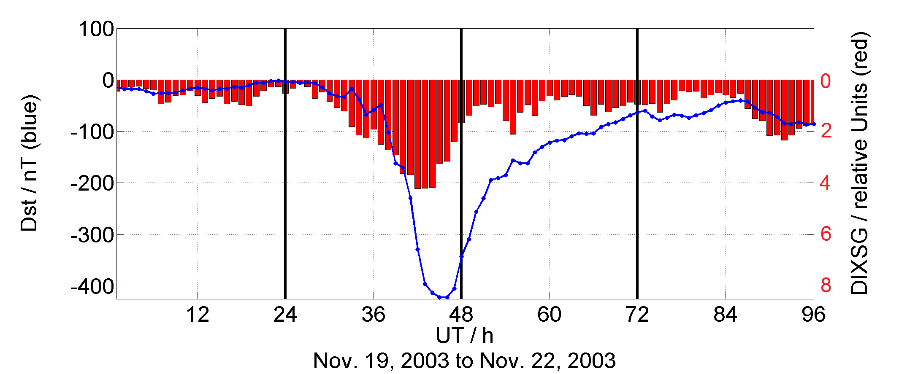
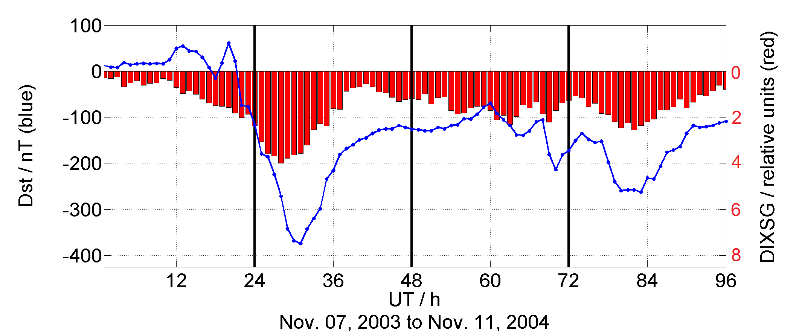
Application of the DIXSG to ionospheric storms

Slide 11
Summary and Conclusions
A new approach for estimating ionospheric gradients using ROT measurements has been presented – Disturbance Ionosphere Index-Spatial Gradients (DIXSG).
DIXSG basically refers to the difference of ROT measurements from two
different ground stations receiving the same satellite.
Time resolution and latency is in the order of the sampling time (< 1min).
A first attempt to scale DIXSG by 5 activity levels has been made.
DIXSG has been computed for different storms indicating ionospheric perturbation degree.
A comparison with ROTI and AATR indicates that DIXSG is a useful approach.
DIXSG on global scale is related to Dst.

Slide 12
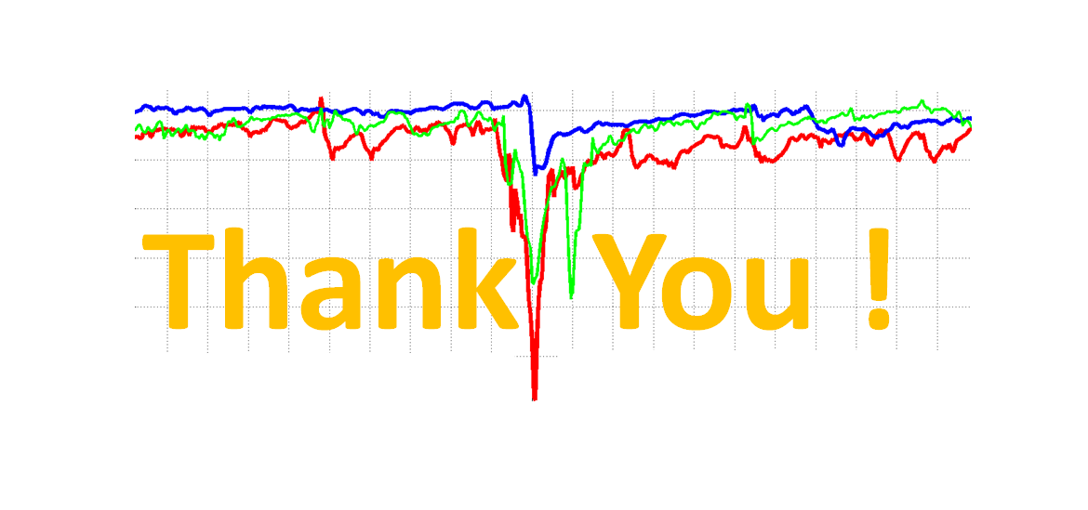
Disturbance Ionosphere Index Spatial Gradient (DIXSG)

