Slide 1
Assessment of ionospheric indices in the frame of ESA Space Weather Network activities
C. Borries¹, B. Dziak-Jankowska⁵, A. Garcia-Rigo⁶, K.S. Jacobsen⁴, G. Kervalishvili², I. Tsagouri³, V. Wilken¹, N. Jakowski¹, M. Hernández-Pajares⁶
1) German Aerospace Center (DLR)
2) German Research Centre for Geosciences (GFZ)
3) National Observatory of Athens (NOA)
4) Norwegian Mapping Authority (NMA)
5) Space Research Center, Polish Academy of Science (SRC)
6) University of Catalonia (UPC)

Slide 2
Outline
Introduction and Objectives
Description & Classification of indices
Case study Sept. 2017
Description of use cases
Index application matrix
Summary and Conclusions

Slide 3
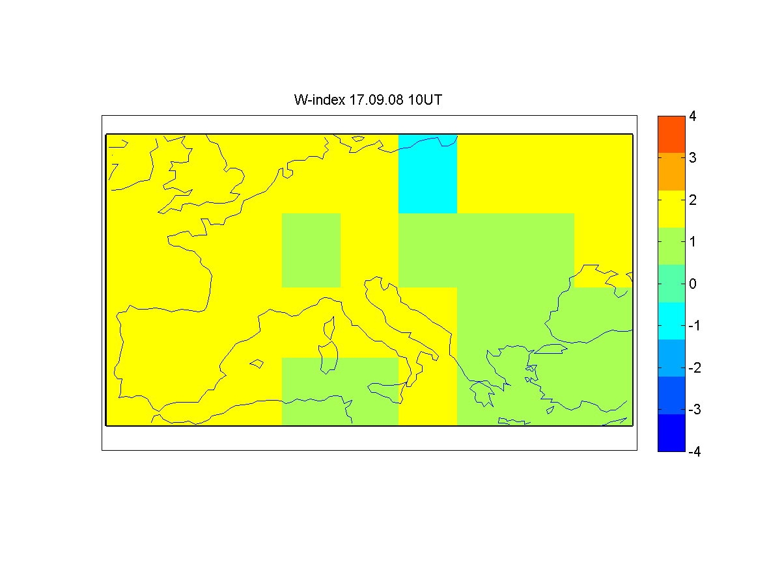
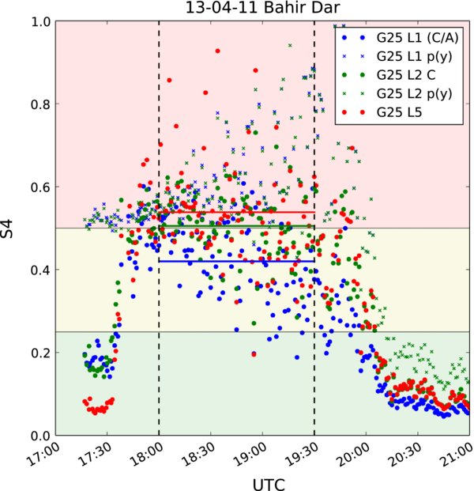
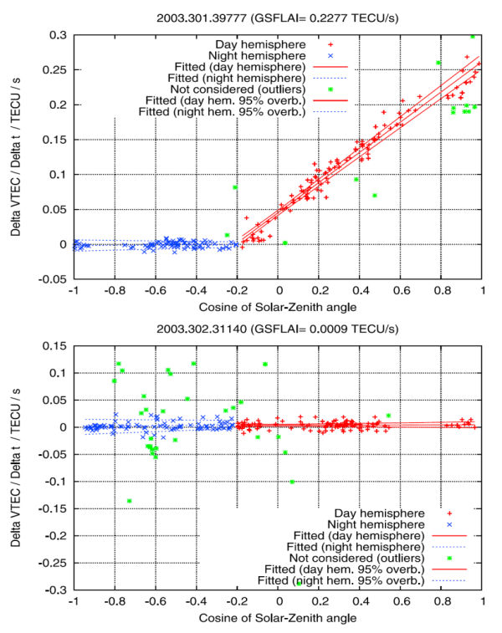
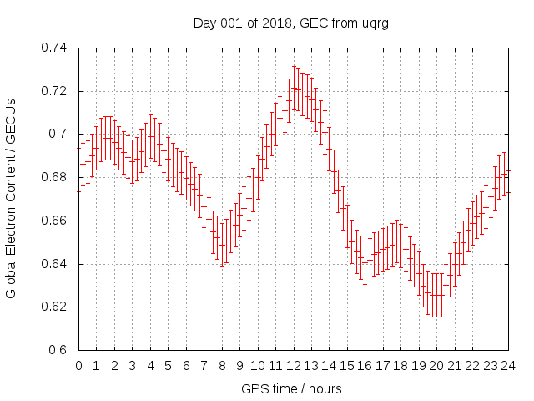
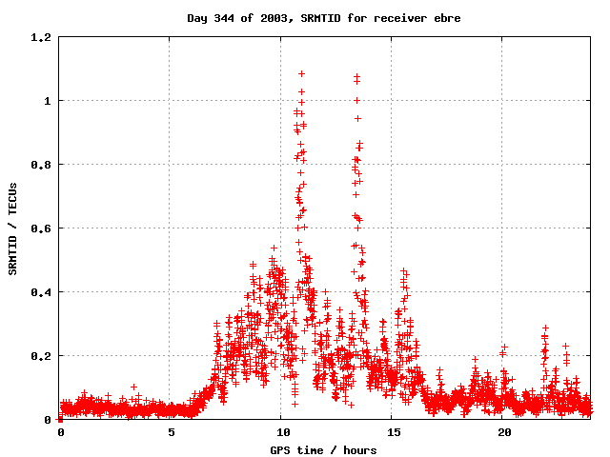
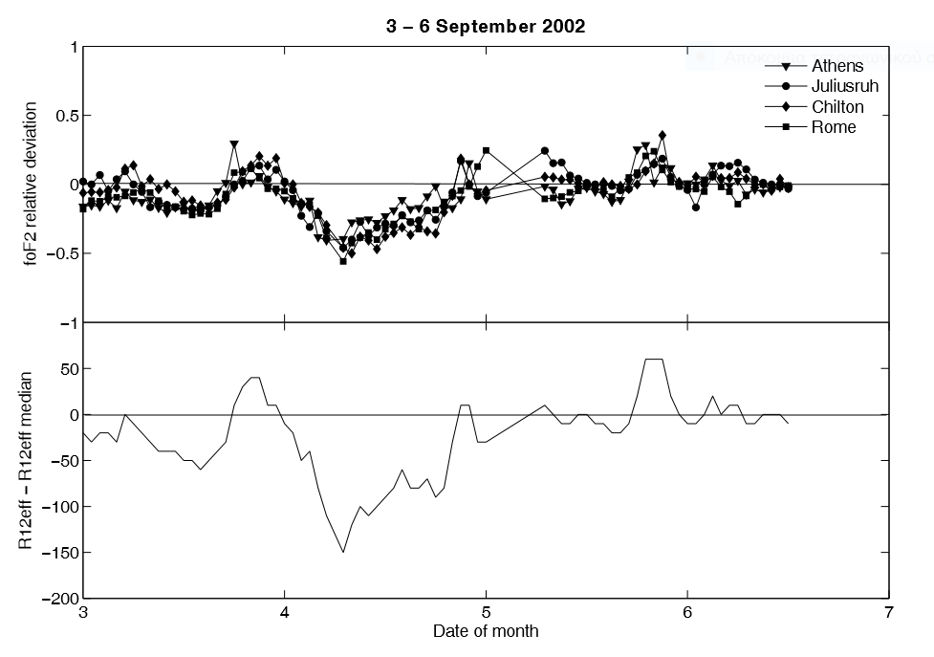
Introduction and Objectives
generation of a catalogue of ionospheric indices their capabilities, performance and range
generate a comprehensive knowledge on applicability of the currently available indices through:
dedicated review of ionospheric indices described in scientific journals
assessing the applicability of indices for different situations of ionospheric disturbances
assessing the applicability of indices for different situations of ionosphere impact on technical systems
Support for generation of ionospheric scales → preparatory work

Slide 4
Description of indices
Index | Name
W-indes | Ionospheric Weather W index
DIAS R12eff | DIAS Effective Sunspot Number
ROTI/ ROTI@ground | Rate of Change of TEC Index
DIXSG | Disturbance Ionosphere Index – Spatial Gradient
SRMTID/SSMTID | Single Receiver Medium Scale Travelling Ionospheric Disturbance Index and Single Satellite Medium Scale Travelling Ionospheric Disturbance index
GEC/ dGEC | Global Electron Content (Rate)
SOLERA | SOLar Euv flux RAte GNSS proxy
SISTED | Sunlit Ionosphere Sudden TEC Enhancement Detector
IBI | Ionospheric Bubble Index
AATR | Along Arc TEC Rate
Dfu/ Dfl | DfoF2-upper and Dfl: DfoF2-lower
S4/ Sigma_Phi | Scintillation index
IG12 | 12-month-running mean of the ionospheric IG index
SIDX/ GIXP | Sudden Ionospheric Disturbance indeX, Gradient Ionosphere indeX
19 well known indices indices developed/ operated in Europe
Based on ionosphere observations, mainly ionosondes and GNSS
Sensible to different kinds of ionosphere perturbations

Slide 5
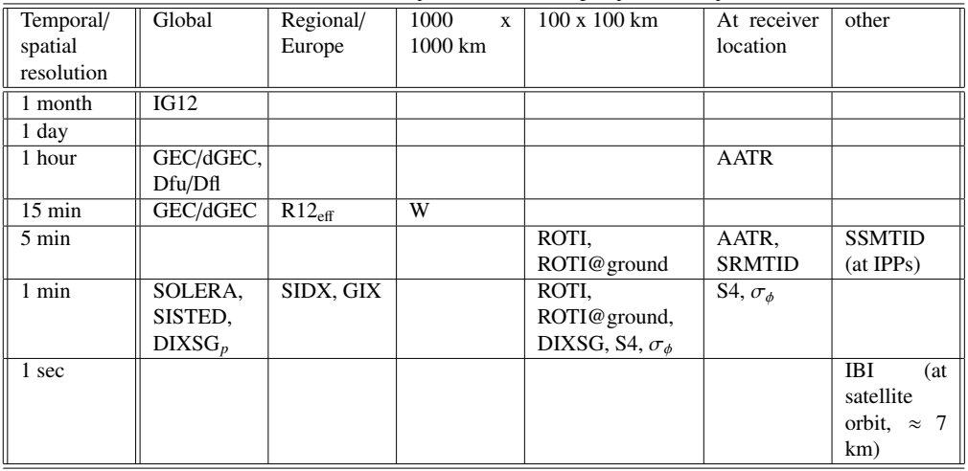
Desciption of indices

Slide 6
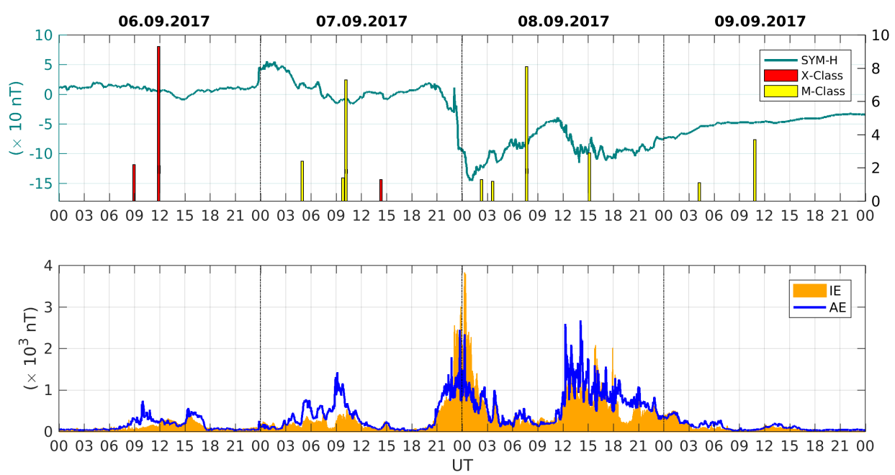
Case study September 2017 space weather event

Slide 7
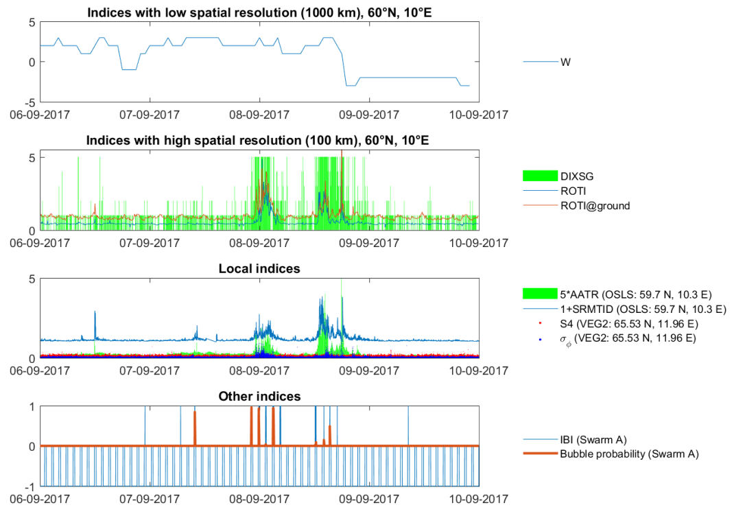
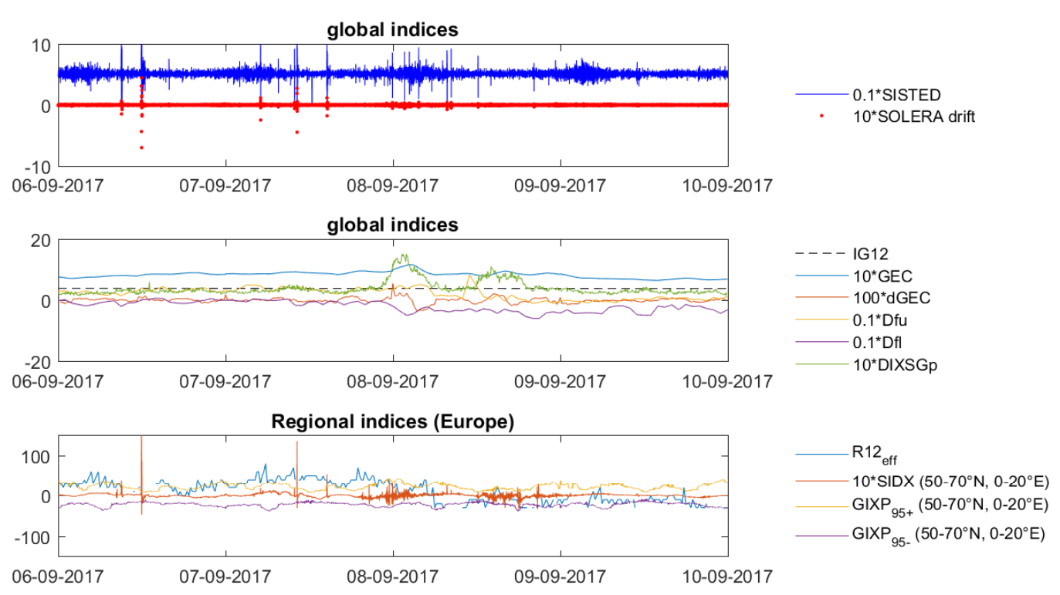
Case study September 2017 space weather event
Storm related ionosphere perturbations
Flare impact

Slide 8
Use cases
Natural envirionment use cases
Ionosphere response to solar flares
Ionosphere response to radio bursts
Ionosphere response to CME, CIR, etc
Small scale irregularities (causing signal scintillation)
Equatorial plasma depletions
MSTID/ LSTID
Planetary waves
Gradients
Ionosphere modelling
Deviation from quiet conditions
EGNOS system degradation
Lost GNSS signal (loss of lock) at ground
Lost communication signals
Performance degradation of network RTK
Degraded positioning accuracy for stationary appl.
Model degradation in single frequency positioning
Degraded positioning accuracy for mobile appl.
Lost GNSS signal (loss of lock) at LEO orbit
Technical system and infrastructure use cases
HF communication
GBAS hazardous misleading information

Slide 9
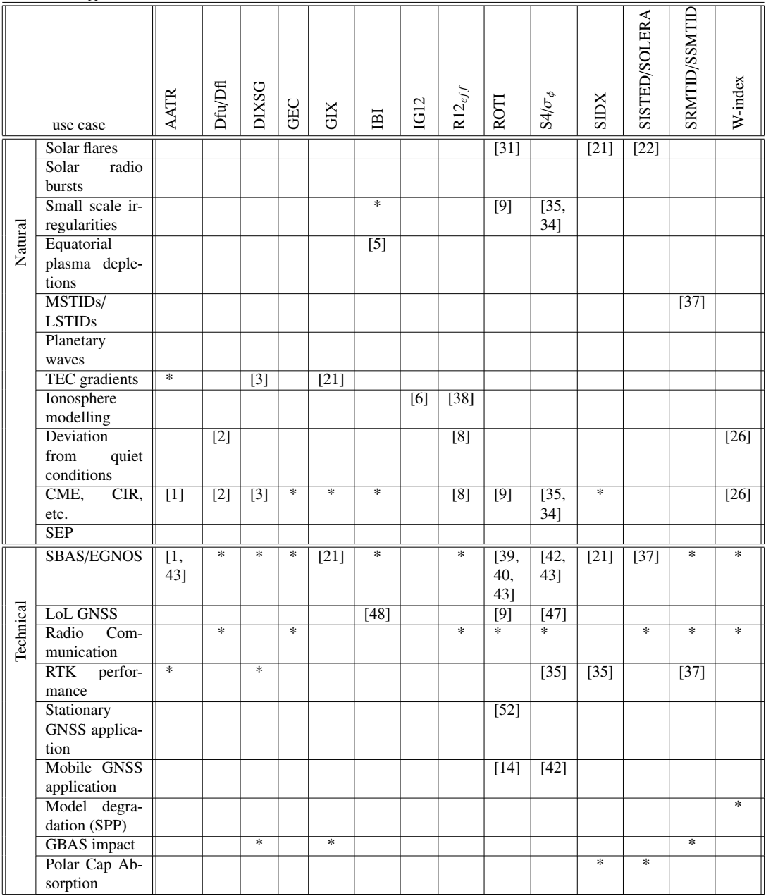
Index application matrix
Overview on applicability of the indices
Based on the assessment of indices and use cases
For each use case all applicable indices are indicated
Numbers indicate references to published applications
Asterisk indicates recommended but not yet published application of indices

Slide 10
Summary and Conclusions
A significant list of ionosphere indices has been analysed with respect to use cases
Technical impact of ionospheric perturbations as well as the impact of natural effects on the ionosphere can be described with indices
In many use cases there are already indices available which can be applied
Some use cases do not have appropriate indices yet
We need scales for quiet, moderate and severe conditions in the ionosphere
Combination of indices recommended for individual use cases
Definition of thresholds necessary (Technical impact is hard to describe, because it often depends on technical devices)
→ more indices and use cases can be complemented in future

