Slide 1
Detector of Solar flare effects on geomagnetism and ionosphere based on GNSS and ionosonde data
J.J. Curto⁽¹⁾, J.M. Juan⁽²⁾, D. Altadill⁽¹⁾, C. Timoté⁽²⁾, E. Blanch⁽¹⁾, A. Segarra⁽¹⁾
(1) Observatori de l’Ebre (CSIC – URL), Roquetes, Spain
(2) Research Group of Astronomy and Geomatics (gAGE)
Universitat Politècnica de Catalunya (UPC), Barcelona, Spain

Slide 2
Outline
Detector of solar flare effects on geomagnetism based on GNSS data
Geomagnetic SFE
GNSS-SF detector
GNSS-SF detector as SFE tracker
Detector of solar flare effects on ionosphere based on ionosonde data
Solar flare effects on ionosonde (SNR)
First steps towards an indicator of energetic solar emissions that can produce Sudden Ionospheric Disturbances and radio fade-outs

Slide 3
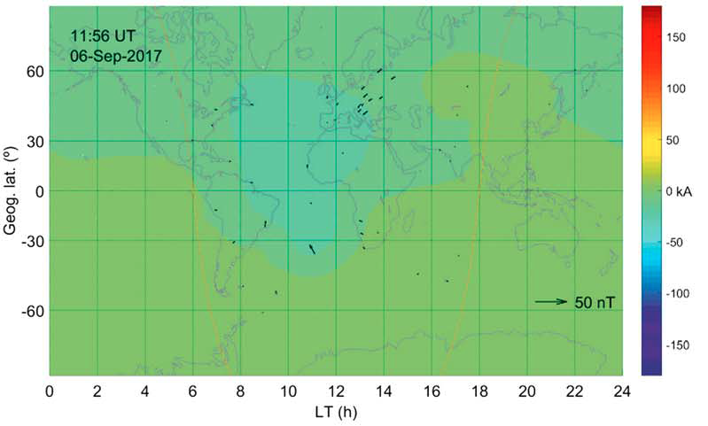
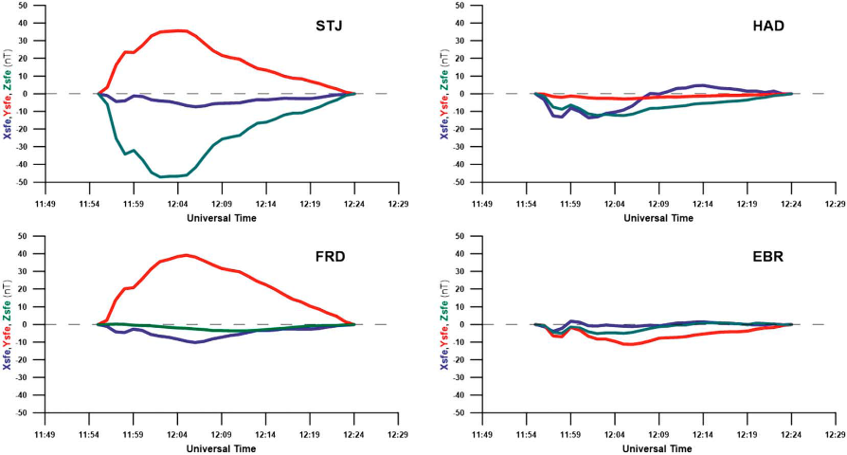
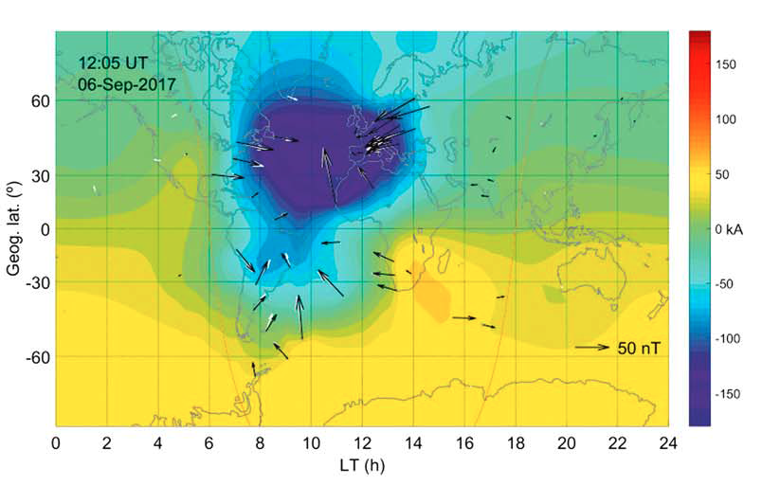
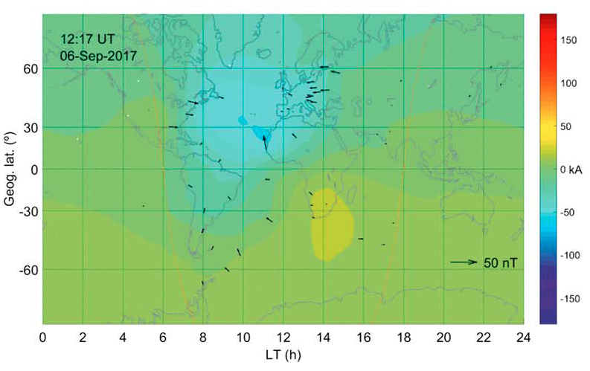
Geomagnetic SFE
Sfe: a short daytime bay or crochet, generally in the sense of the daily variation, tentatively attributed to a solar flare (IAGA International Service of Rapid Magentic Variations)
Magnetic field variation¹ corresponding to the Sfe time on 6 Sep 2017
SECS²-derived evolution of the equivalent current system flowing at ionospheric heights
(St John’s, STJ, Canada)
(Hartland, HAD, UK)
(Fredericksburg, FRD, USA)
(Ebre, EBR, Spain)
¹ Regular diurnal variation has been substracted for a proper comparison
² SECS: Spherical Elementary Current Systems method

Slide 4
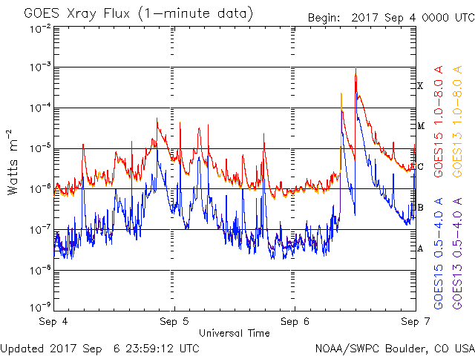
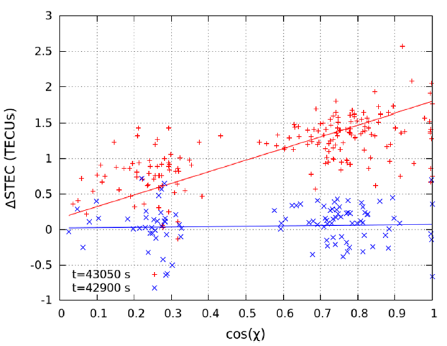
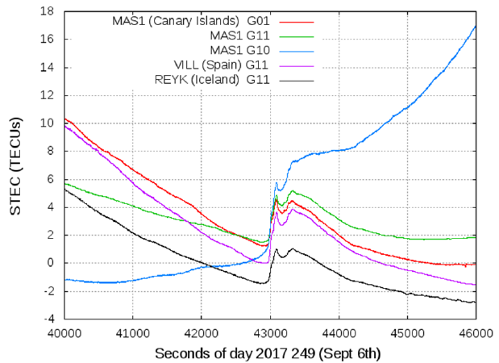
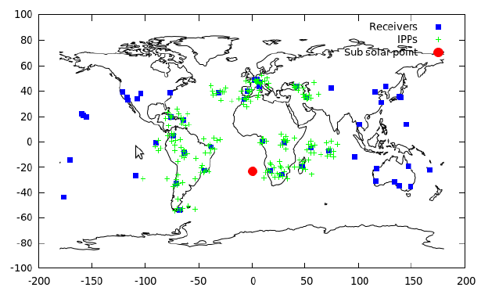
GNSS-SF detector
ΔSTEC and angular distance (χ) relationship as an indicator of a SF ocurrence at SSP (Wan et al., 2002).
1
SFs produce sudden increases in the STEC measurements from GNSS receivers
6 Sept 2017
1
Using world-wide network of GNSS receivers, it is posible to patrol the SFs impact on ionosphere
Notes:
SFs produces sudden increases in the STEC measurements from GNSS receivers. There exists a relationship between STEC and the cosine of the angular distance (x) between the SSP and the IPP, which can be fitted to a straight line. Employing a network of GNSS receivers, it is posible to patrol the ocurrence of an impact of a SF on the ionosphere by this means (STEC-cos(x)).

Slide 5
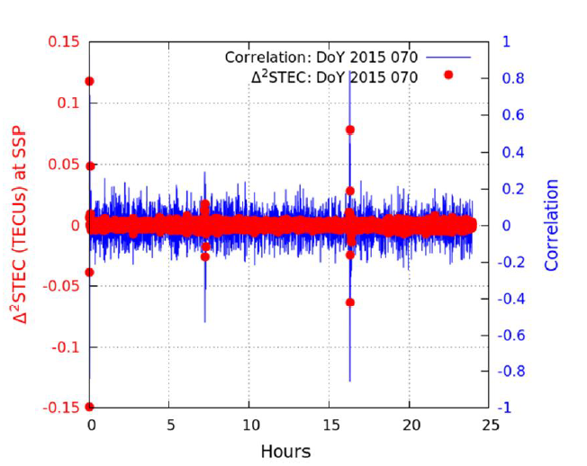
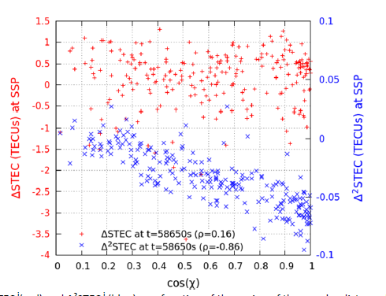
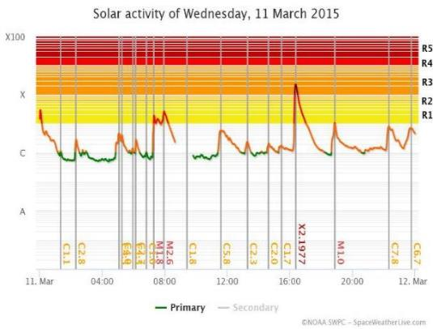
GNSS-SF detector
M2.9
It is necessary to establish a threshold in order to detect SFs in an automatic way. Then, we focus on fast variations during short time intervals by taking into account not the ΔSTEC values but its difference with respect to the previous ones: Δ²STEC. This provides a much more clearer indicator of the occurrence of a SF.
M1.8
X2.2
Both, Δ²STEC or correlation can be used as threshold for detecting SFs in an automatic way
11 March 2015
ꭕ: angular distance
Notes:
Not all SFs are easily detectable from the previous fitting (DSTEC daily behavior makes difficult the definition of a threshold to identify SFs) . A detector focused in fast variations during short time intervals (D2STEC), i.e. DSTEC difference with respect to its previous values, provides a much more clearer dependency, maintaining the linear fitting.

Slide 6
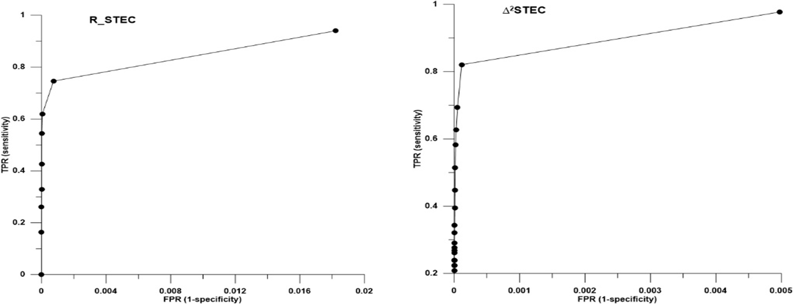
GNSS-SF detector as SFE tracker
Fluss et al., 2005
Some conditions were imposed to adjust the GNSS-SF detector to be used as a complement to confirm Sfe detection by the IAGA SRMV.
Optimal values were found: Δ²STEC>=0.01 and Correl> = 0.25
The number of candidates was reduced relatively by 23% while the coverage of the Sfe was reduced relatively by only 4%.
ρ_STEC = 0,25
Δ²STEC = 0,01
a) ROC curve for correlation b) ROC curve for ∆²STEC.
∆²STEC>=0.01 & corr >= | TP / Relative reduction | FN | TPR | GNSS_SF candidates/ relative reduction | FP | TN | FPR | YI Index
0,0 | 110 (0%) | 24 | 0,820895522 | 1411 (0%) | 1301 | 11447927 | 0.00011363 | 0,82
0,20 | 108 (2%) | 26 | 0,805970149 | 1348 (8%) | 1240 | 11447992 | 0.0001083 | 0,81
0,25 | 105 (4%) | 29 | 0,78358209 | 1184 (23%) | 1079 | 11448159 | 9.4242E-05 | 0,78
0,3 | 96 (12%) | 38 | 0,71641791 | 935 (34%) | 839 | 11448417 | 7.328E-05 | 0,72
0,35 | 89 (19%) | 45 | 0,664179104 | 675 (52%) | 586 | 11448684 | 5.1182E-05 | 0,66
0,40 | 81 (26%) | 53 | 0,604477612 | 521 (63%) | 440 | 11448846 | 3.843E-05 | 0,60
1 | 0 (100%) | 134 | 0 | 0 (100%) | 0 | 11449448 | 0 | 0,0
Contingency table for several threshold values of correlation when we impose simultaneously the fix condition Δ²STEC>=0,01
Notes:
The ROC curves are 2 dimensional graphs in wihch the True positives Fraction is represented on the Y axis and the Flase Positive Fraction is represented on the X axis. It shows the relative compensation betwwn the benefits (true positives) and costs (false positives)

Slide 7
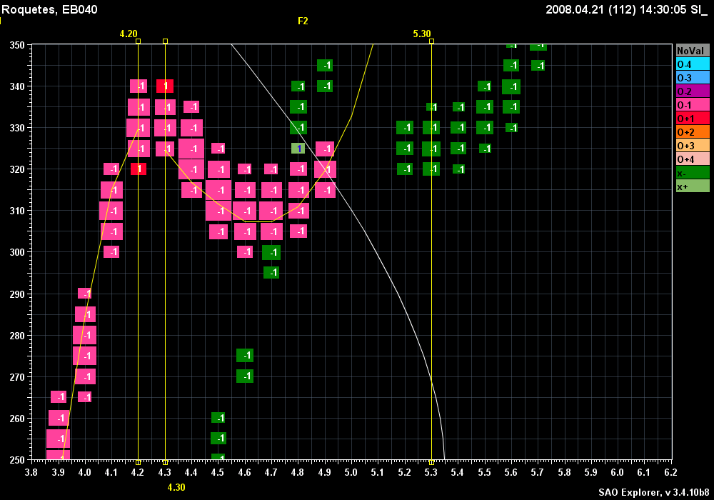
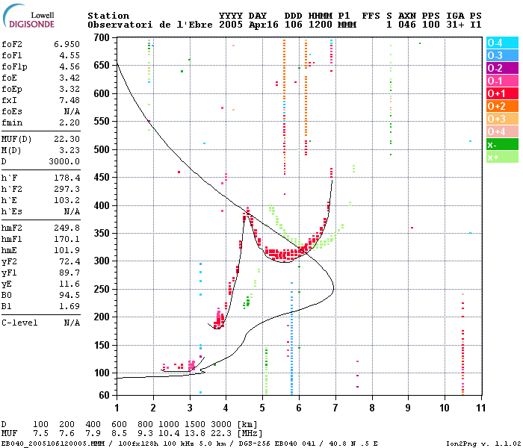
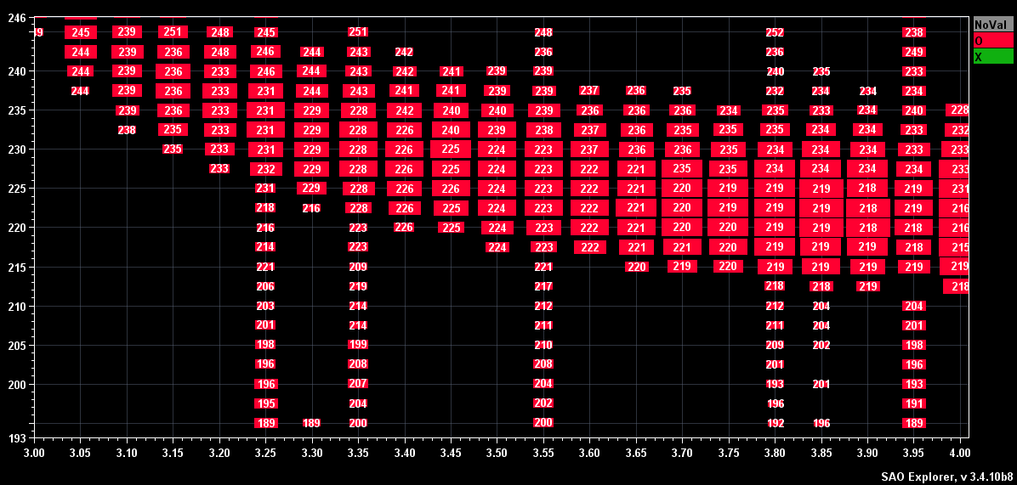
Ionospheric sounding with Digisonde
Ionograms ⇒
h’, fp / Ne⁻ , RO, RX
Precision Heights ⇒
Doppler
Pulses ⇒
Amplitudes
Pulses ⇒

Slide 8
Ionospheric SFE
Solar X-ray flares produces an increase of the ionization at low altitudes in the sun lit hemisphere
Signal absorption at low altitudes
Reduction of the signal amplitude
Diminution of the SNR
These effects on the ionosonde data can be used to predict fade-outs on HF radiowave communication paths in the vicinity of the sounder.

Slide 9
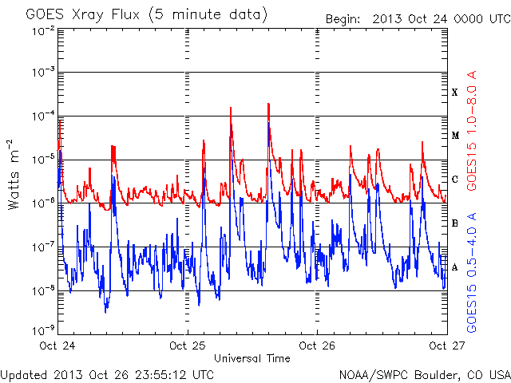
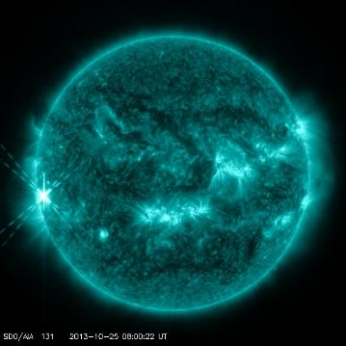
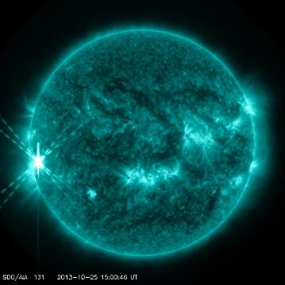
Ionospheric SFE 25 Oct 2013
X1.7, 07:53 - 08:01 - 08:09
X2.1, 14:51 - 15:03 - 15:12
1
2
1
2
SDO/AIA 131 2013-10-25 08:00:22 UT
SDO/AIA 131 2013-10-25 15:00:46 UT

Slide 10
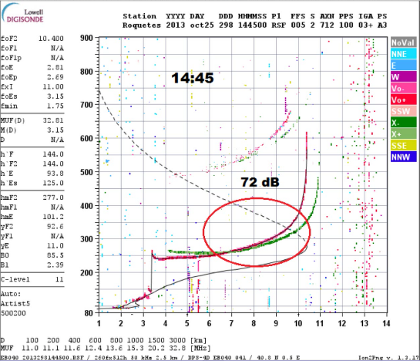
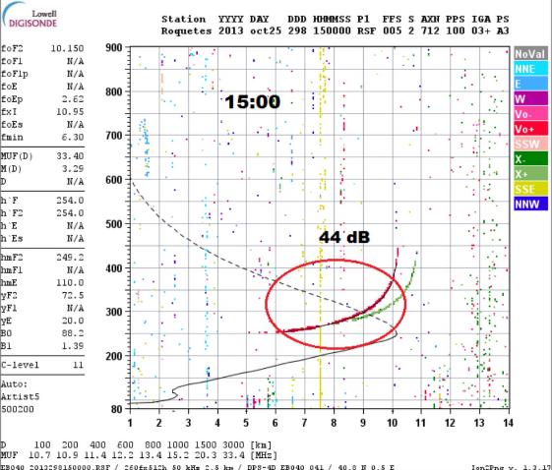
Ionospheric SFE 25 Oct 2013
X2.1, 14:51 - 15:03 - 15:12
2

Slide 11
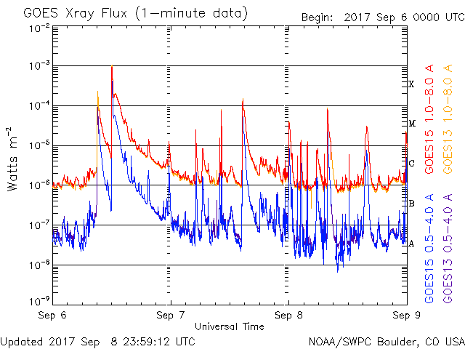
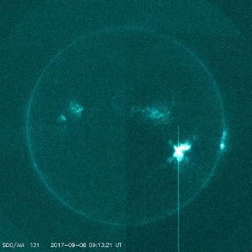
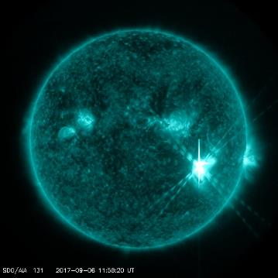
Ionospheric SFE 6-7 Sep 2017
X2.2, 08:57 - 09:10 - 09:17
X9.3, 11:53 - 12:02 - 12:10
M7.3, 10:11 - 10:15 - 10:18
X1.3, 14:20 - 14:36 - 14:55
M8.1, 07:40 - 07:49 - 0758
2
1
4
3
5
1
2
SDO/AIA 131 2017-09-06 09:13:21 UT
SDO/AIA 131 2017-09-06 11:58:20 UT

Slide 12
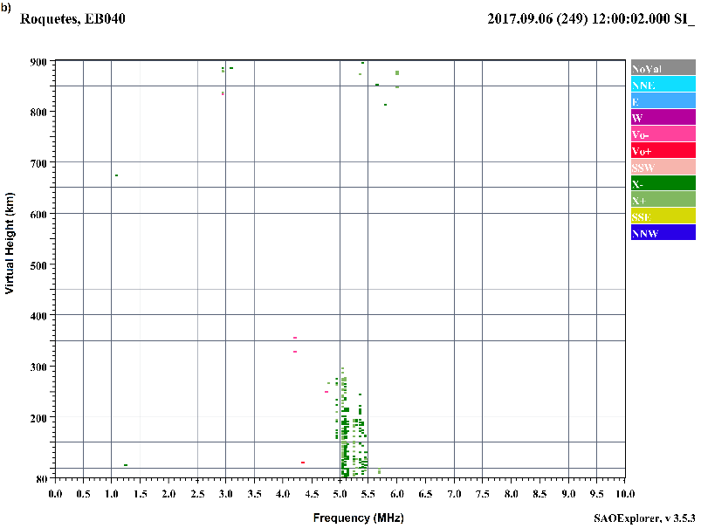
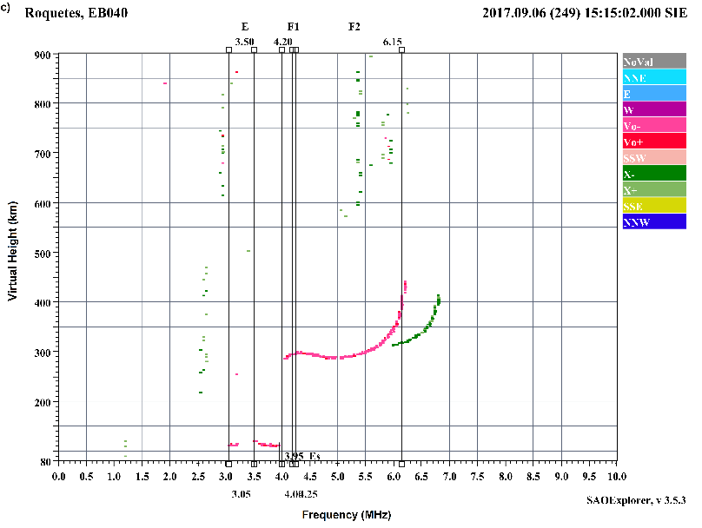
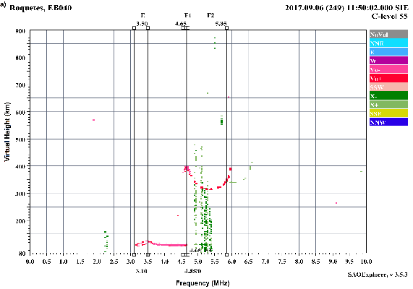
Ionospheric SFE 6-7 Sep 2017
X9.3, 11:53 - 12:02 – 12:10
2
6/09/17 12:00
6/09/17 15:15
6/09/17 11:50
Radio wave absorption
First ionogram recorded at Ebro after SF

Slide 13
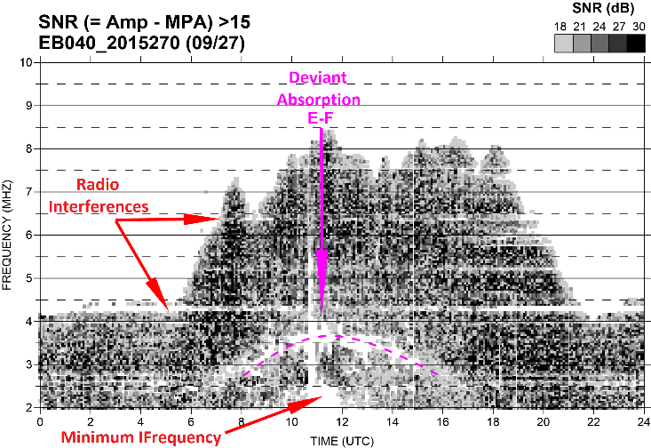
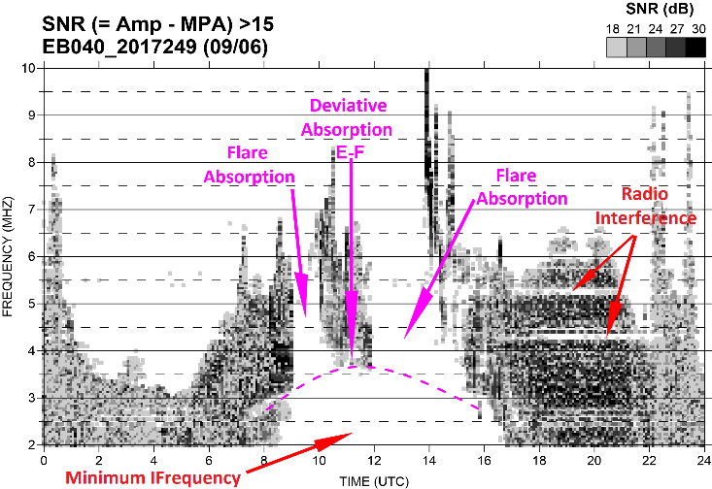
Ionospheric SFE 6-7 Sep 2017
27/09/2015
X9.3, 11:53 - 12:02 – 12:10
2
6/09/17 12:00
06/09/2017

Slide 14
Conclusions
Detector of solar flare effects on geomagnetism based on GNSS data
The GNSS-SF detector presented here has been demonstrated to be useful to detect SFs in an automatic way by terms of Δ²STEC.
GNSS-SF has been tuned to be used as a complement to confirm Sfe detection.
Detector of solar flare effects on ionosphere based on ionosonde data
Ionosondes can be very useful to detect and warn about possible HF communication blackouts in the vicinity of the sounder during solar flares.
Future work can be done in this sense to develop a warning system taking advantage of the existing ionospheric sounder networks such as GIRO

Slide 15
References:
Curto, J. J., Marsal, S., Blanch, E., & Altadill, D. (2018). Analysis of the solar flare effects of 6 September 2017 in the ionosphere and in the Earth’s magnetic field using spherical elementary current systems. Space Weather, 16. https://doi.org/10.1029/2018SW001927.
Curto, J. J., Juan, J. M and Timoté, C. (2019). Confirming Geomagnetic Sfe by means of a Solar Flare Detector based on GNSS. Journal of Space Weather and Space Climate 10.1051/swsc/2019040, 2019.
THANK YOU for your ATENTION
Comments?
Questions?
Suggestions?

