Slide 1
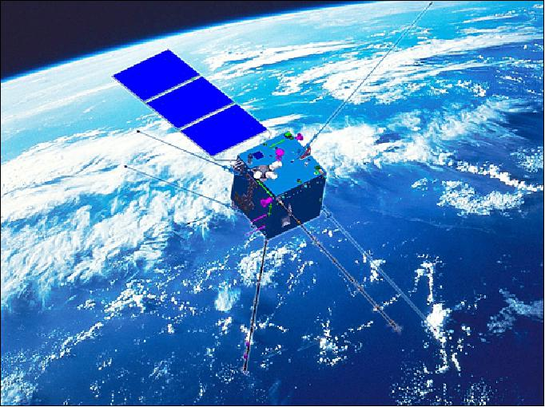



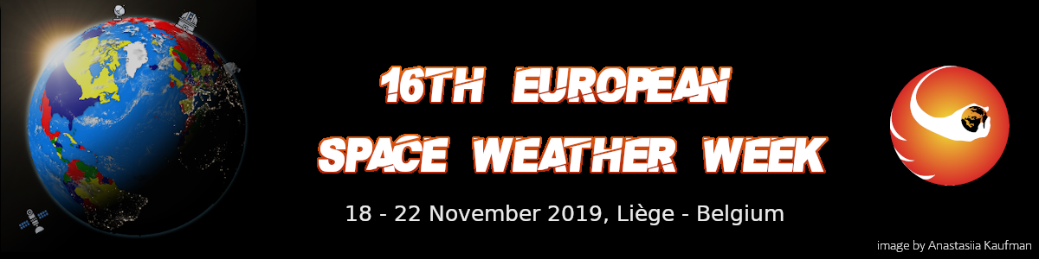
Langmuir probes in the CSES electric field instruments
Piersanti M.⁽¹⁾
on behalf of the CSES-Limadou collaboration
1) I.N.F.N. – University of Rome «Tor Vergata», Italy

Slide 2
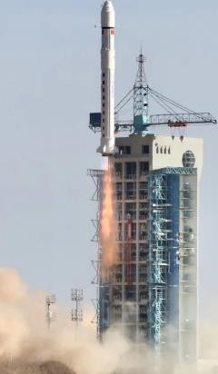
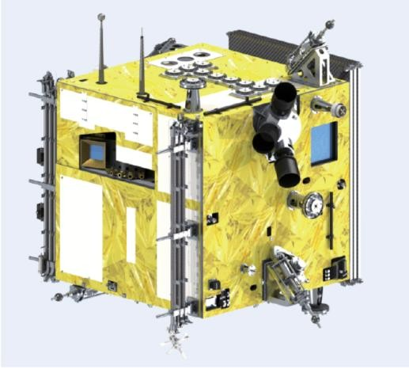
CSES-01 Launched by CZ-2D Vehicle on Feb 2. (15:51)
@Jiuquan Sat. Launching Center
Payloads on board:
High Precision Magnetometer;
Electric Field detector;
Langmuir Probe;
Plasma Analyzer;
High Energy Particle Package;
High Energy Particle Detector;
Tri-beacon beamer;
Radio Occultation Receiver

Slide 3
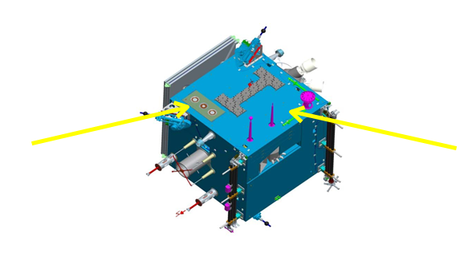
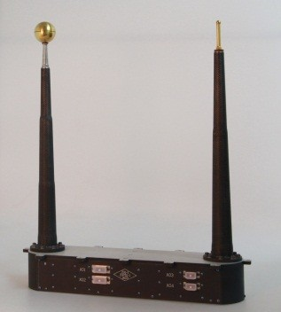
CSES
Quantity | Range
Ne | 5×10⁸~10¹³m⁻³
Te | 500~10000 K
Vp | ±3V
Weight | 5kg
Power | 6W
Telemetry rate | 80kps
Langmuir probe (LP)
Plasma analyzer package (PAP)
x
y
Sensors
LP1: Φ50mm(main) -3V~+3V
LP2: Φ10mm(spare) -6V~+6V
Material : Titanium
Coating: Titanium Nitride (TiN)
up hemisphere: collected
down hemisphere: guard
Boom
• +X : flight direction;
• +Z : points to the earth’s core.
The two booms (50cm) are parallel with each other and along the +x direction.
Launch: 2018/02/02
Orbit: 507km, sun synchronous
Z
Inclination: 97°
Descending node: 14:00
Revisit: 5days，
Work range: -65°~ +65°

Slide 4
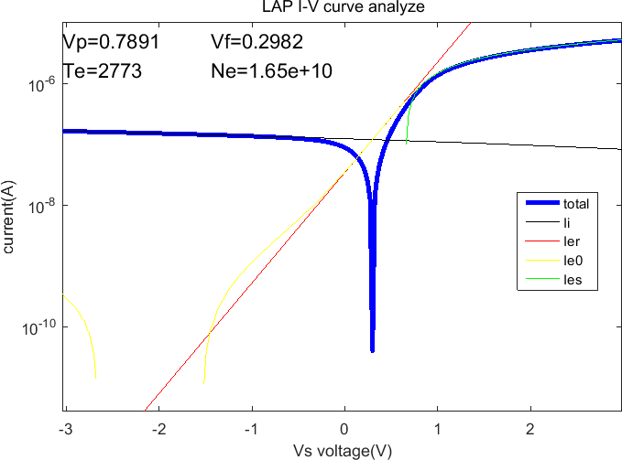
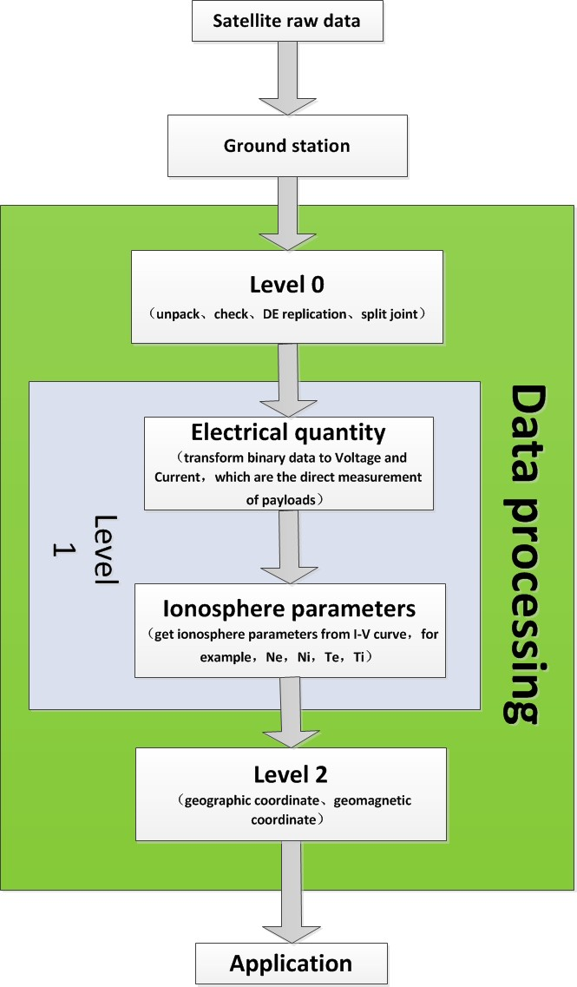
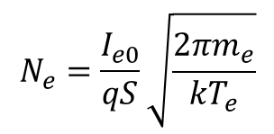
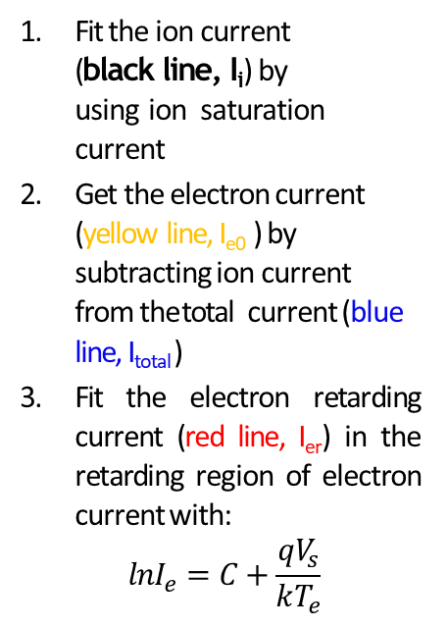
In-orbit Commissioning and LP I-V curve analysis
Power on first 20180206（orbit：61-0）~201809，
More than 3000 orbits data (until 201809).
Fit the ion current (black line, I_{i}) by using ion saturation current
Get the electron current (yellow line, I_{e0} ) by subtracting ion current from the total current (blue line, I_{total} )
Fit the electron retarding current (red line, I_{er}) in the retarding region of electron current with:
$$lnI_{e}=C+\frac{qV_{s}}{kT_{e}}$$
Data processing
4. Fit the electron saturation current (green line, I_{es}) in the saturaton
region of electron current
5. Get the plasma potential point (V_{p}) by solving the crossover point
of electron retarding current and electron saturation
current.
$$N_{e}=\frac{I_{e0}}{qS}\sqrt{\frac{2πm_{e}}{kT_{e}}}$$

Slide 5
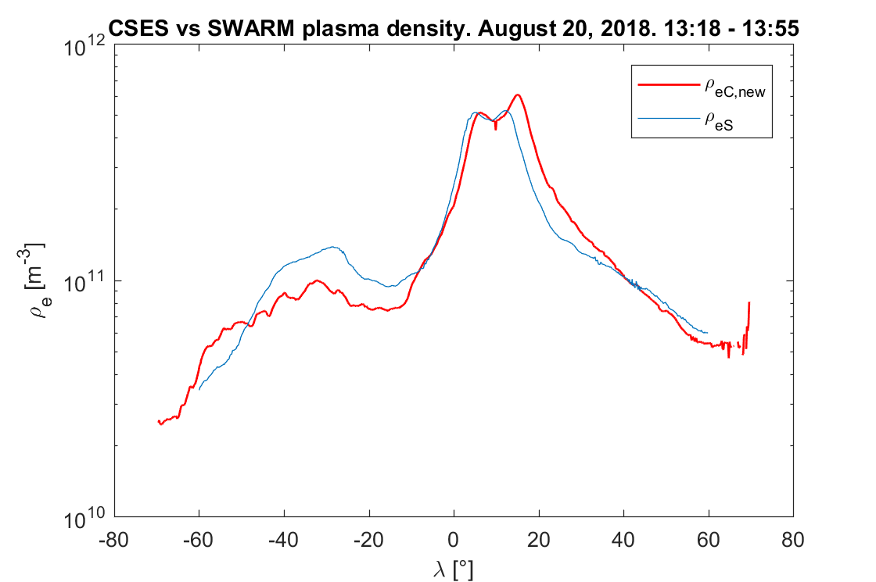
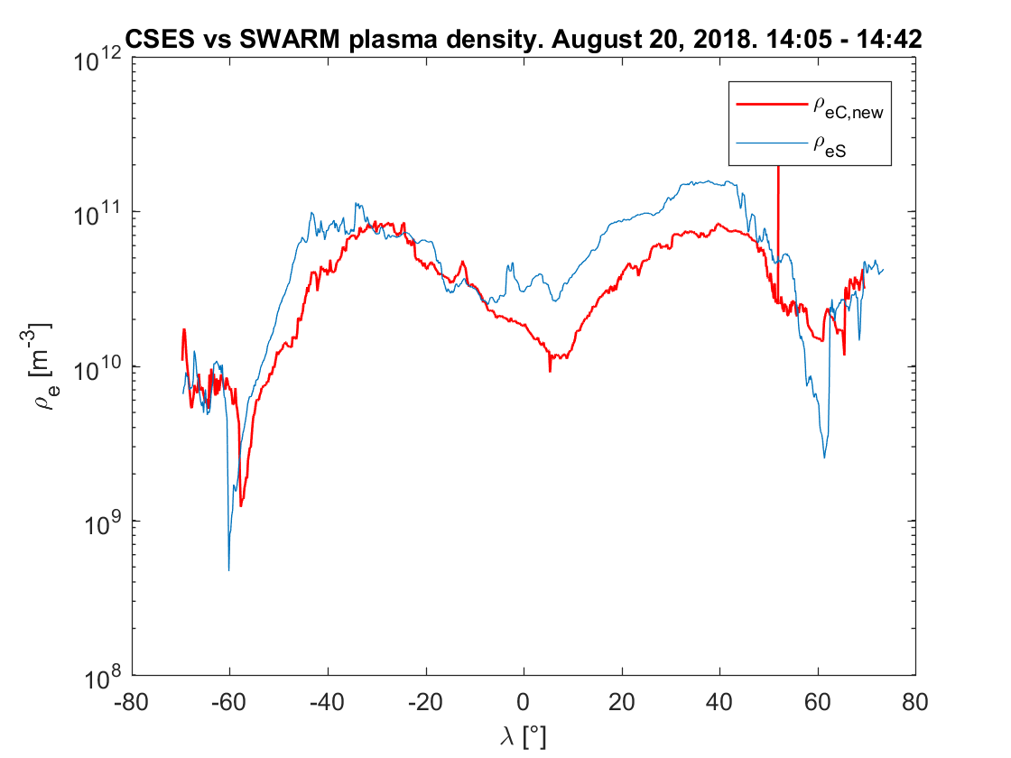
Swarm-A vs CSES: August 2018
We choose August 20 because of the very close orbits;
We pushed up ρ_{eC} to take into account the difference in altitude (35% using IRI2012 model) and sheat effect (50% using Wipple theory).
Both the diurnal (upper panel) and the nocturnal (lower panels) orbits show very good agreement;
Different fluctuations around the baseline is due to the difference in the orbits positions and times.

Slide 6
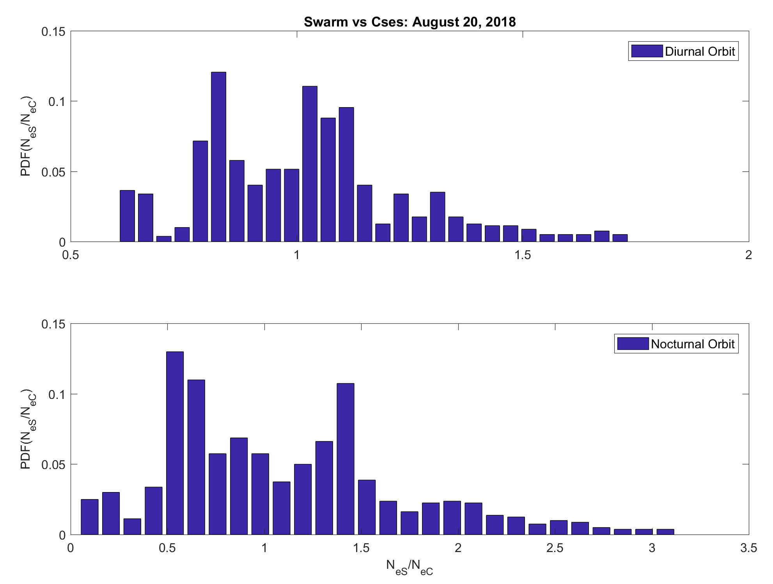
Swarm A vs CSES01 – August 2018
The histograms of the ratio between Swarm and CSES plasma densities confirms the good agreement.
In fact, both the diurnal and the nocturnal ratios are centered around 1.
The worst cases are during nightside orbits.

Slide 7
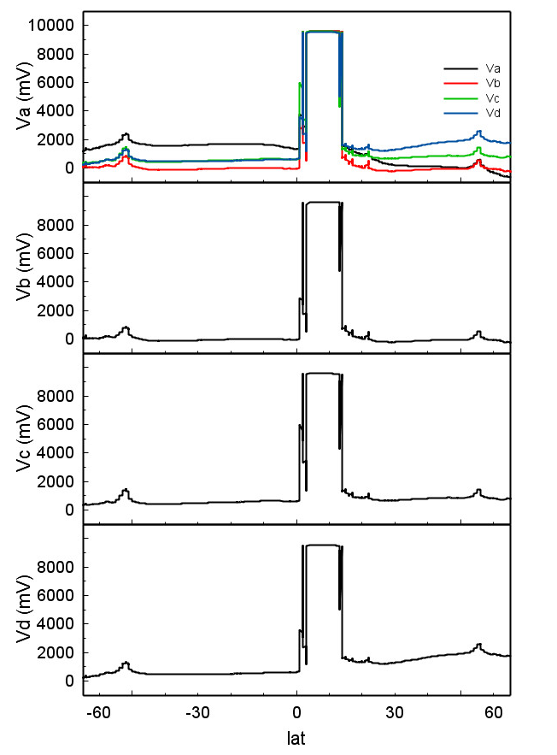
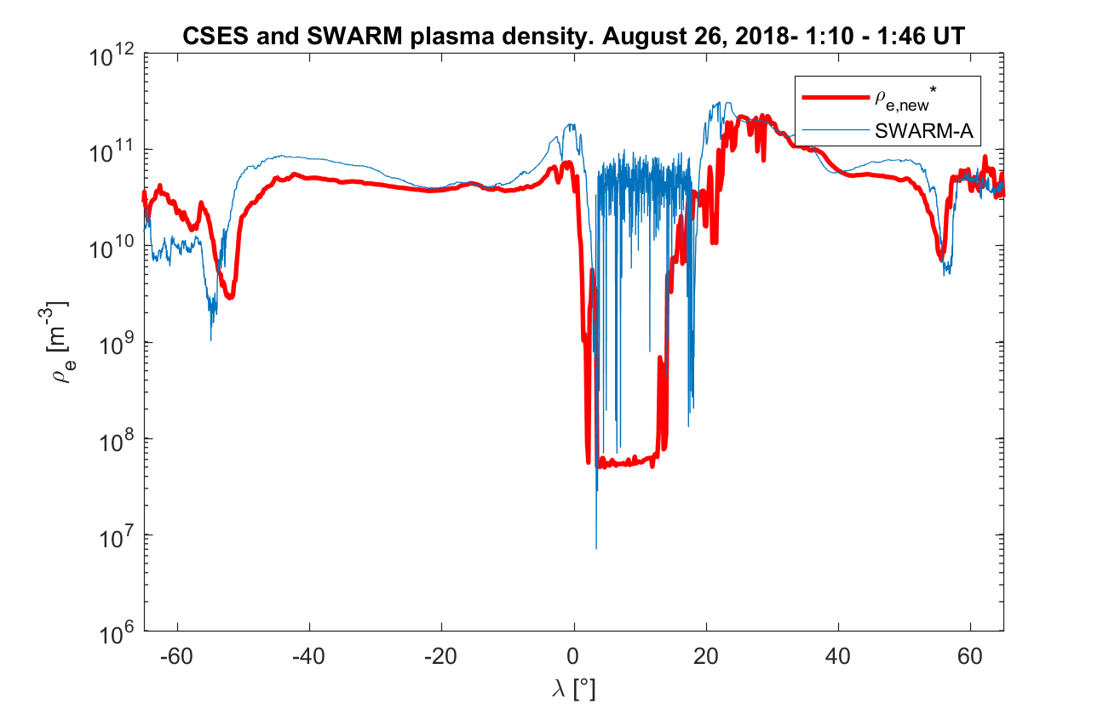
Plasma bubble detection – August 26, 2018
On August 26, 2018 both CSES and Swarm passed through a huge Plasma bubble (panel A).
It was well detected by CSES LAP, while the Swarm LP seems to have a saturation.
The huge variation of the plasma density was confirmed by the Electric Field detector (EFD) on board CSES, measuring the Electric field (panels B)
EFD probe in plasma collects a total current which is the sum of:
- Ion current (linearly depending on Ni)
- Electron current (linearly depending on Ne)
- Photo-electron current (≈20 µA/m^2 @ V<Vp; 0 A @ V>Vp)
- Bias current (fixed 500nA)
If ion and electron fluxes become smaller the bias pushes V_{f} to positive values.
EFD
LAP
B)
A)
Only a reduction of about 3 order of magnitude in Ne make it possible
the bias current to push the V_{f} up to about 10V

Slide 8
Conclusions
CSES satellite was succesfully launched on February 2, 2018 on a sunsynchronous orbit (14:00 LT);
The Langmuir probe on board works very well and the plasma data gives reliable observations;
The comparison between Swarm satellite and CSES plasma density observations shows a very good agreement expecially at low and middle latitudes for both dayside and nightside orbits;
CSES LAP shows a very good ability to detect huge plasma density depletions (plasma bubbles).
The CSES LAP and other payloads data are ready to be used for Space Weather studies.
The data are available at http://www.leos.ac.cn

