Slide 1
GALILEO IONOSPHERE PREDICTION SERVICE
ESWW16 • Liège• 18 November, 2019
Joaquim FORTUNY-GUASCH – Joint Research Centre

Slide 2
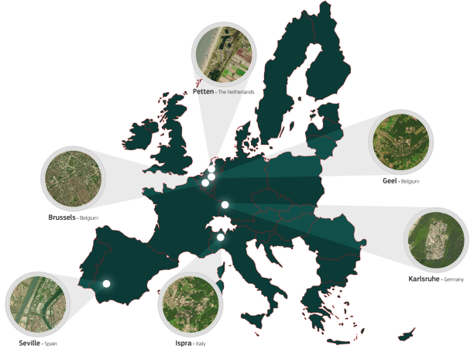
the Joint research centRE (JRC)
As the European Commission's science and knowledge service, the Joint Research Centre supports EU policies with independent scientific evidence throughout the whole policy cycle
Policy neutral:
JRC has no policy agenda of its own
JRC contribution to EU GNSS Programmes:
EU Institutions
(DG GROW, GSA)
European Space Agency (ESA)

Slide 3
Galileo, its users and Space Weather
As a GNSS provider, the European Union is investing into monitoring and prediction capability to assist GNSS users anticipate potential degradation of the GNSS performance, and hence take the necessary measures to safeguard business.
A prototype has been delivered early 2019 to help monitor and forecast the ionospheric activity:
  http://ips.gsc-europa.eu/
  Focus on aviation and high accuracy applications
  3 geographical scales: local, regional, global
  Prediction products up to 24h:
    Scientific products: Sun activity, CMEs, TEC, Scintillation
    Impact at user domain: positioning error, loss of lock, etc
JRC was involved in the prototype development as scientific advisor

Slide 4

JRC role in the operation of the prototype
The prototype is currently being ported at JRC with the following objectives:
Continue the validation of current IPS products
Identify improvements and enhancements at:
  Products’ level
  Algorithmic level
  Computing and SW architecture level
Explore cooperation opportunities
Provide guidance for the future migration to the Galileo Service Center (GSC, Madrid), service provider for Galileo users
This will key position the JRC to:
Monitor and predict potential ionosphere-related disturbances affecting the GNSS user communities
Advise EC accordingly to take action
This will key position the JRC to:
Monitor and predict potential ionosphere-related disturbances affecting the GNSS user communities
Advise EC accordingly to take action

Slide 5
validation of the prediction Algorithms: SUN
JRC has noticed that some of the solar disk images in the IPS Solar Physics product series are not always optimally shaped.
Note the misdetection of solar spots in the right hand plot!
JRC has started first trials of an automatic control of the Sun disk images directly from the FITS format in which they are provided.

Slide 6
validation of LTF TEC: Scenario
Specific geomagnetic events under analysis for the testing (CH: Coronal Hole, CME: Coronal Mass Ejection).
JRC has set a new benchmark comparing against the IPS LTF product consists of the TEC derived from JASON-3 mission altimetry data.

Slide 7
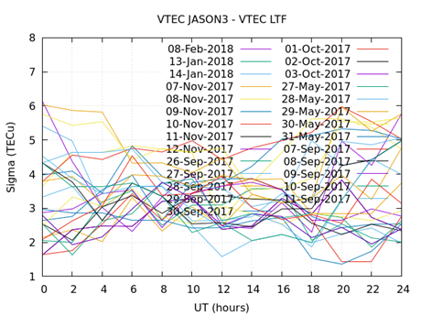
validation of LTF TEC: Results
BIAS: Results are compatible with the study performed in (Hernandez-Pajares et al., 2016) where ~190 million of intercomparisons were made during 15 years; most part of the biases were from 1 up to few TECu (in absolute value).
Sigma: Totally compatible with (Hernandez-Pajares et al., 2016) where the sigma was typically ranging from 3 to 10 TECu.
Notes:
Let us remember that the bias is affected by the missing plasmaspheric component (topside electron contribution) in the altimeter measurements, which is a small value, and the altimeter bias excess (few TECu). Nevertheless, the current results are compatible with the study performed in (Hernandez-Pajares et al., 2016) where 7 reliable sources of VTEC maps were compared against altimeter measurements

Slide 8
IMPROVEMents and enhancements: POLAR CAPS
Following the Arctic policy published by EC in 2016, there are more and more discussions between EC and the Arctic countries regarding the lack of connectivity infrastructure in such countries.
Moreover, Arctic routes for maritime and aviation are becoming increasingly interesting.
  p://ips.gsc-europa.eu/
JRC can contribute to support these developments via IPS
HOW?
JRC is performing an analysis of the Total Electron Content (TEC) available within Global Ionospheric Maps (GIM) at the very specific areas of the Northern and Southern Poles.
The JRC main challenge is to evidence the usefulness (or not) of GIM to monitor the ionospheric activity at the Polar Regions

Slide 9
IMPROVEMents and enhancements: POLAR CAPS
Northern Pole Cap
Southern Pole Cap
Two potential new products to be added to the IPS portfolio would be the following: nowcasting of the ionosphere at the Northern and Southern polar caps.
The example corresponds to VTEC monitoring at 0400UT of day 360 of 2018.
Notes:
the Southern Pole presents worse performances than the Northern Pole, fact that is compatible with the reduced number of stations in the Southern Hemisphere.

Slide 10
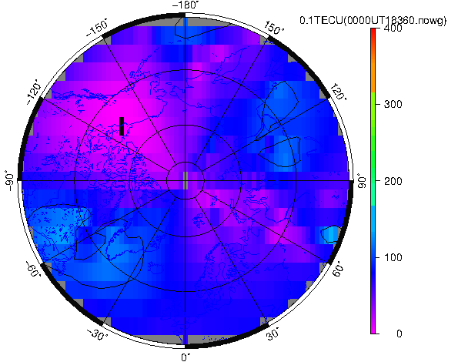
IMPROVEMents and enhancements: Polar Caps
The movie corresponds to VTEC monitoring of complete day 360 of 2018, updates every 15 minutes.

Slide 11
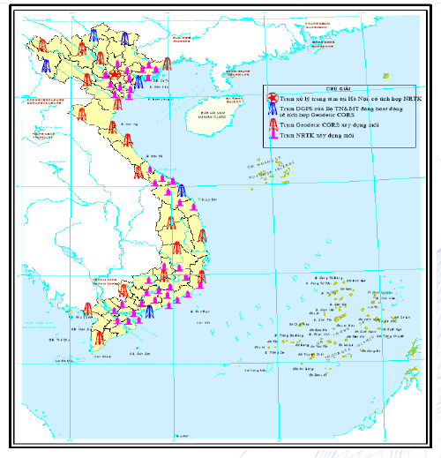
COOPERATIOn opportunities
IPS has already proven to be a successful framework to promote collaborations with 3rd parties. For instance:
Vietnam:
Tailoring regional products to the area covered by the Vietnam’s network CORS.
Analysis & characterization of ionospheric features occurring in that area.
IPS to promote standardization. Seek for common approaches for:
Data sources
Product formats

Slide 12
conclusions
JRC is evaluating the current prototype to make it a future IPS service:
Objective is to integrate the IPS into the Galileo Service Center in Madrid, to broadcast notifications to users of upcoming degradation of GNSS service.
Final goal is to deploy a service, which is challenging.
Next steps:
Collection of user suggestions and feedback for future improvement of products portfolio and their dissemination;
Harmonization of products and raising awareness at user level;
Investigation of possible agreement with data providers to extend and guarantee the coverage over critical regions (high latitude and equatorial regions);
Possible increase of the forecast horizon (limited in IPS to 24 h);
Extension of the forecasting of GNSS performance to different applications.
Notes:
Today the operative version of IPS is focused on high accuracy and aviation where requirements are more mature;

Slide 13
Follow-up activities
Roadmap of activities for the next 2 years:
Implementation of improvements at:
  Products’ level
  Algorithmic level
  Computing and SW architecture level
Close monitoring of upcoming solar peak
Contribute to preparadness actions for mitigating the effects of space weather events on EU assets
Collaboration with research insititutes, in EU and international , to fill in potential gaps in terms of products

Slide 14
THANK YOU
14
http://ec.europa.eu/galileo

