Slide 1
Geoeffectiveness of the 12 X-class flares in 2002
B. Schmieder^{1;2} , R.-S. Kim² , B. Grison³ , K. Bocchialini⁴ , R.-Y. Kwon²
1. Observatoire de Paris, 2. KASI, Korea, 3.IAP, Czech Rep., 4. IAS, FR
Key Points:
Analysis of the chain of events (flare, CME, L1, SEP, Dst).
Why do we get only weak geoeffectiveness related to the 12 X-class flares?
(Geoeffectivity is discussed based on Dst minimum, Sudden storm commencement SSC, and solar energetic particules SEP)

Slide 2
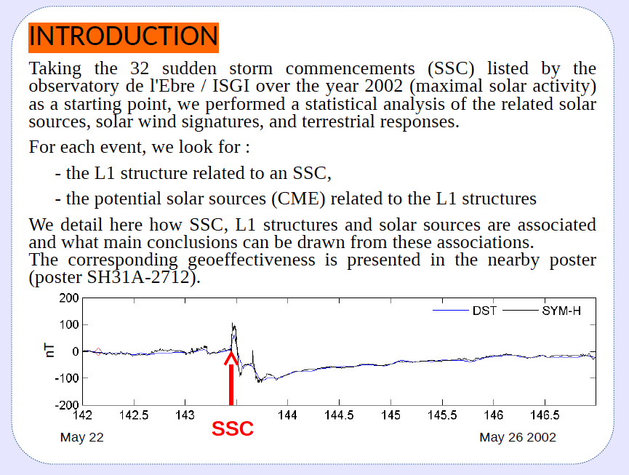
Introduction: geoeffectivity in 2002 (SSC)
Bocchialini et al 2018

Slide 3
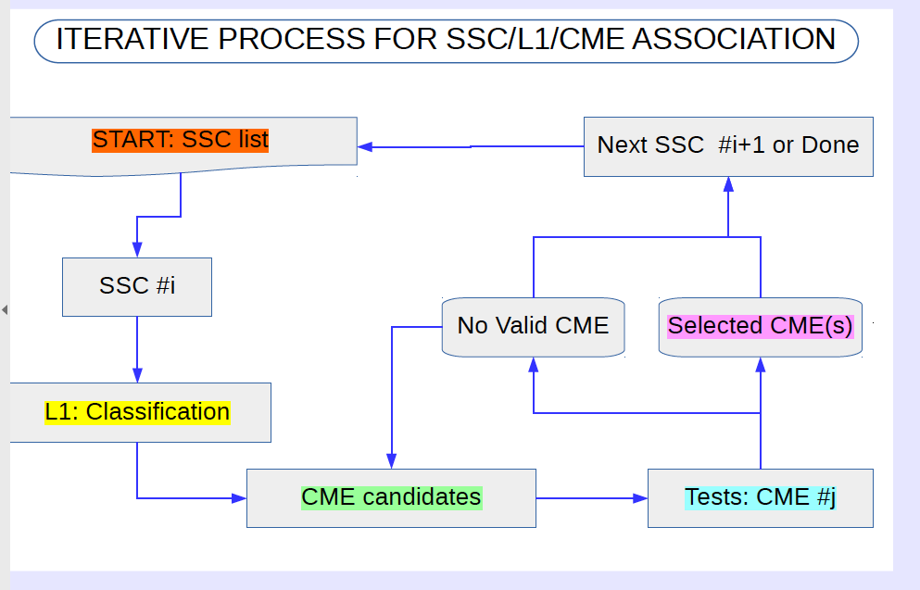
The question is: What produces the geoeffectivity (SSC) in 2002?

Slide 4
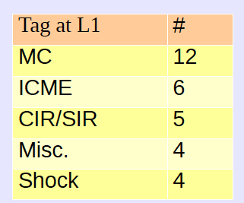
Classifications of the structure at L1 on 2002
32 SSCs finally 29 SSC sources are identified
This categorization relies on published lists
of classified events:
ICME catalogs see Cane and Richardson, 2003,
2010, and Jian et al., 2006b
• MC catalogs (Huttunen et al., 2005;
Lepping et al.,2006; Zhang et al., 2007;
Li et al., 2011)

Slide 5
Statistics of the solar sources of geoffectivity in 2002
44 CMEs, with solar source:
Source of CME :
91 % from an active region (with or without filament)
60 % implies the eruption of a filament (in or without AR)
75% Halo CMEs induce SSCs
52% CMEs have a speed > 900km/s
22 CMEs are associated with GOES C-class events among 2000 ,
19 CMEs with M-class event among 200,
3 with X-class events among 12 X – class flares
(Bocchialini, Grison, Menvielle, , Cornilleau, ..Schmieder et al Solar Physics 2018)

Slide 6
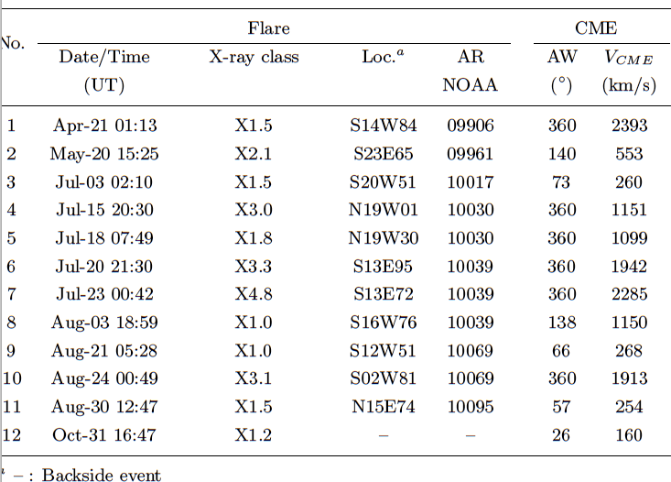
The 12 X-class flares in 2002

Slide 7
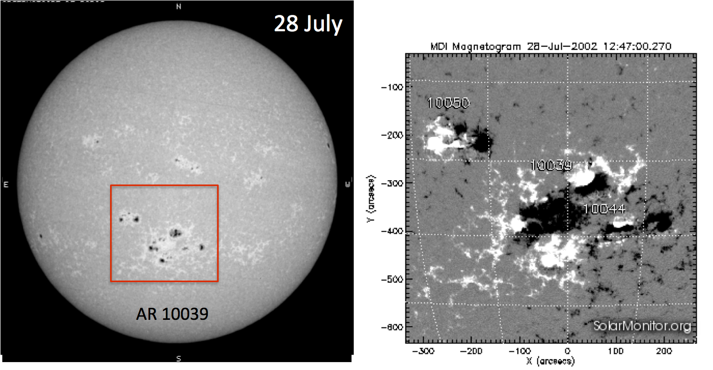
AR 10039
Complex magnetic configuration
Flares occur close to the limb

Slide 8
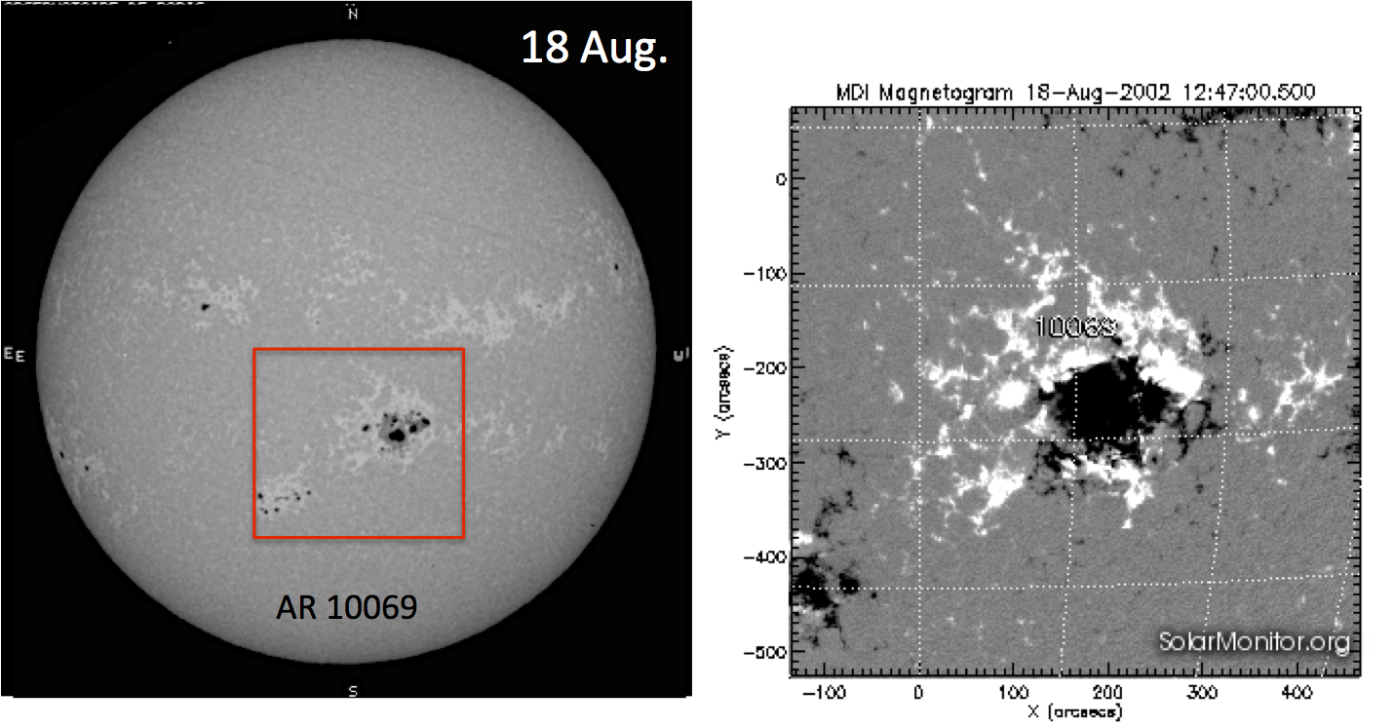
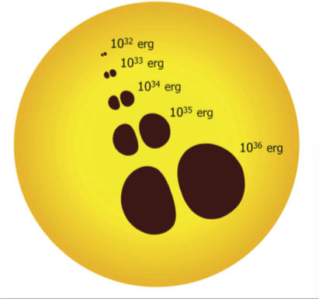
AR 10069
δ spot
Flares occur on August 21 and 24 when the active region is close to the West limb

Slide 9
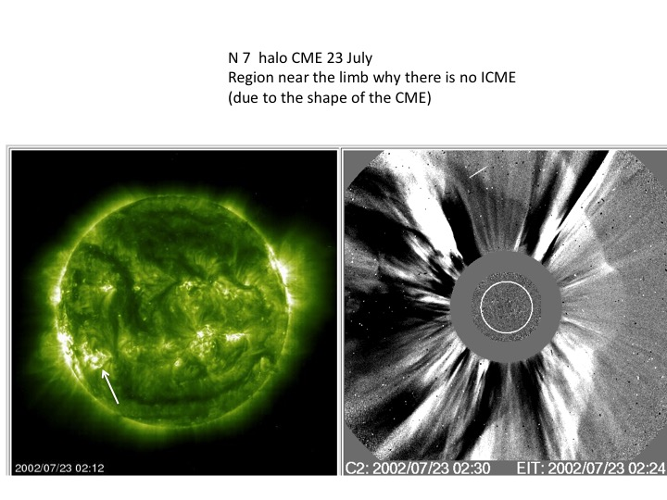
AR 10039

Slide 10
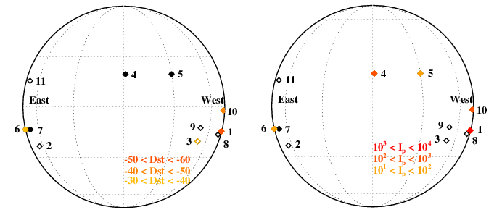
Relationship with the longitude
Preferential longitudes (Webb 2002, Lee etal 2014, Vasanth 2015) due the Parker spiral
on the West. But SEP can go through the magnetic field lines (Podgorny 2018).
Dst moderate and weak
Ip < 10⁴
Unusual high rate of X class flares near the limb

Slide 11
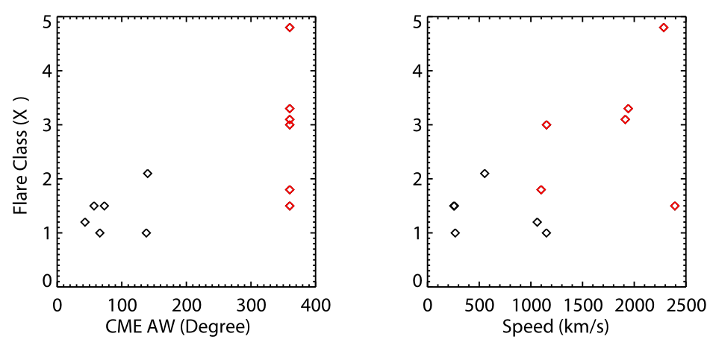
6 X-class flares with fast Halo CMEs
Red diamonds halo CMEs

Slide 12
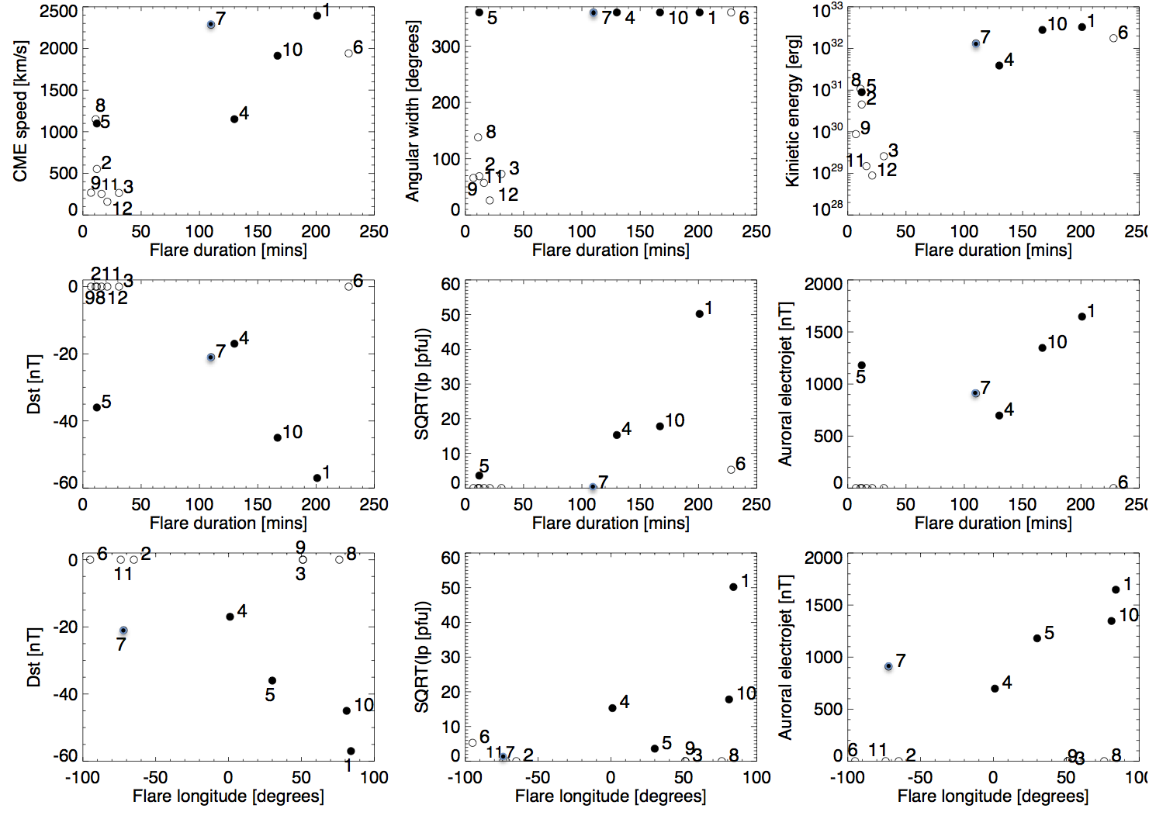
Relationship with the flare duration

Slide 13
Characteristics of the ICMEs at L1
Flare/CME -10- 24 August

Slide 14
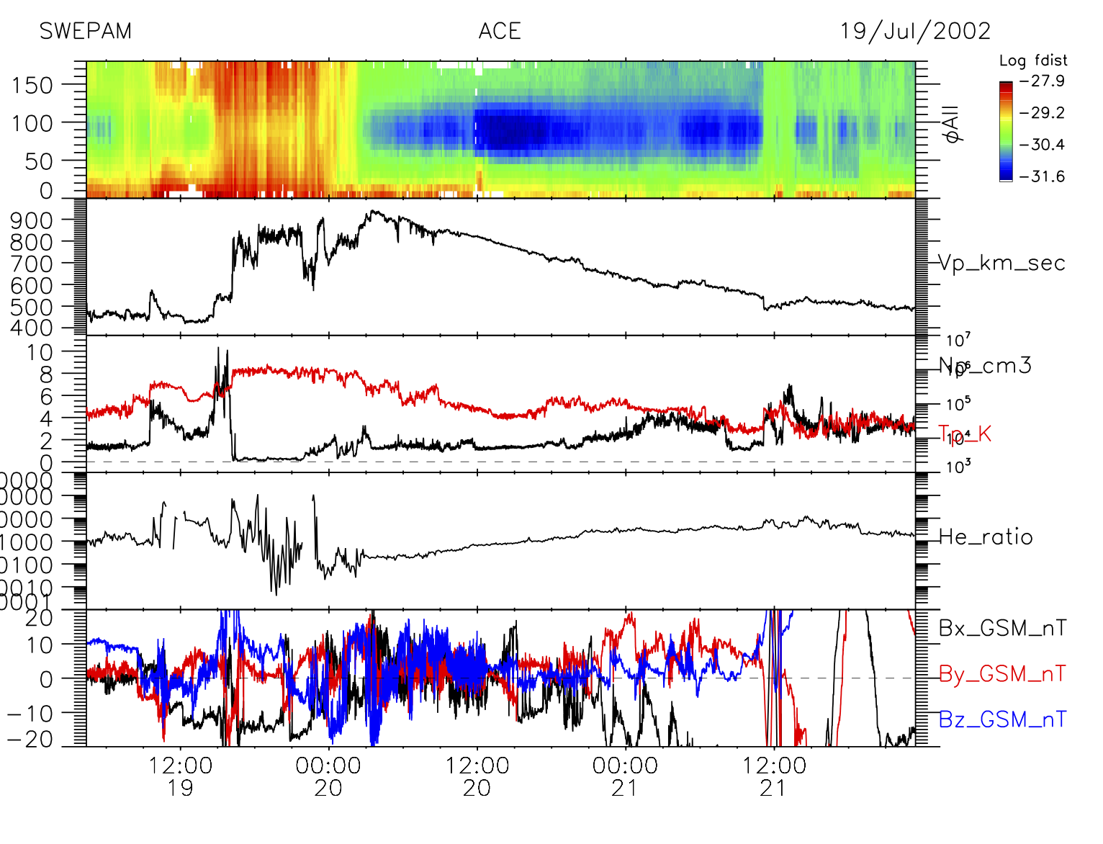
Flare/CME 15 July with a central meridian source
July

Slide 15
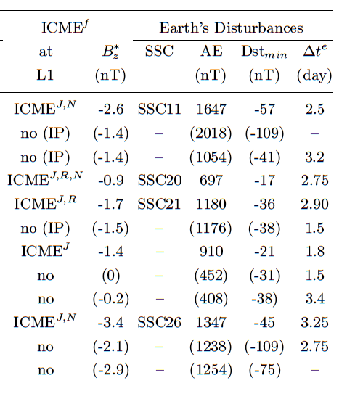
B*z
B*z s the integrated
Normalized value of Bz
During the ICME
B*z is between -0.9 and - 3.4 nT ,
very low, and explains the low geoeffectivity.

Slide 16
Conclusion
We analyse the causes of weak geoeffectiveness (Dst, SEP) of the 12 X-class
flares by analysis of the chain of events: (flare, CME, L1, SEP, and Dst).
2 All the good proxies to forecast an intense geoeffective storm do not work in 2002.
The X-class flares with fast halo CMEs are related only to weak geomagnetic
storms. One reason: the sources are mainly on the solar limb.
3 The energetic budget and the partition between kinetic energy, thermal energy
and particles are difficult to be established.
Importance of the component z of the IMF magnetic field
CMEs and ICMEs are deformed, deflected through their journey
in solar wind. Parker Solar Probe and SO will unveil Solar Wind Secrets.
Schmieder, Kim, Grison, Bocchialini, Kwoon 2019, JGR submitted

Slide 17
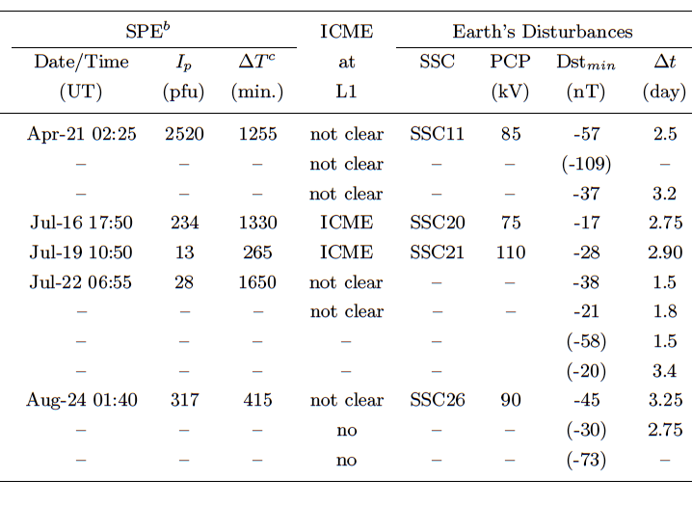
The geoeffectivity related to the12 X-Class flares - ICME at L1

Slide 18
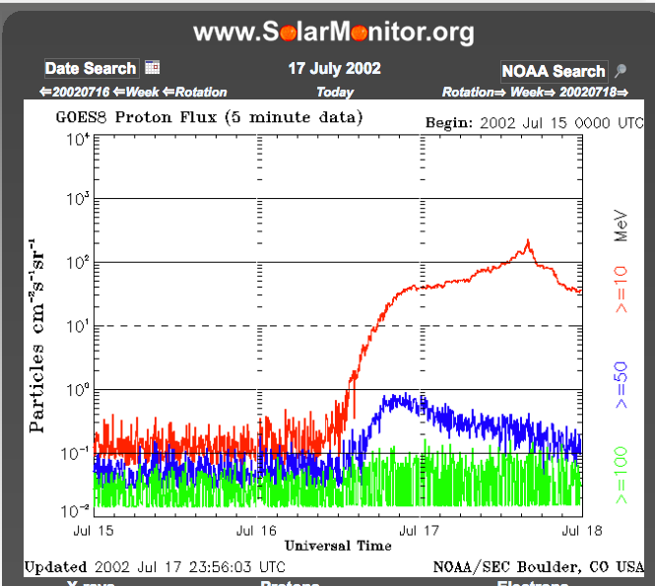
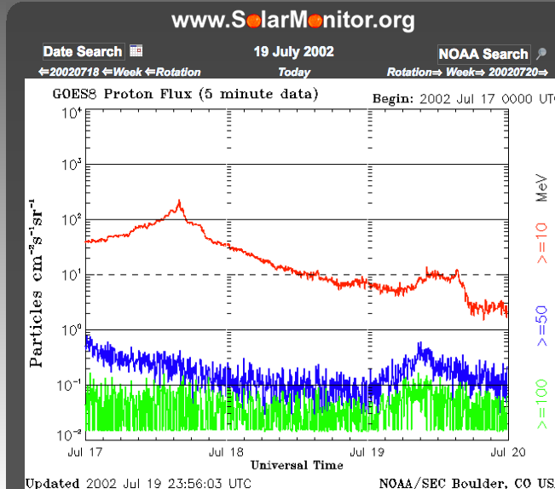
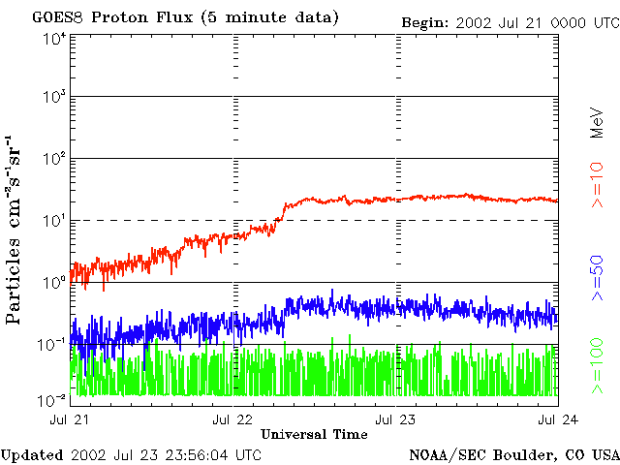
Solar Energetic particles
Case 4 Max
Case 5
Case 6
Start
12:00
Start
10:50

Slide 19
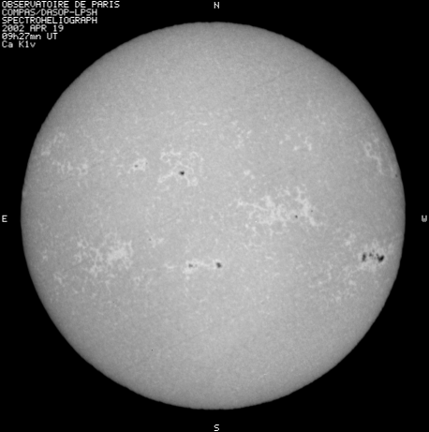
AR 09906 19 April 2002
Moderate geomagnetic storm
Flare X1.5 S14 W84
21 April
SEP= 2520 pfu
Dst = -57
PCP= 85 kV

Slide 20
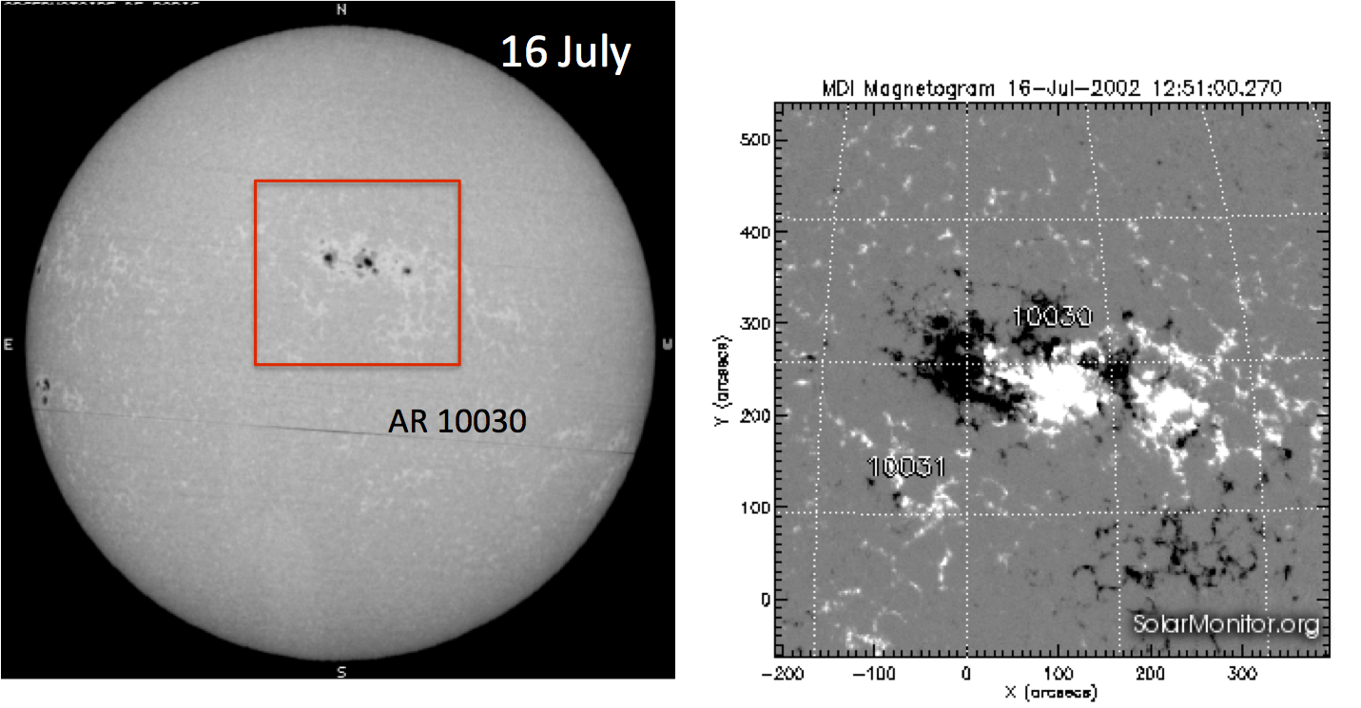
AR 10030

Slide 21
Space weather context
Large sunspot lead to large flares (Sammis 2000, Aulanier et al 2013, Maehara et al 2014)

Slide 22
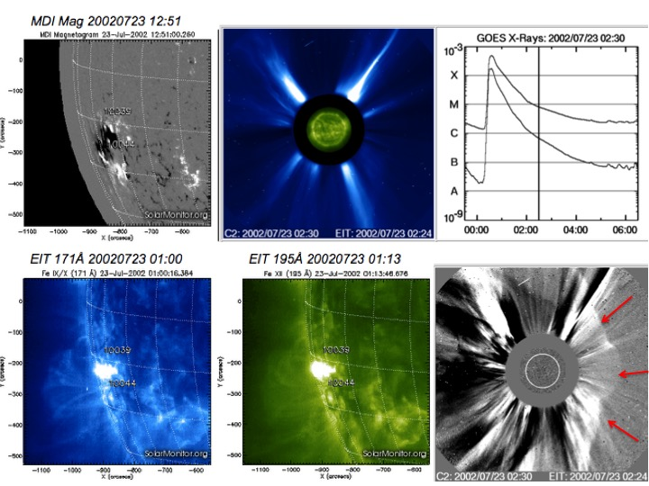

Slide 23
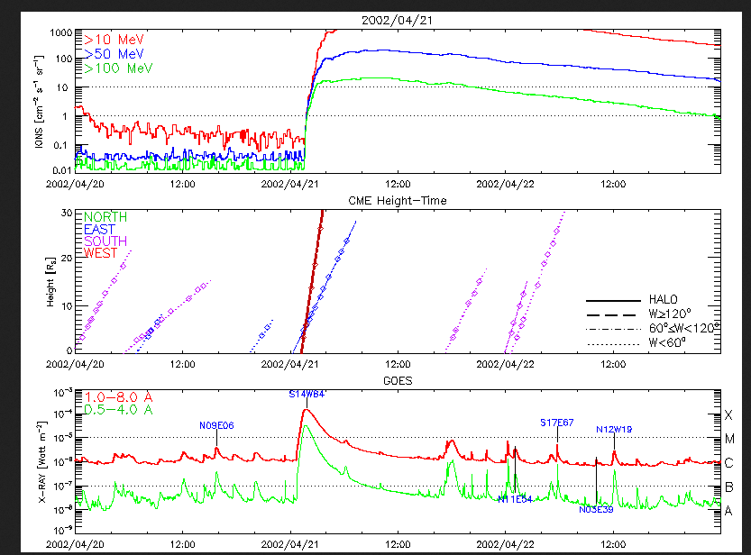

Slide 24
Relationship between flares and CMEs
Good correlations (red diamonds are halo CMEs)
Bocchialini et al 2018 found that flares with halo CME have 90 % chance of being
related to geoeffectivity

Slide 25
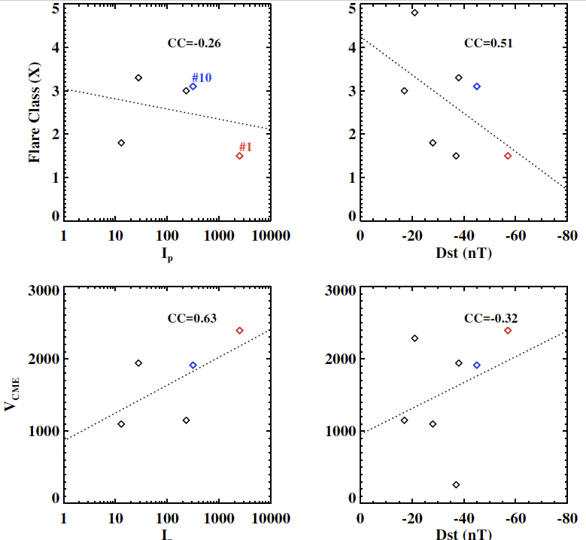
NO Relationship between flare CME and Dst and IP
Too low number ?

Slide 26
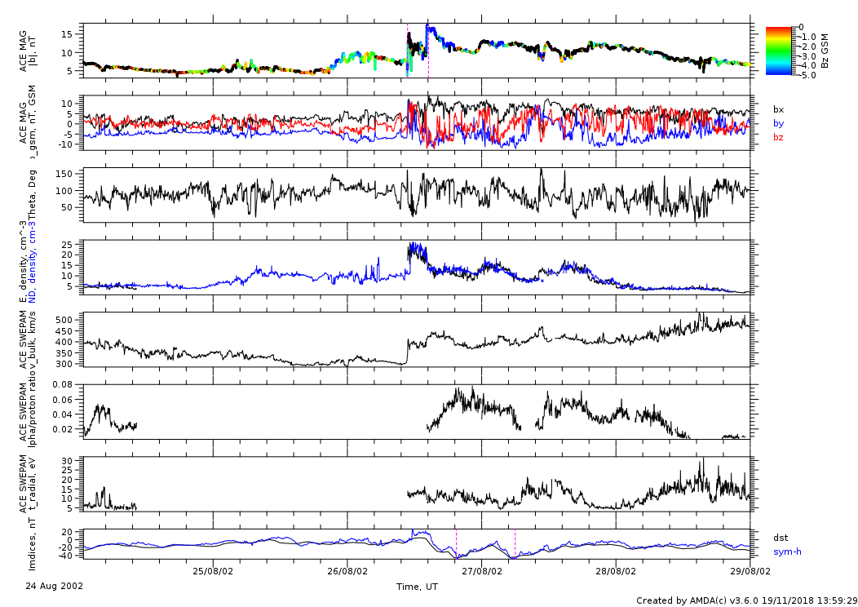
Relationship at L1 (24 Aug.)
Bz < 0

Slide 27
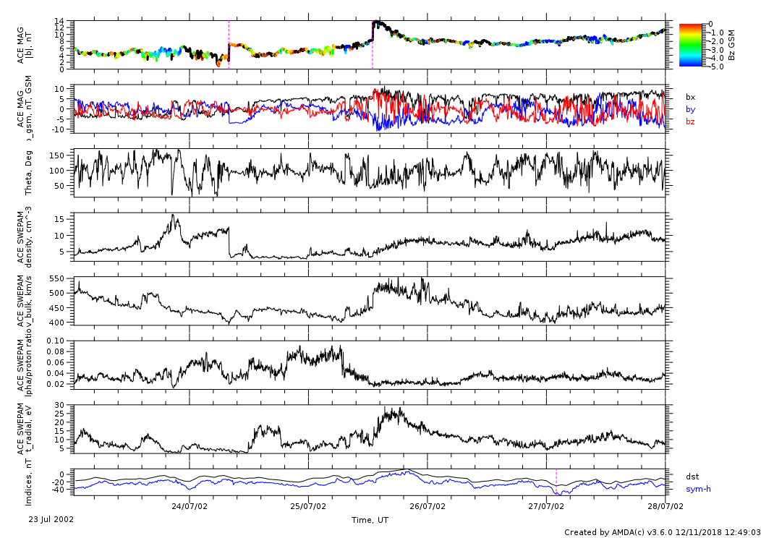
Relationship in L1 (July 23 )
Two
Disconti
nuities
Bz <0 late
So Dst min.
Is late
Low plasma density
Solar wind increase
No clear ICME

Slide 29
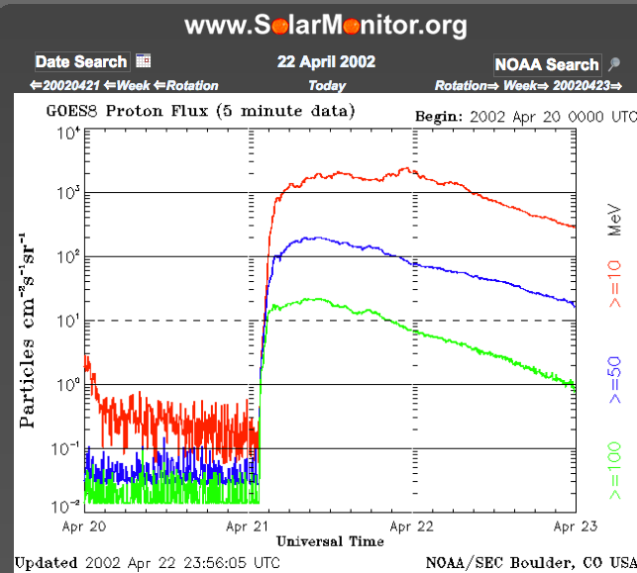
Wrong maximum

Slide 30
Statistics of the solar sources of geoffectivity in 2002
44 CMEs, with solar source:
Source Radio
The more geoeffective events (min(Dst)<-51nT) are associated with Type IV radio waves
Big X flares are not automatically associated to big geoeffective events
22 CMEs are associated with GOES C-class events among 2000,
19 CMEs with M-class event among 200,
3 with X-class events among 12.
(Bocchialini, Grisons, Menvielle, Cornilleau, ..Schmieder et al Solar Physics 2018)
But extreme geoeffective events are associated with fast CMEs and
energetic X flares and large active center . Gopalwamy et al 2015

Slide 31
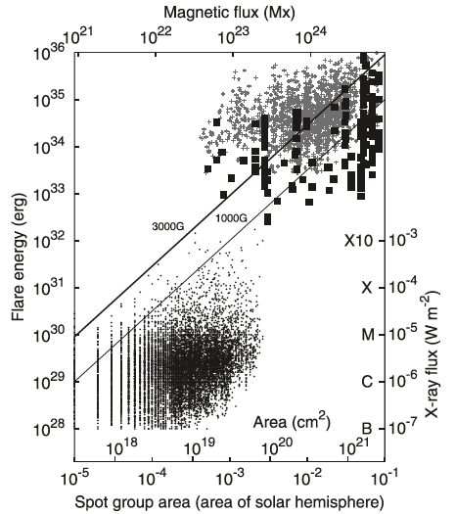
Syndrome of “superflares”
Aulanier et al. 2013
“Give me a big spot, and I can give you a big flare.” BUT don t forget
Give me more stress!
Maehara et al. 2015
(Kalher 1982, Gosling 1990)

Slide 32
Nine flares among the 12 X-class flares are clustered in July , August in 3 productive flare ARs
AR 10030, AR 10039, AR 10069
January
Feb.
July-Aug.
Sept Oct.

Slide 33
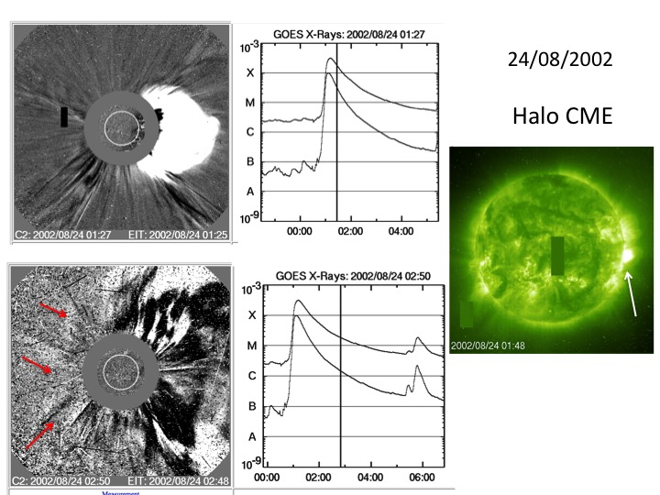
AR 10069

Slide 34
The 12 X-class flares and Halo CME
ICME
ICME
The 6 X flares with halo CME are related to an SSC (2 not) and a Dst minimum

