Slide 1
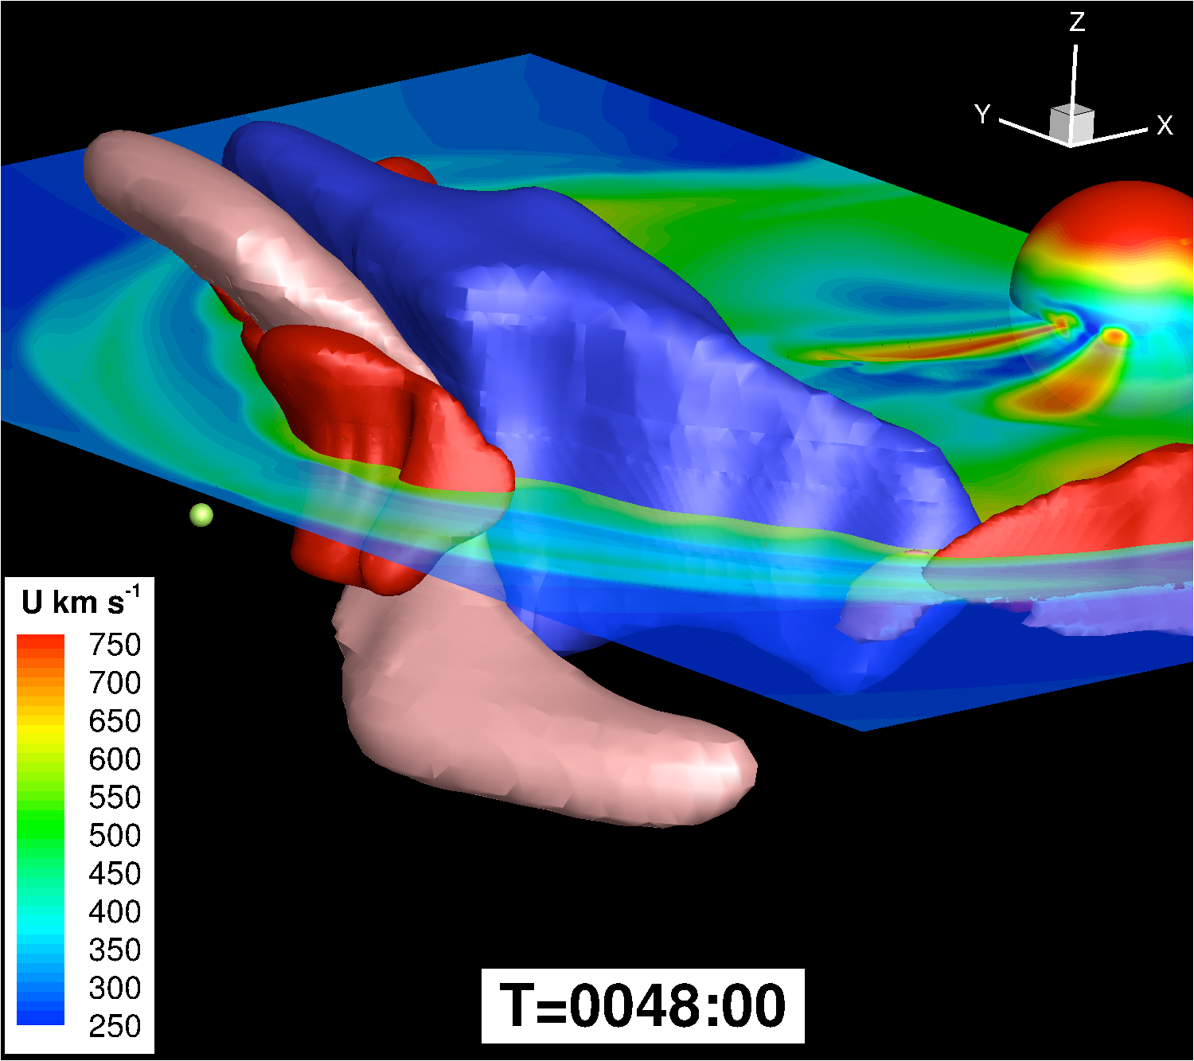
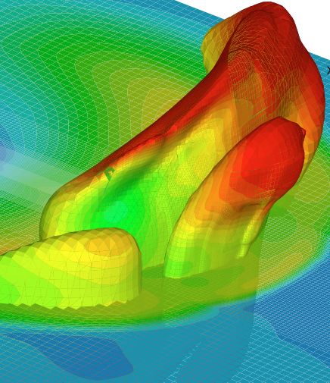

Multi-Spacecraft Measurements of a Geo-Effective Coronal Mass Ejection:
CME Radial Expansion
Noé Lugaz, Réka M. Winslow, Charles J. Farrugia, Tarik M. Salman, Toni Galvin
(University of New Hampshire)
and Christina O. Lee (UCB)
European Space Weather Week, Nov 19, 2019

Slide 2
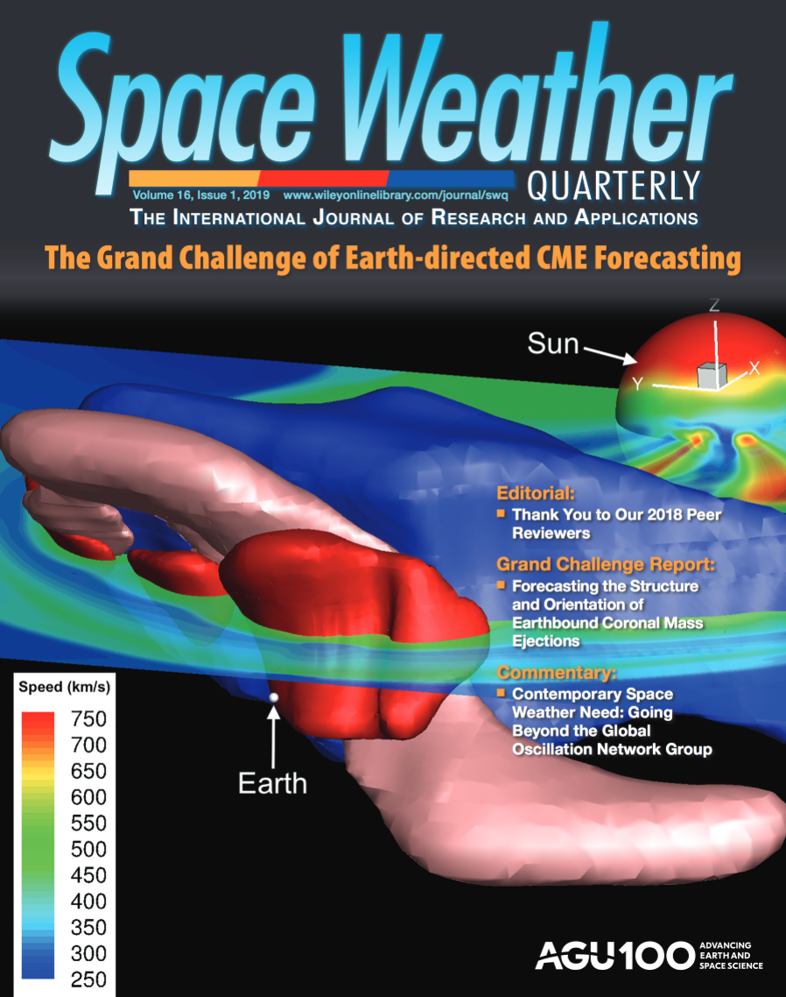
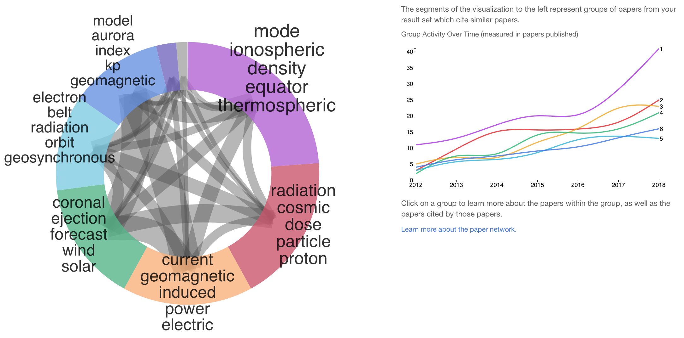
(AGU) Space Weather Journal
2018 Impact Factor: 3.7 (greater than JGRA, lower than GRL). About 120 papers published per year.
Mean # of days to first decision < 30 days (comparable to GRL, 25% less than JGRA).
Moved to open access. All manuscripts submitted since mid-October. First fully open-access issue in January 2020. Publication fees (“article processing charges”): €2200.
New Editor-in-Chief: N. Lugaz (2020-2023). Papers relevant to all sub-disciplines of space weather.

Slide 3
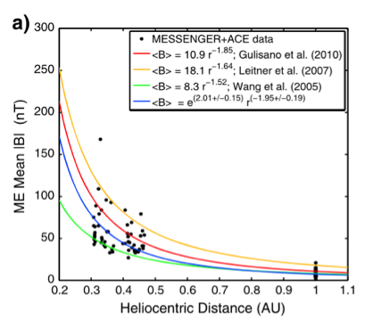

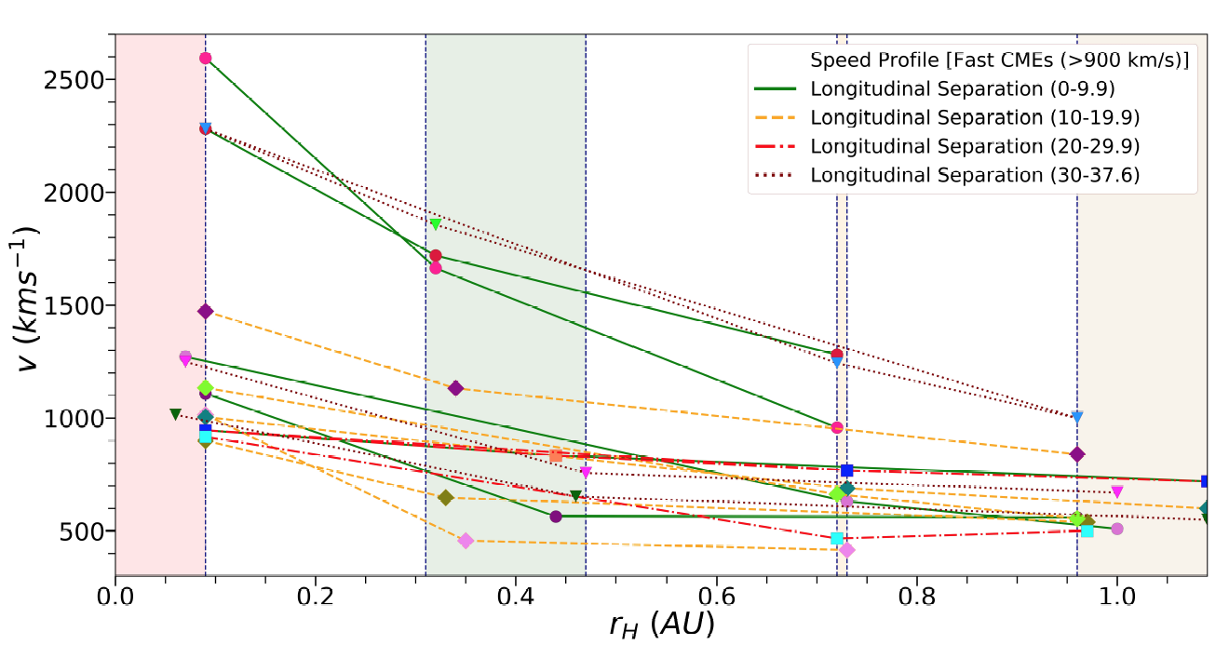
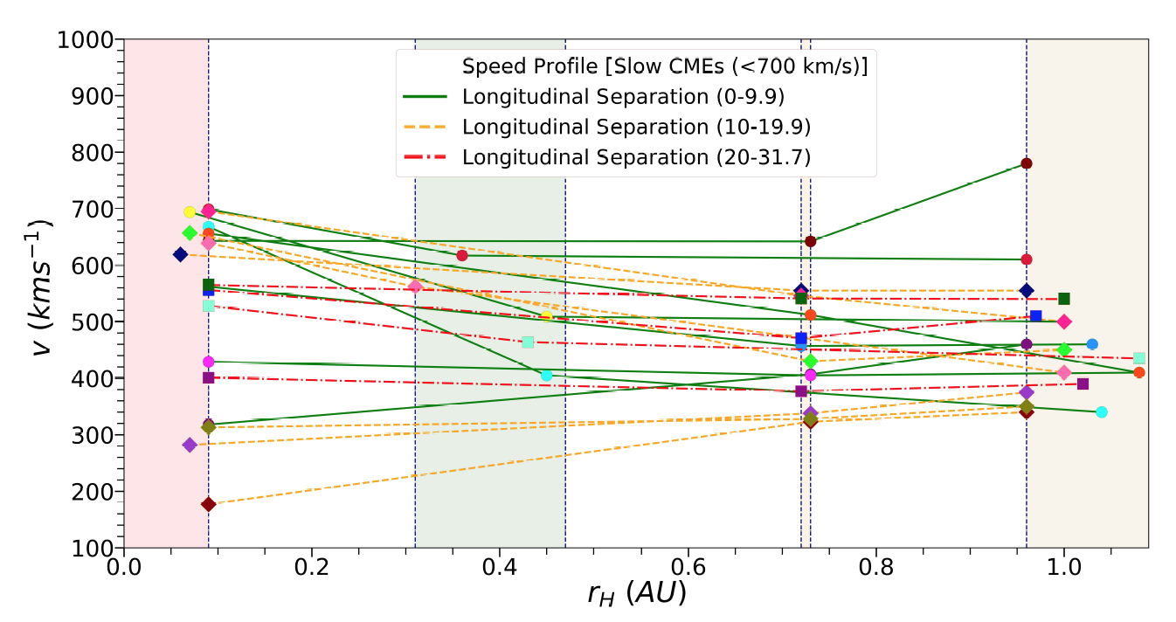
CME Expansion and Radial Evolution
A lot of what we ”think” we know is from statistical studies.
These and theoretical analyses reveal that the magnetic field inside CMEs evolve as r^{-1.75±0.4}. It is associated with an increasing CME size.
We can test these thanks to conjunction events.
  MESSENGER (2011-2015), VEX (2006-2015), ACE/Wind, STEREO.
  ~45 events in conjunction (Salman, Lugaz et al., JGR, in revision).
  Determined the initial CME speed from coronagraphic observations.
  Estimated CME speed at MESSENGER and VEX by using a drag-based approximation combined with known arrival time/speed.
  Contains a range of CME speed and profile.
Winslow et al., 2015
Liu et al., 2005

Slide 4
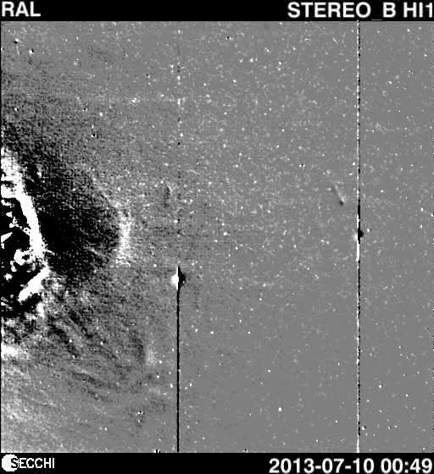
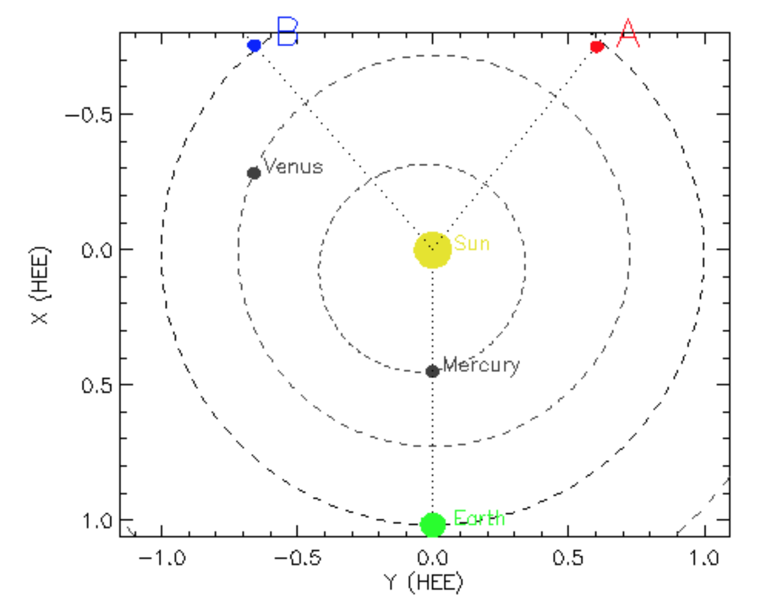
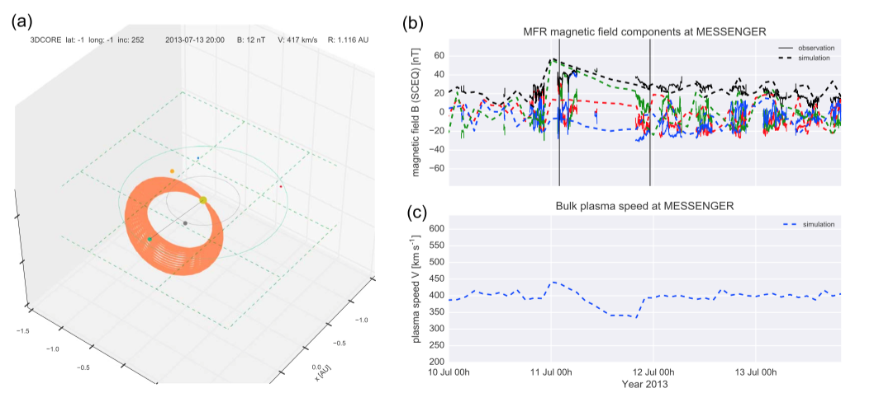
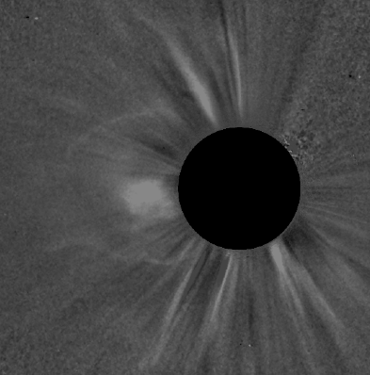
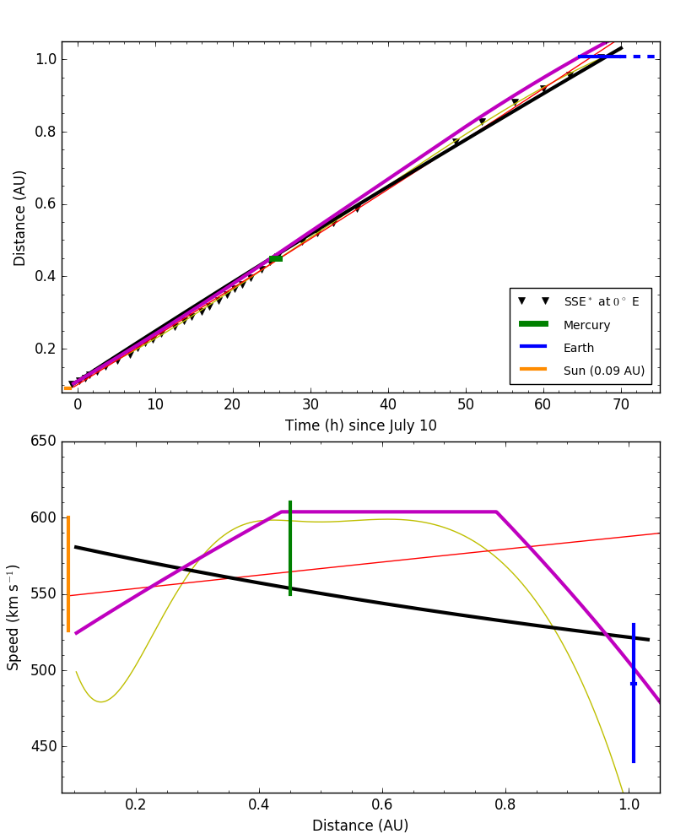
Case Study: 2013 July 9
Same CME as the case example for 3DCORE (Möstl et al., Space Weather, 2018). Also part of Hess & Zhang (2017)’s list.
Speed in the corona ~ 600 km/s. Direction of W1-W12.
Best observed remotely by STEREO-B. Not good enough data to perform stereoscopic HI analysis.
Impacted MESSENGER at Mercury (0.45 AU) and Wind/ACE at L1 (1.01 AU) on July 11 & 12-14.
Max speed at Earth of 540 km/s. Transit speed of 530 km/s (S-M), 556 km/s (S-E) or 570 km/s (M-E)
Different techniques and fitting to determine position/speed constrained by arrival times/speed indicate a nearly constant propagation speed (includes DBM of Vrsnak, 2010).

Slide 5
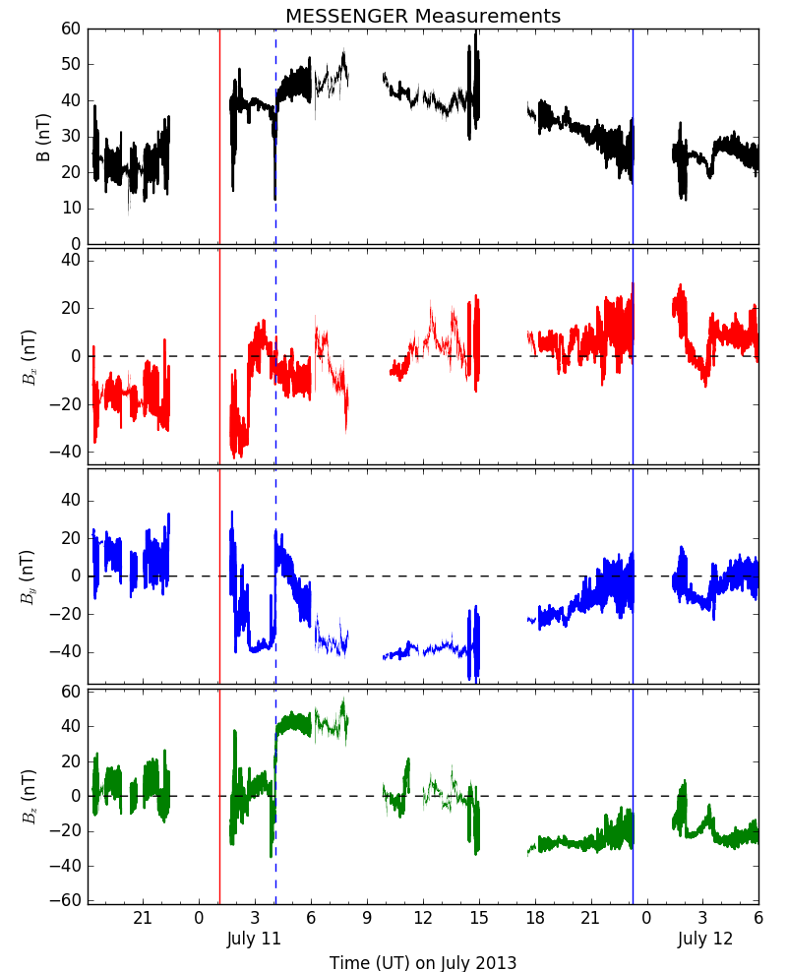
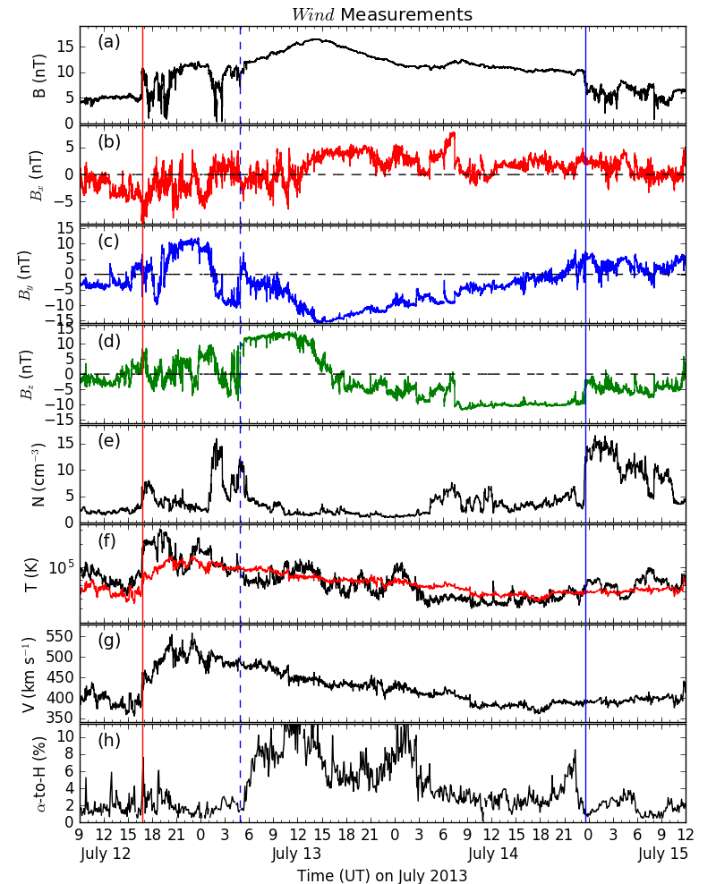
In Situ Measurements
Very similar magnetic field profiles at MESSENGER and Wind. MVA consistent with a NWS cloud.
Front boundary at Earth taken to be associated with the S-N and W-E rotation to easily match front boundary at Mercury.
End boundary clear at Earth. Not as clear at Mercury.

Slide 6
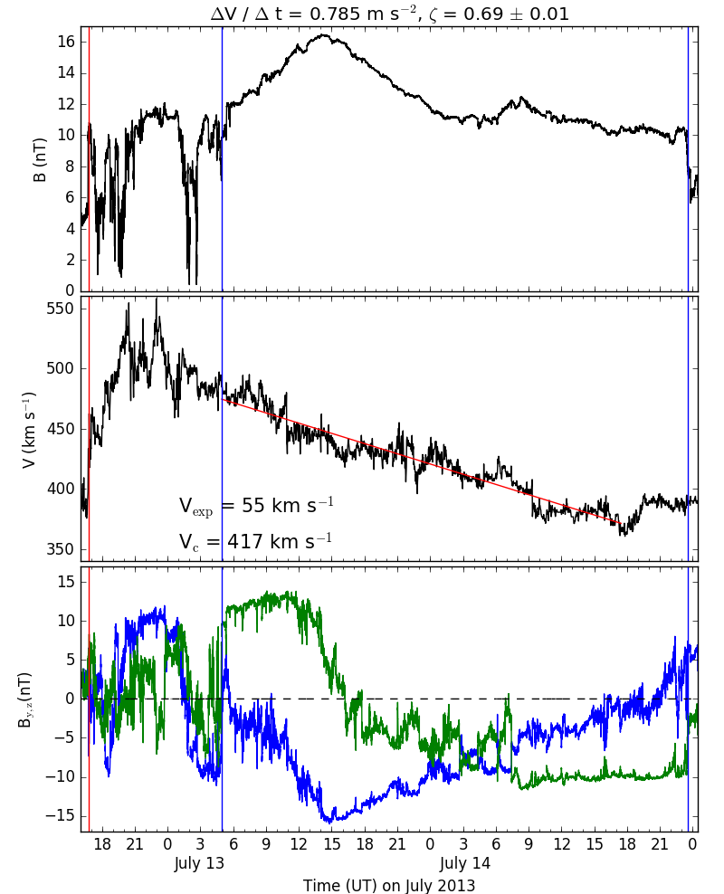
CME Radial Expansion
The formalism of Démoulin & Dasso (2009) and Gulisano et al. (2010) can be followed to determine the dimensionless expansion parameter, ζ.
ζ = 0.69 ± 0.01 relatively typical (~small).
At Earth, the magnetic ejecta (ME) is of long-duration (~42 h) and wide (~0.42 AU).
At Mercury, the ME is already of long-duration (~20 h).
The two in situ measurements can be combined to determine α, the exponent decrease of B (B = B₀ (r/r₀)^{α} ).
  Theoretically, α = -2 ζ.
  Using B_{max}, α = -1.60.
  Using B_{av}, α = -1.31.
  Overall, this is consistent with formalism of Gulisano+, 2010.
This is an example of a long-duration (wide) CME at Earth, which is not expanding fast in the heliosphere (between Mercury and Earth).
The very long duration is either due to extreme expansion below 0.4 AU or the initiation mechanism itself.

Slide 7
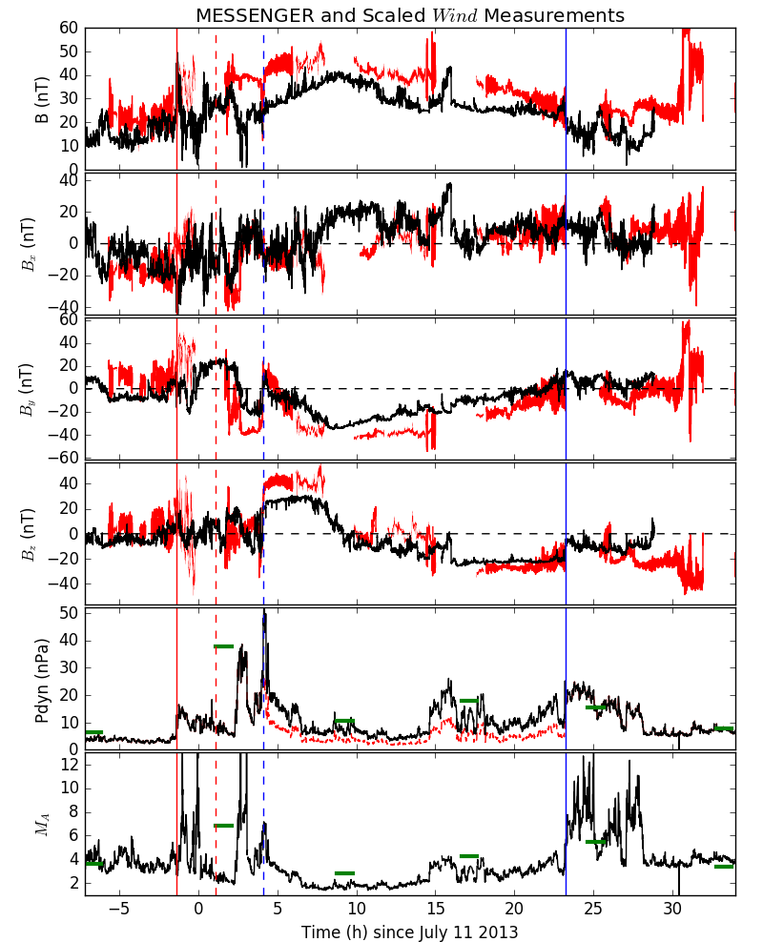
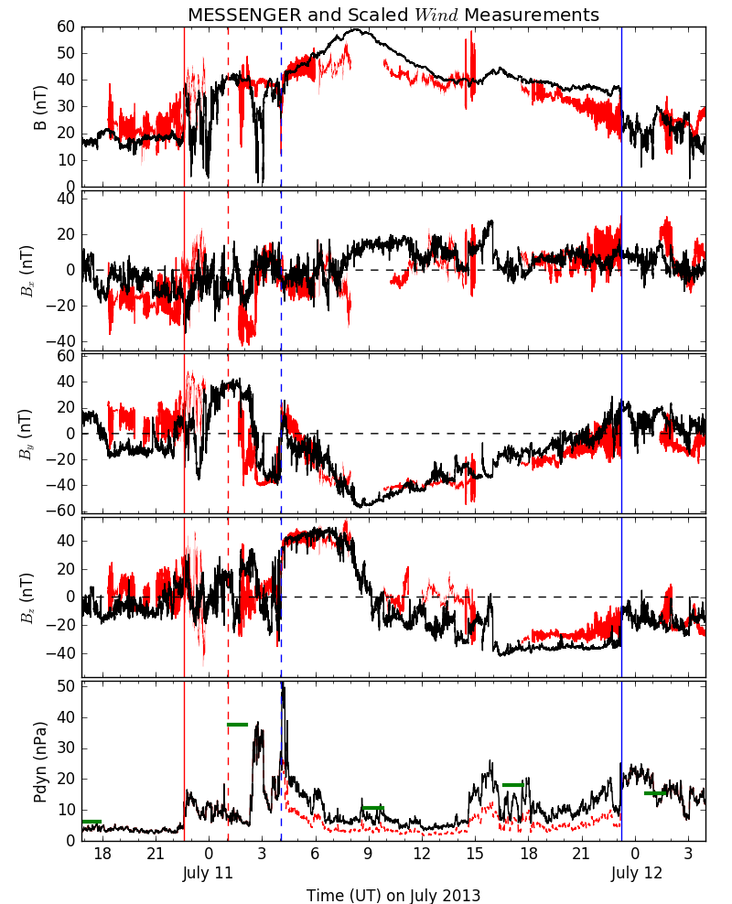
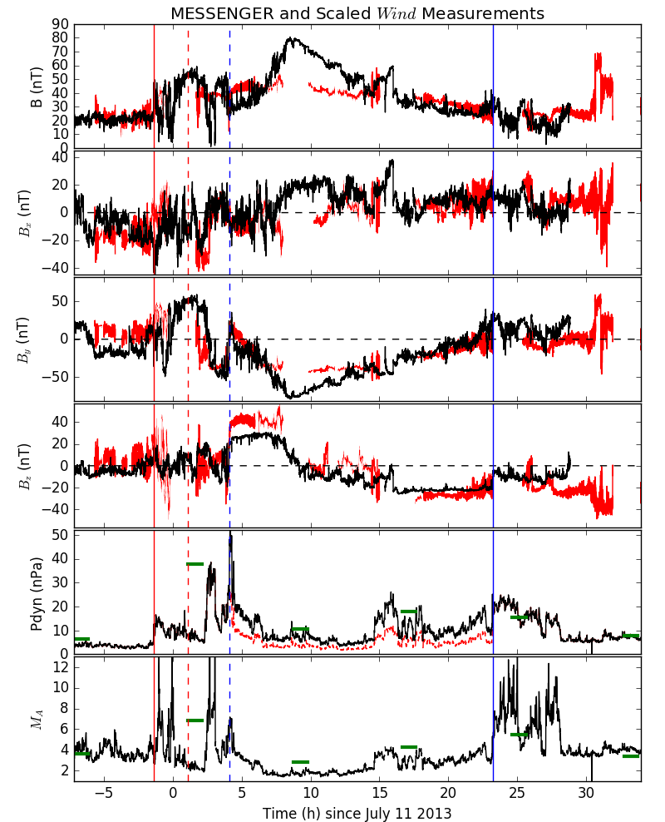
What Type of Expansion?
Uniform scaling as r-1.6 between Mercury and Earth works well.
Initial attempt at different scalings for the 3 components (r⁻¹ and r⁻² for different components) indicate that uniform scaling works best for this particular ME.
If general, such a finding is not consistent with a ME going through a quasi-steady force-free expansion.

Slide 8
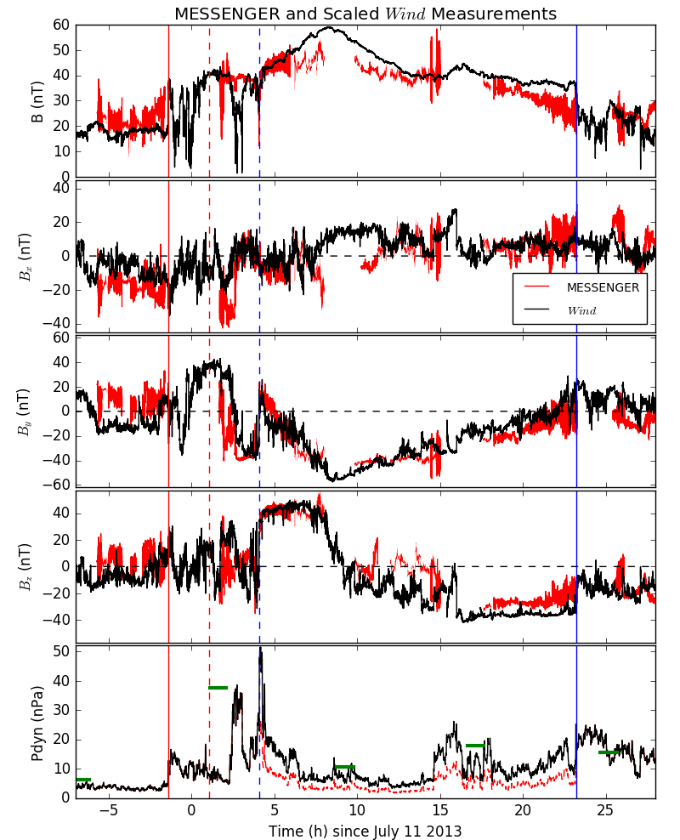
CME Sheath
Let’s check expansion: scaling Wind B as r^{-1.6,} compressing the time by 2.25 and shifting time to match beginning and end of ME .
Clearest deviation for simple expansion: the sheath (no big surprise here).
  Sheath is 2.5h at MESSENGER, 12.2h at Wind, i.e. sheath “expanded” about twice more than ME.
  Taking into consideration the speed difference, ~60% of sheath is newly accumulated (~0.09 AU).
  The 20 hours upstream of the sheath at Mercury have become part of the sheath at Earth.
  The structure at the end of the sheath is a planar magnetic structure at Earth with a normal perpendicular to the ME axis. It expands with the same rate as the ME. It is already there at Mercury.
The newest part of the sheath is recently shocked material and the oldest may be of coronal origin or accumulated before the shock formed.

Slide 9
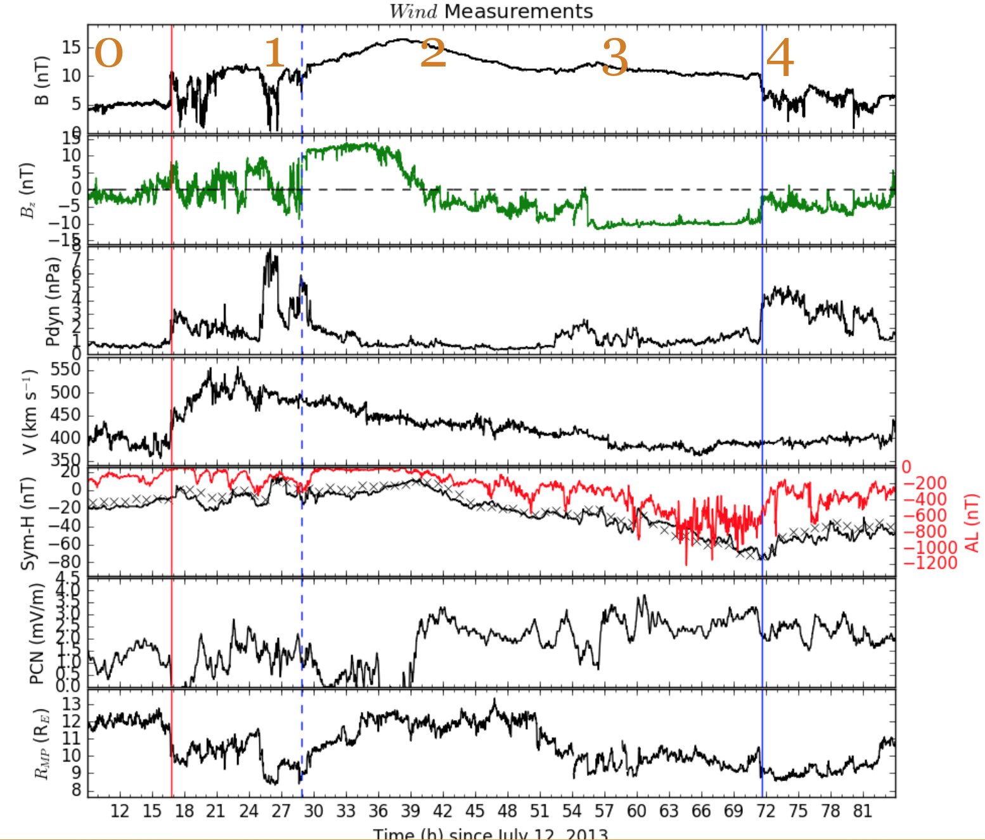
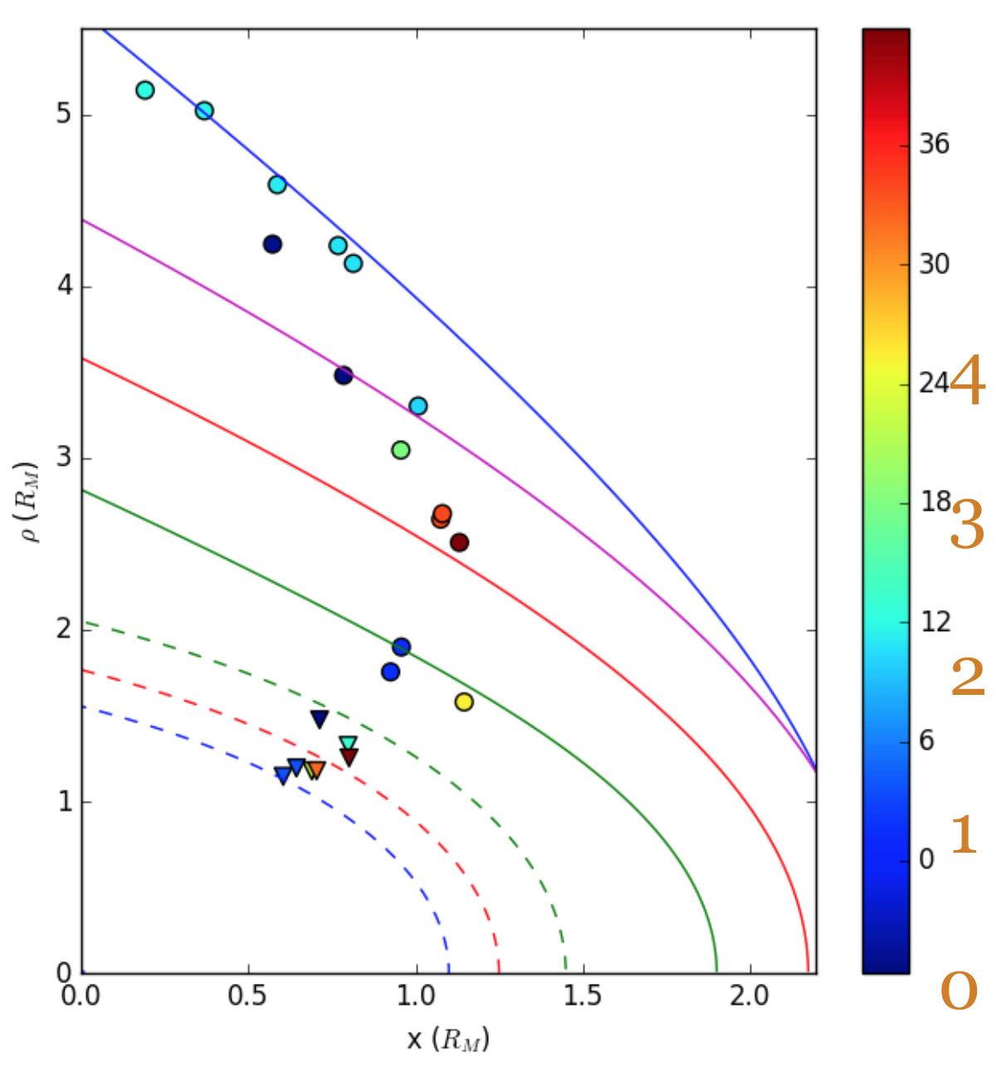
Effect on Planetary Magnetospheres
At Earth, “typical” N-S CME: compression of dayside magnetosphere due to the sheath, moderate storm (peak Dst -81 nT) due to B_{south} in the second half of ME (30h main phase).
At Mercury, typical? and somewhat similar: compression of dayside magnetosphere during sheath, large expansion of magnetosheath during ME.

Slide 10
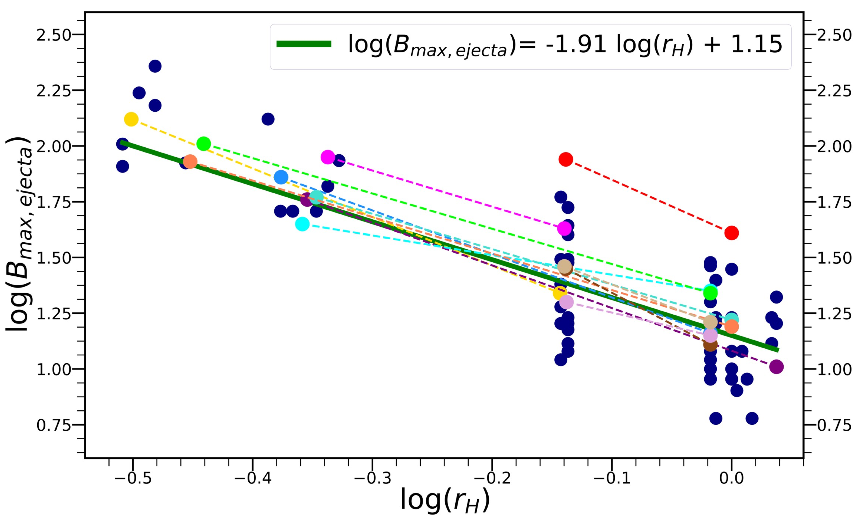
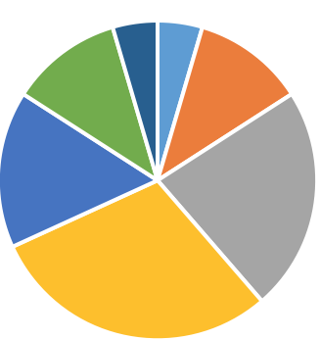
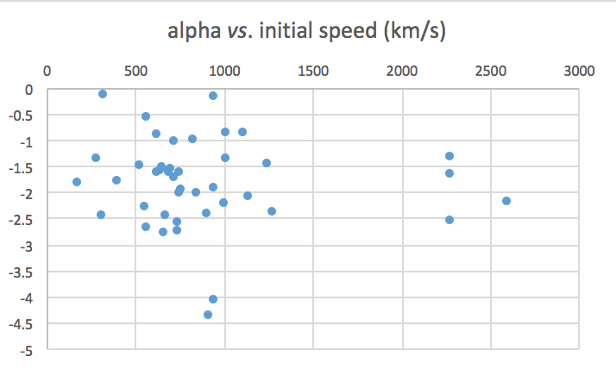
CME Expansion: Statistical vs. Conjunctions
Statistical and theoretical analyses reveal that the magnetic field inside CMEs evolve as r^{-1.73±0.41}.
We perform an analysis of 45 conjunction events (Salman et al., JGRA, in revision).
  For each events, get the maximum magnetic field in the magnetic ejecta
    MESSENGER and VEX have “gaps” when the s/c is inside the magnetosphere.
    The trend for these 90 datapoints is r^{-1.91} comparable to previous studies.
  From 2 data points, one can calculate α = log (B₂/B₁)/log(r₂/r₁).
  This can be compared to the exponent decrease in statistical studies.
α > -0.5
α < -3
  Average: -1.75 (Match!)
  Median: -1.65 (Match!)
  St-dev: 0.84 (uh-uh)
  Only 20/44 events within -1.75 ± 0.4
  No clear trend on initial CME speed.
    -1.69 ± 0.42 (MES to 1 AU)
    -2.06 ± 0.53 (VEX to 1 AU)
    Statistically significant but not controlled for differences in CME properties.
-1< α < -0.5
-3< α < -2.5
-1.5< α < -1
-2.5< α < -2
-2< α < -1.5
Notes:
Typical magnetic field inside CME is twice stronger at Venus than Earth

Slide 11
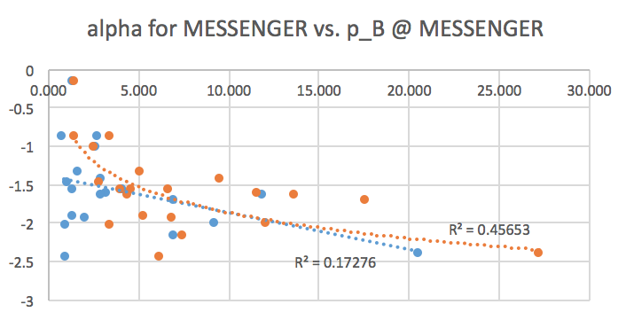
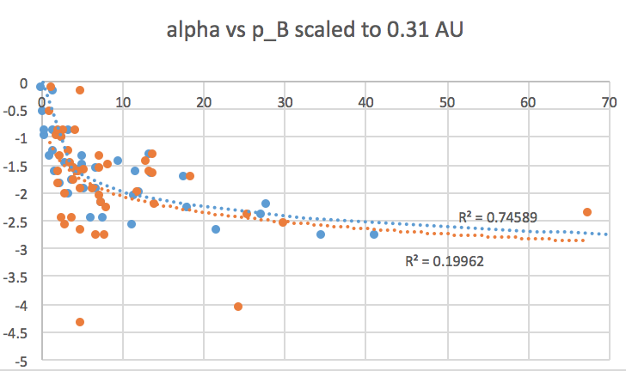
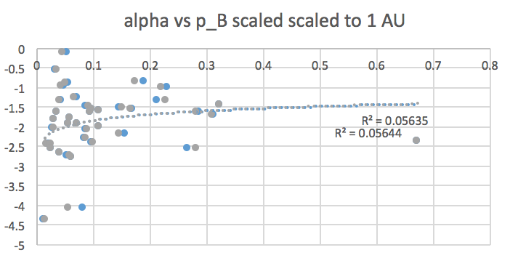
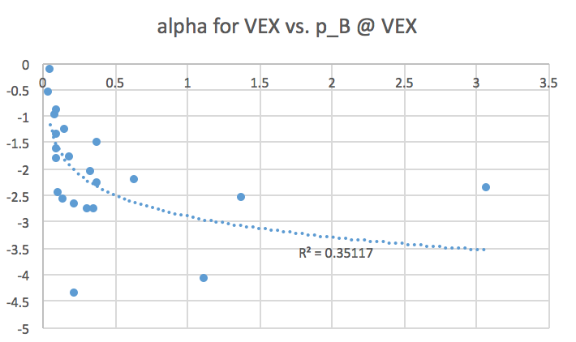
What Creates CME Radial Expansion?
Two main schools of thoughts:
  CME over-expansion: CME expands due to the larger total (magnetic) pressure inside the ejecta as compared to solar wind total pressure.
  CME expansion: CME expands due to pressure balance between the ejecta and the solar wind and the solar wind total pressure decreasing with distance.
How to test these? Compare α to B_{cme}. Problem is that B_{cme} depends on distance.
  Large alpha (expansion) are associated with high p_{B} in the inner heliosphere.
  No relation with p_{B} at 1 AU. The information is lost.

Slide 12
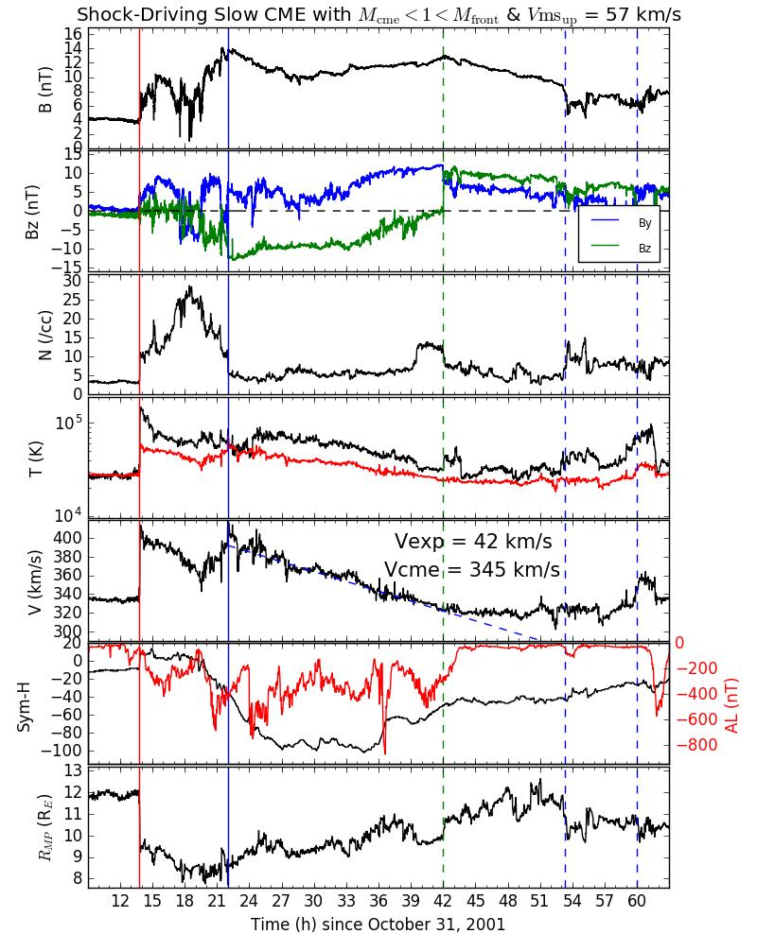
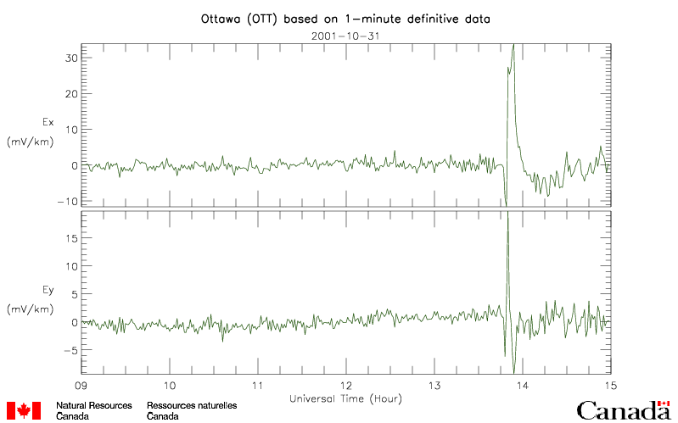
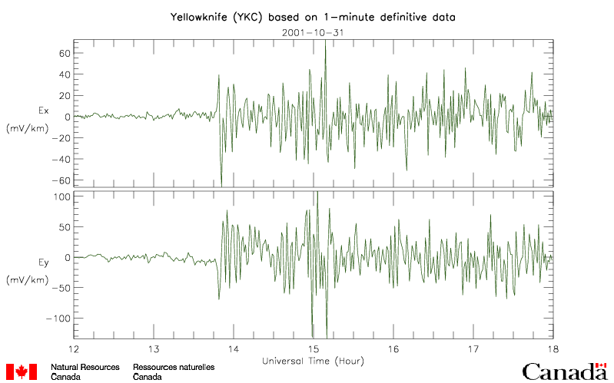
Why Does Radial Expansion Matter? Slow CMEs Driving FF Shocks
350 km/s CME don’t usually drive shocks!
Some slow CMEs at 1 AU drive shocks because of the radial expansion (Lugaz et al., 2017).
What is the Mach number of ME center vs ME front?
    Here M_{cme} < 1 < M_{front}: no shock without expansion!
Shock speed at 1 AU: 415 km/s; CME front 390 km/s
  Why a shock? upstream solar wind: 330 km/s + Fast magnetosonic speed: 55 km/s
  The CME is convected with the solar wind, expansion creates the shock.
      ξ ~ 1.25 (large expansion)
No clear halo.
  Hard to predict this would have a shock at 1 AU.
Sheath compresses dayside MP to ~8.2 R_{E}

Slide 13
Other related topics
Sub-L1 Space Weather Forecasting Platform: a change in expansion rate from r⁻¹ to r⁻³ for L1 is negligible. For a platform at 0.7 AU, this is difference of 100% in the predicted value at 1 AU (30 nT at 0.7 AU means either 21 nT or 10.3 nT). See my talk Thurs. at 18:00.
This is a way to validate numerical models if we know the way actual CMEs expand. In addition to test and validate using acceleration/arrival time, we should match expansion/magnetic fields. See Al-Haddad poster 5.p22

