Slide 1
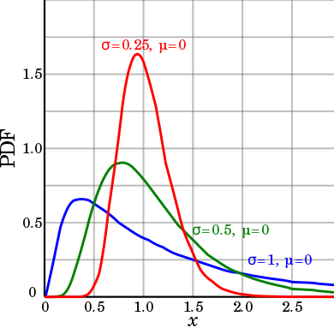
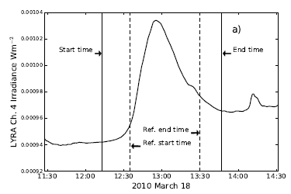
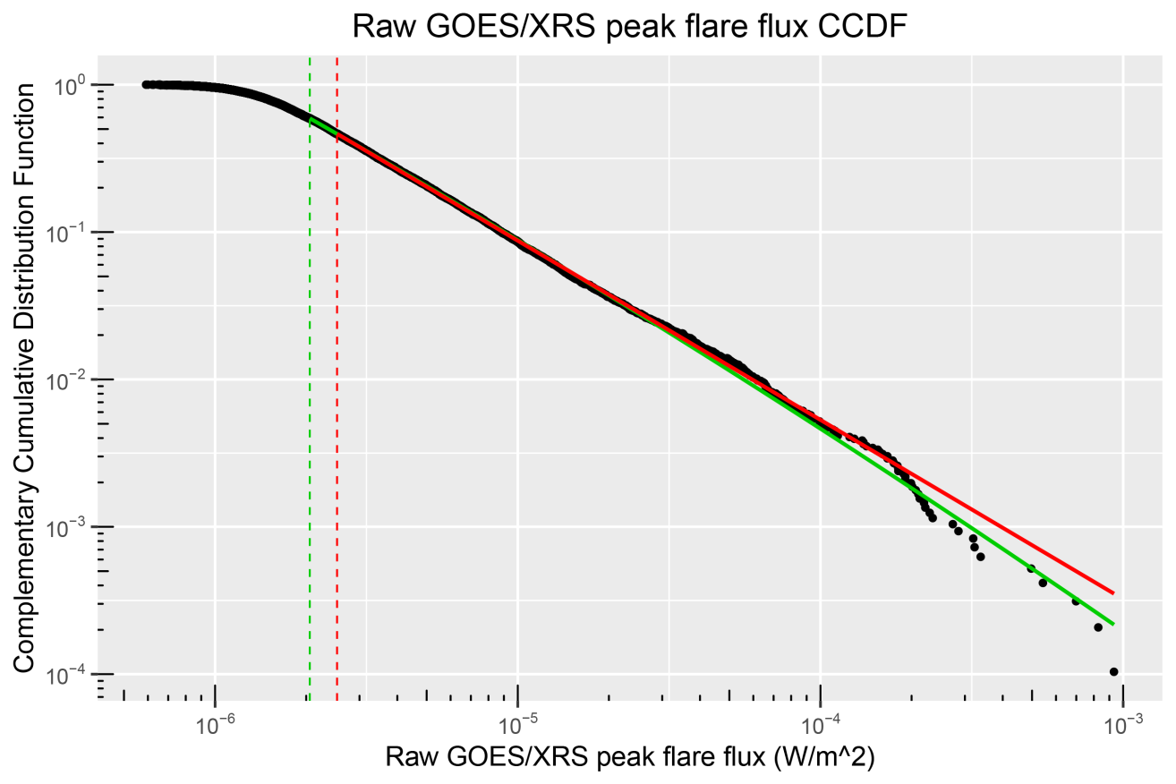
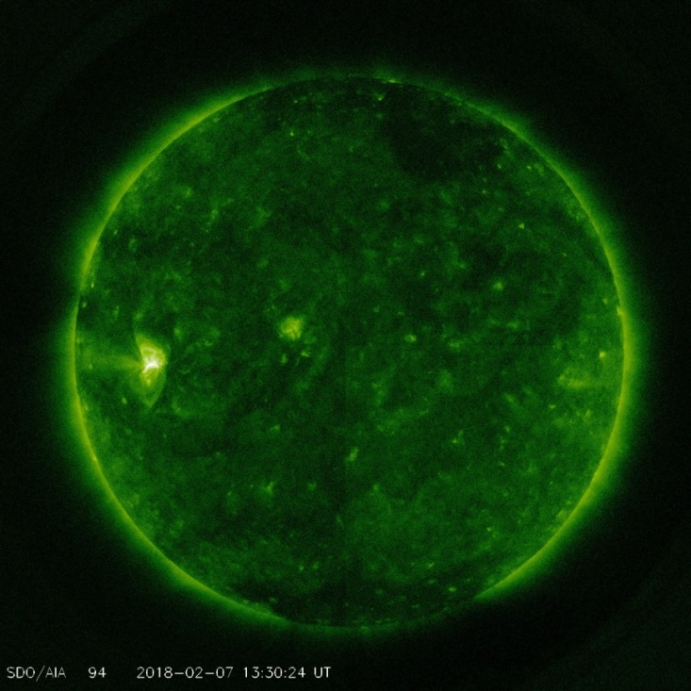
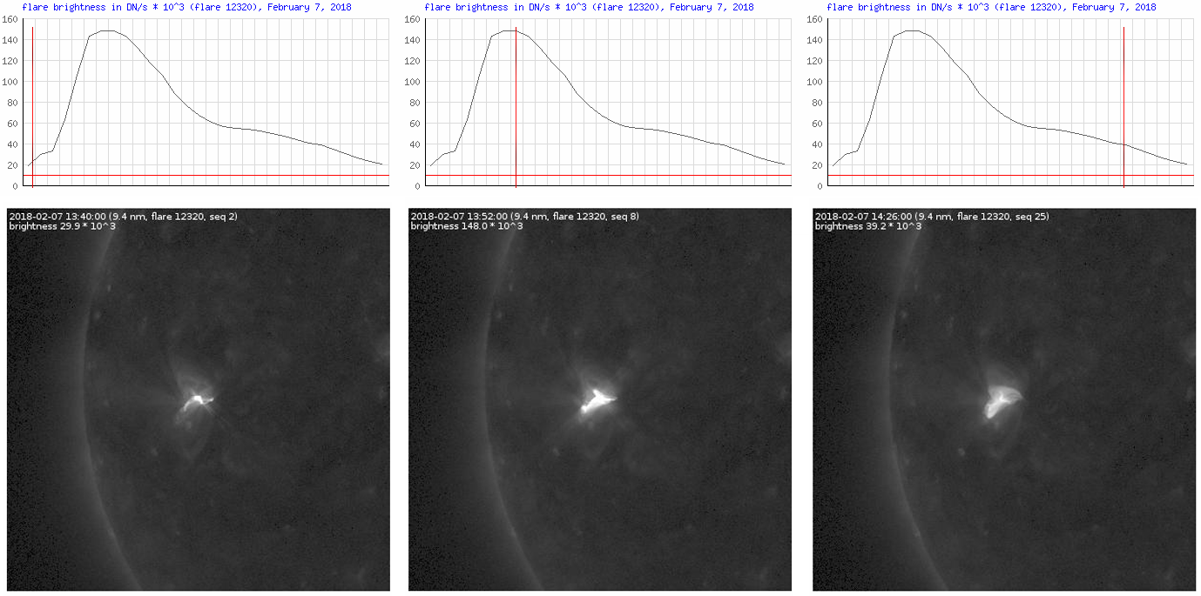
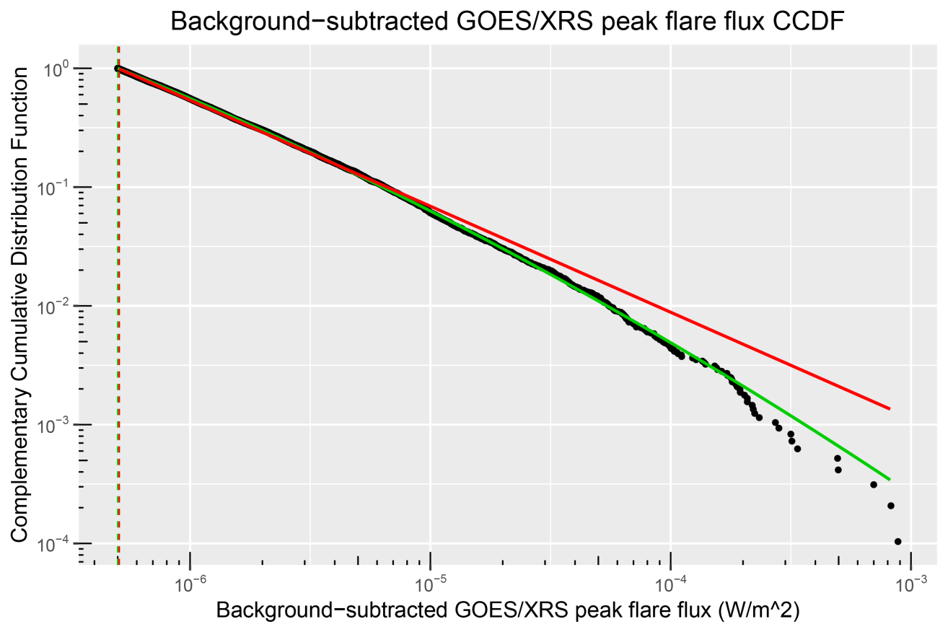
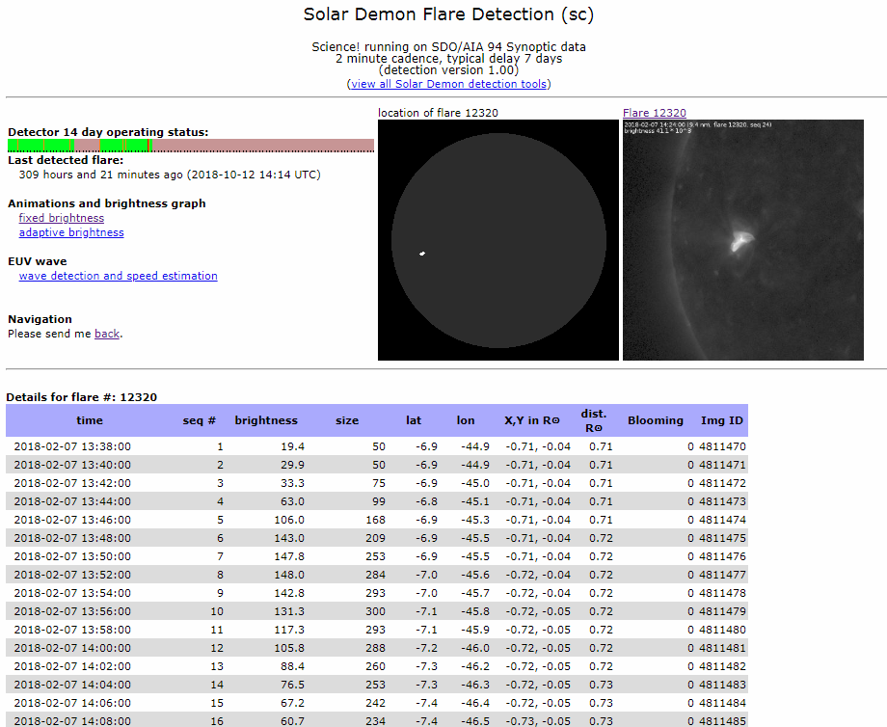
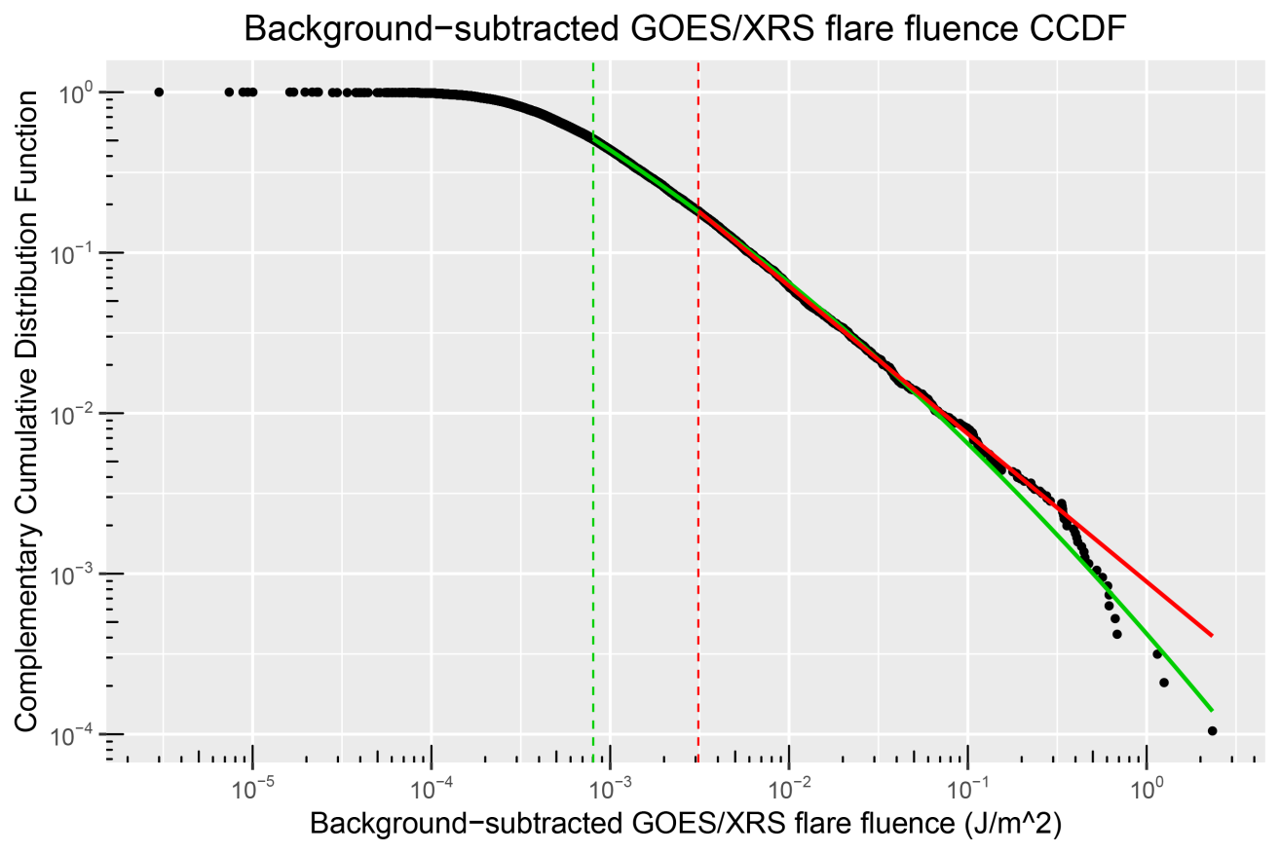
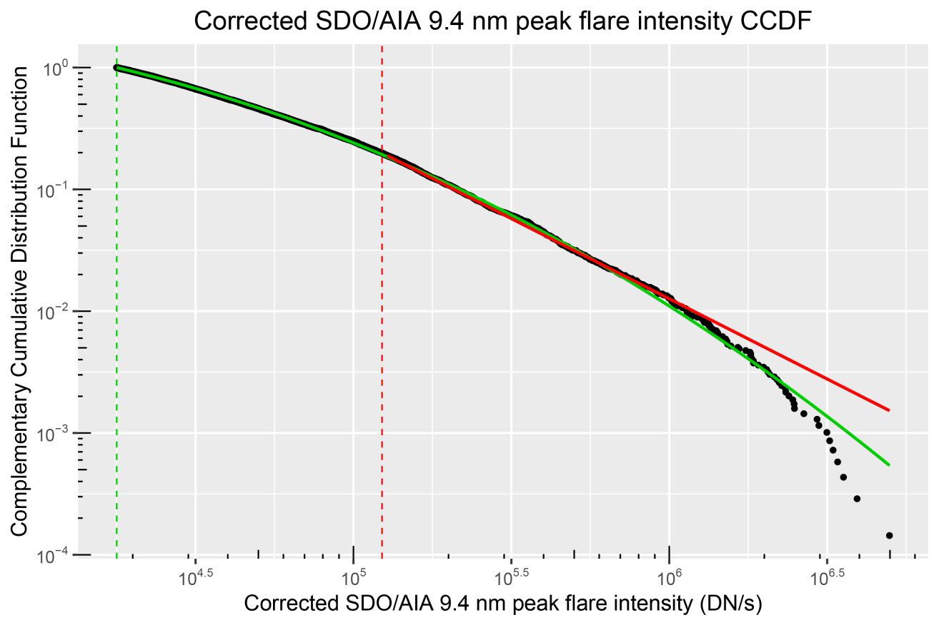
Flare parameters: evidence for lognormal rather than power law distributions
C. Verbeeck¹, E. Kraaikamp¹, D.F. Ryan², O. Podladchikova¹
¹Royal Observatory of Belgium, Solar-Terrestrial Centre of Excellence
² NASA Goddard Space Flight Center
Abstract
Solar-Terrestrial Centre of Excellence
In many statistical solar flare studies, power laws are claimed and exponents derived by fitting a line to a log-log histogram. It is well-known that this approach is statistically unstable, and very large statistics are needed to produce reliable exponent estimates. This may explain part of the observed divergence in power law exponents in various studies. Moreover, the question is seldom addressed to which extent the data really do support power law behavior. We perform a comprehensive study of 6,924 flares detected in SDO/AIA 9.4 nm images by the Solar Demon flare detection software between 2010 May 13 and 2018 March 16, and 9,601 flares detected during the same period in GOES/XRS data by the LYRAFF flare detection software.
We apply robust statistics to the SDO/AIA 9.4 nm peak intensity and the GOES/XRS raw peak flux, background-subtracted peak flux, and background-subtracted fluence, and find clear indications that all background-corrected data are better described by a lognormal distribution than by a power law, while the raw GOES/XRS peak flux is best described by a power law. This may explain the success of power law fits in flare studies using uncorrected data.
The behavior of flare parameter distributions has important implications for large-scale science questions such as coronal heating and the nature of solar flares. The apparent lognormal character of flare parameter distributions in our data sets suggests that the assumed power law nature of flares and its consequences need to be re-examined with great care.
Lognormal distribution
A random variable X is lognormally distributed if and only if Y = ln(X) has a normal distribution.
If µ and σ are the mean and standard deviation of Y, then X = exp(µ + σ Z), with Z a standard normal variable.
Robust statistical analysis
GOES/XRS flare data
Maximum Likelihood Estimation (MLE)
Maximizes the log of likelihood function $p\left(x | α\right)= \prod_{i=1}^{n}{\frac{α−1}{x_{min}}}{\left(\frac{x_{i}}{x_{min}}\right)}^{−α}$for a power law $f(x)\sim x^{−α}$ with exponent α and lower limit $x_{min}$. MLE is very robust, with accurate exponent estimation for samples of size ~100 or larger (sample size should be 10000 or larger when fitting a line to a log-log histogram).
We have employed the LYRAFF² algorithm to produce GOES/XRS flare occurrence distributions between 2010-05-13 and 2018-03-16. LYRAFF detects flares in the GOES/XRS 0.1-0.8 nm channel and calculates raw and background-subtracted peak flux as well as background-subtracted fluence for every flare. For optimal overlap with the SDO/AIA flare data set, we have retained only GOES/XRS flares with background-subtracted peak flux values above B5 level.
Goodness-of-fit p: is the model compatible with the data?
If p > 0.1, the considered model (e.g., power law or lognormal) is not rejected by the data.
Likelihood ratio: comparing two competing models
The likelihood ratio compares how well two competing models describe the data. If p’ < 0.1, one of the models describes the data significantly better than the other one. If this is the case, a positive/negative likelihood ratio means the lognormal/power law model describes the data significantly better.
²Ryan et al., A&A, 592, A133 (2016).
Statistical analysis of GOES/XRS data
SDO/AIA flare data
power law/lognormal
Orders of magnitude 2.57/2.66
% data points 47/59
Goodness-of-fit p 1.00/NaN
Ratio test 1.06 (p’ = 0.29)
For every observed flare and for every AIA image in which this flare is observed (at time t), Solar Demon¹ calculates the flare intensity at time t, i.e., the sum of the pixel values in the flare mask. Hence, the peak flare intensity, which is the maximum value of this light curve (middle image below) is not polluted by the non-flaring part of the Sun (which is the case, e.g., for GOES/XRS flux).
Conclusion: Raw GOES/XRS peak flare flux has a power law distribution.
power law/lognormal
Orders of magnitude 3.24/3.25
% data points 100/100
Goodness-of-fit p 0.00/0.34
Ratio test 4.20(p’ = 0.00)
Conclusion: The lognormal distribution fits the background-subtracted GOES/XRS peak flare flux data significantly better than the power law distribution.
SDO/AIA 9.4 nm image showing a C8.1 flare detected by Solar Demon at 13:38 UTC on 2018-02-07.
power law/lognormal
Orders of magnitude 2.88/3.46
% data points 18/51
Goodness-of-fit p 0.23/0.46
Ratio test 3.74(p’ = 0.00)
It is well-known that the SDO/AIA channels have suffered from degradation over time. We have corrected the SDO/AIA 9.4 nm flare intensities by employing the evolution of their behavior with respect to GOES/XRS flare flux values over time. The resulting data set of corrected SDO/AIA 9.4 nm peak flare intensities (from 2010-05-13 until 2018-03-16) is analyzed below.
Conclusion: The lognormal distribution fits the background-subtracted GOES/XRS flare fluence data significantly better than the power law distribution, over a wider range.
¹Kraaikamp & Verbeeck, J. Space Weather Space Clim. 5, A18 (2015).
Statistical analysis of SDO/AIA data
Conclusions
power law/lognormal
Orders of magnitude 1.61/2.45
% data points 20/100
Goodness-of-fit p 0.03/0.21
Ratio test 11.55 (p’ = 0.00)
We have studied 6,924 flares detected in SDO/AIA 9.4 nm images by Solar Demon between 2010-05-13 and 2018-03-16, and 9,601 flares detected by LYRAFF in GOES/XRS data during the same period. We have applied robust statistics to the SDO/AIA 9.4 nm peak intensity and the GOES/XRS raw peak flux, background-subtracted peak flux, and background-subtracted fluence, and have found clear indications that all background-corrected data are described significantly better by a lognormal distribution than by a power law, while the raw GOES/XRS peak flux is best described by a power law. These results suggest that, after the necessary subtraction of the solar background from the raw signal, flare parameters such as peak flare flux and flare fluence exhibit intrinsic lognormal behavior instead of the much-acclaimed power law behavior.
We hypothesize that the observed lognormal distribution of flare parameters is related to continuous fragmentation of flux elements near the footpoints of coronal loops. Direct currents can be generated in the corona by slow random motion of coronal loop footpoints and can produce magnetic reconnection on fast timescales when dissipated.
Conclusion: the lognormal distribution fits the SDO/AIA 9.4 nm peak flare intensity data significantly better than the power law distribution, over a wider range.
The black curve shows the Complementary Cumulative Distribution Function (CCDF) of the corrected SDO/AIA 9.4 nm peak flare intensity. The red and green curves are the CCDF of the MLE power law and lognormal fits to the data, respectively. The vertical red and green lines, respectively, are the lower limits x_{min} for which the power law and lognormal fits are valid.
C. Verbeeck, E. Kraaikamp, D.F. Ryan, O. Podladchikova, “Solar Flare Distributions: Lognormal Instead of Power Law?”, ApJ, 884:50 (2019)
doi: 10.3847/1538-4357/ab3425.

