Slide 1
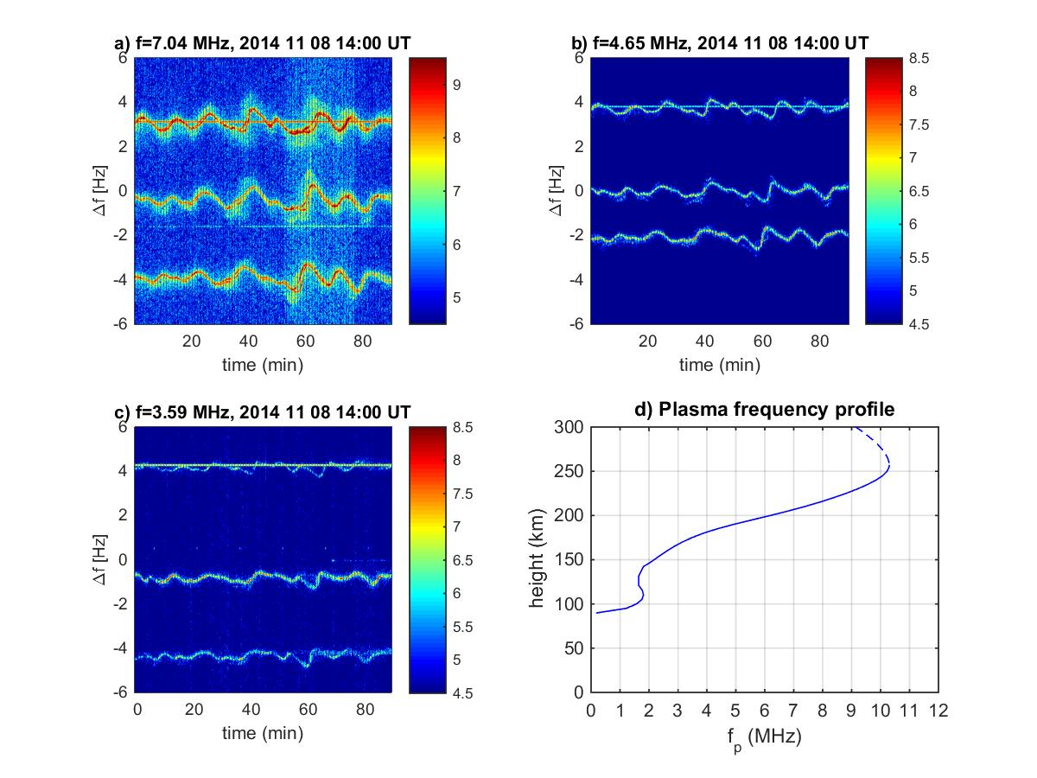
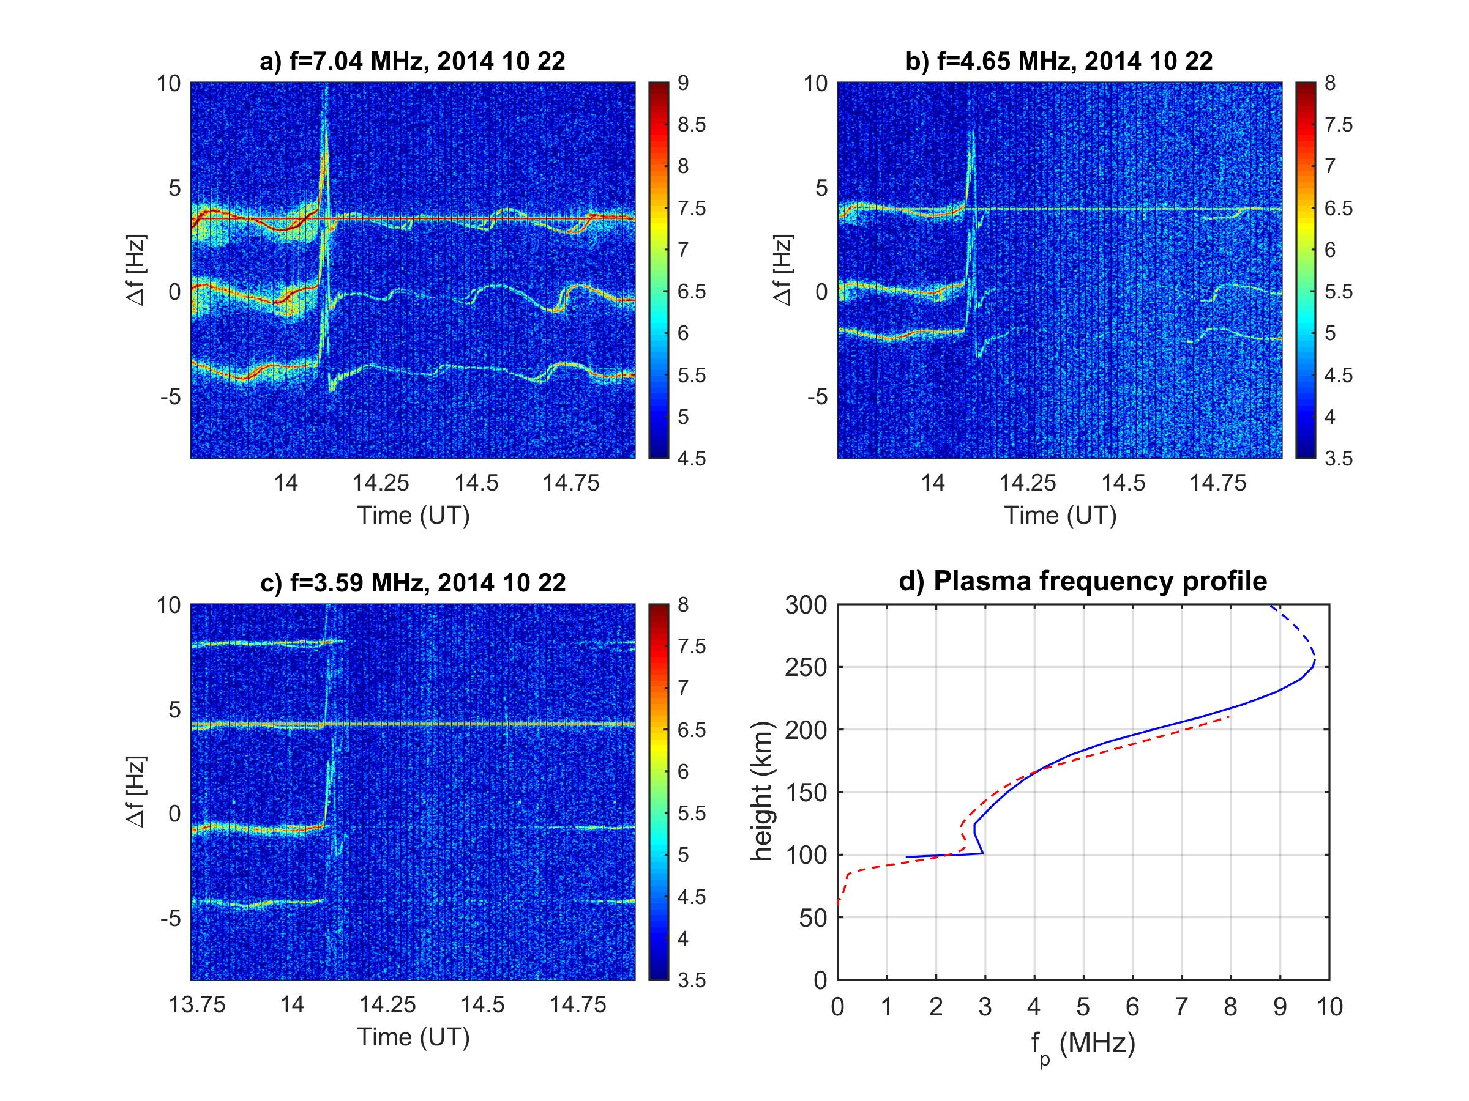
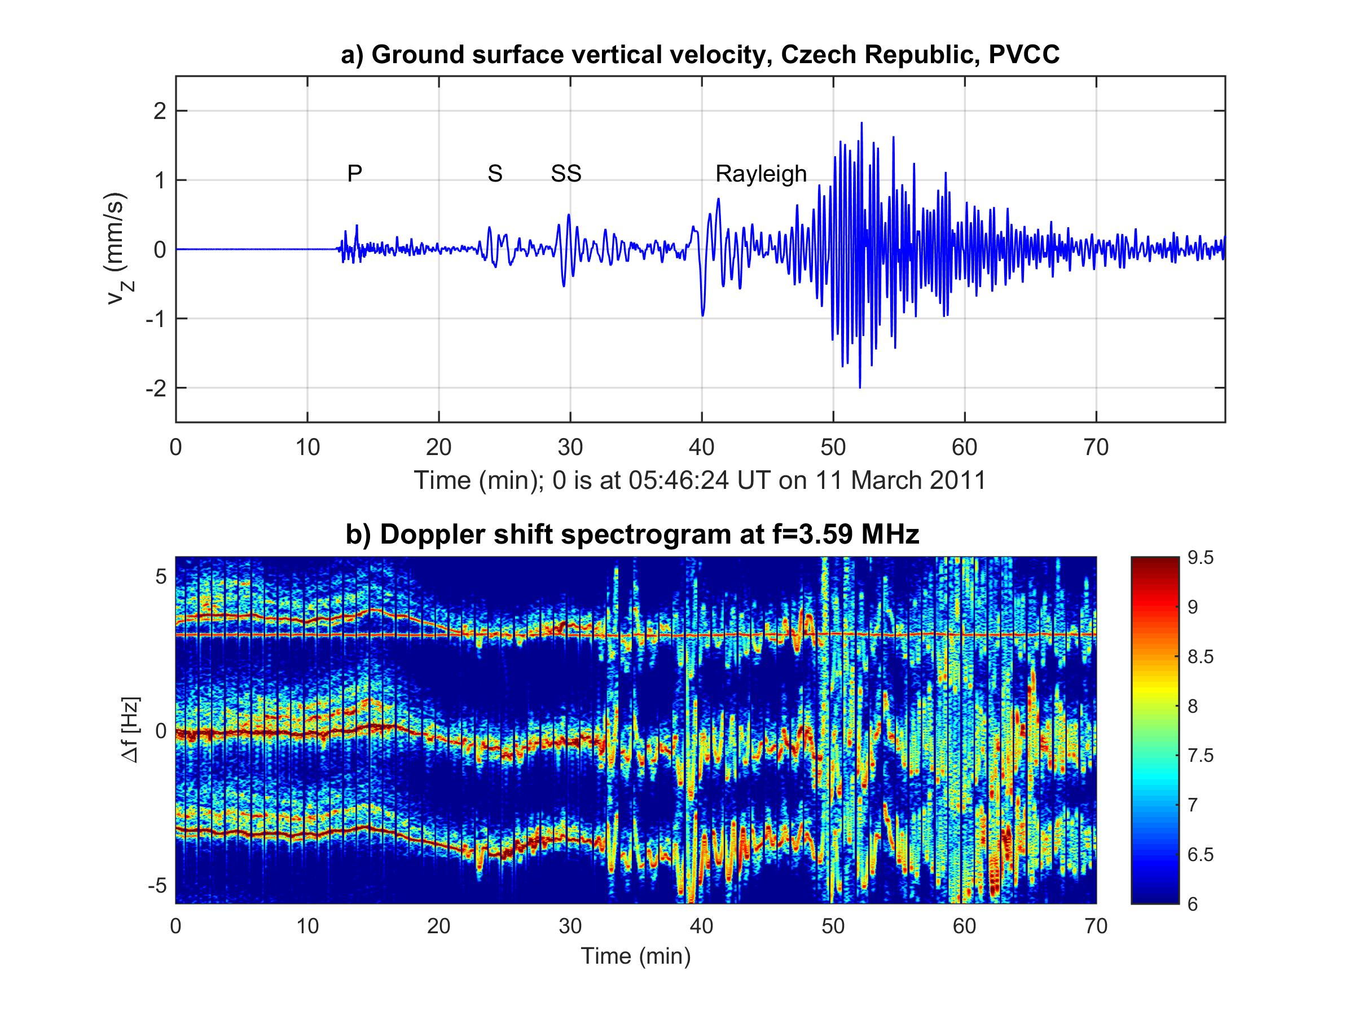
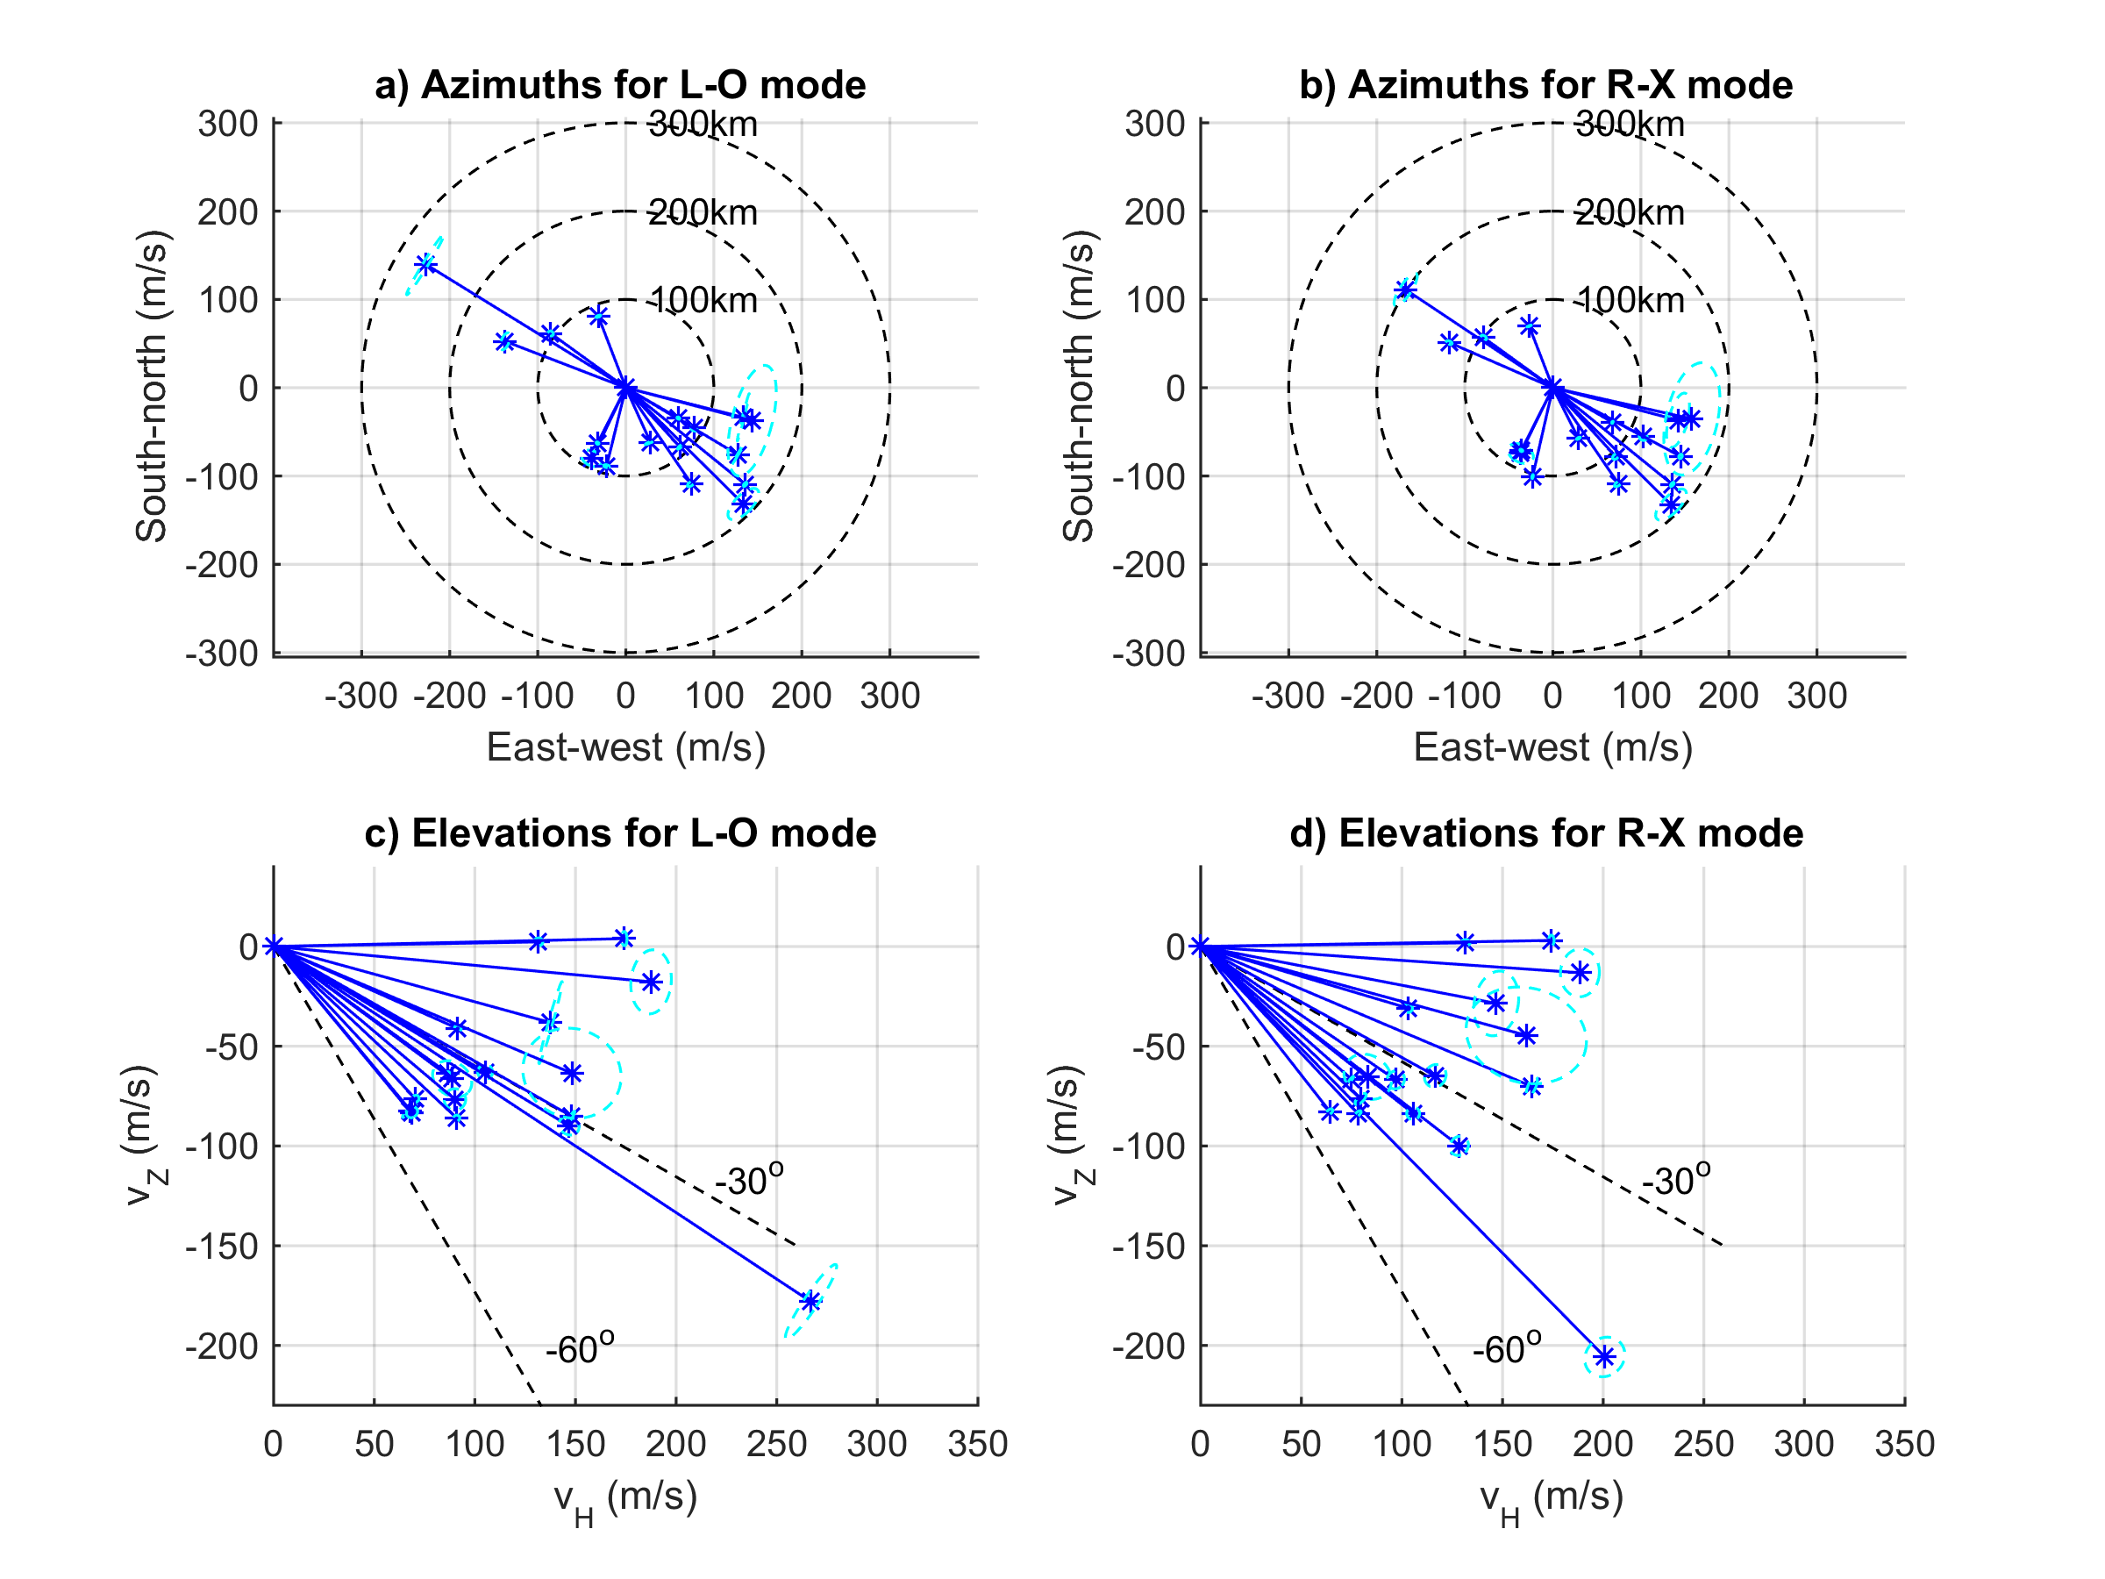
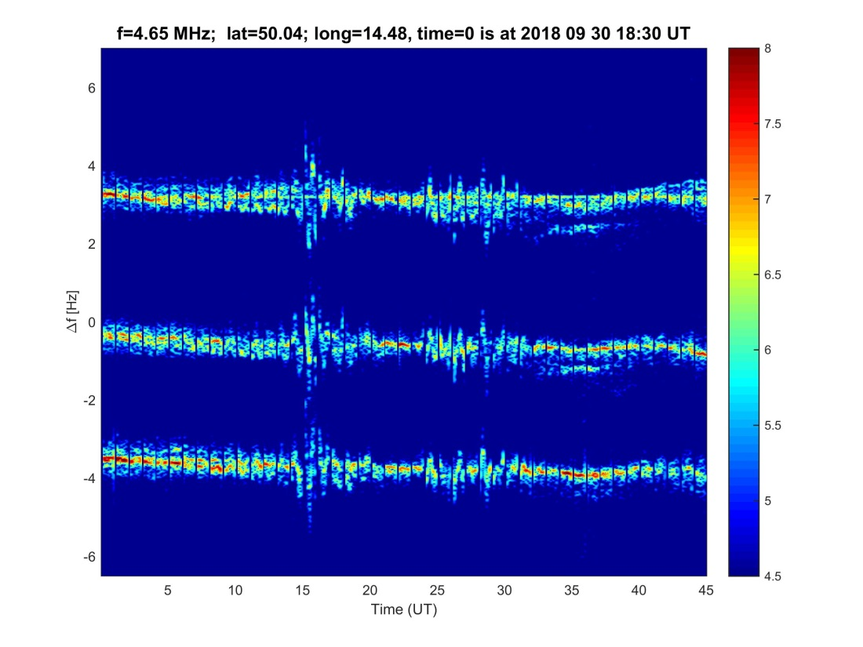
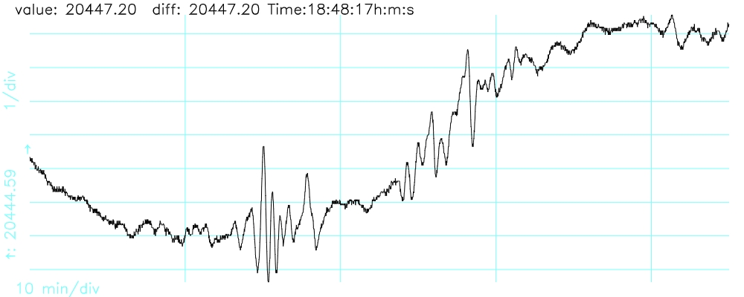
Investigation of ionospheric disturbances
by continuous HF Doppler sounding
Chum, Jaroslav (1), jachu@ufa.cas.cz, Laštovička, Jan (1), Rusz, Jan (1)
(1) Institute of Atmospheric Physics CAS, Bocni II/1401, 14100 Prague 4, Czech Republic
Multipoint and multi frequency continuous Doppler sounding in the Czech Republic
Example of TID (GW) observation
Example of infrasound observation in the ionosphere
Example of ionospheric response to
X-ray solar flares
March 11, 2011 Japan, Mw 9.0 earthquake;
Observation in the Czech Republic,
~9000 km distance from the epicenter
Height of observation: ~210 km
Fig. 1. Doppler shift spectrograms recorded on 8 November 2014 from 14 to 15:30 UT at 7.04 MHz (a), 4.65 MHz (b), and 3.59 MHz (c) and true height profile obtained by digital ionospheric sounder DPS4 at 14:45 UT.
Fig. 4. a-c) Doppler shift spectrograms recorded at f=7.04, 4.65 and 3.59 MHz during X1.6 solar flare on 22 October 2014. d) measured (blue) and IRI-16 (red) profile of plasma frequency at 14:00 UT.
Attenuation of signals in the lower ionosphere (D and E layers) depends on frequency (Chum et al., 2018b).
Results of 3D analysis of GW propagation
Fig. 3 a) Vertical velocity v_{z} of ground surface motion in the Czech Republic and b) observed Doppler shifts on three sounding paths.
Different kinds of seismic waves are separated. Coseismic responses to all the individual wave packets are observed in the ionosphere with ~9 min delays. The signals on the ground and in the ionosphere are well correlated the frequency content is similar (Chum et al., 2012; 2018a); .
Example of ionospheric oscillations induced by geomagnetic pulsations
a)
Summary
Perturbations in the ionosphere on short time scales (~10s to several tens of minutes) can be investigated using continuous multi-point HF Doppler sounder.
3D analysis of medium scale TIDs (gravity waves) showed that typical observed values were:
absolute phase velocity ~100-200 m/s, elevation of phase vector ~-50º-0º, period ~10-40 min, attenuation with height~ 0.05-0.2 dB/km
Infrasound in the ionosphere was detected after significant earthquakes or passages of severe weather systems.
Doppler shifts at different sounding paths (transmitter-receiver pairs) changes simultaneously during geomagnetic pulsations or sudden storm commencements via ExB drifts or during significant X-ray solar flares.
Signals differ at various sounding frequencies during solar flares as they reflect at different altitudes. They also undergo different attenuation in the D layer.
Fig. 2. GW velocities in 3D obtained for selected events observed from July to December 2014. As the Doppler sounder does not distinguish between ordinary L-O and extraordinary R-X modes, both modes are considered separately. a) and b) Horizontal velocities in the azimuthal plane calculated under assumption of the L-O and R-X mode, respectively. c) and d) Horizontal and vertical velocities calculated under assumption of the L-O and R-X mode, respectively (Chum&Podolská, 2018).
b)
References
Chum, J., & Podolská, K. (2018). 3D analysis of GW propagation in the ionosphere. Geophysical Research Letters, 45, 11,562–11,571. https://doi.org/10.1029/2018GL079695
Chum, J., J.-Y. Liu, K. Podolská, T. Šindelářová (2018), Infrasound in the ionosphere from earthquakes and typhoons, J. Atmos. Sol. Terr. Phys., 171, 72-82, doi:/10.1016/j.jastp.2017.07.022
Chum,J., Urbář, J., Laštovička, J., Cabrera, M. A., Liu, J.Y., Bonomi, F., Fagre, M.,Fišer, J. & Mošna, Z. (2018b), Continuous Doppler sounding of the ionosphere during solar flares, Earth, Planets and Space, 2018, 70:198, https://doi.org/10.1186/s40623-018-0976-4
Chum, J., F. Hruska, J. Zednik, and J. Lastovicka (2012), Ionospheric disturbances (infrasound waves) over the Czech Republic excited by the 2011 Tohoku earthquake, J. Geophys. Res., 117, A08319, doi:10.1029/2012JA017767.
Fig. 4. a) Doppler shift spectrograms recorded in the Czech Republic from 18:30 to 19:15 UT showing ionospheric response to geomagnetic pulsations. b) H component of geomagnetic field at the observatory Budkov (Czech Republic) for the same time interval.

