Slide 1
ISEP: A Joint SRAG/CCMC Collaboration to Improve Space Weather Prediction for Crew Protection during Near-Term Lunar Surface and Cis-Lunar Missions
Janet E. Barzilla, Ph.D.¹; Kerry Lee, Ph.D.²; Edward Semones²; A. Steve Johnson, Ph.D.¹; Kathryn Whitman, Ph.D.⁴; Philip Quinn, Ph.D.¹; M. Leila Mays, Ph.D.³; Maria Kuznetsova, Ph.D.³; Joycelyn Jones³; Christopher Mertens⁵
¹Leidos Exploration and Mission Support, Houston, TX; ²NASA Johnson Space Center, Houston, TX; ³NASA Goddard Space Flight Center, Greenbelt, MD; ⁴University of Houston, Houston, TX; ⁵NASA Langley Research Center, Hampton, VA

Slide 2
ISEP Collaboration
Purpose:
To transition space weather models of interest in human spaceflight from research to operational (R2O) use to support forecasting needs for exo-LEO missions

Slide 3
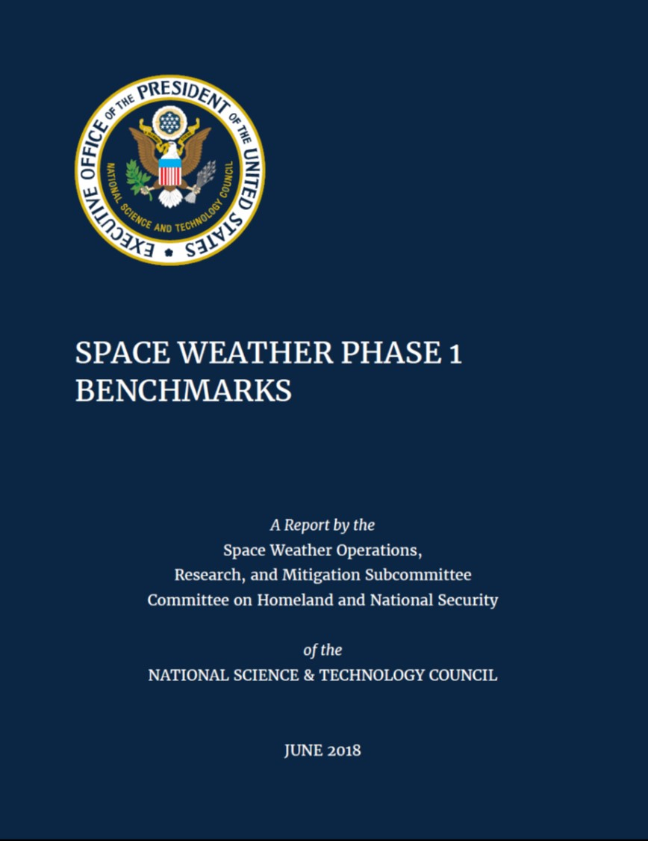
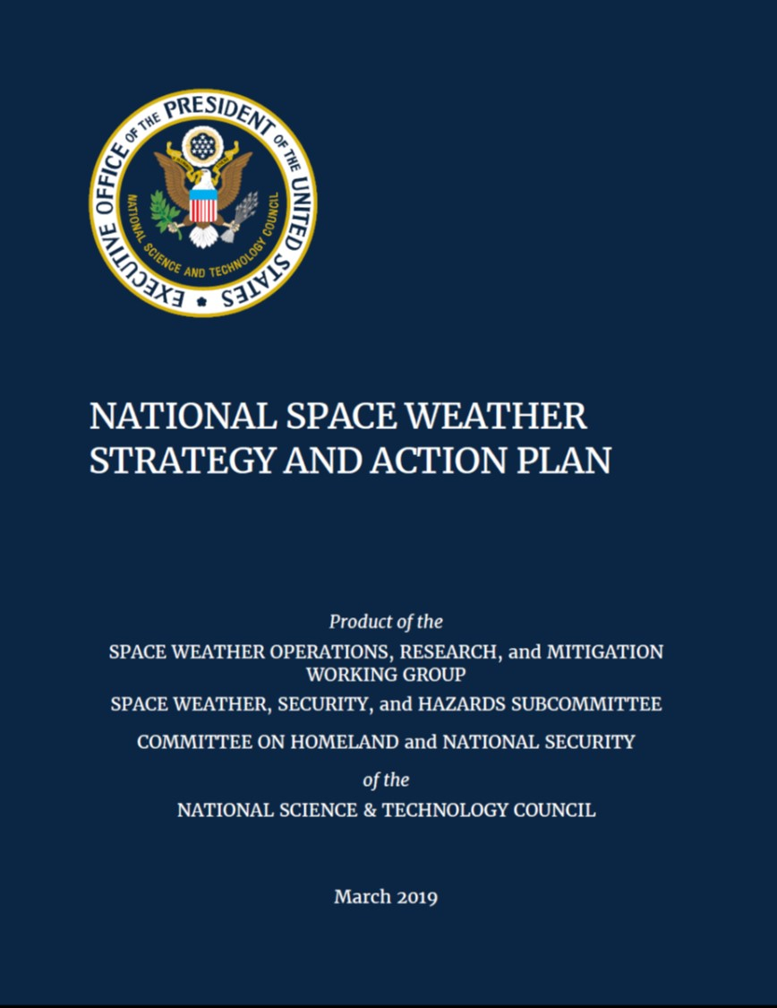
Space Weather Forecasting for Long-Duration Missions Beyond LEO – Programmatic Level
National Space Weather Action Plan (SWAP) and National Space Weather Strategy (2015)
National Science and Technology Council products
Details six goals to prepare for space weather effects on multiple systems; includes associated deliverables and timeline
Phase 1 Benchmarks released in June 2018
Updated Space Weather Strategy and Action Plan in March 2019
Continued Support for Space Weather Strategy in Legislature
H.R.3086 (2017)
S.141 (2017)
S.881 (2019)

Slide 4
Congressional Activity: Bipartisan Effort
115th Congress (2017-18)
116th Congress (2019-20)
H.R. 3086 introduced (2017)
Originally co-sponsored by Rep. Ed Perlmutter (D-CO) and then-Rep. Jim Bridenstine (R-OK)
S. 141 introduced/passed by Senate (2017)
‘Space Weather Coordination Act’
Directs Office of Science and Technology Policy (OSTP) to coordinate effort “to improve the nation’s ability to prepare, avoid, mitigate, respond to, and recover from potentially devastating impacts of space weather events.”
S. 141 approved by the House (July 24)
Added focus to private sector efforts
Created National Committee for Space Weather Observation and Forecasting
S. 881 introduced (March 26)
‘Space Weather Research and Forecasting Act’
Intent similar to that of bills from 115th Congress
April 03 – Reported without amendment favorably

Slide 5
Space Weather Science and Applications (SWxSA)
Managed by NASA Heliophysics Division
Advancement of understanding of space weather to enable improvement to prediction capabilities
Supports objectives outlined in National Space Weather Strategy and Action Plan (2019)
Utilize multi-agency collaborations
National Science Foundation (NSF)
National Oceanic and Atmospheric Administration (NOAA)
Department of Defense (DoD)

Slide 6
ISEP Collaboration
Space Weather Forecasting Needs for Human Spaceflight
Human Spaceflight Applications with the ISEP Project
Collaborations in Support of the ISEP Project

Slide 7
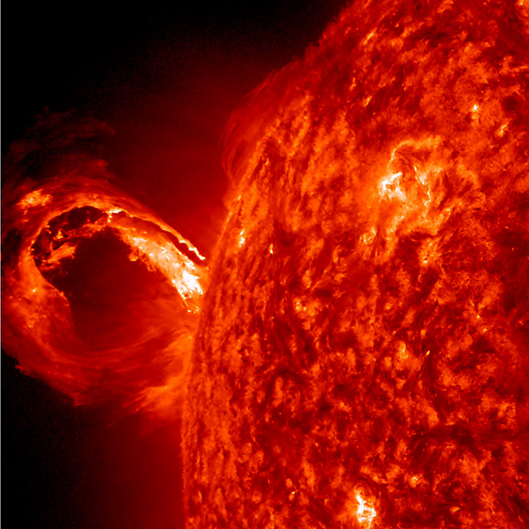
Space Weather Concerns for Human Spaceflight – A Quick Summary for ISS Operations
X-Ray Flare
No Impact
Can be associated with SPE/ESPE
Geomagnetic Storm
Impact only if there is an increase in solar energetic particles (SEP)
Can ‘compress’ Earth’s geomagnetic field/ protection
Solar Particle Event (SPE)
Definition: >10MeV proton flux >10pfu (GOES)
Minimal impact unless crew is EVA
Low energy particles do not penetrate vehicle
Energetic Solar Particle Event (ESPE)
Definition: >100MeV proton flux >1pfu (GOES)
Concern – SRAG monitors closely and makes recommendations to Flight Control Team (FCT)
Crew may be asked to avoid lower-shielded areas or shelter in highly-shielded areas of vehicle
Image of Coronal Mass Ejection (CME) taken by NASA’s Solar Dynamics Observatory (SDO) on May 1, 2013.
From: https://sdo.gsfc.nasa.gov

Slide 8
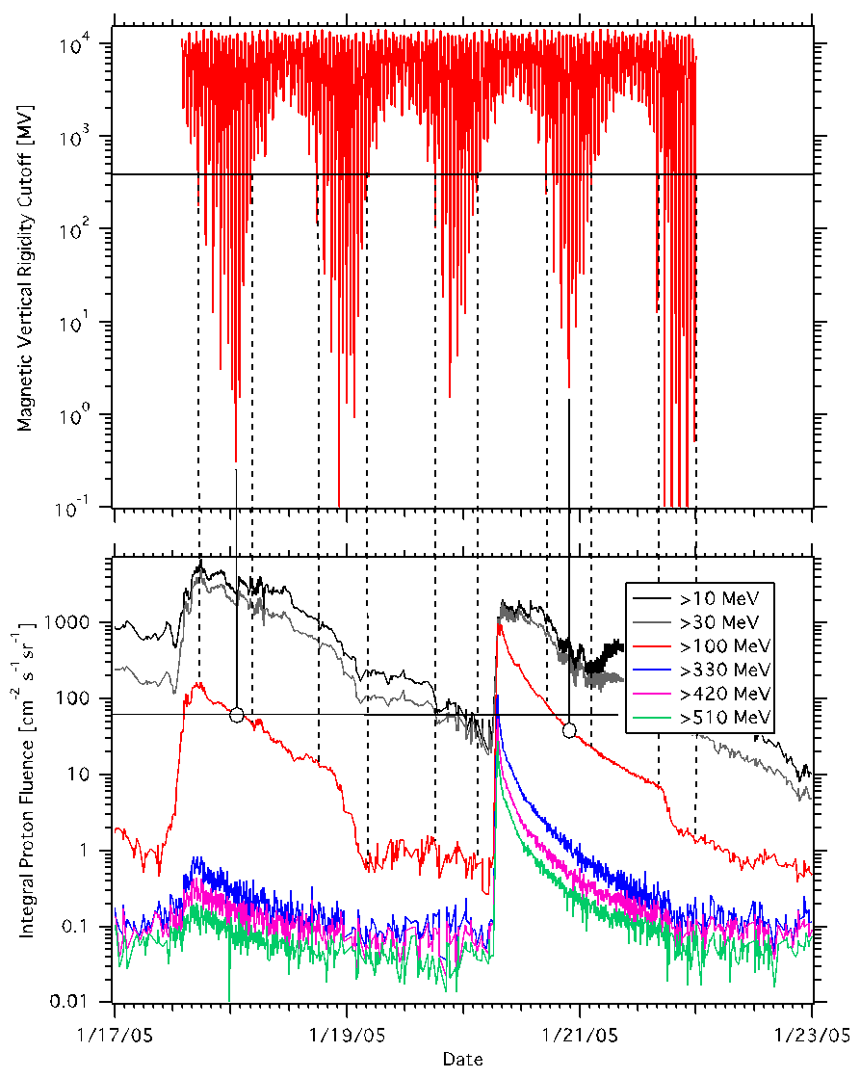
Role of LEO Mission Proximity to Earth
Low-Earth Orbit (LEO) missions, including ISS, take advantage of Earth’s geomagnetic field for protection during majority of impact due to large SPEs/ESPEs.
If shelter is recommended, crew is notified when vehicle enters and leaves ‘areas of high-risk orbital alignment’ (10-15min/orbit)
No impact to crew when vehicle is outside these areas
All recommendations worked through FCT, considering other high-priority mission activities

Slide 9
SRAG – Current Roles and Responsibilities
SRAG provides 24/7 mission support for ISS
Focus on ALARA – As Low As Reasonably Achievable
“Big Three” questions the Console Operator always fields:
Will there be an event (SEP)?
How ‘intense’ will it be?
How long will it last?
The console operator’s ability to answer the “Big Three” questions is limited by current technology
Daily briefings provided by NOAA/SWPC to gain situational awareness
When large X-ray flare or SPE observed, SRAG is alerted by SWPC as well as own internal systems
Space weather models are available to assess possible impacts; this approach is best described as ‘now-casting’

Slide 10
Mission Support for Exo-LEO Missions
SRAG will continue 24/7 mission support for ISS, but there are complications:
Free space mission → Crew cannot use protection from Earth’s geomagnetic field
Vehicle design process incorporates advances in particle transport modeling and shielding technologies
Improvements to space weather forecasting capability (modeling) needed to give FCT information to act upon when making crew recommendations
Crew cannot shelter continuously for days; they need to know when they can exit shelter
Reduced communications capability → FCT requires longer lead time to determine recommendations for crew action
A 12-24 hour lead time would give the FCT more ability to act prior to communication blackout periods
An ideal alert/warning system will
Maximize true event predictions and
Minimize false positive / true negative event predictions

Slide 11
ISEP Collaboration
Space Weather Forecasting Needs for Human Spaceflight
Human Spaceflight Applications with the ISEP Project
Collaborations in Support of the ISEP Project

Slide 12
Operational Schema for Exo-LEO Missions
Exploration Concept of Operations: Guideline Development
Real-Time Spacecraft Instrument Data
Real-Time Satellite Data / NOAA Report
Flight Rule Development
SRAG Real-Time Acute Dose Projections
Flight Rule Reference Real-Time
ISEP Environment Predictions
Contingency Actions

Slide 13
‘Big Three’ – Model Focus
Will there be an event (SEP)?
Probability Scoreboard
How ‘intense’ will it be?
Proton Peak Flux Scoreboard
How long will it last?
Flux Time Series Scoreboard

Slide 14
Research Model Investments to Operational Tools
Focus on two paths
Statistical-based models:
Models will be integrated to run as an ensemble output for peak SEP fluence.
Physics-based models:
Higher complexity over statistical models
Less mature
Build on past agency investment in forecasting temporal evolution.
Leverage current capabilities
ISEP infrastructure funded under NASA Space Technology Mission Directorate (STMD) FY12-FY14
GSFC/CCMC and JSC/SRAG expertise and functionality to develop ensemble techniques and operational architectures

Slide 15
ISEP Collaboration
Space Weather Forecasting Needs for Human Spaceflight
Human Spaceflight Applications with the ISEP Project
Collaborations in Support of the ISEP Project

Slide 16
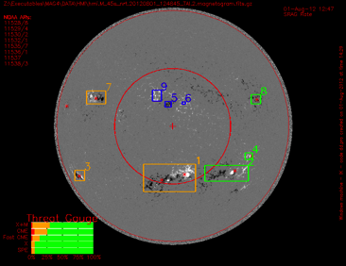
Magnetogram Forecast (MAG4) Probability Scoreboard
Developer | University of Alabama Huntsville (PI: D. Falconer)
Summary | Probabilistic forecasting tool that uses SOHO/MDI and SDO/HMI magnetogram data to project likelihood of solar flares, CMEs and SPEs
FY19 Work | Derive and implement forecast curves for X+M-flares, X-flares and SPEs using historic HMI data Study and report on forecast curves for CMEs/fCMEs using historic HMI data Improve model robustness Deliver code to SRAG/CCMC
FY20 Work | Continue to provide expertise for improving model robustness
Of Note | Also used for All-Clear projection
Active Region (AR)
30º cone
Western limb
Line-of-Sight Magnetogram
MAG4 image
BACK

Slide 17
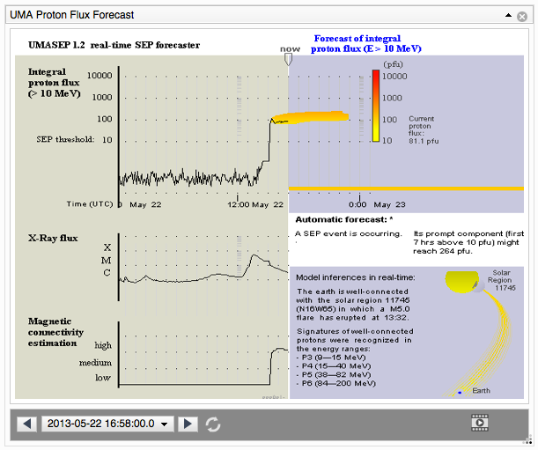
University of MAlaga Solar Energetic Particles (UMASEP) Proton Peak Flux Scoreboard
Developer | University of Malaga (PI: M. Nunez)
Summary | Using GOES SXR and differential proton flux data, assesses connectivity and provides projection of event onset and intensity. Versions exist for >10MeV (-10), >100MeV (-100) and GLEs (-500)
FY19 Work | Update output displays for operational use Update model output format per CCMC request Deliver code to SRAG/CCMC and help CCMC implement
FY20 Work | Continue working with CCMC on implementation UMASEP-30/UMASEP-50 development Event comparison tool
Of Note | Also used for All-Clear projection UMASEP-500 part of HESPERIA collaboration (HORIZON 2020 program)
(current UMASEP model running in real-time at CCMC)
BACK

Slide 18
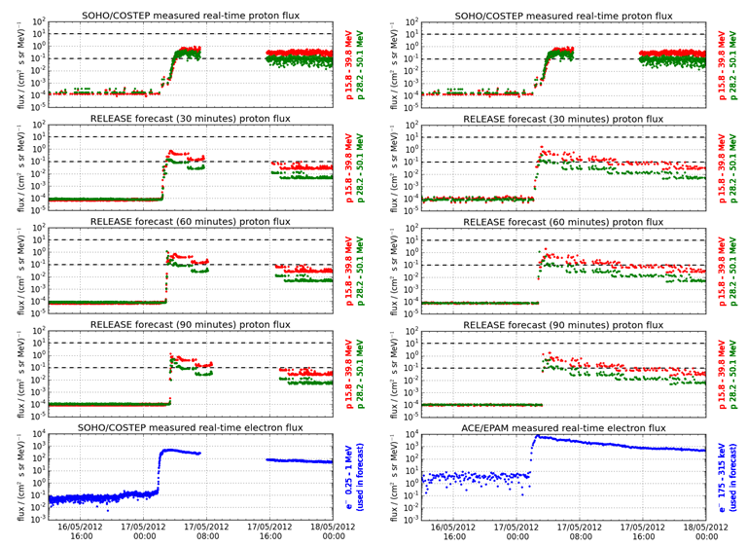
Relativistic Electron Alert System for Exploration (REleASE) Proton Peak Flux Scoreboard
Developer | University of Kiel / National Observatory of Athens (PI: O. Malandraki)
Summary | Using electron measurements from SOHO/COSTEP/EPHIN and ACE/EPAM, forecast proton flux at 15.8-39.8MeV and 28.2-50.1 energy bands
FY19 Work | Update output displays for operations Update model output format per CCMC request
FY20 Work | Deliver code to SRAG/CCMC and help CCMC implement
Of Note | Original version developed by A. Posner and used COSTEP data Model hosted at CCMC (iSWA) Can be used in All-Clear forecast product Current version (HESPERIA) developed in collaboration with HORIZON 2020 program
Example of real-time forecast from HESPERIA REleASE model. Output graph provided by HESPERIA REleASE collaboration to SRAG in September 2019 report.
BACK

Slide 19
SEP Predictions inspired by STEReo (SEPSTER) Proton Peak Flux Scoreboard
Developer | NASA GSFC / University of Maryland College Park (PI: I. Richardson)
Summary | Using observed CME speed and connection angle (based on solar wind speed and CME longitude), forecasts peak proton flux at 14-24MeV and time to reach peak
FY19 Work | Derive method to predict peak proton intensities at different energy ranges (>10MeV, >30MeV, >50MeV, >100MeV) Create and deliver the SEPSTER code to be hosted at CCMC
FY20 Work | Host model on operational server Continued work on expansion of model to different energy ranges possible Continued validation possible
Of Note | Simple empirical model Robust and reliable Fully automated, running hourly at CCMC
Richardson et al, Space Weather (2018)
BACK

Slide 20
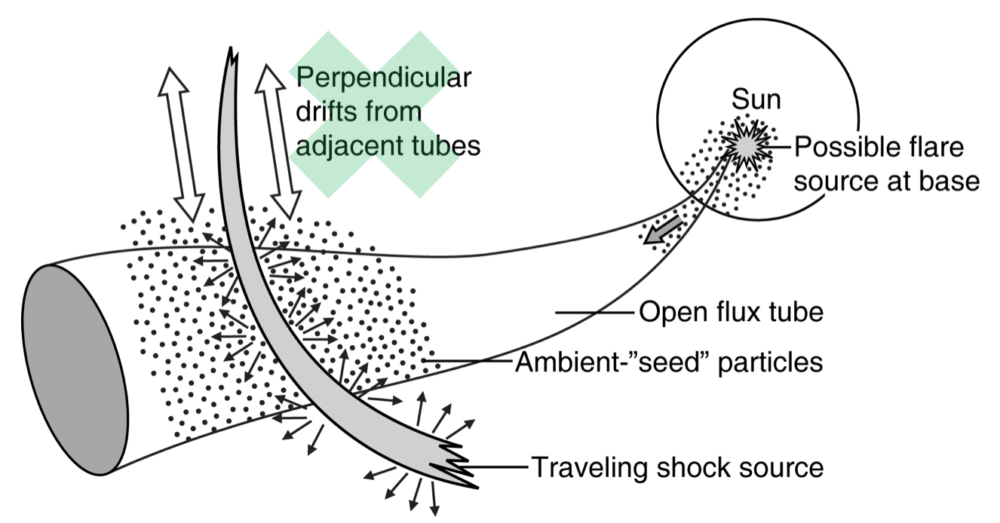
ENLIL + SEP MODel (SEPMOD) Flux Time Series Scoreboard
Developer | University of California Berkeley (PI: J. Luhmann)
Summary | Coupled to ENLIL (CME/solar wind MHD model), SEPMOD accelerates particles from shock to observer along solar wind magnetic field lines. Model originally predicted 1-100MeV proton flux time profile (user-specified ranges).
FY19 Work | Extended output energy range to 500MeV (>100MeV and >300MeV provided) Explore coupling of SEPMOD to WSA model (coronal reflection)
FY20 Work | Validation work planned with ISEP and CU Boulder CIRES/NOAA SWPC Complete WSA model incorporation Test use of a cluster of several field line start points around observer Test inclusion of SEPMOD ‘flare’ source option
Of Note | Can predict SPE time profile over broad energy range
(Presented at GSFC Space Weather Workshop, 2017)
BACK

Slide 21
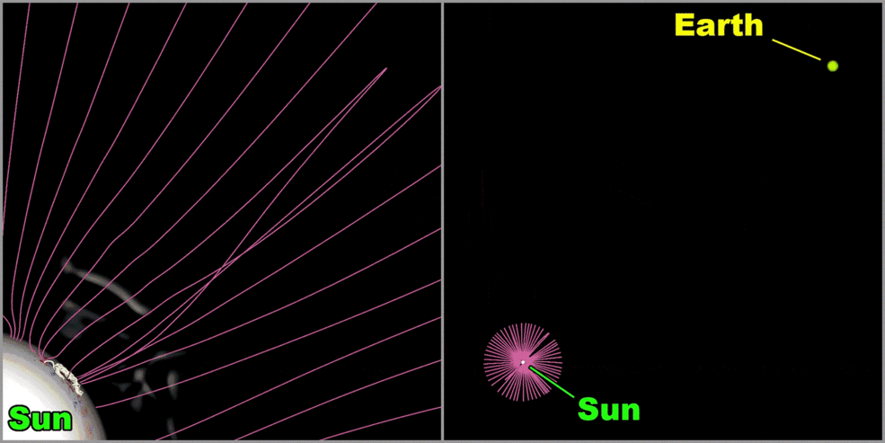
SPE Threat Assessment Tool (STAT) Flux Time Series Scoreboard
Developer | Predictive Sciences, Inc / University of New Hampshire (PI: J. Linker)
Summary | STAT couples CORHEL/MAS (CME formation and eruption) and EPREM (particle transport in heliosphere) to provide >10MeV, >50MeV and >100MeV proton flux time profile.
FY19 Work | Improved model design Simulation of 3 historical CMEs for inclusion in output database
FY20 Work | Incorporation of STAT into Scoreboard interface Operational use of STAT database
Of Note | STAT currently simulates historic events only
Model of CME observed 14 Jul 2000
www.nasa.gov; Charting a Course for Astronaut Safety as NASA launches to the Moon and to Mars; 30 Nov 2018
BACK

Slide 22
New Directions: Machine/Deep Learning
June 2019: Working meeting – Applying Machine Learning / Artificial Intelligence Technology to forecasting of Solar Proton Events
September 2019: Began collaboration with Georgia State University for initial steps in application of ML technology to SPE forecasts
November 2019: Pursuing collaboration with Southwest Research Institute for development of reliable particle seed spectrum for use by SEP modelers
More to come…

Slide 23
ISEP Support for Exo-LEO Missions
SRAG current forecasting capabilities for ISS support lags capabilities required for exo-LEO missions
ISEP will fill the gaps, giving SRAG tools needed to better assess impacts of changes to the space environment
With a better idea of (1) If an SPE will occur, (2) How big will the event be and (3) How long will it last, SRAG can better recommend crew action to support both ALARA and mission-critical task completion

Slide 24
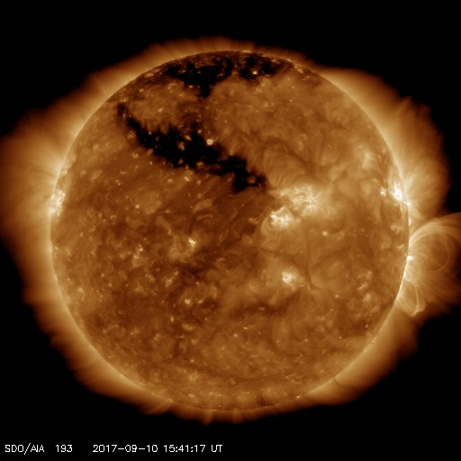
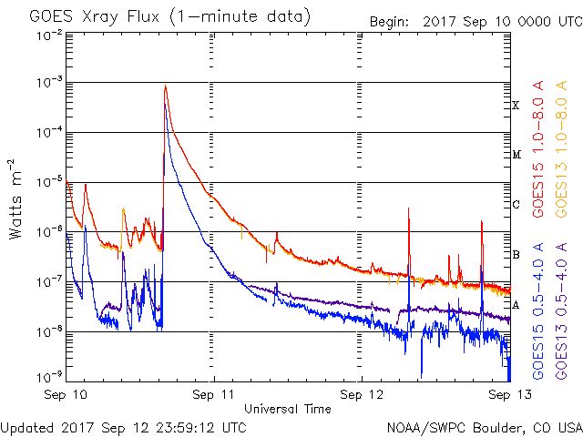
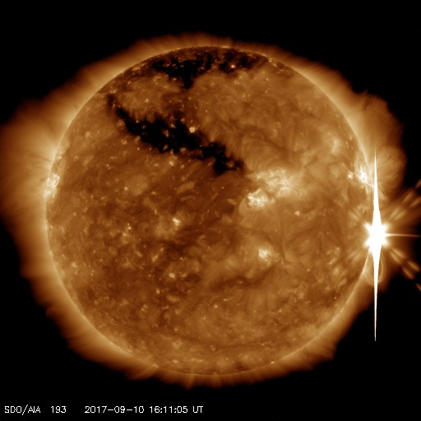
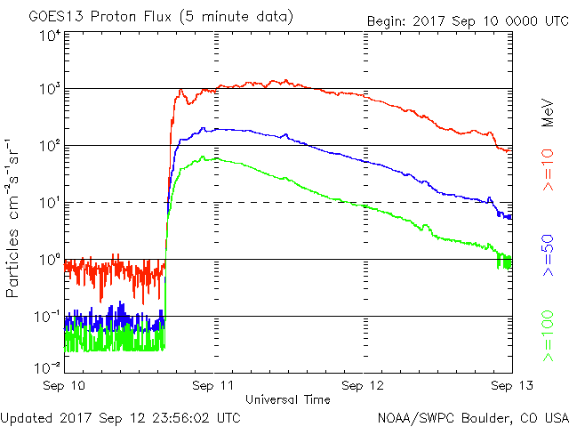
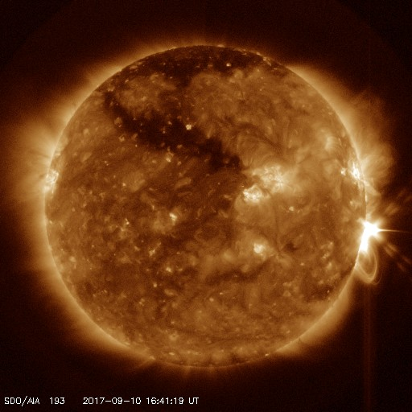
Questions?
Sept 10, 2017 Event
15:53 GMT
X-ray flux > M5
16:06 GMT
X-ray peak @ X8.2
16:25 GMT
100MeV protons > 100pfu
16:45 GMT
10MeV protons > 10pfu
Imagery: sdo.gsfc.noaa.gov
GOES data charts: swpc.noaa.gov

