Slide 1
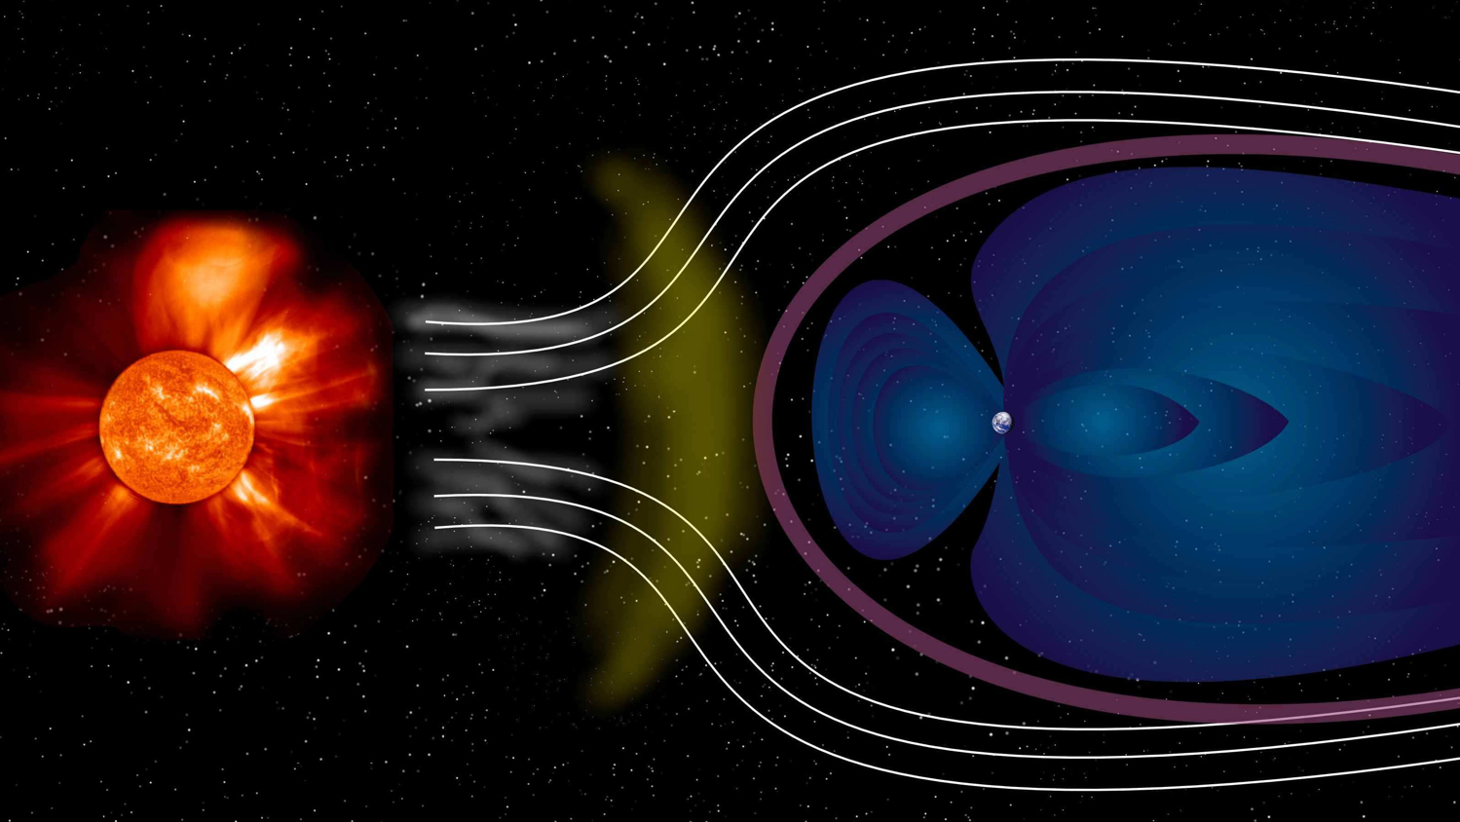
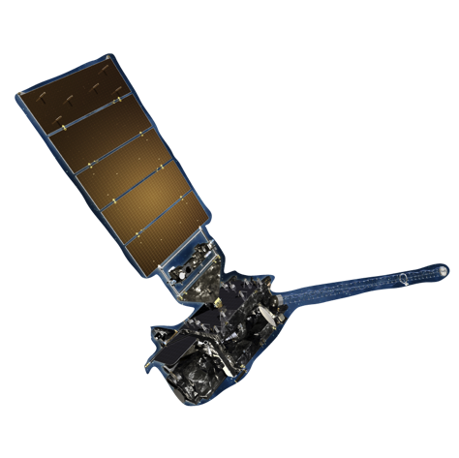
Applications and Models for Satellite Anomaly Analysis Janet Green (Space Hazards Applications, LLC) R. Quinn, Y. Shprits, J. Likar, A. Kellerman, P. O’Brien, S. ClaudePierre, A. Boyd, S.Huston, P. Whelan. N. Reker
Background image:: ESA

Slide 2
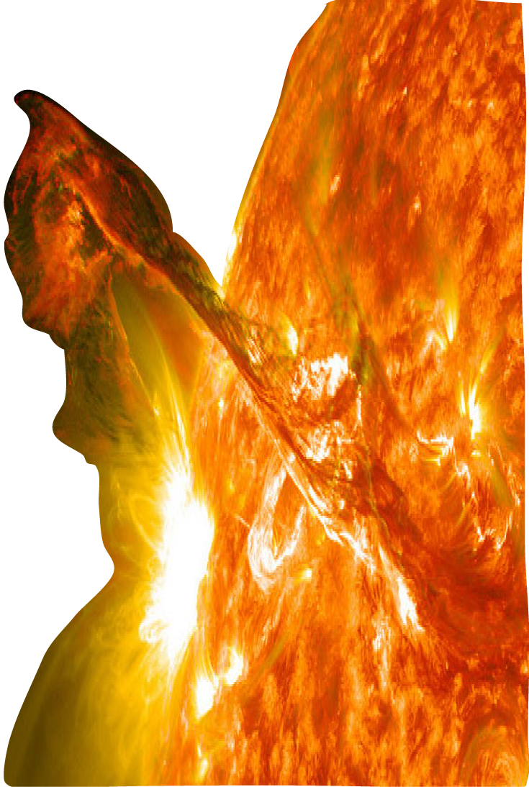
The Issue
On-orbit anomaly
Surface charging
Internal Charging
Single Event Effects
Total Dose Effects
Increased
particle
radiation
Service outage
Mission Loss
Space
weather
Background image:: ESA
Anomaly Attribution
Guides response
Predicts future occurrences
Leads to improved design
Image Credit NASA/SDO

Slide 3
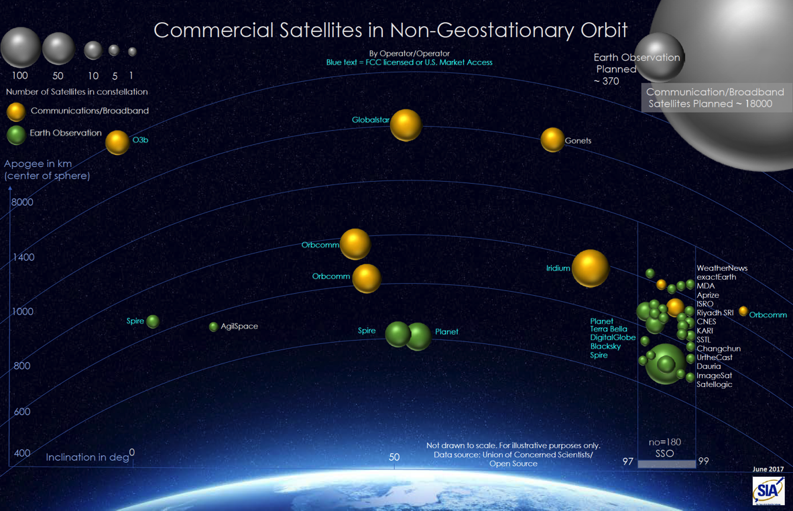
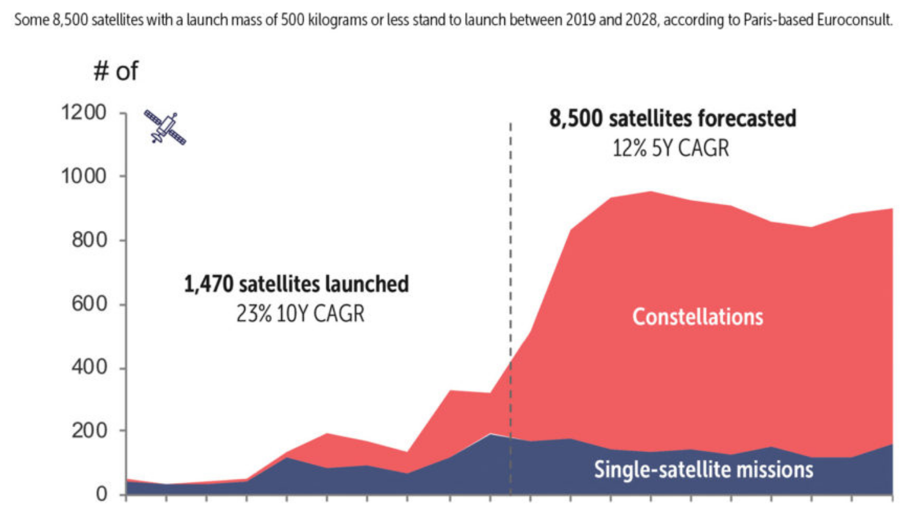
The Concern
Growing industry and increasing reliance on constellations
New services rely on large constellations:
Satellite internet, Satellite Imaging
SIA 2017
Space News 2019

Slide 4
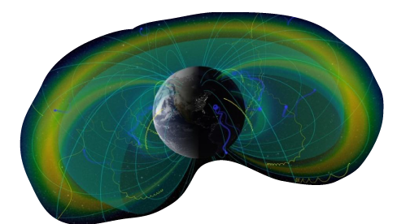
Ideal Attribution Tool
Intensification of particle radiation due to space weather leads to anomalies.
The ideal tool would have:
1) Global RT data or environment model to give particle flux along any satellite orbit.
2) Method to translate flux to effect, i.e. hazard quotient, SEE upset rate etc.
3) All brought together in an easy to use and access interface with real time/ retrospective info
Environment (model or data)
Engineering effect
User Interface
Calculate anomalies
Image Credit NASA
Gorini 2012

Slide 5
The Challenge
Environment (model or data)
Engineering effect
User Interface
Surface Charging:
Low to medium energy particles associated with substorms during moderate Kp activity in the dusk magnetospheric regions.
Internal Charging:
Higher energy electrons associated with some storms that peaks around L=4
Single Event Upsets:
Solar Proton Events associated with solar flares and coronal mass ejections
Total Ionizing Dose:
All of the above.
Accurate RT global models do not exist for all particle populations, effects tools are not always coupled to environments, no common user interfaces.

Slide 6
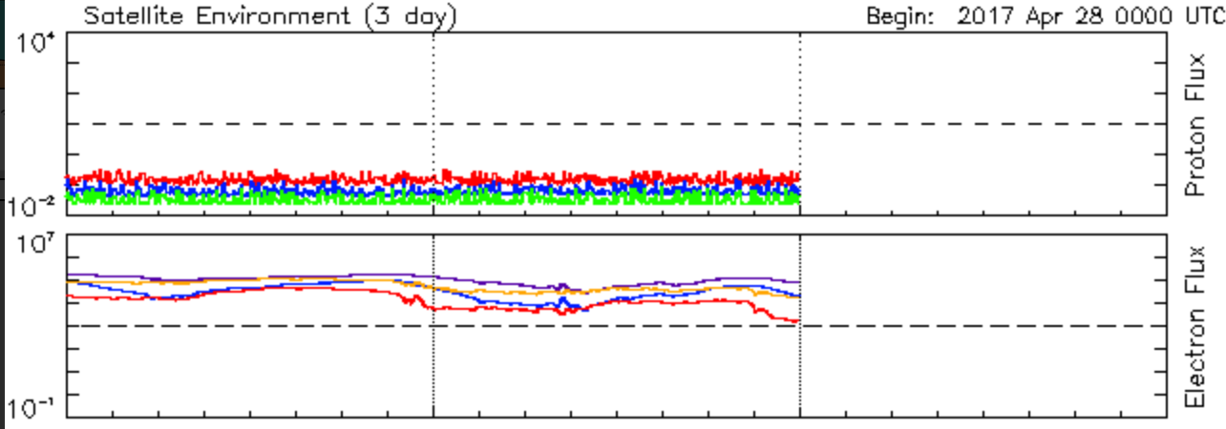
Current Attribution
Anomaly Investigation/Monitoring
Some anomalies go undiagnosed because attribution is a research project requiring significant time and expert knowledge
Limited data difficult to compare to full mission
Fluxes need to be translated into the four specific hazards
Fluxes at GEO do not describe full magnetosphere
“Knowing what we know now this process should be automated.”

Slide 7
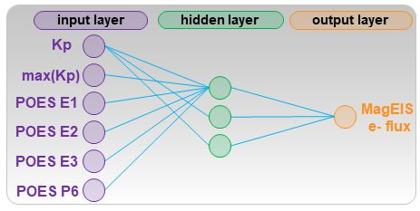
SHELLS
Specifying High-altitude Electrons Using Low-altitude LEO Systems (SHELLS)
The project will deliver a data driven global specification of Earth’s high energy electron environment that includes retrospective, real time, and forecast outputs using machine learning techniques.
Image Credit NOAA/NASA
Image Credit NASA

Slide 8
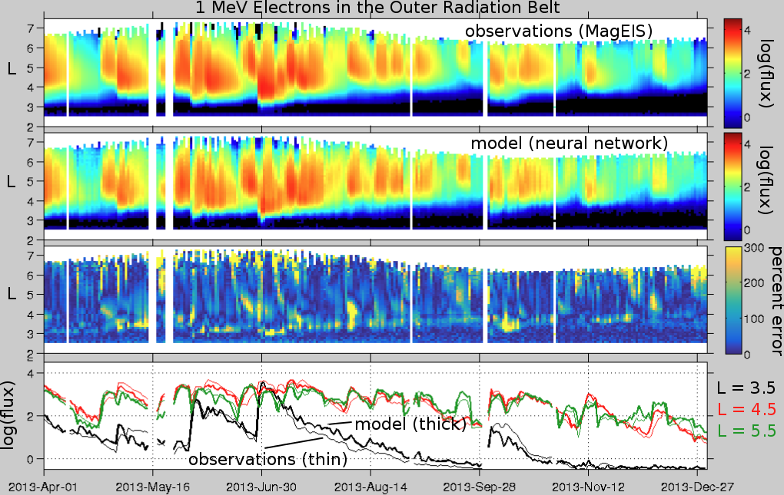
SHELLS
Specifying High-altitude Electrons Using Low-altitude LEO Systems (SHELLS)
Uses a neural network to learn the mapping from low altitude POES electron flux to near equatorial Van Allen Probes fluxes
With the learned mapping, electron flux can be specified from L=2-6 at equatorial/off equatorial regions using Kp and POES
Will produce a long-term (solar cycle) history of the environment and real-time nowcast/forecast
Could be used for data assimilation input to physics models
NN mapping

Slide 9
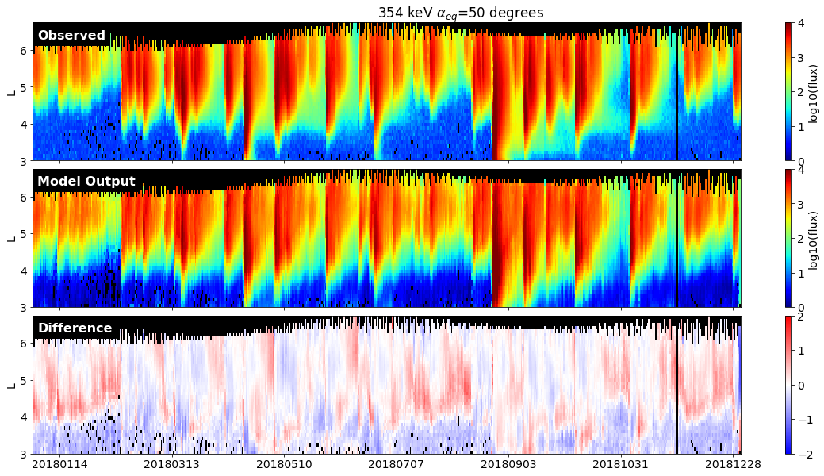
SHELLS
Specifying High-altitude Electrons Using Low-altitude LEO Systems (SHELLS)

Slide 10
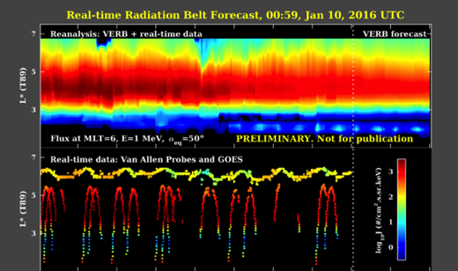
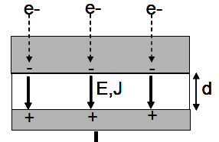
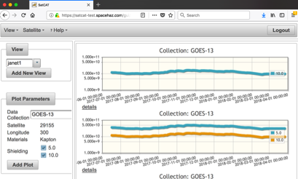
About SatCAT
Allows users to respond quickly and confidently with the right action
The Satellite Charging Assessment Tool
Is an online interactive web application that allows users to generate, display, and analyze an accumulated charge history for a user chosen satellite, shielding, and materials
Provides recent mission history and updates in real time
Environment (model or data)
Engineering effect
User Interface
VERB
Bodeau, 2010
Spacehaz.com/satcat2.html

Slide 11
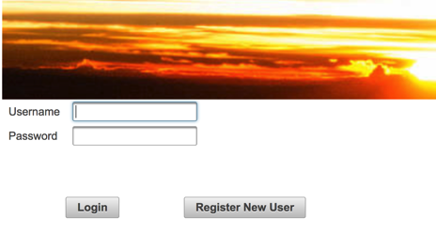
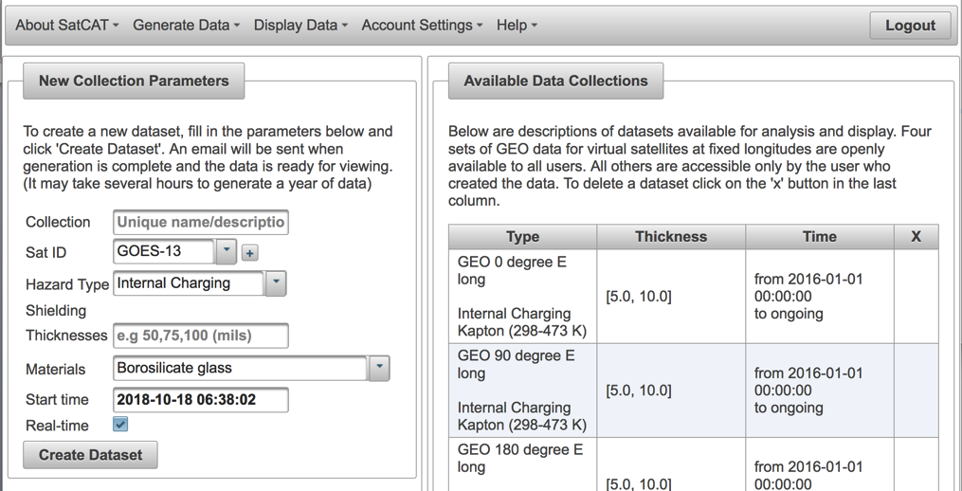
SatCAT
Anomaly Investigation
Secure user login
Choose satellite from Spacetrak catalogue, shielding thickness, material
Generate a dataset that is stored in a database and updated in real time

Slide 12
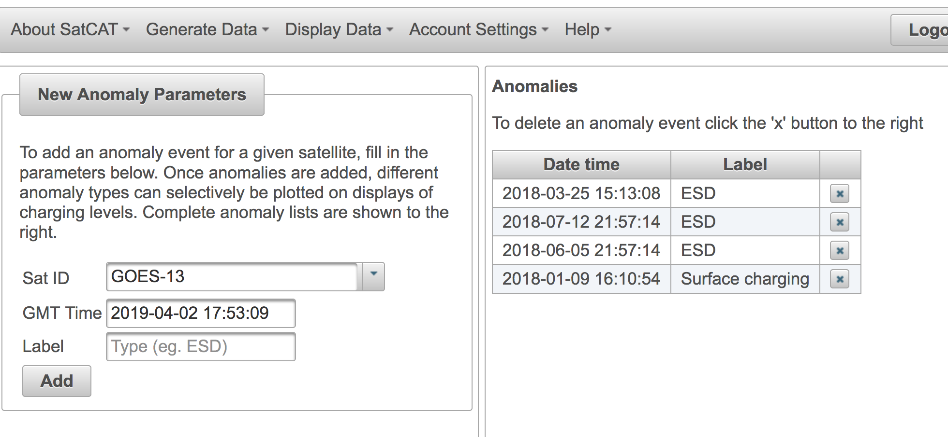
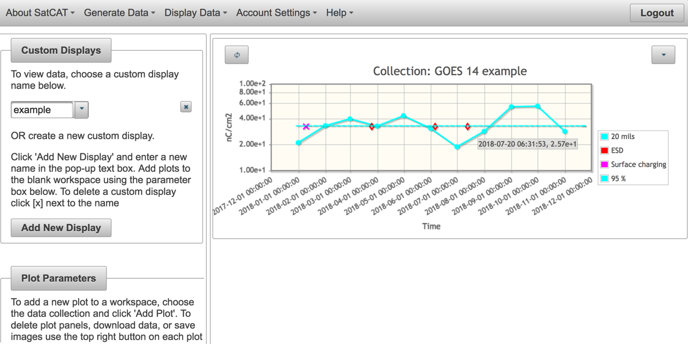
SatCAT
Anomaly Investigation
Add anomaly points to plots
Plot and download data and images

Slide 13
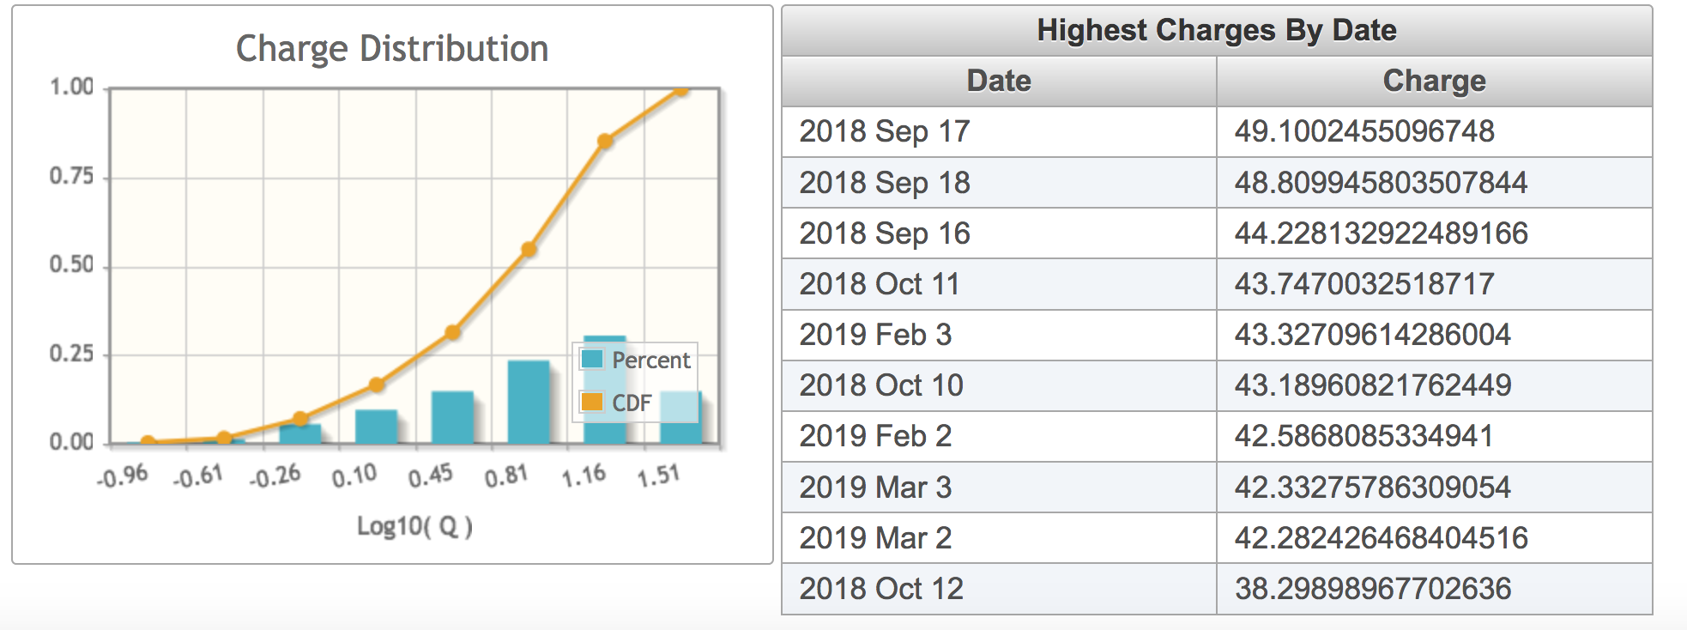
SatCAT
Anomaly Investigation
Statistical plots

Slide 14
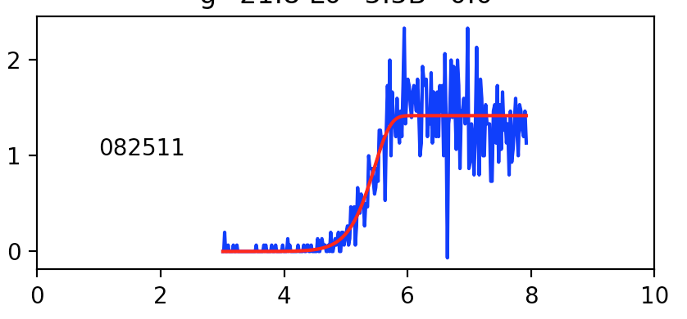
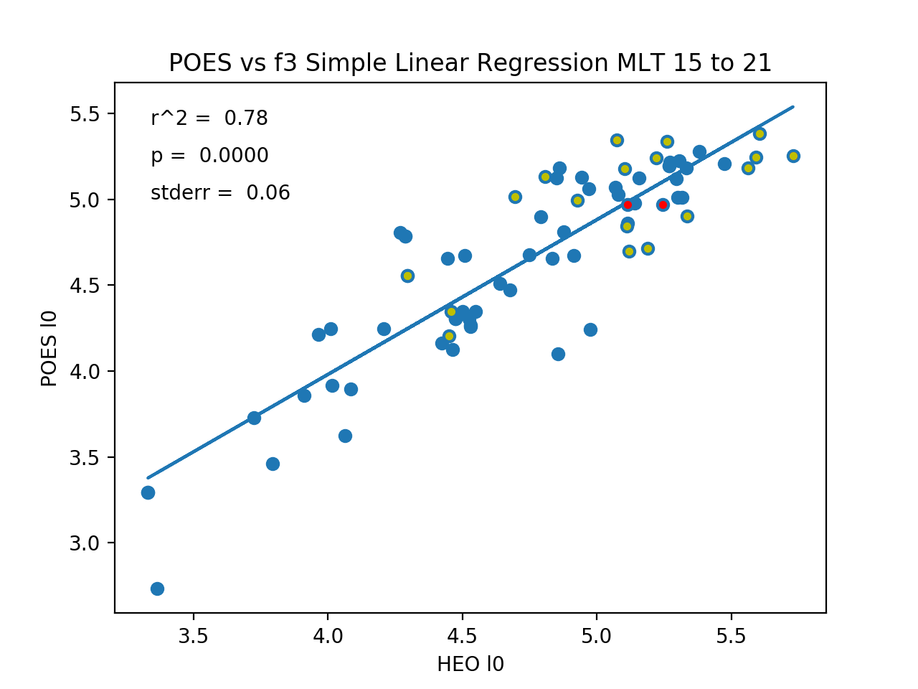
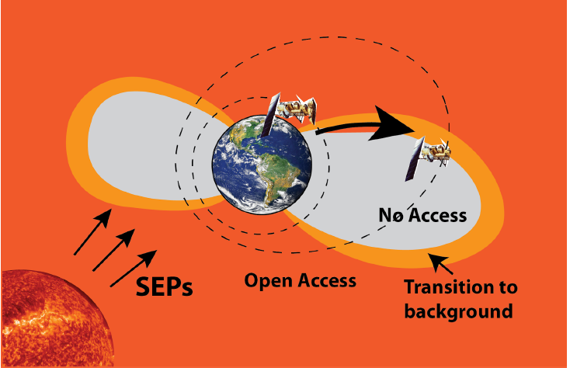
SPAM
Intended for Attribution of SEU’s caused by Solar Energetic Particles
Fit low (POES) and high altitude (HEO) proton fluxes to Weibull functions
Regress POES/HEO parameters in 4 MLT quadrants to create a mapping function from high to low altitudes
Once the mapping function is established SEP fluxes can be mapped throughout the magnetosphere with just POES
POES real time mapping captures more of the dynamic proton access than statistical models.
Weibull Fit

Slide 15
Summary
Changes in the satellite industry (use of large constellations) may make anomaly analysis more critical.
Tools are needed that bring together data/models with physics/engineering understanding to simplify anomaly attribution and make the process accessible and feasible for end users.
Additional models and interfaces are needed for comprehensive attribution that addresses 4 types of hazards.
Internal charging:
SHELLS neural network radiation environment
SatCAT
SEE:
SPAM (Solar Particle Access Model)

