Slide 1
Goals and Mission Status
W. Dean Pesnell
NASA, Goddard Space Flight Center

Slide 2
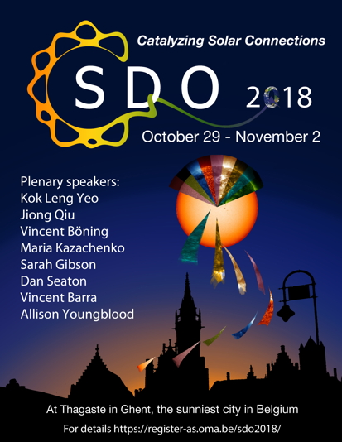
Welcome to the SDO 2018 Science Workshop!
#SDO2018

Slide 3
Goals
Celebration of SDO science results
Cross-pollination of methods and ideas
Concepts for next senior review proposal

Slide 4
Logistics
Sessions resemble the Prioritized Research Goals of SDO’s 2017 Senior Review Proposal
Provides the SDO team with input for how those goals were met
Invited plenary speakers set the stage, contributed papers flesh out the results
Poster sessions include ePosters
Please sign up for mini-workshops

Slide 5
Code of Conduct
Participants are expected to adhere to the following guidelines at all times:
Be respectful
Behave professionally
Be collaborative
https://register-as.oma.be/sdo2018/code_of_conduct.php

Slide 6
Logistics
Reception tonite
The dinner Wednesday night is an excellent time to socialize, especially by wearing a Crazy Hat!
Lunch is available Thursday during the main meeting to allow celebration of All Saint’s Day
Lunch is available Friday after the mini-workshops

Slide 7
Talks
Please upload your talk in advance at
https://register-as.oma.be/sdo2018/upload.php

Slide 8
Mini-Workshops
Workshop | Conveners
SunPy Mini-Workshop (Thursday) | Kirk, Bobra, Barnes
Demystifying Machine Learning | Mason, Bobra
SDO in the Age of Deep Learning | Cheung, DeRosa, Jin
Quest for the True Field: Inter-calibration Among Vector-Magnetograms | Hoeksema, Pevtsov
Methods for Ring Diagram Helioseismology | Bogart, Birch, Schou
EUV Calibration | Eparvier, Jones

Slide 9
Mission Status
Spacecraft is doing great!
Started second extended mission Oct. 1, 2017
No flight software changes are planned
Over 320 million solar images as of today
Streamlining calibrations
Still 1200 years of propellant left
We plan to transfer remaining propellant after raising orbit at end of mission

Slide 10
Status of Science Investigations & SOCs
AIA: Fully Functional, 4500 Å rarely exposed
EVE: MEGS-A turned off, cal. rocket June 18
HMI: Fully functional
SOCs: ~12 PB of data in JSOC and EVE SOC; all freely available

Slide 11
Some Research Results
Waves from surface to corona
Analysis techniques moving across boundaries
Excellent cross-pollination
Clarify and muddy the meridional flow profile
Multi-cellular, varies in time
Data-driven models of the corona
Enormous progress the last few years
Machine learning techniques in predictions
Ever more popular each year

Slide 12
Publications
Almost 3200 refereed publications
About 1 per day since launch!
51 Ph.D. dissertations using SDO data, one was completed last week
Keep up the excellent work!

Slide 13
Public relations and data events
SDO supported outreach during last year’s total solar eclipse
The double eclipses of the Sun by the Earth and Moon are also popular
For some reason there is a large community who think we don’t know our orbit
Next SDO Data Event: Mercury transit in November 2019
#SDO2018

Slide 15
Joe Gurman
Joe Gurman, NASA Project Scientist of SoHO, is a great solar scientists and an early proponent of open data systems. He plans to retire soon. I think we should keep him in mind as we learn new things this week.
Thanks, Joe!

Slide 16
Last Item of SDO 2018
What does the science community want from SDO for the next 2-10 years?
#SDO2018

Slide 17
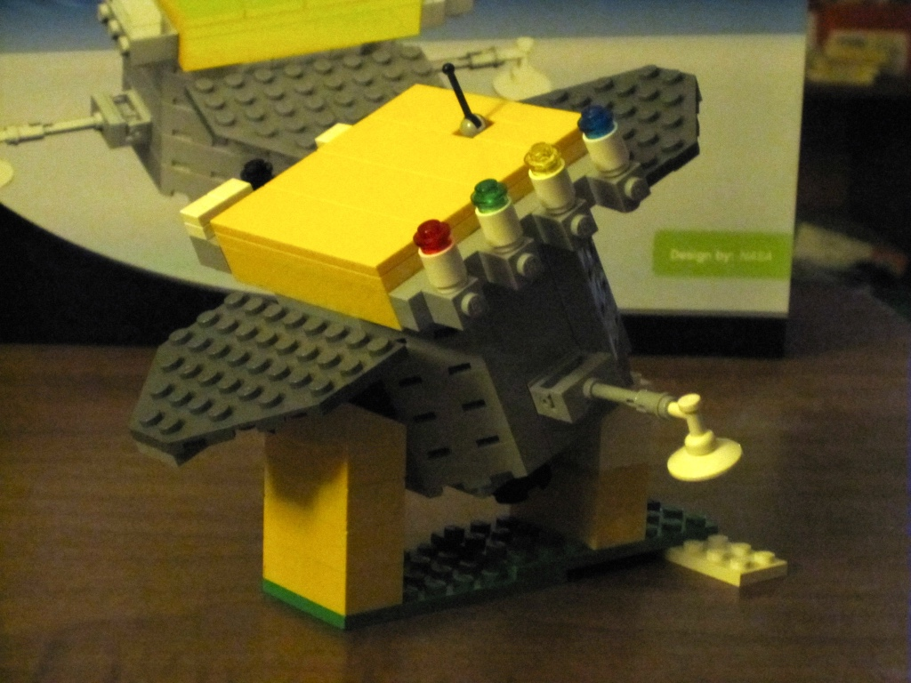
Crazy Hat Contest
First prize is a genuine, Lego SDO model!
One of only two left!
Buy one, build one, but don’t forget to wear one to the dinner.
#SDO2018

