Slide 1
The GOES EUVS Model: New Operational Spectral Irradiances from GOES-R
Edward M.B. Thiemann¹, Francis G. Eparvier¹, Thomas N. Woods¹, Andrew R. Jones¹, Martin Snow¹, Donald L. Woodraska¹, Janet Machol²
Laboratory for Atmospheric and Space Physics, University of Colorado, Boulder, USA
NOAA Space Weather Predictions Center, Boulder, USA
Planetary Science • Space Physics • Solar Influences • Atmospheric Science • Engineering • Mission Operations & Data Systems
http://lasp.colorado.edu
Notes:
Note: This template has some issues with older versions of PowerPoint. Please ensure you are using the latest version (which is a free upgrade on LASP computers).

Slide 2
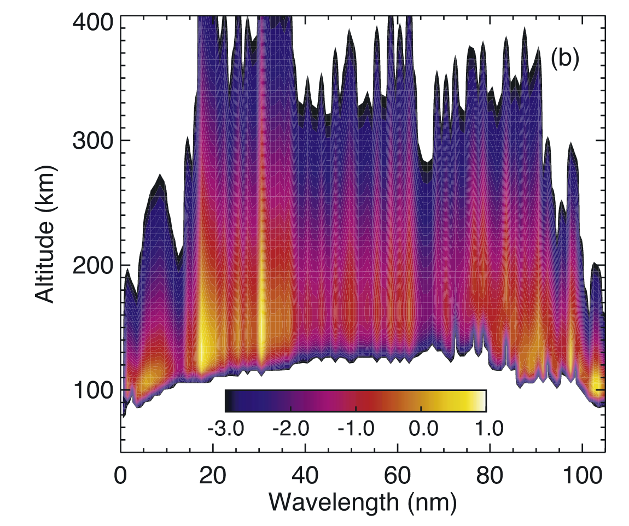
A Need for Calibrated EUV Irradiance
Solar EUV radiation is the primary energy input to the Earth’s upper atmosphere.
Creates the dayside ionosphere and heats the thermosphere.
EUV irradiance is a key (if not the) major input into physics-based upper atmospheric models for research and space weather forecasting.
It’s highly structured in wavelength and variable in time.
Integrated ionizing irradiance varied by ~50% over the past solar cycle.
~15% variability common during a 27-day solar rotation period.
~100% increase during X10 flares, occurring in minutes.
Therefore, time dependent EUV irradiance spectra are needed to estimate the state of the upper atmosphere.
Direct measurements (Drawbacks: spectrally incomplete, higher latency).
Models (Drawbacks: higher uncertainty).
EUV Power Deposited In
Earth’s Atmosphere
Solomon & Qian JGR 2005

Slide 3
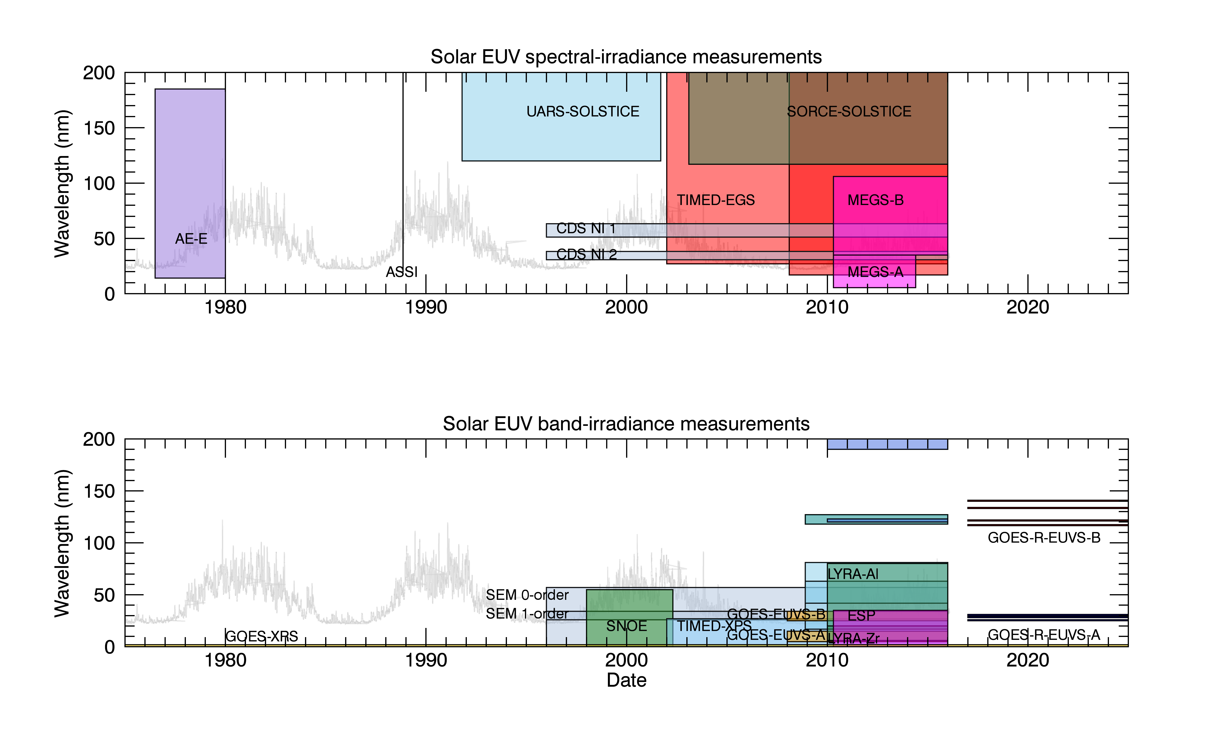
EUV Measurements: Past, Present and Future
The EUVS Model
F10.7 Driven Models
Since January 2017 and planned through 2035, GOES EXIS will measure 7 lines from 25-141 nm at <10 s cadence and 30 second latency.
These lines drive the GOES EUVS Model, which has been calibrated against SEE and EVE.

Slide 4
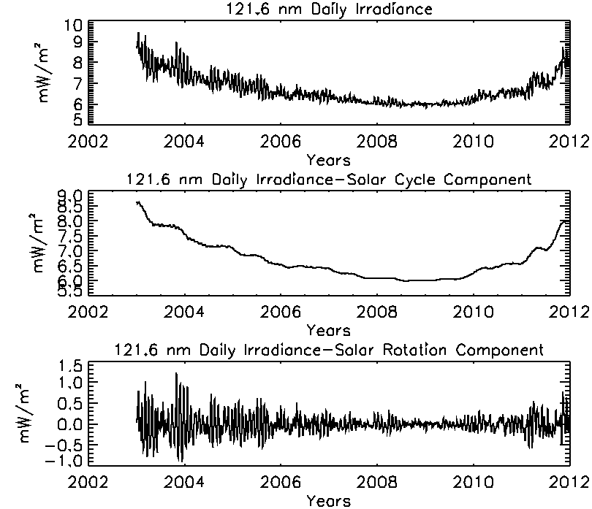
EUV Proxy Modeling
The demand for EUV irradiance estimates over a wide range of time led to the development of EUV proxy modeling.
Hinteregger81
EUVAC
FISM
They decompose irradiance into multiple time scales.
Use measurements of emissions that form at similar regions in the Sun’s atmosphere to model unmeasured emissions.

Slide 5
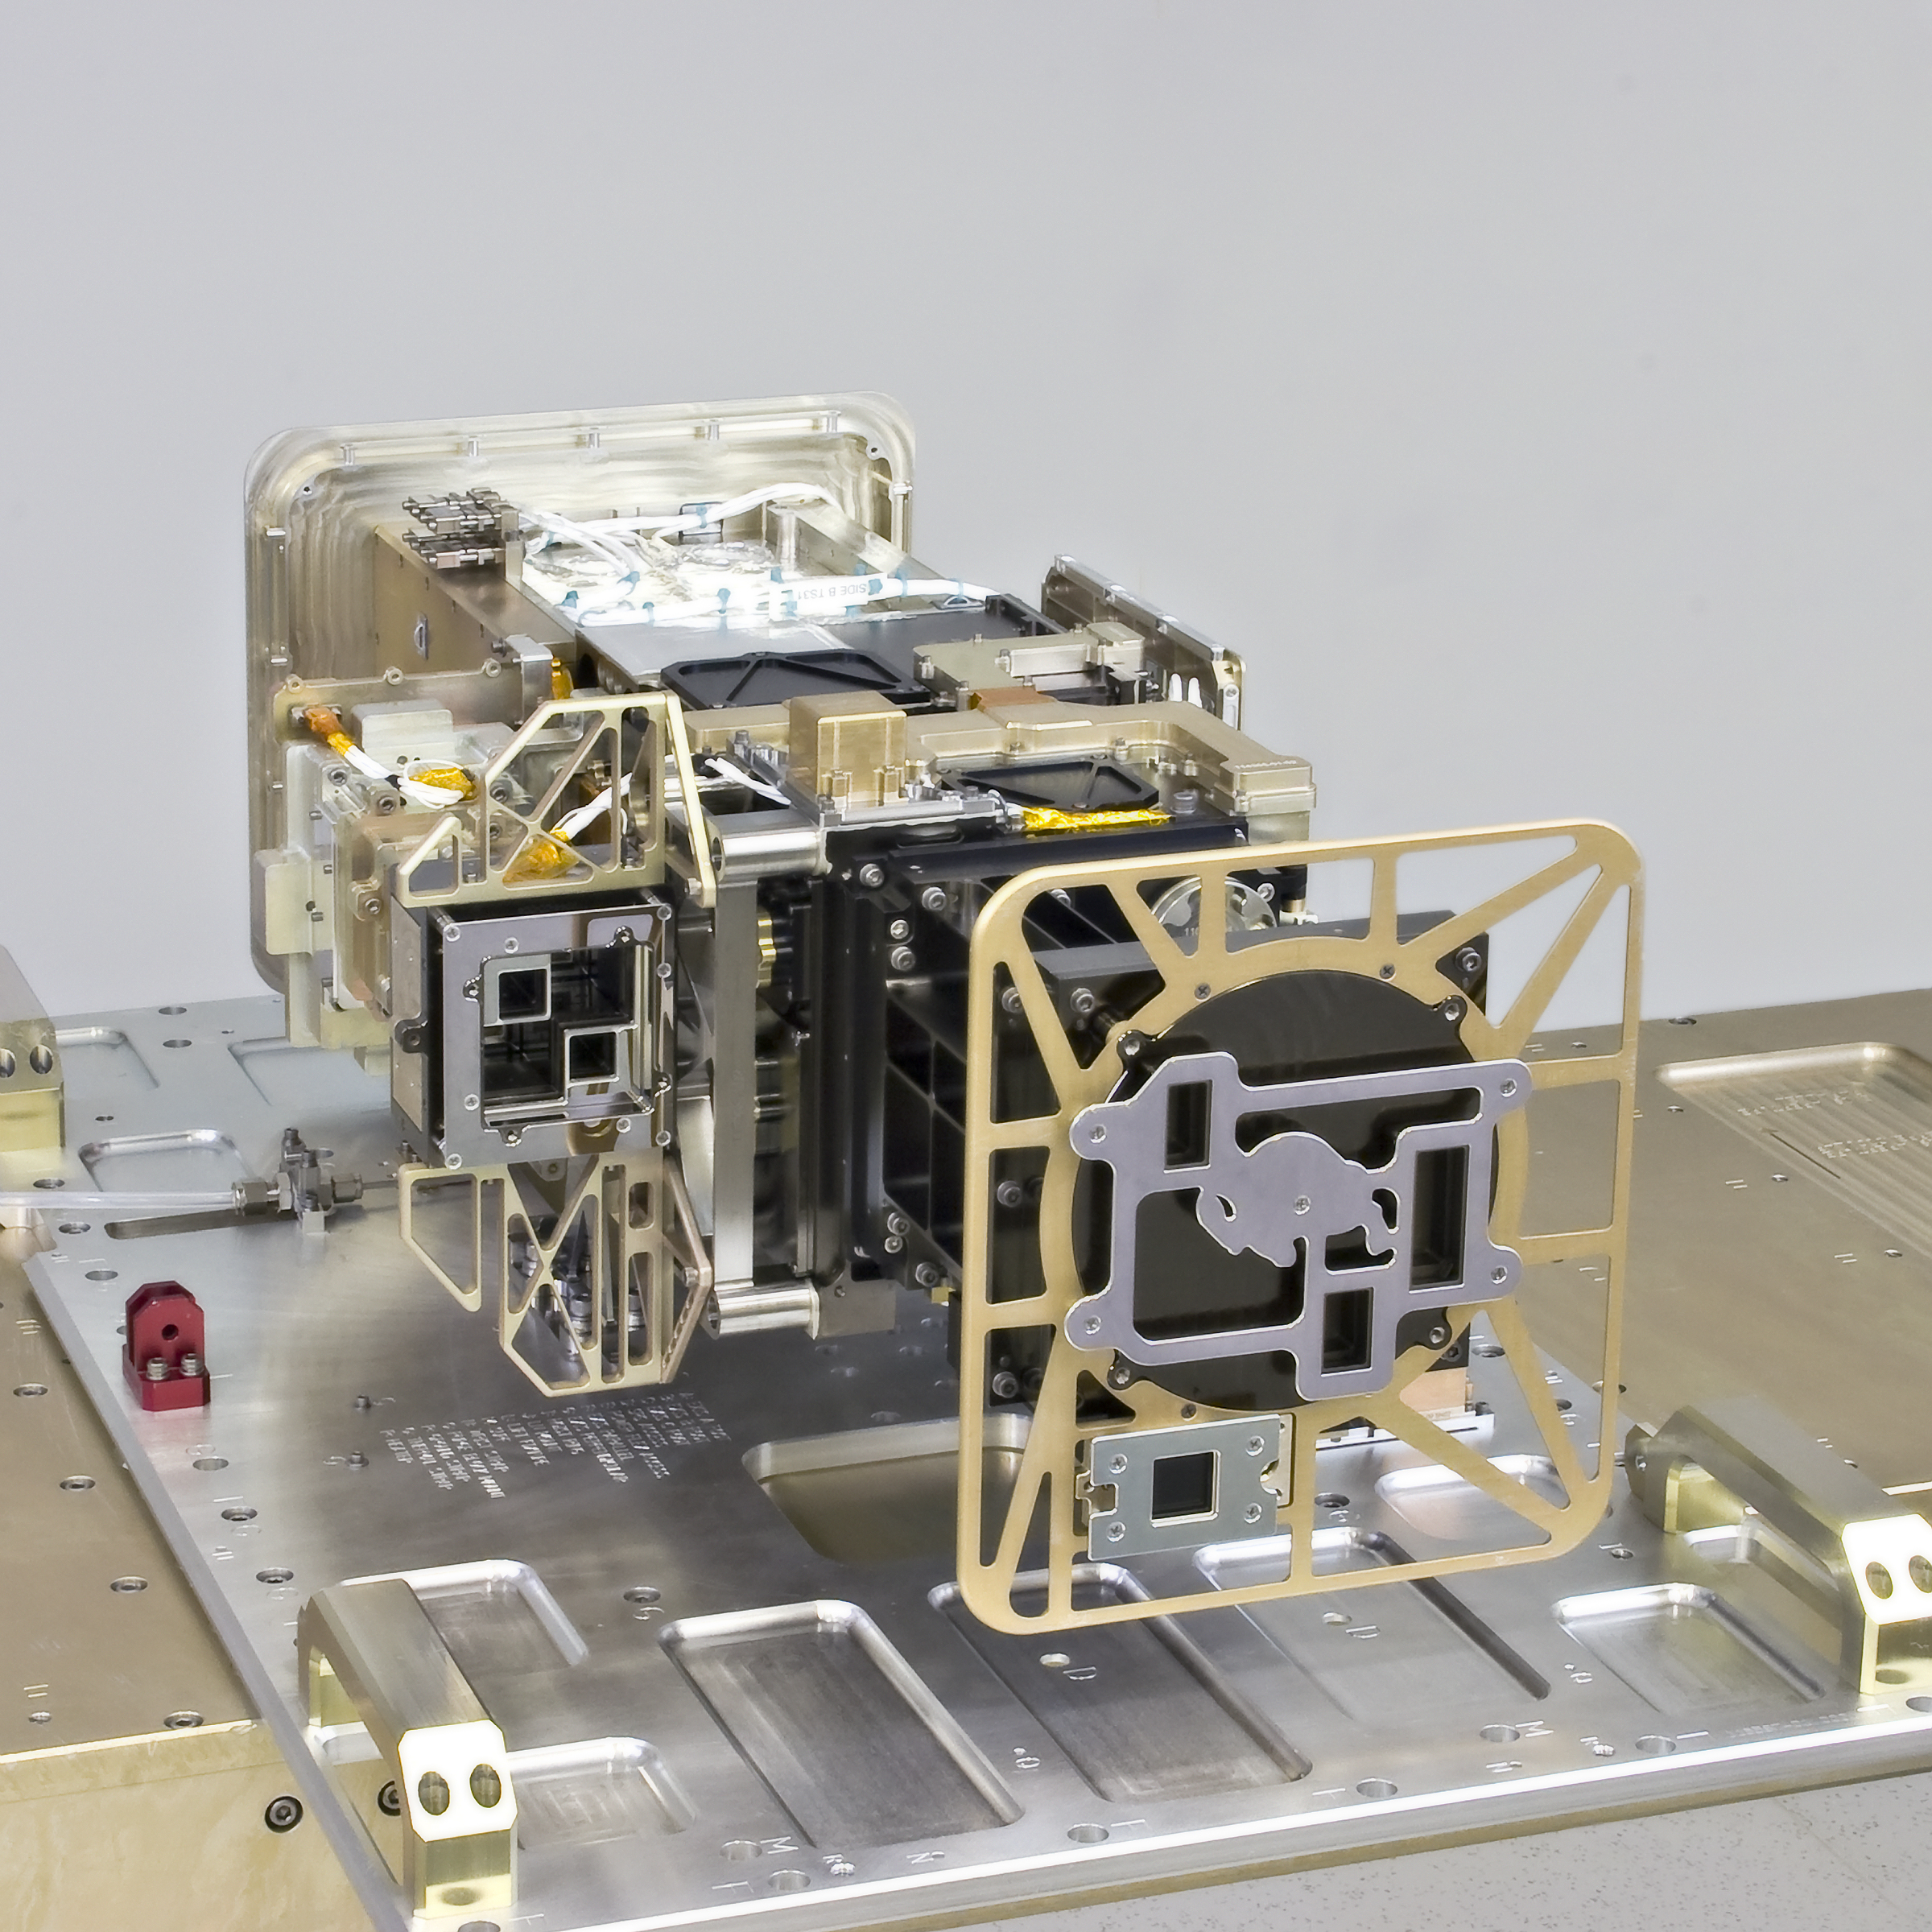
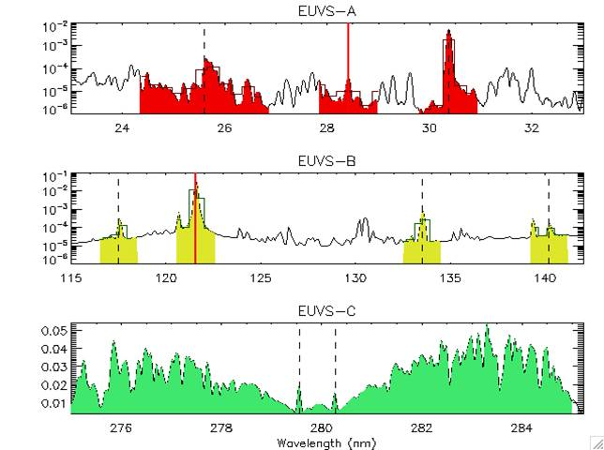
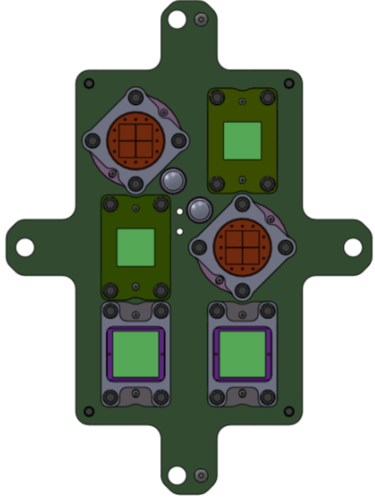
GOES-R EUV and X-ray Irradiance Sensors
EXIS = EUV and X-ray Irradiance Sensors
The Key Components of EXIS:
EUVS = Extreme Ultraviolet Sensor
XRS = X-Ray Sensor
EXEB = EUVS/XRS Electrical Box
EUVS
XRS
A2:
Solar max/flare
λ = 0.05-0.4nm
A1:
Solar min
λ = 0.05-0.4 nm
B1:
Solar min
λ = 0.1-0.8 nm
B2:
Solar max/flare
λ = 0.1-0.8nm
Dark
Dark

Slide 6
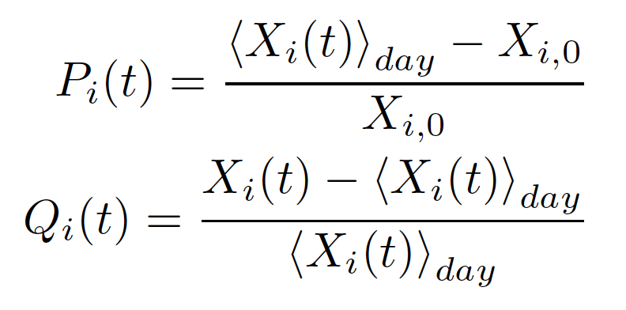
The GOES EUVS Model for EUV Irradiance
EUVS model uses EXIS measurements with set of regression coefficients at two time-scales to reconstruct EUV irradiance spectra.
Daily average and 1 second variability around the daily average.
Multi-linear regression and broad range of formation temperatures represented by EXIS negates the need for solar cycle/rotation decomposition.
NOAA primary low latency model resolution is coarse.
5 nm bins from 5-115 nm and one 117-127 nm (Ly-α) bin
Additional secondary binning will also be distributed.
1 nm resolution
Stan-band binning

Slide 7
EUVS Model Calibration Methods
The SEE and EVE datasets are used with overlapping simulated. EXIS measurements to find model coefficients using linear regression methods with multiple inputs.
Simulated EXIS measurements are cross-calibrated with EXIS line irradiances.
Do not use XRS emissions b/c they tend to increase model error
Model uncertainties are combination of how well historical data are reproduced by the model using simulated EXIS measurements and the cross-calibration between EXIS and the overlapping simulated measurements.

Slide 8
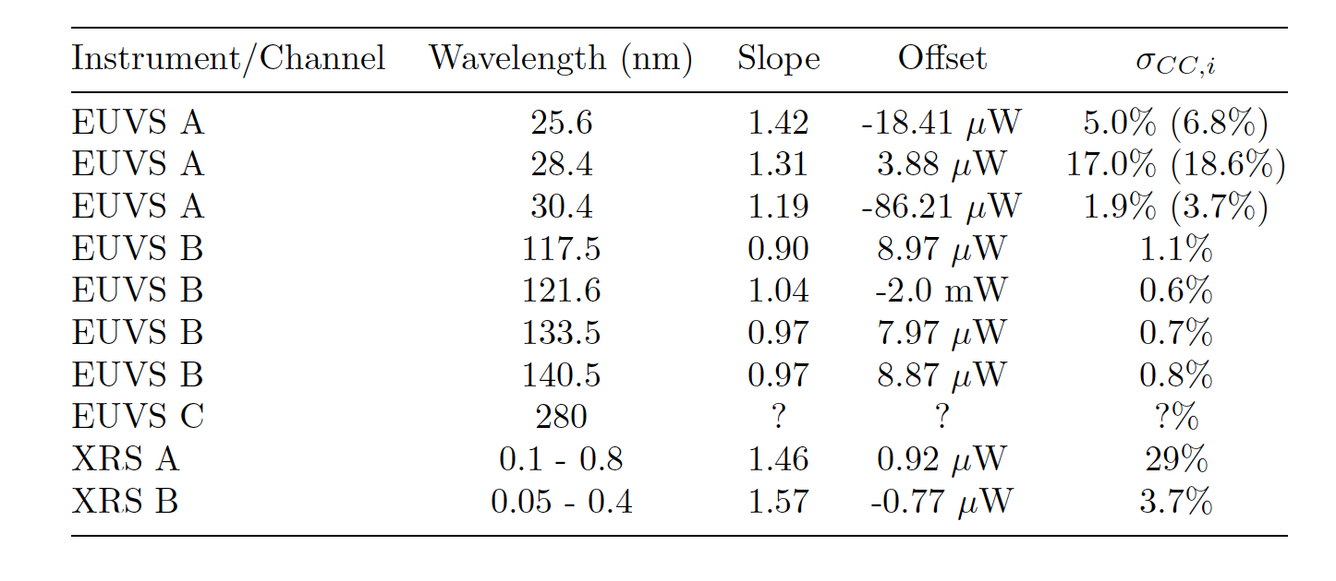
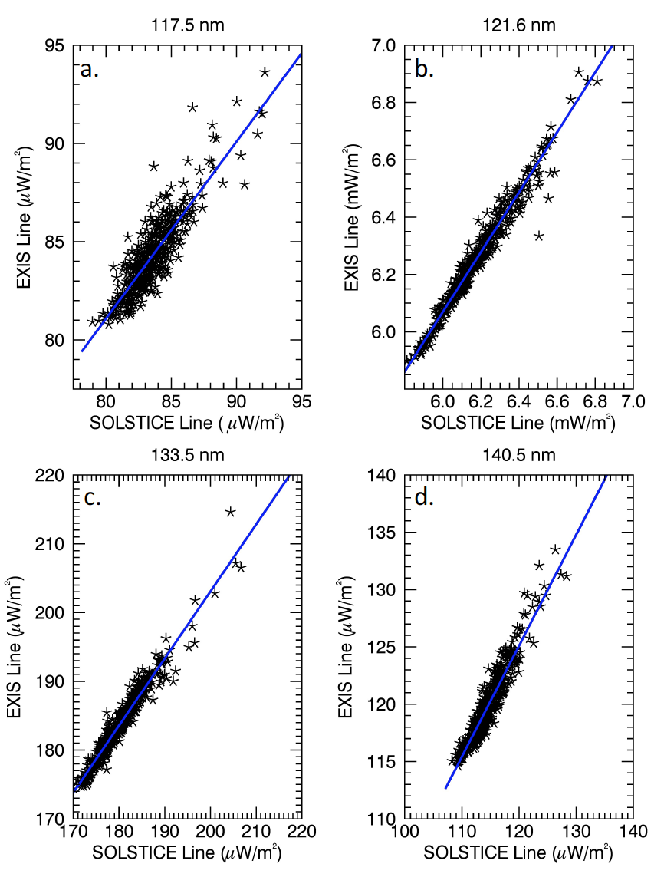
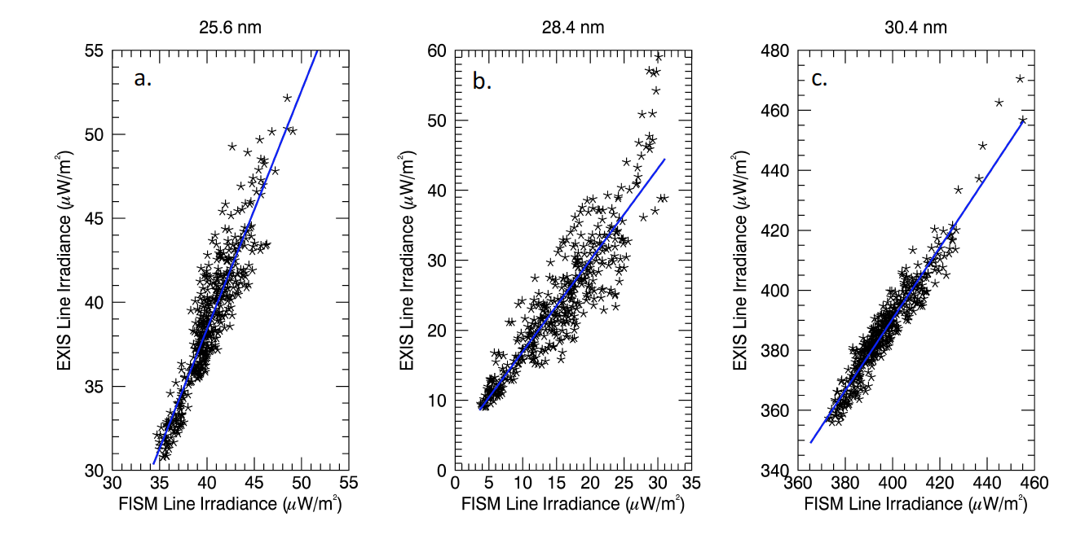
EXIS Measurement Cross-calibration
Cross-Calibration Uncertainty
EUVS B
117.5 nm
121.6nm
EUVS A
25.6 nm
28.4 nm
30.4 nm
133.5 nm
140.5 nm

Slide 9
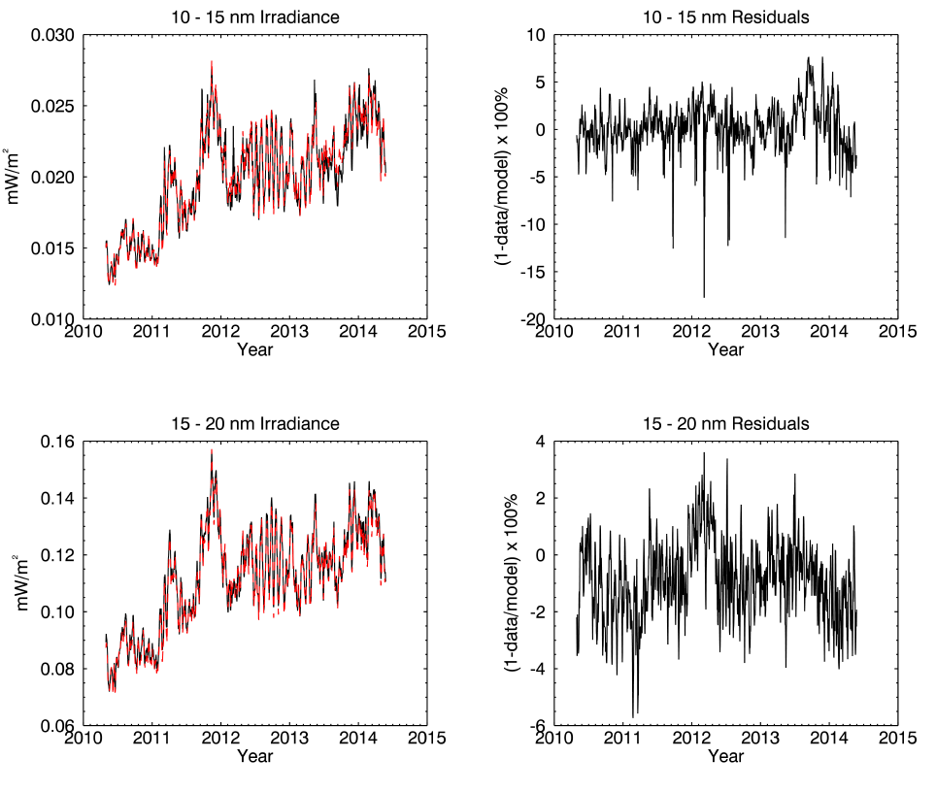
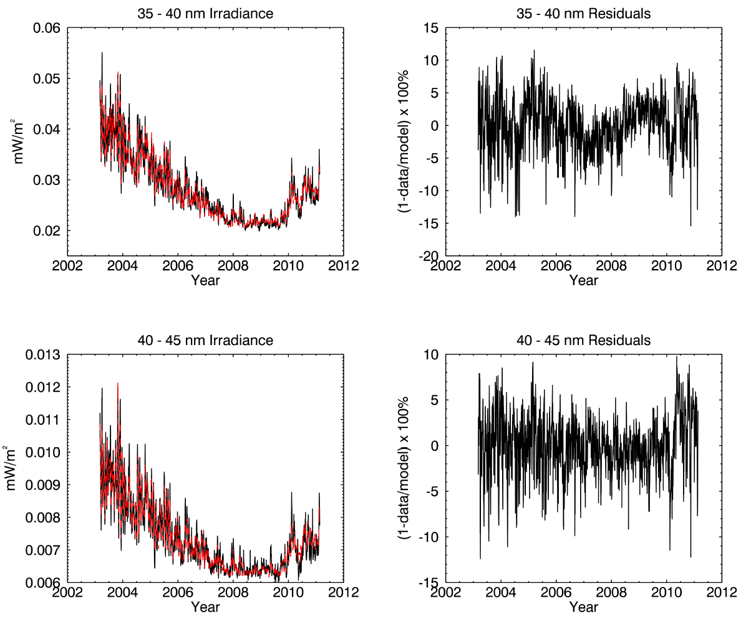
Sample EUVS Model Daily Average Results
EVE Based Bins
SEE Based Bins

Slide 10
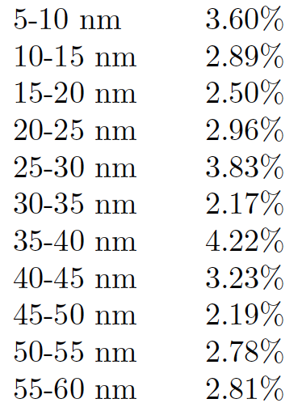
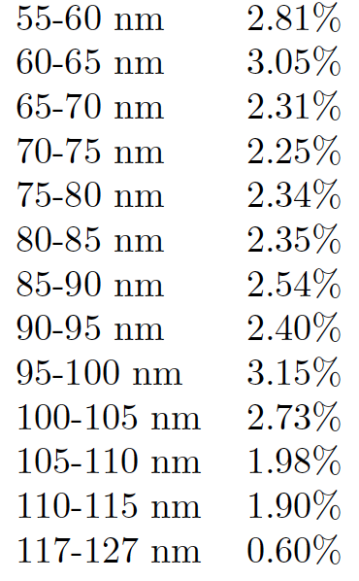
EUVS Model Uncertainty: Daily Average Irradiance
Model uncertainty is combination of how well model reproduces measurements and cross-calibration of simulated and actual EXIS measurements.
Model uncertainty at 5 nm resolution is very low, < 3% for most bins.

Slide 11
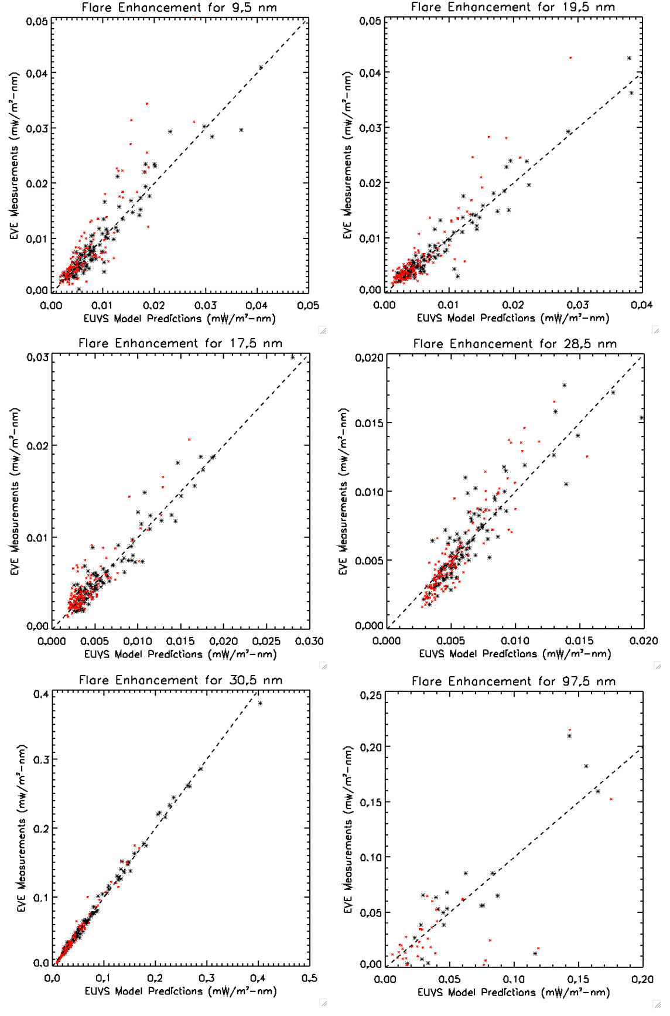
EUVS Model Flare Component Results
Flare component found using > M flares from EVE and GOES EUVS-E.
248 flares 6-35 nm
60 flares 35-105 nm
Found limb-ward flares increased overall model error at longer wavelengths.
Model does not explicitly adjust for flare limb darkening
Model trained with flares <45º from disk-center.
Model uncertainty increases somewhat for limb-ward flares.
9.5 nm (Fe 18)
19.5 nm (Fe 24)
17.5 nm (Fe 9)
28.5nm (Fe 15)
30.5 nm (He 2)
97.5 nm (Ly-γ, C 3)

Slide 12
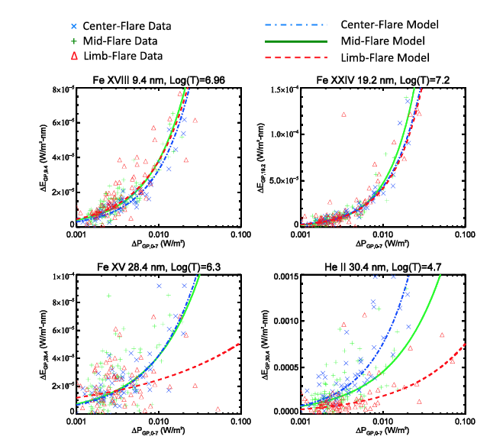
EUVS Model Flare Component Results
EUVS Model
Flare component found using > M flares from EVE and GOES EUVS-E.
248 flares 6-35 nm
60 flares 35-105 nm
Found limb-ward flares increased overall model error at longer wavelengths.
Model does not explicitly adjust for flare limb darkening
Model trained with flares <45º from disk-center.
Model uncertainty increases somewhat for limb-ward flares.
Marked improvement over FISM-M b/c EUV lines are much better proxy than soft x-rays.
9.5 nm (Fe 18)
19.5 nm (Fe 24)
FISM-M
17.5 nm (Fe 9)
28.5nm (Fe 15)
30.5 nm (He 2)
97.5 nm (Ly-γ, C 3)
Thiemann et al. JGR 2017

Slide 13
Summary and Conclusions
A new era has begun with GOES-R as the collection of an extended record of EUV irradiances has begun, with an anticipated research value comparable to the GOES soft x-rays measurements.
The EUVS Model format is at 5 nm bins from 5-115 nm + Ly-α.
Additional 1 nm and Stan Band binning will also be available.
Daily average spectral irradiance uncertainty is very low < ~3% typ.
Flare irradiance error is much smaller (~50-80%) than FISM models.
EUV lines much better than soft x-rays for flare EUV irradiance modeling. FISM should incorporate EUV emissions where available.
Provisional GOES EUVS Model data will be made public in early 2019. A paper describing the model to be submitted later this month.

Slide 14
Questions?

Slide 15
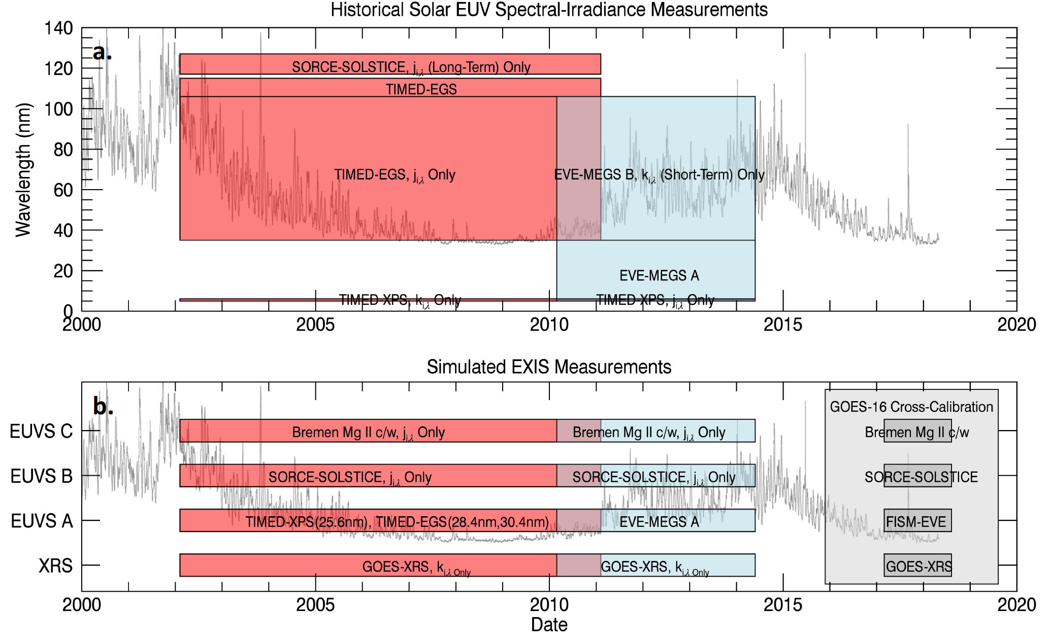
EUVS Model Calibration Datasets

