Slide 1


Joint observations of the X9.3 and X8.2 flares on 2017 September 6 and 10 by PROBA2/LYRA, SDO/EVE, and MAVEN/EUVM
M. Dominique, A.N. Zhukov, L. Dolla, L. Wauters, I.E. Dammasch, Royal Observatory of Belgium / STCE
E. Thiemann, LASP – University of Colorado
P. Heinzel, Astronomical Institute, Czech Academy of Sciences
G. Lapenta, Katholieke Universiteit Leuven
SDO workshop, October 30 2018, Brussels

Slide 2
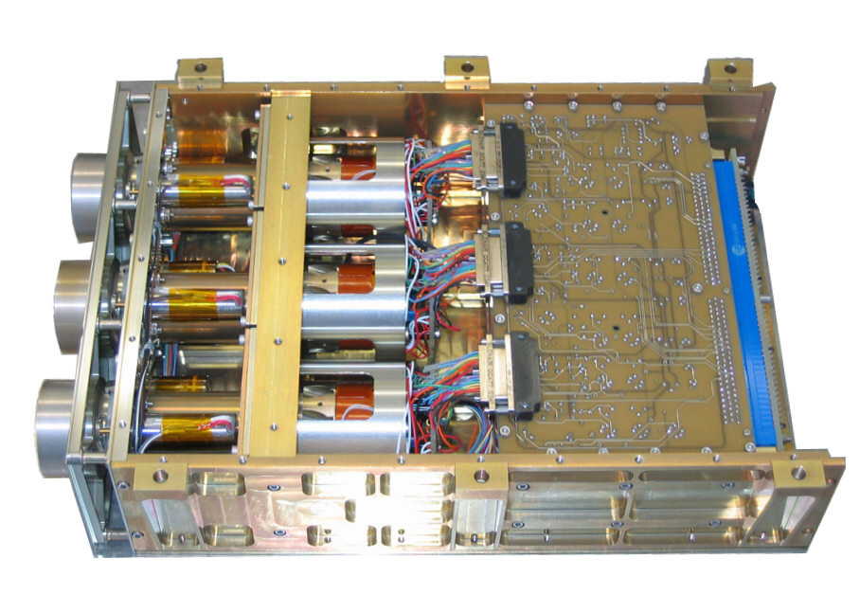
LYRA channels spectral response to quiet-Sun
Channel 1 – Lyman alpha: 120-123 nm
Channel 3 – Aluminum: 17-80 nm + < 5nm
Channel 2 – Herzberg: 190-222 nm
Channel 4 – Zirconium: 6-20 nm + < 2nm

Slide 3
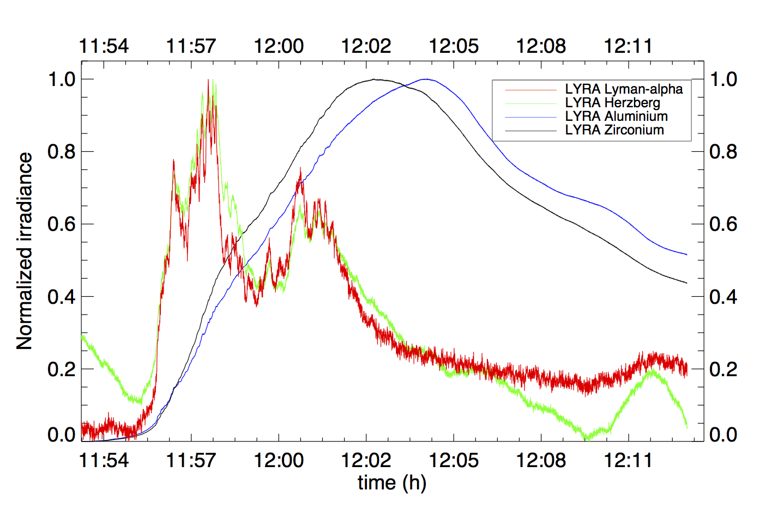
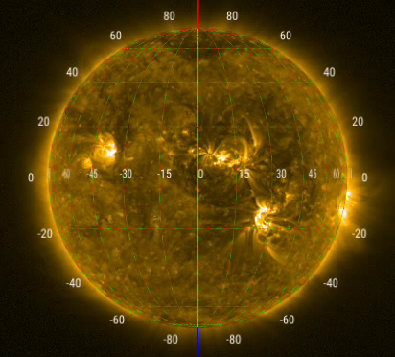
The X9.3 flare on September 6, 2017 as seen by PROBA2
PROBA2/SWAP
Seen in all four channels of LYRA, first flare seen by the channel 2 (Herzberg channel)!

Slide 4
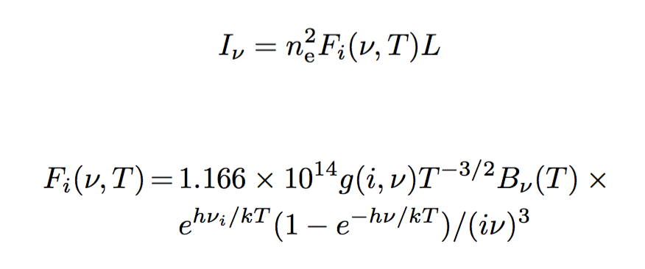
Origin of the flare emission in channel 2
Hypotheses:
  The flare signal in this channel primarily comes from an increase of the H Balmer continuum
  Emission is produced by an optically thin, dense chromospheric slab of thickness L ≈ 200 km (Heinzel et al. 2017)
  T = 10000 K
  Emitting surface estimated on SDO/HMI observations = 240 Mm²
Hubeny and Mihalas, 2015
I = radiance
n_{e} = electron density
ν = frequency
i = principal quantum number of the
energy level in the H atom
L = slab thickness
T = temperature
g = Gaunt factor ≈ 1
B_{ν} = Planck function

Slide 5
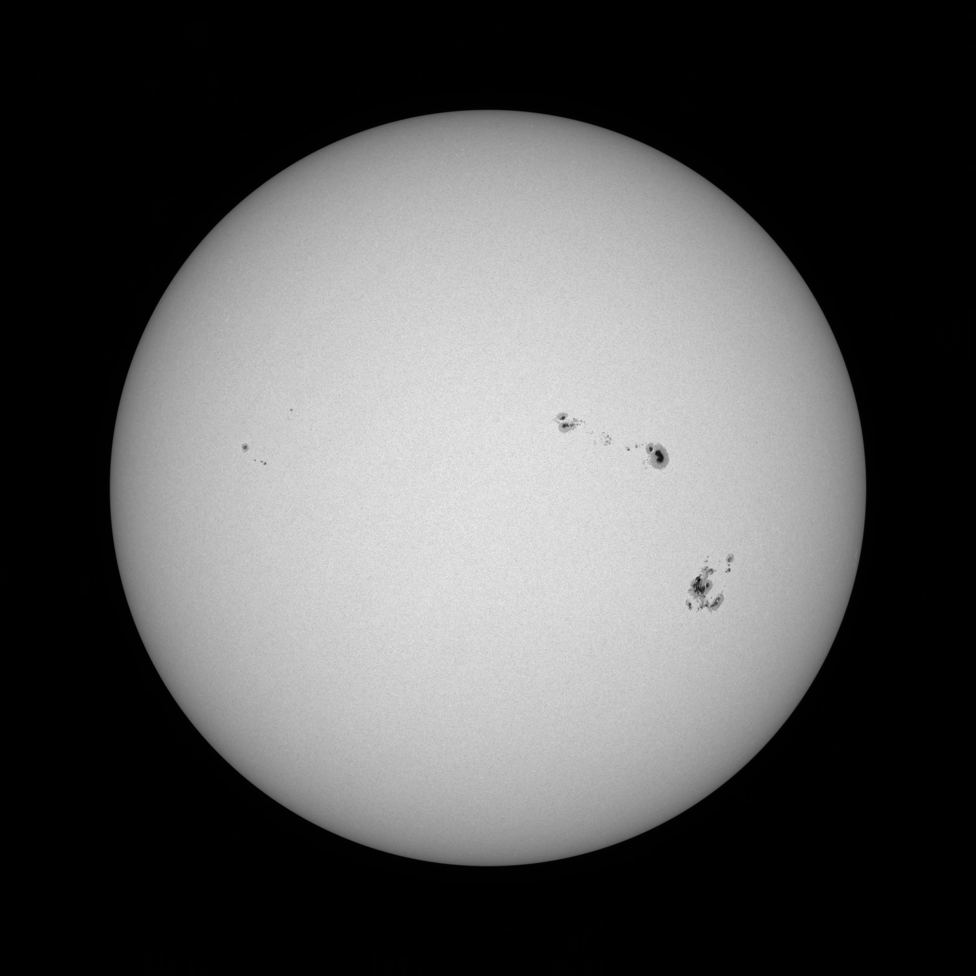
Origin of the flare emission in channel 2
Hypotheses:
  The flare signal in this channel primarily comes from an increase of the H Balmer continuum
  Emission is produced by an optically thin, dense chromospheric slab of thickness L ≈ 200 km (Heinzel et al. 2017)
  T = 10000 K
  Emitting surface estimated on SDO/HMI observations = 240 Mm²

Slide 6
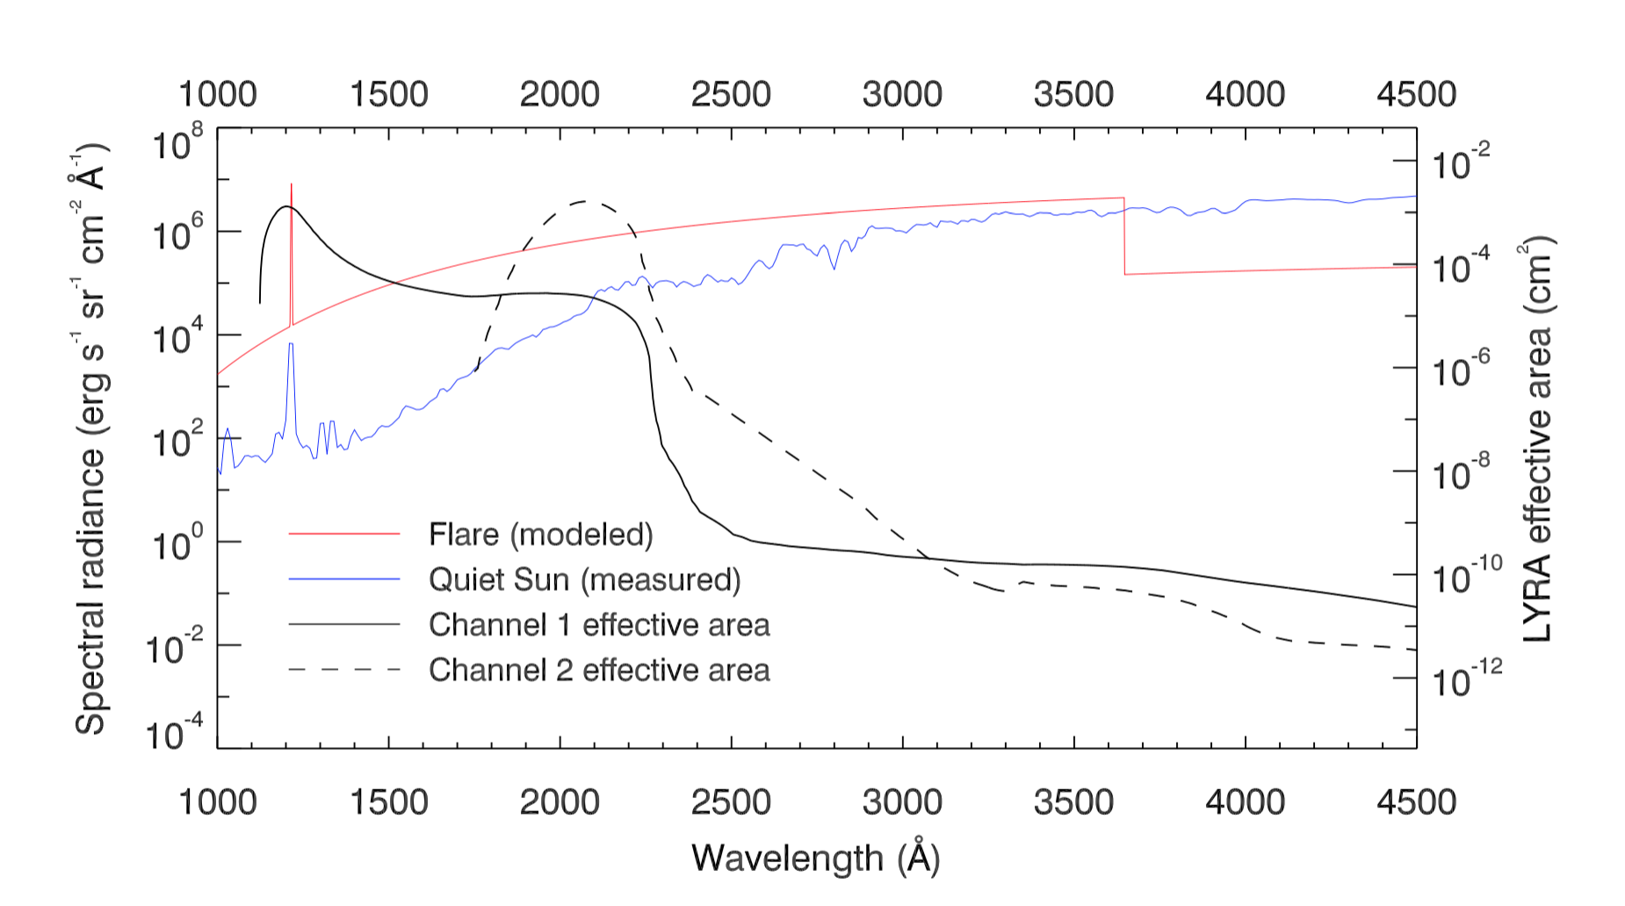
Origin of the flare emission in channel 2
Determination of n_{e}:
  The modeled spectrum multiplied by the channel spectral response and integrated over the passband matches the measurements:
  => n_{e} at peak time
  ≈ 6.7 x 10¹³ cm⁻³
Dominique et al., accepted in ApJL
Realistic, comparable to other similar studies (e.g. Neidig et al., 1993; Kerr and Fletcher, 2014; Heinzel et al., 2017)

Slide 7
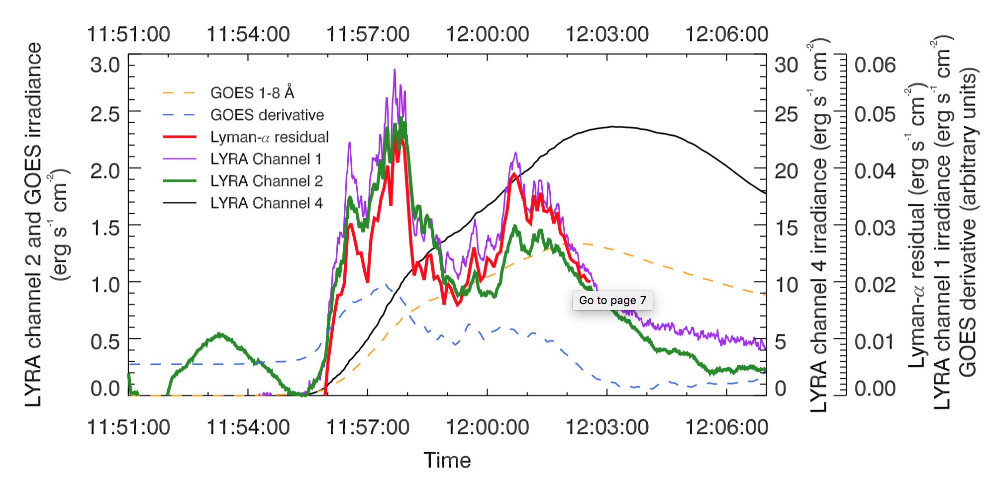
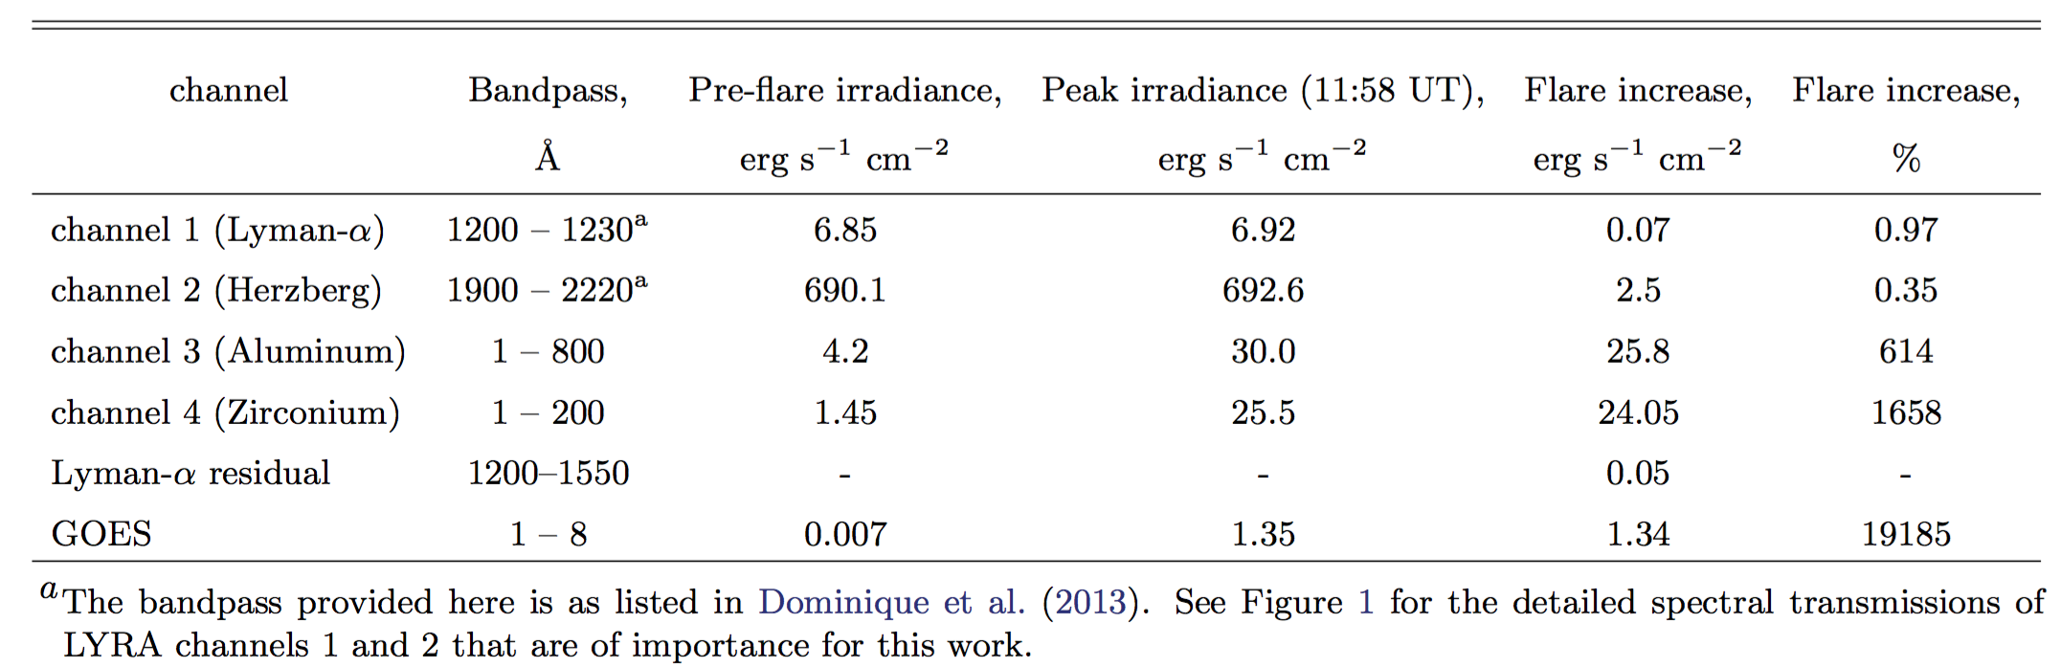
Extraction of the out-of-band contribution from channel 1
Dominique et al., accepted in ApJL
GOES 1-8 Å
GOES derivative
LYRA channel 2
LYRA channel 4
Extracted Lyman-α

Slide 8
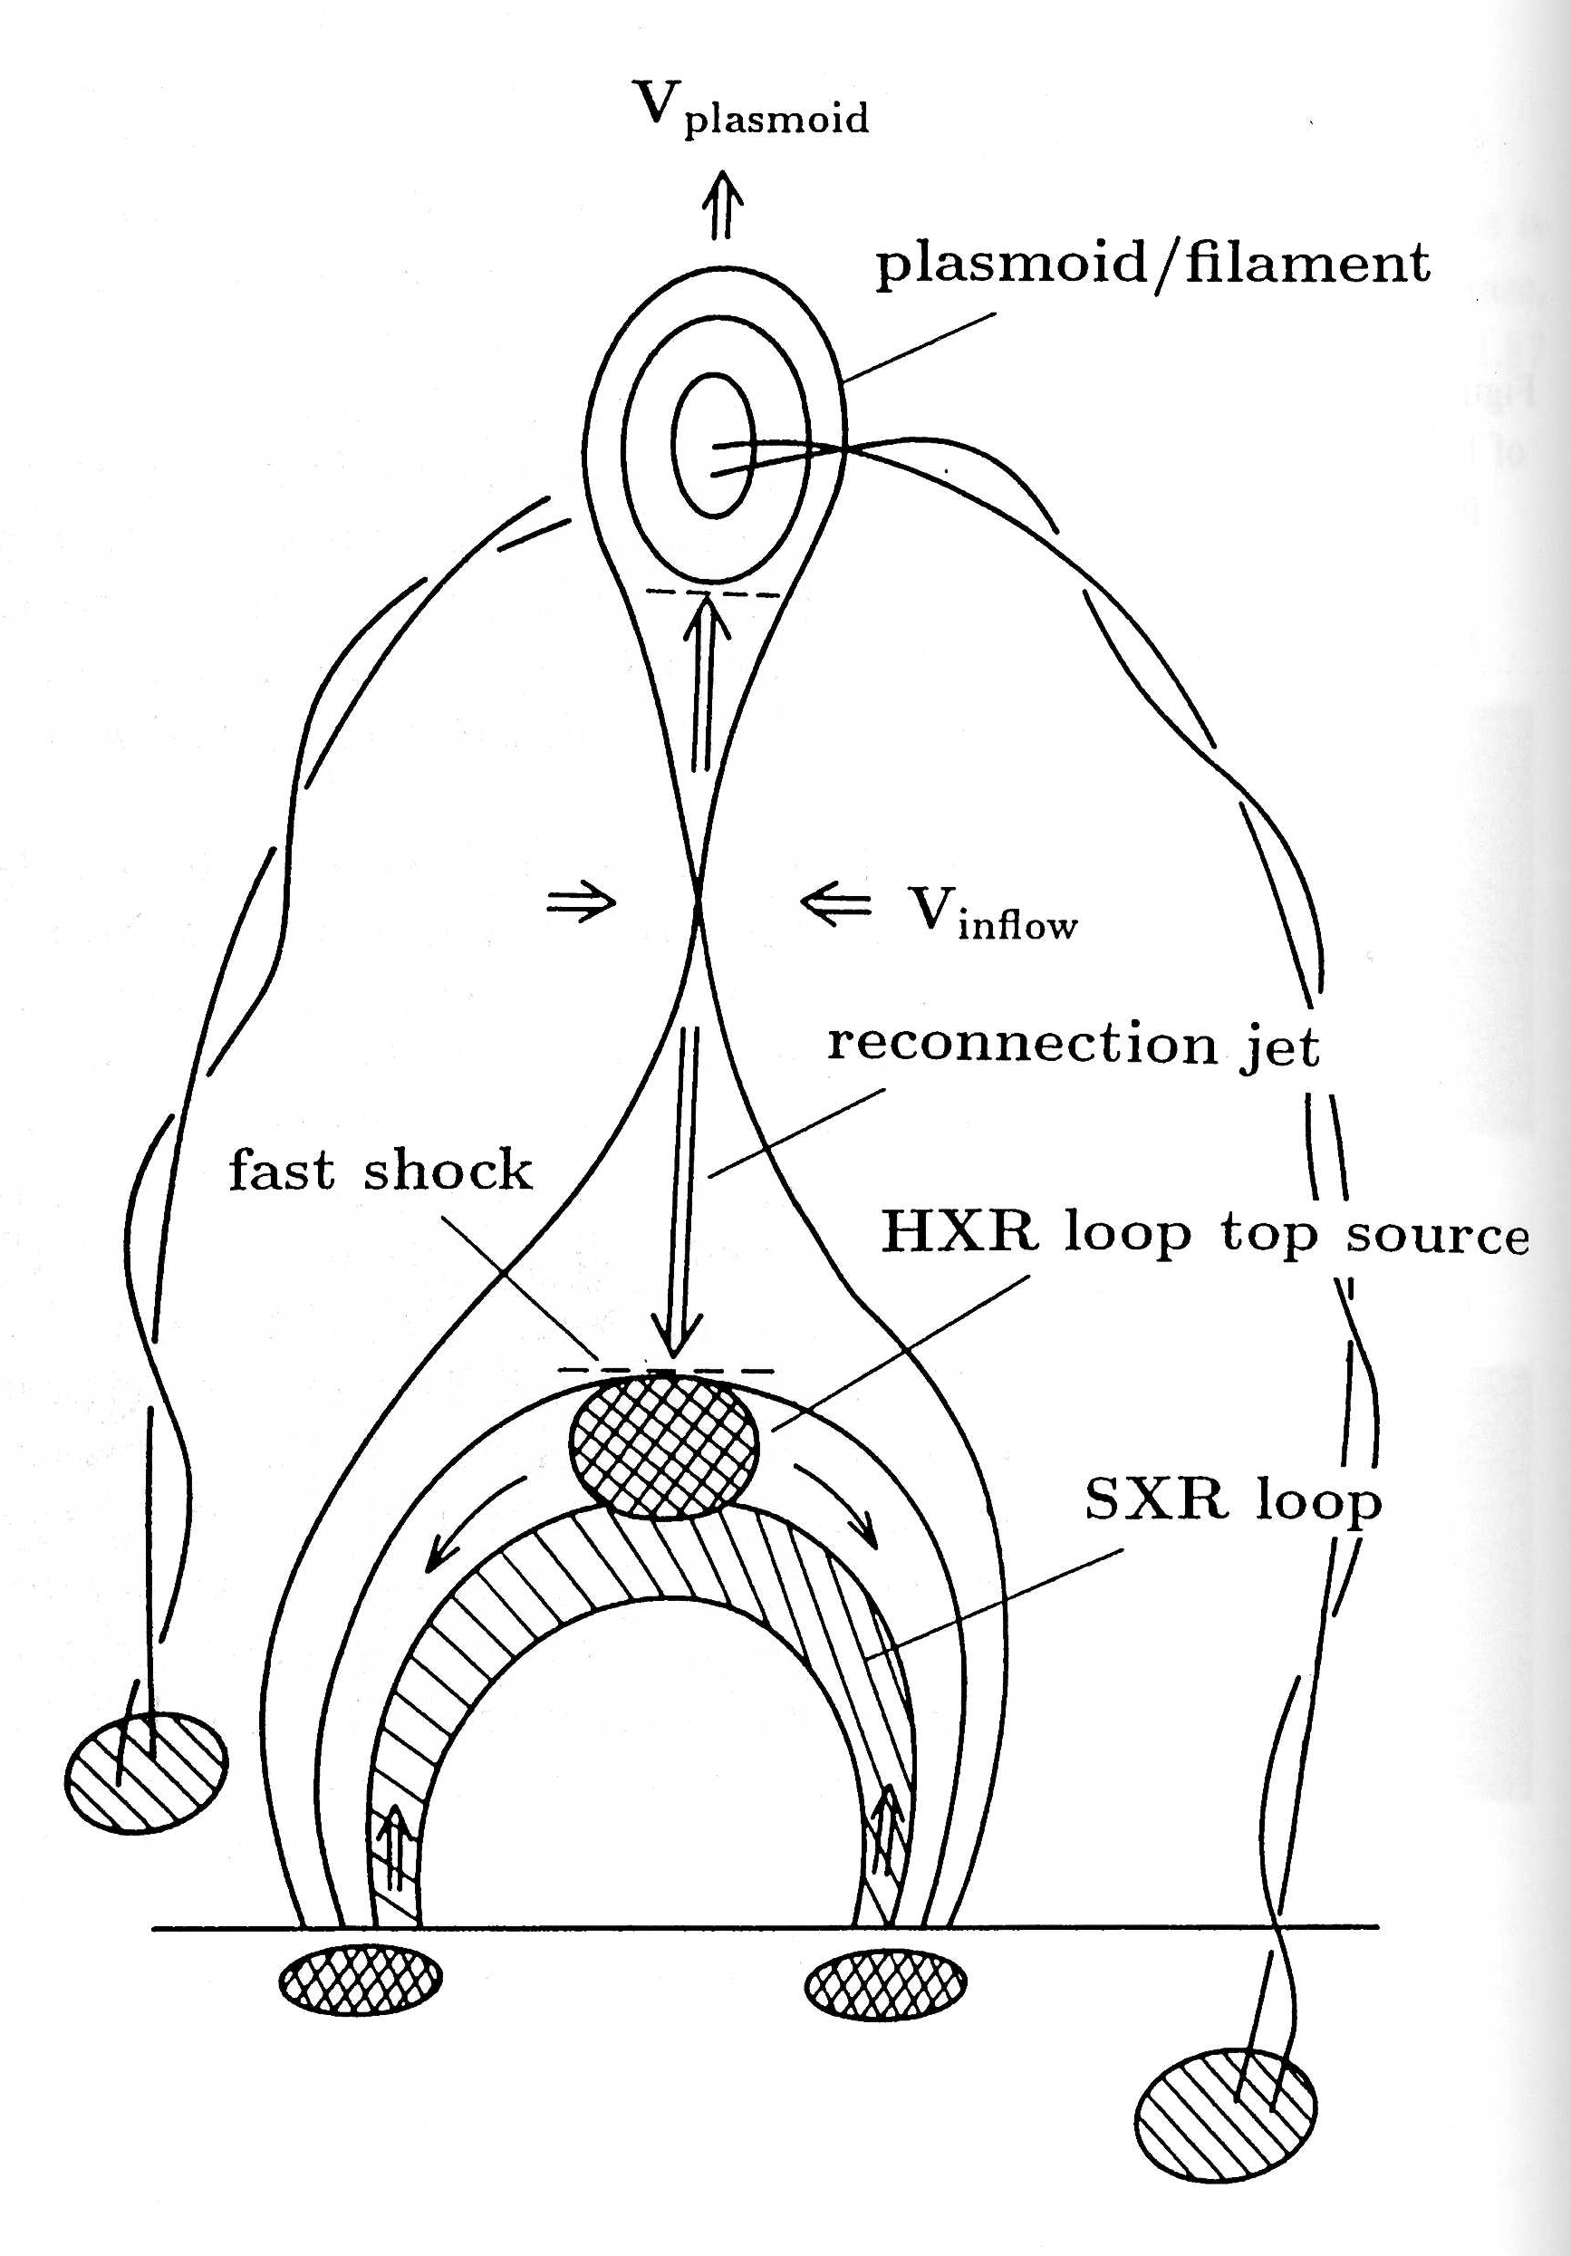
Quasi-periodic pulsations (QPPs)
Two main mechanisms evoked (see e.g. Nakariakov and Melnikov, 2009) :
Reconnection = quasi-periodic process
Modulation of the electron beam and loop system by an MHD wave
Usually easier to detect in non-thermal emission (bigger amplitude)

Slide 9
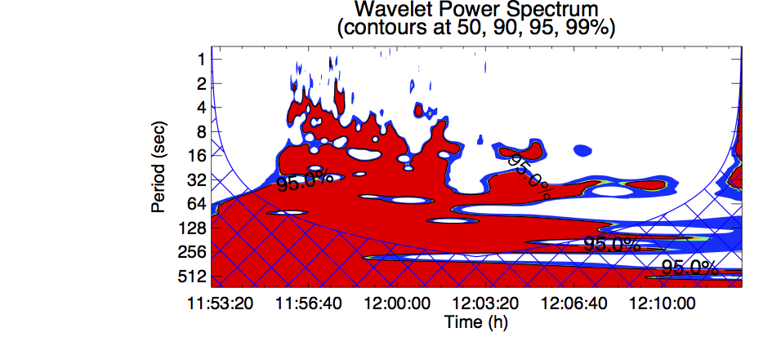
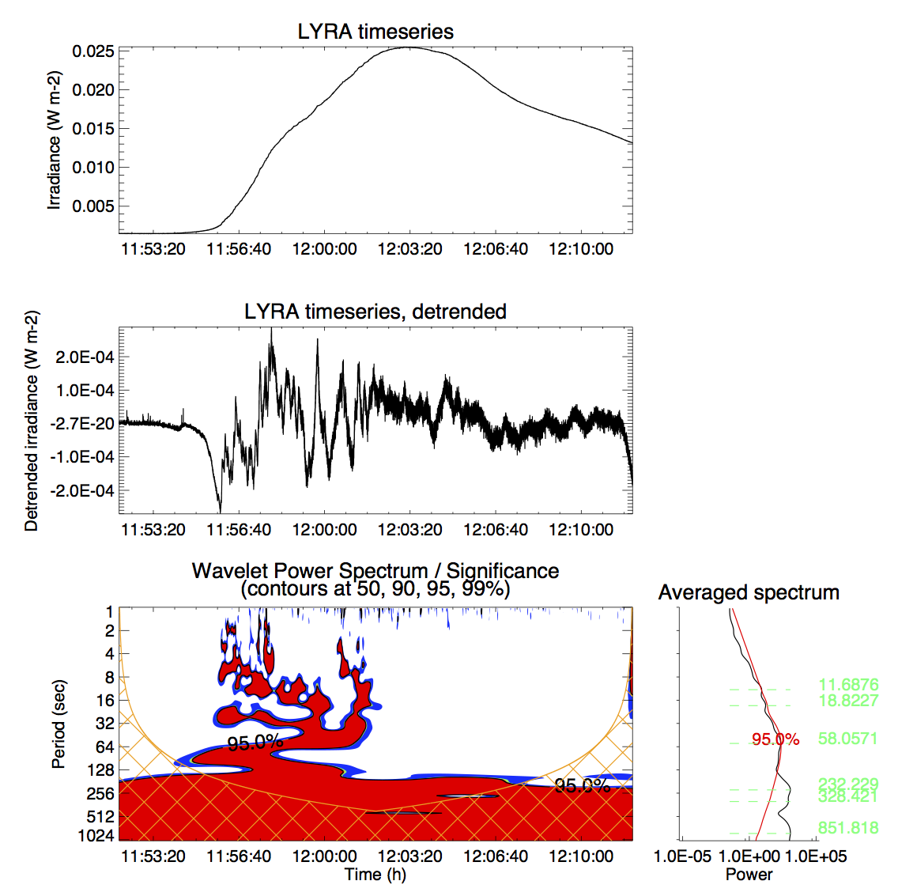
QPPs in LYRA channel 4 + ESP-Q
Detrending needed (here 60 s)
Periods at 12 s and 19 s consistent in both ESP and LYRA
Detection at 58 s caused by the detrending process
(Dominique et al., 2018)
ESP
LYRA

Slide 10
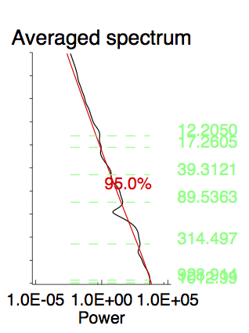
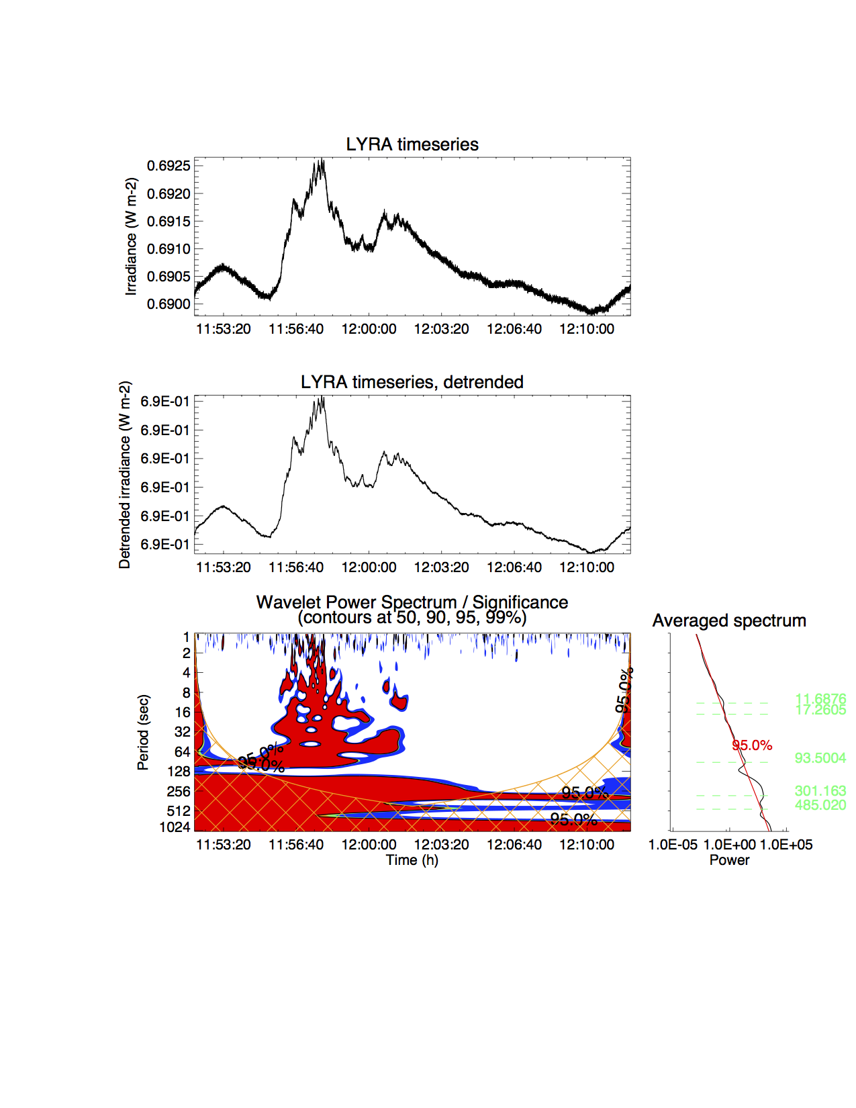
QPPs in channels 1 and 2
channel 1
No detrending needed
Common periods detected: 12 s, 17 s, 90 s and 300 s
One additional period in channel 1: 40 s
Periods consistent with Kolotkov et al., 2018
channel 2

Slide 11
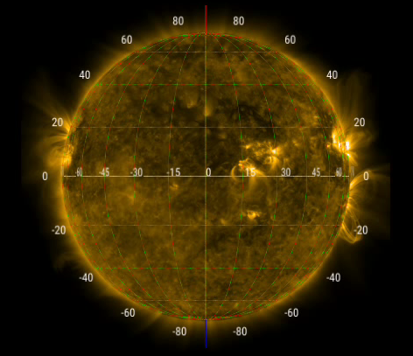
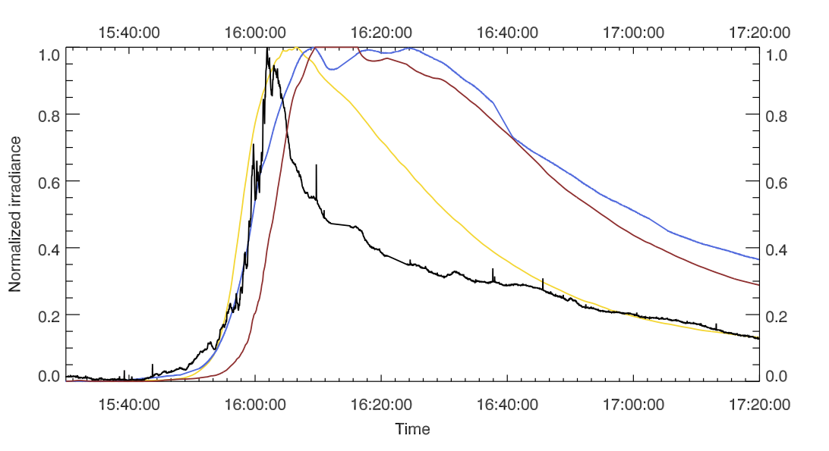
X8.2 flare on September 10, 2017
No signature in LYRA channels 1 and 2
MAVEN/EUVM (orbiting Mars) detected flare emission in Lyman-α
Flare behind the limb (at least one footpoint occulted)
GOES 1-8 Å
MAVEN Lyman-α
MAVEN 0-70 Å
LYRA 1-800 Å

Slide 12
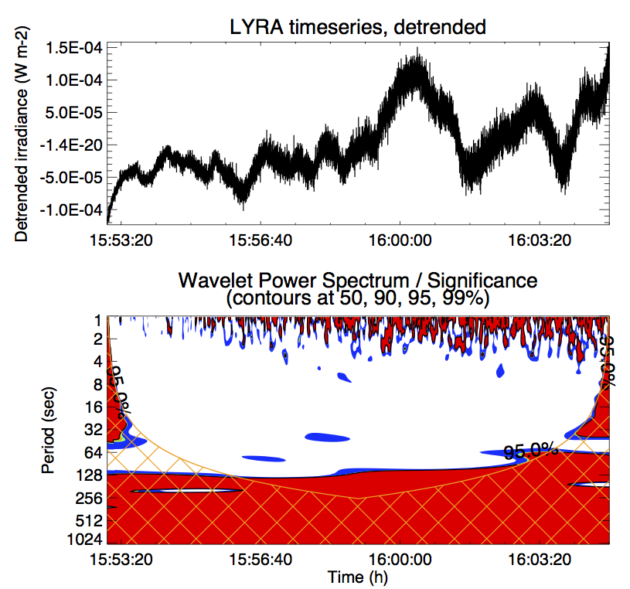
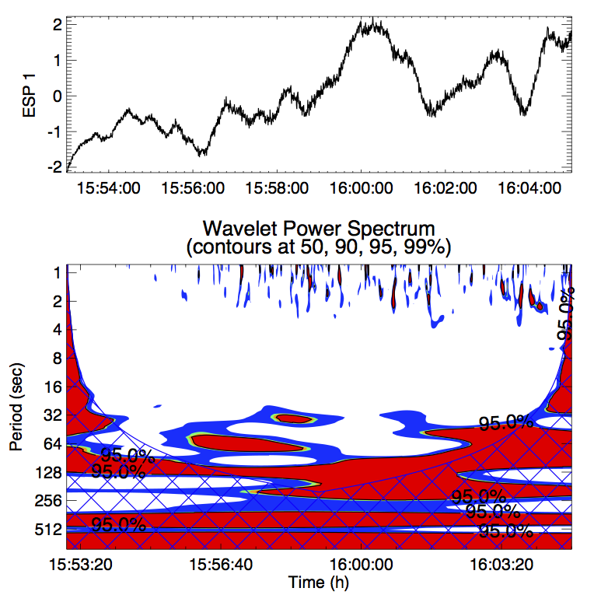
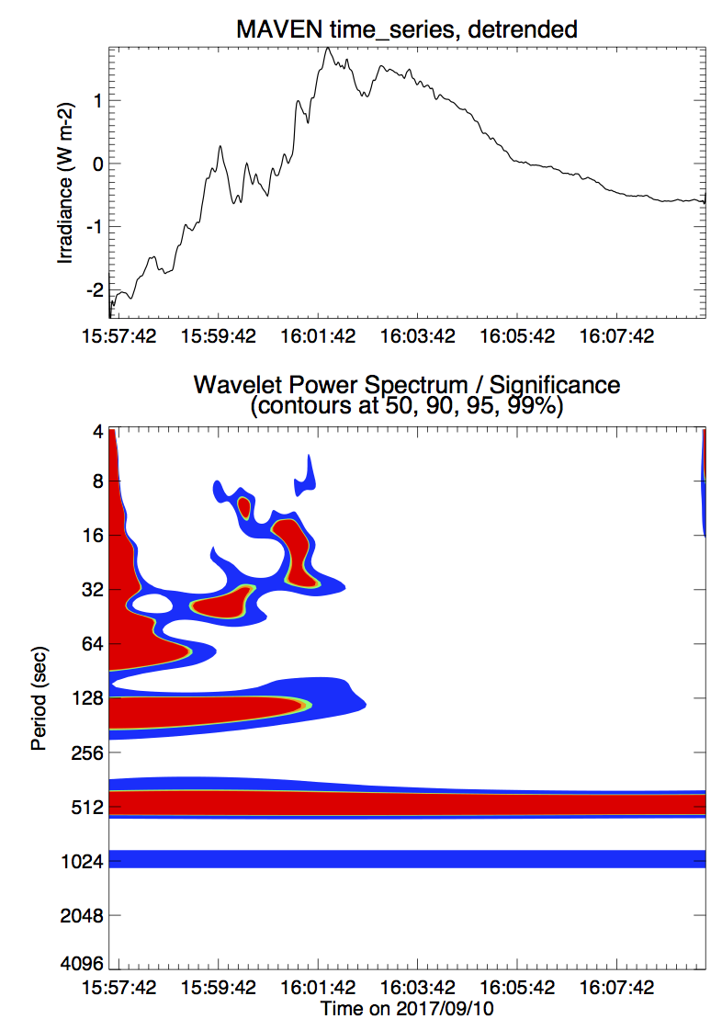
QPPs in the X8.2 flare
LYRA and ESP-Q
  A period at ~50 s seems to be present but below the 95% confidence level except for a short time interval in ESP
MAVEN
  QPPs with periods at ~17 and ~50 s are clearly detected in all channels

Slide 13
Conclusions
Flare X9.3 on September 6 2017
  We report on the first flare signature observed in the channel 2 (1900-2220 Å) of LYRA
  This flare also produced a signature in Lyman-α
  Most of the flare emission seen in the channel 2 is associated to an increase of the H Balmer continuum
  QPPs were observed in all four channels of ESP and LYRA, in particular periods at ~12 and ~19 s.
Flare X8.2 on September 10 2017
  No signature in LYRA channels 1 and 2, although MAVEN detected Lyman-α flare
  Detection of QPPs in LYRA or EVE is not clear.
  QPPs well observed in MAVEN, with periods at ~17 and ~50 s

Slide 14
Thank you!

Slide 15
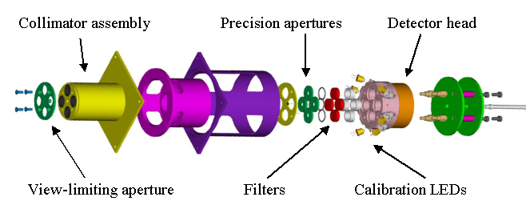
PROBA2/LYRA fact sheet
3 redundant units protected by separated covers
4 broad-band channels
High acquisition cadence: nominally 20Hz
3 types of detectors:
  standard silicon
  2 types of diamond detectors: MSM and PIN
    radiation resistant
    blind to radiation > 300nm
Calibration LEDs with λ of 370 and 465 nm

Slide 16
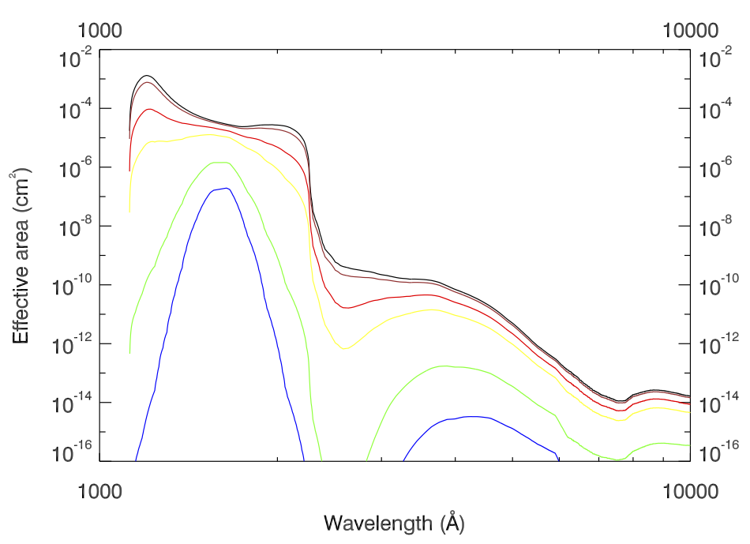
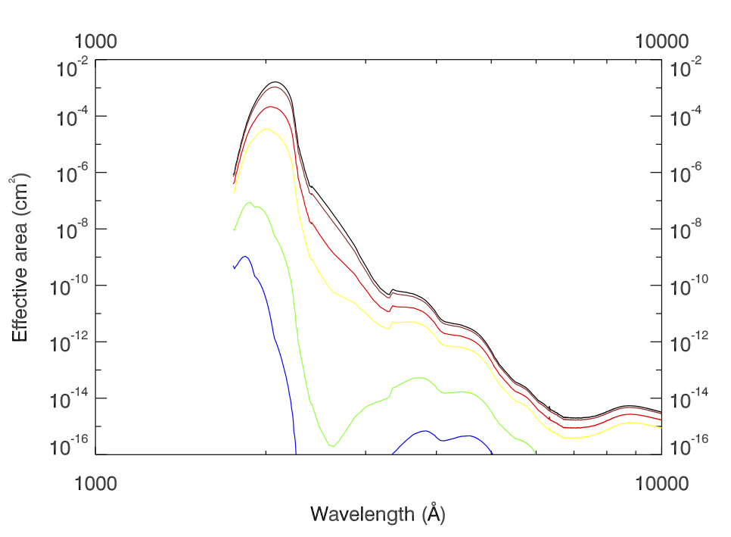
Impact of degradation: Carbon contamination
During the flares: special observation campaign with the least degraded unit (unit 1)
Loss of signal in channels 1 and 2: 50% and 25% respectively. Can be explained by a layer of ~10 nm of C
 | C layer (nm)
 | 0
 | 10
 | 50
 | 100
 | 300
 | 500
Channel 1
Channel 2

