Slide 1
Solar flare distributions: lognormal instead of power law?
Cis Verbeeck, Emil Kraaikamp, Lena Podladchikova
Royal Observatory of Belgium
SDO Workshop, Ghent, Belgium, October 29, 2018
Solar-Terrestrial Centre of Excellence

Slide 2
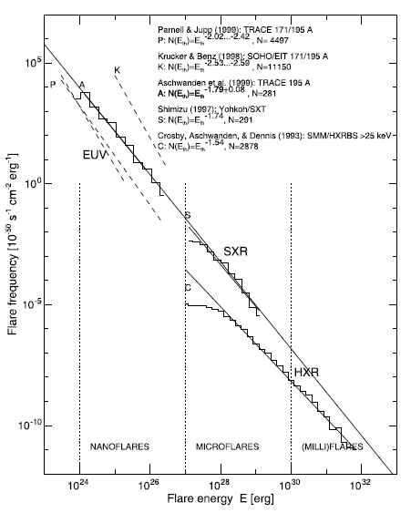
Flare parameter distributions
Flare parameter distributions are generally assumed to follow a power law
Several authors have found power law behavior in flare parameter distributions and have estimated power law exponents
Estimated exponents varied between 1.35 (Berghmans, Clette and Moses 1998) and 2.59 (Krucker and Benz 1998)
Aschwanden et al., Space Sci Rev 2016

Slide 3
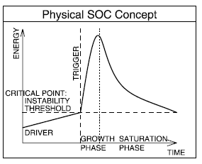
Self Organized Criticality (SOC)
Power law behavior is often interpreted as Self Organized Criticality (SOC)
SOC concept introduced by Bak et al., Phys Rev Lett 1987
Aschwanden, ApJ 2014: “SOC is a critical state of a nonlinear energy dissipation system that is slowly and continuously driven towards a critical value of a system-wide instability threshold, producing scale-free, fractal-diffusive, and intermittent avalanches with powerlaw-like size distributions”
See review Aschwanden, Crosby et al., Space Sci Rev 2016
Lu & Hamilton, Astrophys. J. 1991:
“pile of magnetic fields” model for solar flares
Several more complex SOC models for solar flares
Aschwanden, Crosby et al., Space Sci Rev 2016
Notes:
In a physical SOC concept, the driver is a slow and continuous energy input rate, the criticality mechanism is replaced by a critical point
in form of an instability threshold, where an avalanche is triggered, usually consisting of a nonlinear growth phase and a subsequent saturation phase.

Slide 4
New dataset: SDO/AIA 94 Å flares detected by Solar Demon
Solar Demon flare detection operates on SDO/AIA 94 Å synoptic level 1.5 science data @ 2 minute cadence
On average, detects GOES B5 flares and above
Accurate flare location and shape information (no macro-pixels, accurate on pixel-level)
Able to distinguish simultaneous flares at different locations (unlike e.g., GOES flares)
Background solar intensity does not affect the measured flare intensity
Allows to filter the data, e.g., only consider flares that were entirely on-disk
Big science catalog:
8 274 events in current data set (May 13, 2010 - March 16, 2018)
Solar Demon – an approach to detecting flares, dimmings, and EUV waves on SDO/AIA images, Kraaikamp and Verbeeck 2015, http://dx.doi.org/10.1051/swsc/2015019

Slide 5
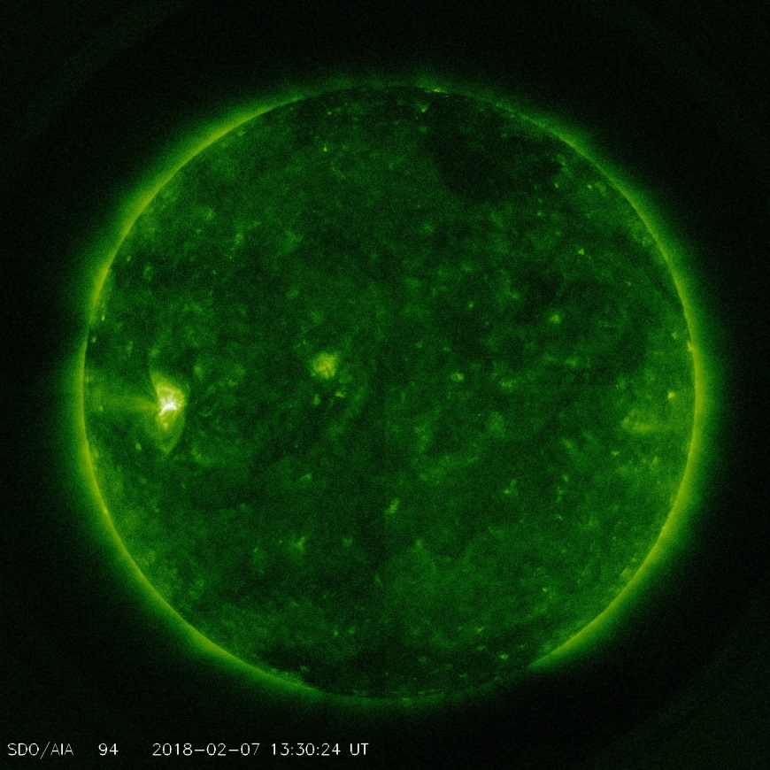
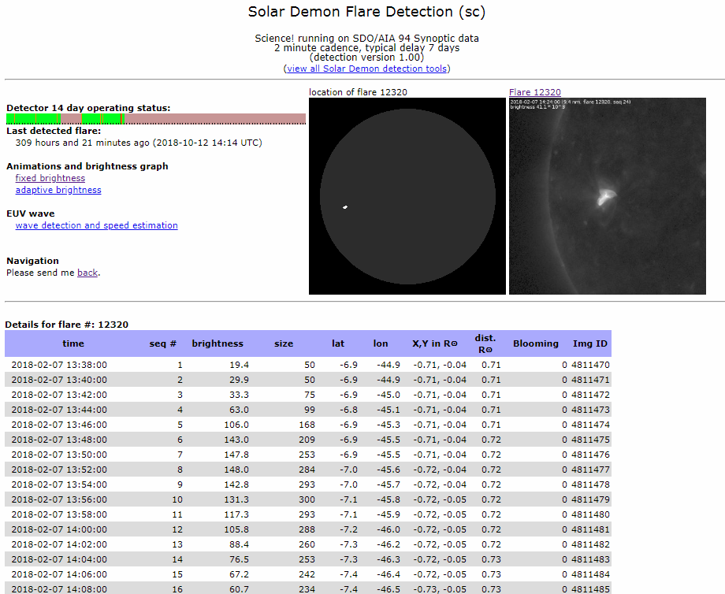
Solar Demon – Flare Detection http://solardemon.oma.be
SDO/AIA 9.4 Å showing AR 2699 on February 7, 2018
A C8.1 flare detected by Solar Demon on February 7 at 13:38 UTC. For each detected flare, Solar Demon tracks the flare time, intensity, size, accurate location on pixel level, and pixel saturation.
Solar Demon – an approach to detecting flares, dimmings, and EUV waves on SDO/AIA images, Kraaikamp and Verbeeck 2015, http://dx.doi.org/10.1051/swsc/2015019

Slide 6
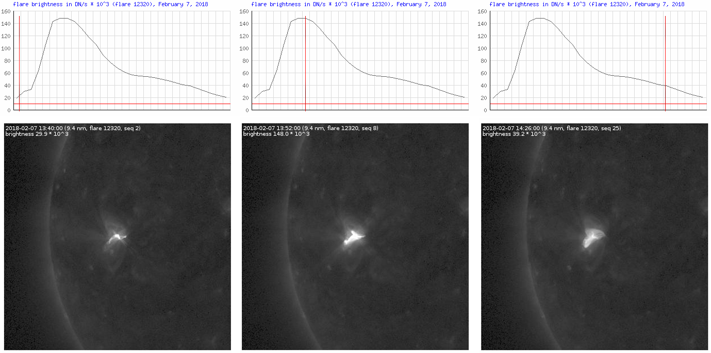
Solar Demon – Flare Light Curves
Flare intensity at time t = sum of all pixel values of the flare pixels in the image at time t
Solar Demon – an approach to detecting flares, dimmings, and EUV waves on SDO/AIA images, Kraaikamp and Verbeeck 2015, http://dx.doi.org/10.1051/swsc/2015019

Slide 7
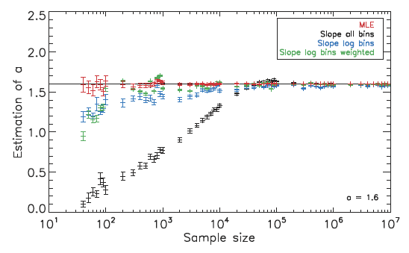
Estimating the exponent α –
Graphical method versus MLE
Linear fit on log-log histogram
Exploits the fact that power law Cumulative Distribution Function (CDF) is a straight line in a log-log plot
Used very often
Maximum Likelihood Estimation (MLE)
Maximizes the log of likelihood function
This leads to a single closed formula involving every data point x_{i}:
D’Huys et al., Sol Phys 2016
Notes:
The likelihood function p(x|alpha) is the probability that the data (x_i)_i were drawn from the theoretical power law distribution with exponent alpha. We look for the alpha which maximizes this likelihood.
D’Huys et al. 0216: Evolution of the scaling parameter estimate as a function of sample size using the improved graphical methods. The true value for α is 1.6 and is indicated by the horizontal line.
We show the estimates for α based on linear binning (in black), logarithmic binning (in blue), logarithmic binning with weights (in green), and the MLE method (in red).

Slide 8
Estimating the exponent α –
Graphical method versus MLE
Linear fit on log-log histogram
Exploits the fact that power law Cumulative Distribution Function (CDF) is a straight line in a log-log plot
Used very often
Maximum Likelihood Estimation (MLE)
Maximizes the log of likelihood function
This leads to a single closed formula involving every data point x_{i}:
Lower cut-off x_{min} needs to be selected
Lin or log bins, weighted or unweighted
Very sensitive to bin size
Accurate exponent estimation requires very large sample size (~10⁴ or larger)
x_{min} is only parameter to be selected
Accurate exponent estimation for samples of size ~10² or larger

Slide 9
Robust statistical analysis of
SDO/AIA 94 Å flare parameters
In the present study, we follow the approach suggested by Clauset et al., SIAM Review 2009:
Finding optimal value of x_{min}: for every value of x_{min}, calculate MLE fit(x_{min}), then minimize the Kolmogorov-Smirnov distance between the empirical distribution and the MLE fit(x_{min})
If x_{min_s} is the selected value of x_{min},, our best MLE fit to the data is MLE fit(x_{min_s})
Goodness-of-fit p is provided by bootstrapping. The hypothesis that the model is a reasonable fit to the data, is rejected if p < 0.1.
Implementation: R package “poweRlaw” based on Clauset et al. method
Notes:
K-S distance is the maximum absolute difference between the CDF of the empirical distribution and the CDF of the fit in a data point.

Slide 10
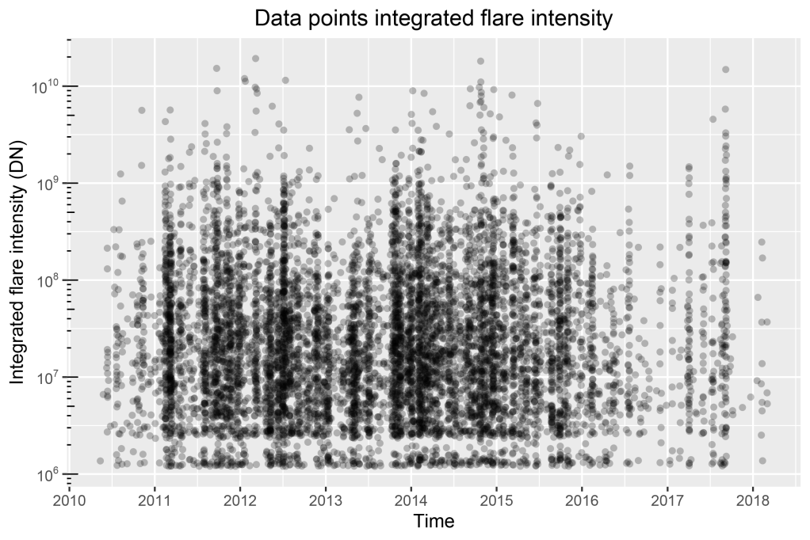
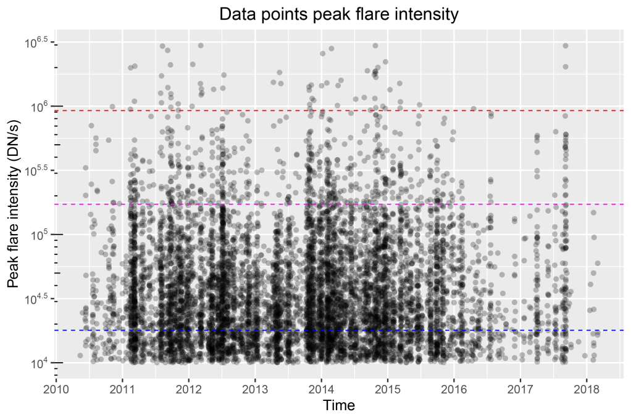
Data points 2010-2018
Solar Demon detected 8 274 on-disk flares between May 13, 2010 and March 16, 2018
Integrated flare intensity (left plot): short duration flares (consisting of only 1, 2 or a few images) create near empty horizontal bands in the lowest part of these plots
Peak flare intensity (right plot): the blue, magenta, and red horizontal lines correspond roughly to GOES C1, M1 and X1 flares
Notes:
Results are for on-disk flares only. Off-limb flares can introduce bias since we may miss part of the flare behind the limb.
Number of data points (flares): 8274
Integrated flare intensity: short duration flares (consisting of only 1, 2 or a few images) empty horizontal bands in the lowest part of these plots.
Integrated intensity is the sum of the intensities (sum of all pixel values of flare pixels in an image) over all images. Hence, it will be on average twice as large for flares lasting 2 images (4 minutes) than for flares lasting one image (2 minutes). One can thus understand and see there is a gap in between the average integrated brightness for one image and the average integrated brightness for two images. This effect also causes the small bump in the lower part of the CCDF of the integrated brightness.

Slide 11
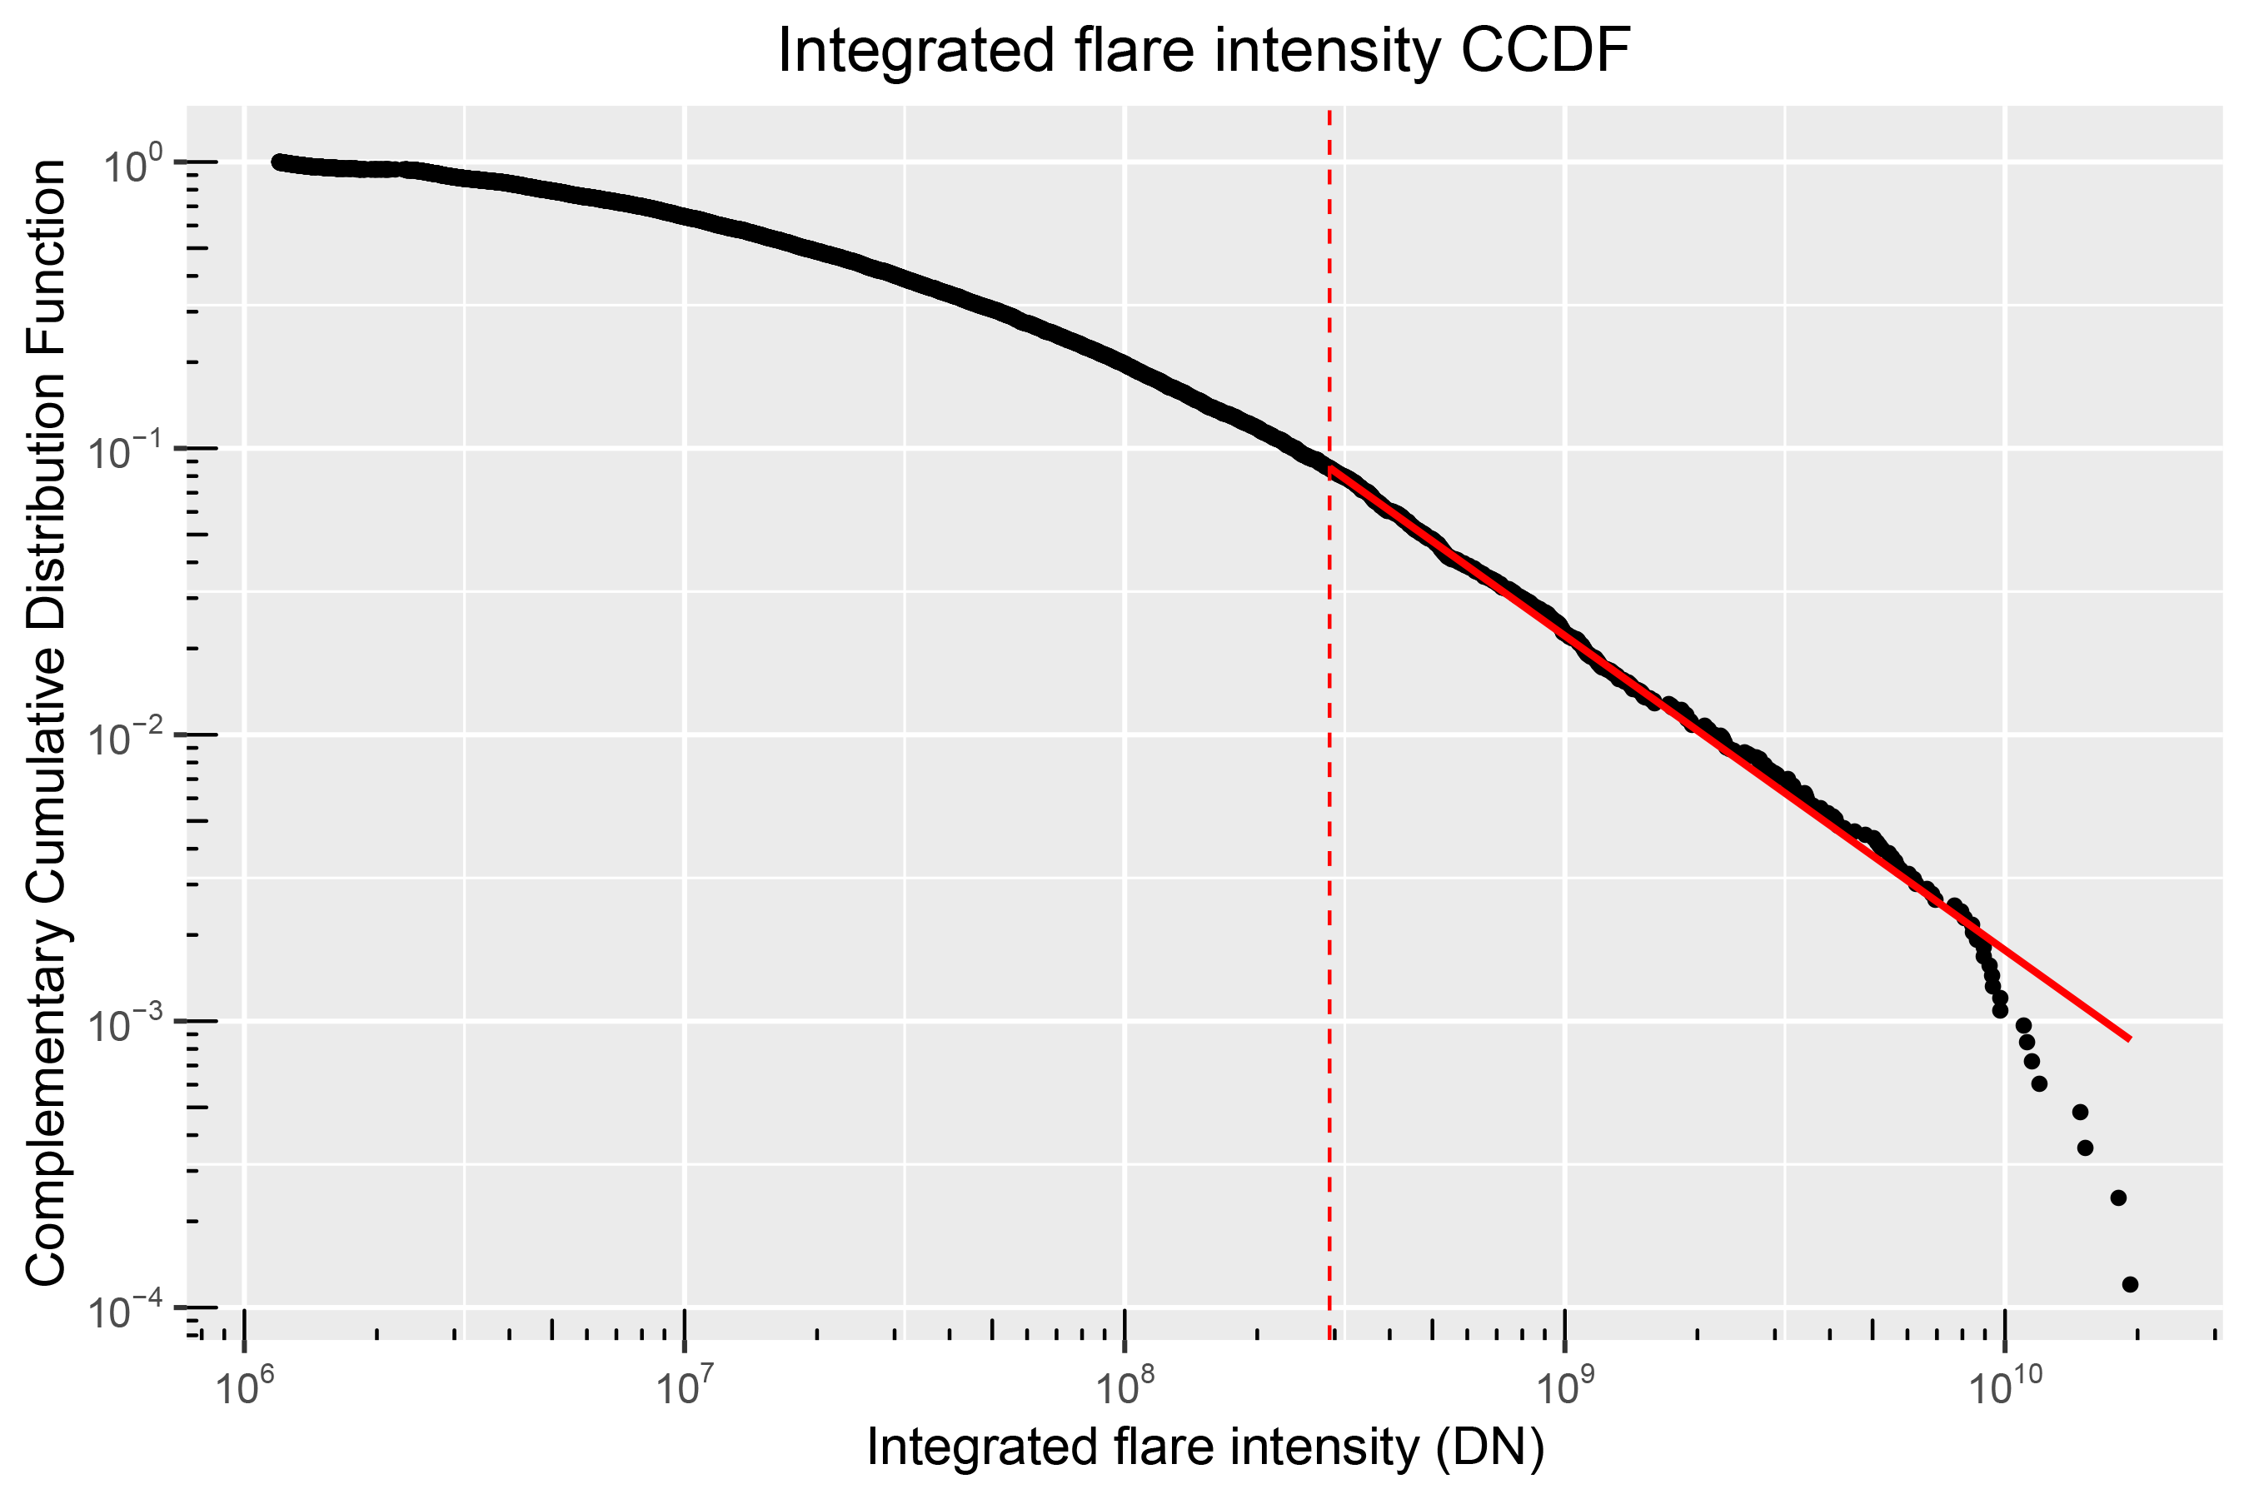
Integrated flare intensity distribution not well-described by power law
SDO/AIA 94 Å, 2010-2018 (Solar Demon)
power law fit (2.10) all data
Orders of magnitude 1.82 4.21
% data points 9 100
p-value 0.32
Notes:
There is a slight bump in the first part of the CCDF. This is due to the fact that there are some “holes” in the range of integrated intensities between flares of 1 image (lasting 2 minutes) and 2 images (lasting 4 minutes).
This kind of hole disappears for longer-lasting flares. So this is just a kind of bias introduced by the sampling cadence of 2 minutes, it’s no real feature of the distribution.
Power law is no good since only 1.82 orders of magnitude and 9% of data points (thus, only on a very limited part of the data range). Best exponent over this range = 2.10 +/ 0.01.
The fits and p values were calculated with the R package “poweRlaw”, based on A. Clauset, C.R. Shalizi, and M.E.J. Newman, "Power-law distributions in empirical data" SIAM Review 51(4), 661-703 (2009). (arXiv:0706.1062, doi:10.1137/070710111). The fundamental idea in this method is to use Maximum Likelihood Estimators to estimate parameters. Comparing distributions involves the Kolmogorov-Smirnov distance.

Slide 12
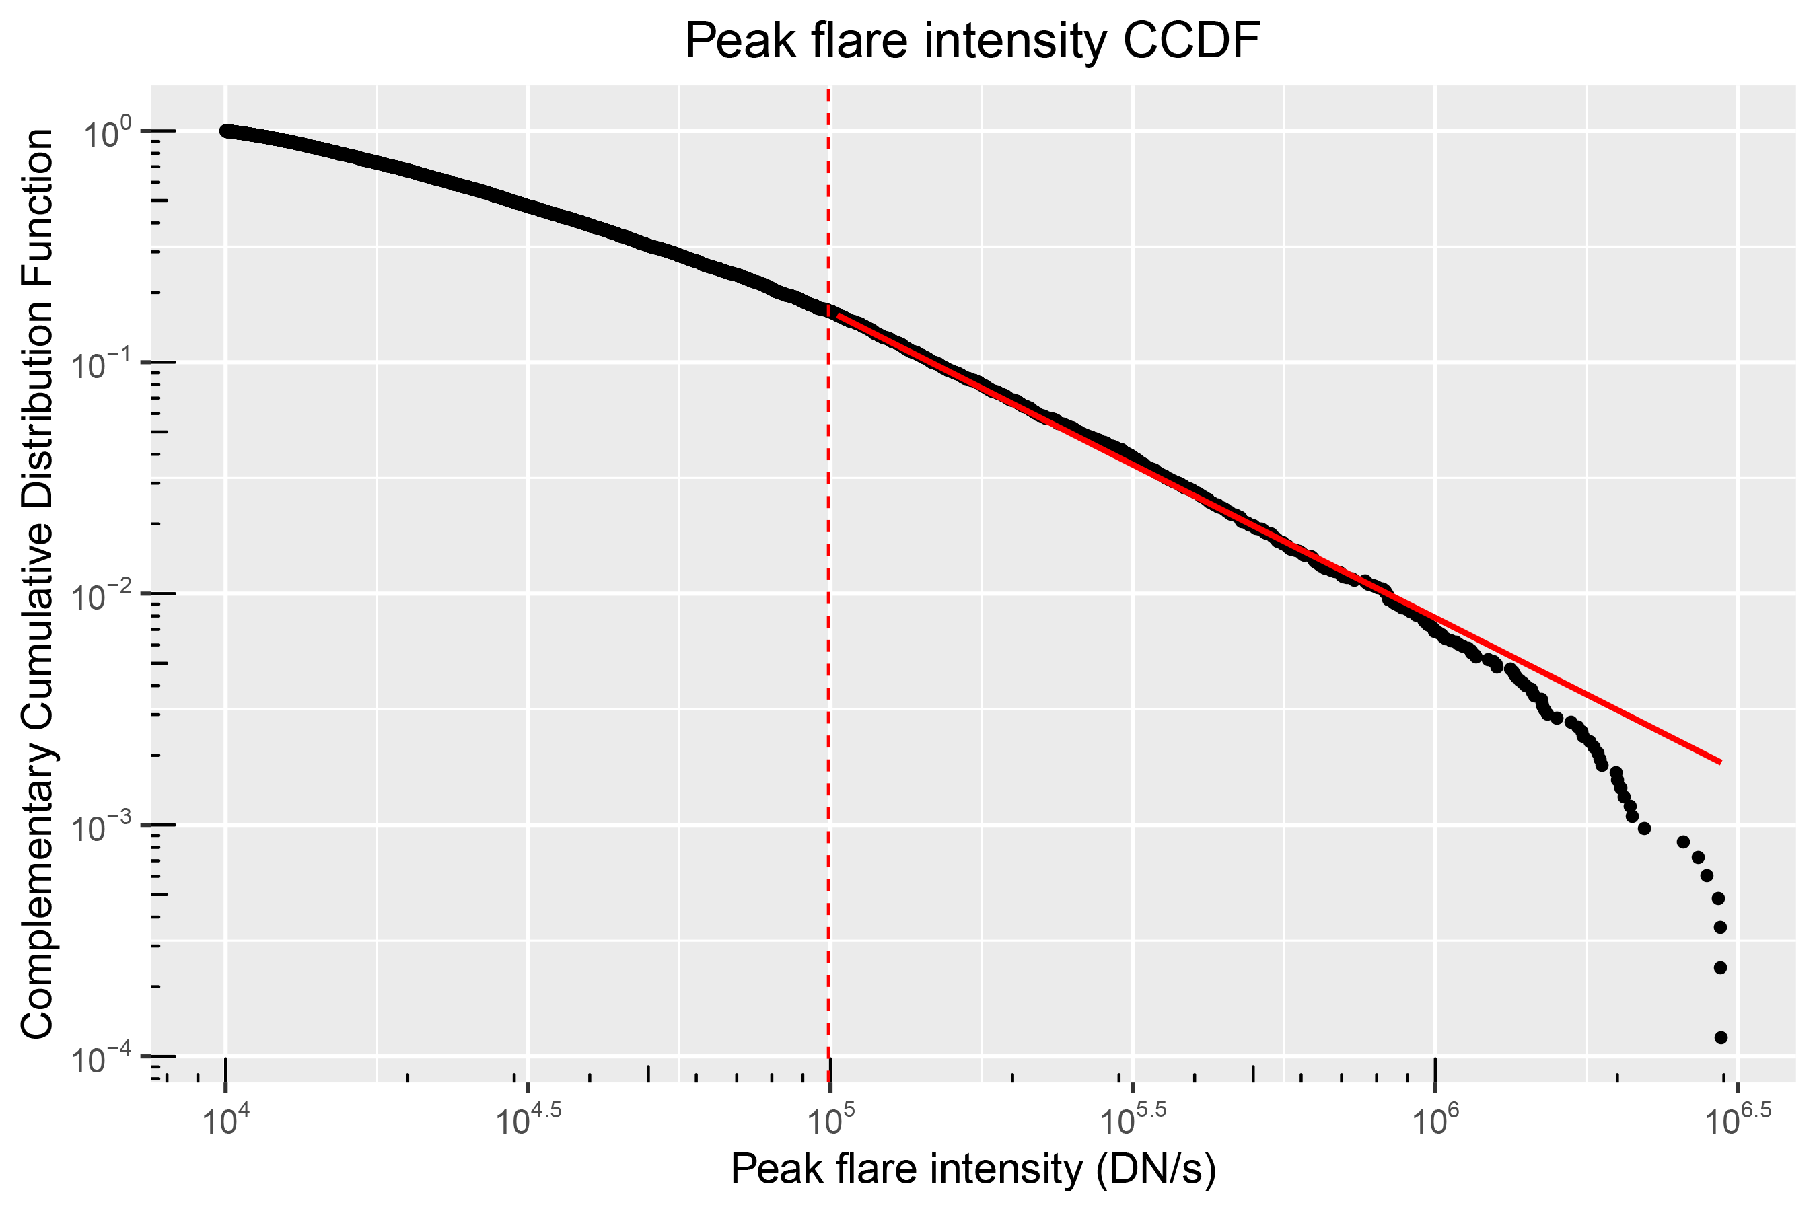
Peak flare intensity distribution not well-described by power law
SDO/AIA 94 Å, 2010-2018 (Solar Demon)
power law fit (2.32) all data
Orders of magnitude 1.48 2.47
% data points 17 100
p-value 0.04
Notes:
There is no bump in the CCDF here, as there are no “holes” in the range of peak flare intensities.
Power law is no good since only 1.48 orders of magnitude and 17% of data points (thus, only on a very limited part of the data range). Best exponent over this range = 2.32 +/- 0.01.
The fits and p values were calculated with the R package “poweRlaw”, based on A. Clauset, C.R. Shalizi, and M.E.J. Newman, "Power-law distributions in empirical data" SIAM Review 51(4), 661-703 (2009). (arXiv:0706.1062, doi:10.1137/070710111). The fundamental idea in this method is to use Maximum Likelihood Estimators to estimate parameters. Comparing distributions involves the Kolmogorov-Smirnov distance.

Slide 13
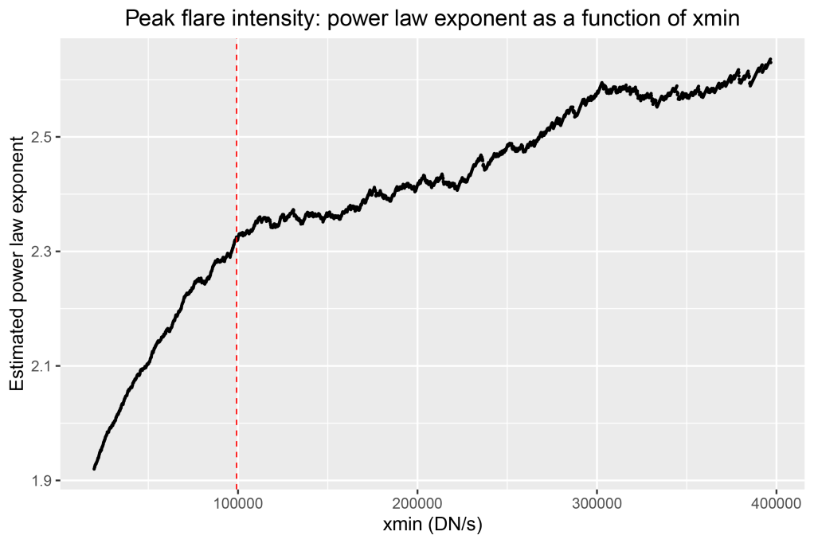
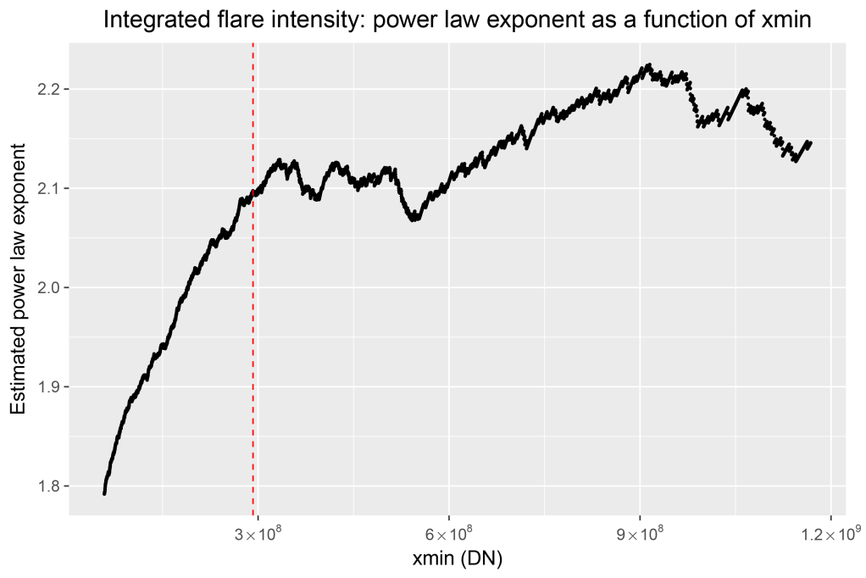
Power law exponent as a function of x_{min}
For every value x_{min} (the lower cut-off value for the power law fit),
we plot the exponent of the corresponding power law fit.
There is no range in x_{min} where the exponent is near constant (horizontal regime). This also suggests that a power law model
is not a good description of the data.

Slide 14
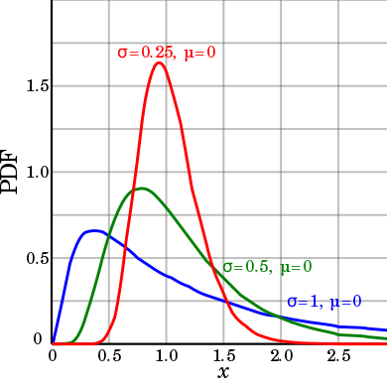
Introducing the lognormal distribution
A random variable X is lognormally distributed if and only if
Y = ln(X) has a normal distribution.
If µ and σ are the mean and standard deviation of Y,
then X = exp(µ + σ Z), with Z a standard normal variable.
A lognormal process is the statistical realization of the product of many
independent random variables,
each of which is positive.

Slide 15
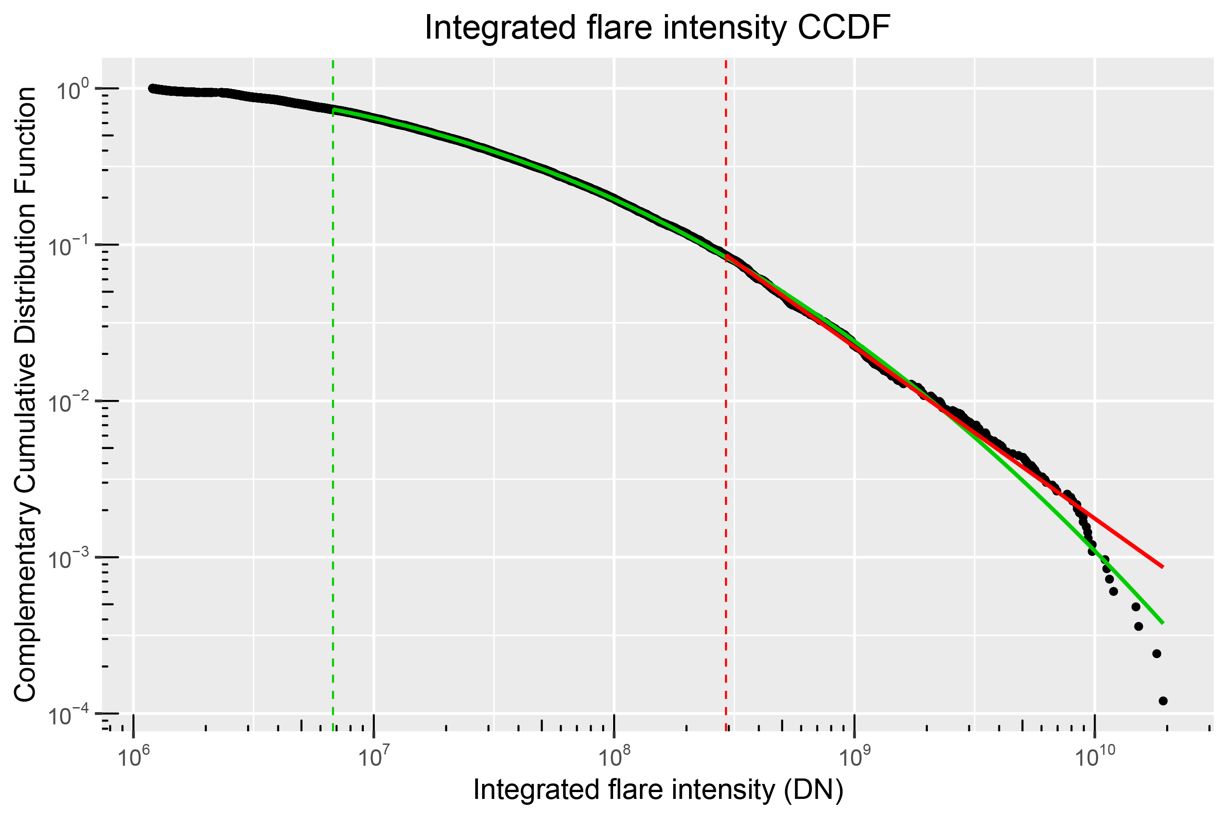
Integrated flare intensity distribution is well-described by lognormal
SDO/AIA 94 Å, 2010-2018 (Solar Demon)
power law fit (2.10) lognormal fit all data
Orders of magnitude 1.82 3.45 4.21
% data points 9 73 100
p-value 0.32 0.68
Ratio test: lognormal significantly better than power law
(test statistic: 34.81; p_one_sided: 0)
Notes:
Power law is no good since only 1.82 orders of magnitude and 9% of data points (thus, only on a very limited part of the data range). Best exponent over this range = 2.10 +/- 0.01.
Lognormal is better: more than 3 (!) orders of magnitude, 73% of data points, p-value tells us lognormal is a good fit to the data over that range (because p > 0.1).
Ratio test compares lognormal to power law. Lognormal is significantly better since a) test statistic > 0 (this means lognormal is better than power law) and b) p_one_sided is smaller than 0.1 (this means the above result is statistically significant).
The fits, p values and ratio test were calculated with the R package “poweRlaw”, based on A. Clauset, C.R. Shalizi, and M.E.J. Newman, "Power-law distributions in empirical data" SIAM Review 51(4), 661-703 (2009). (arXiv:0706.1062, doi:10.1137/070710111). The fundamental idea in this method is to use Maximum Likelihood Estimators to estimate parameters. Comparing distributions involves the Kolmogorov-Smirnov distance.

Slide 16
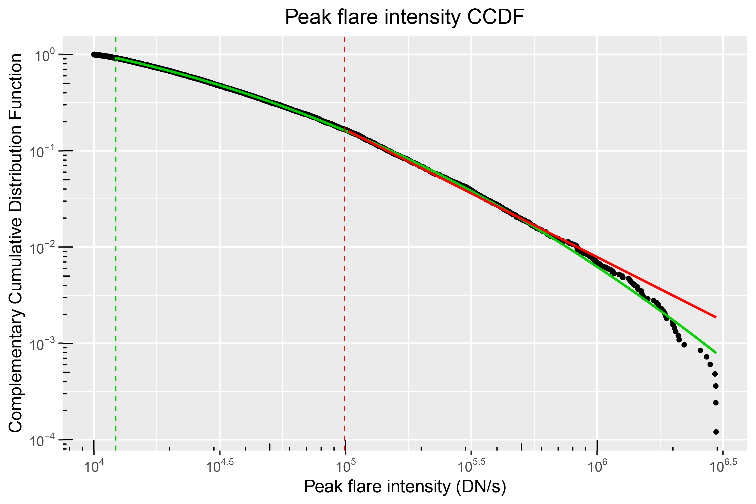
Peak flare intensity distribution is well-described by lognormal
SDO/AIA 94 Å, 2010-2018 (Solar Demon)
power law fit (2.32) lognormal fit all data
Orders of magnitude 1.48 2.39 2.47
% data points 17 92 100
p-value 0.04 0.28
Ratio test: lognormal significantly better than power law
(test statistic: 24.66; p_one_sided: 0)
Notes:
Power law is no good since only 1.48 orders of magnitude and 17% of data points (thus, only on a very limited part of the data range). Best exponent over this range = 2.32 +/0.01.
Lognormal is better: almost 2.4 orders of magnitude, 92% of data points, p-value tells us lognormal is a good fit to the data over that range (because p > 0.1).
Ratio test compares lognormal to power law. Lognormal is significantly better since a) test statistic > 0 (this means lognormal is better than power law) and b) p_one_sided is smaller than 0.1 (this means the above result is statistically significant).
The fits, p values and ratio test were calculated with the R package “poweRlaw”, based on A. Clauset, C.R. Shalizi, and M.E.J. Newman, "Power-law distributions in empirical data" SIAM Review 51(4), 661-703 (2009). (arXiv:0706.1062, doi:10.1137/070710111). The fundamental idea in this method is to use Maximum Likelihood Estimators to estimate parameters. Comparing distributions involves the Kolmogorov-Smirnov distance.

Slide 17
Discussion
How can this result be reconciled with the many papers that describe the power law distribution of flare parameters as observed in various data sets?
Different studies do not agree on the actual power law exponent, finding a whole range of exponents both below and above 2
This divergence of exponent values may be partly due to pollution of the data sets by the solar background
Data sets lacking spatial information about flares will typically classify simultaneous flares in different regions of the Sun as a single flare, adding bias to the data set
It has been shown that first justifying and then fitting a power law model to data via graphical methods can be misleading (Clauset et al. 2009; D’Huys et al. 2016)
Implications of lognormal instead of power law flare distributions:
SOC paradigm for solar flares needs to be revisited. See next talk by Podladchikova et al.
Do flares provide enough energy for coronal heating? The sufficiency criterion needs to be revisited.
Notes:
Lognormal distributions can arise as a product of i.i.d. random variables, e.g., in fractionation. See talk by Podladchikova et al. for other approach.

Slide 18
Conclusion
Flare data set detected by Solar Demon on SDO/AIA 94 Å synoptic level 1.5 science data
8 274 events (May 13, 2010 - March 16, 2018)
Separate detection of simultaneous flares at different locations
Background solar intensity does not affect the measured flare intensity
Robust statistical analysis (MLE) of integrated and peak flare intensity distribution
Comparing CCDF of data and power law fit, goodness-of-fit, and exponent stability plot all indicate that power law fit does not describe the data well
Comparing CCDF of data and lognormal fit and goodness-of-fit indicate that lognormal fit does describe the data well
Direct comparison (likelihood ratio) indicates that lognormal fit describes the data better than power law
Lognormal fit is valid over much wider domain than power law fit (92% vs. 17% and 73% vs. 9% for peak and integrated intensity resp.)
This work was submitted to Ap.J

Slide 19
Thank you for your attention! Questions?

Slide 20
Reserve slides

Slide 21
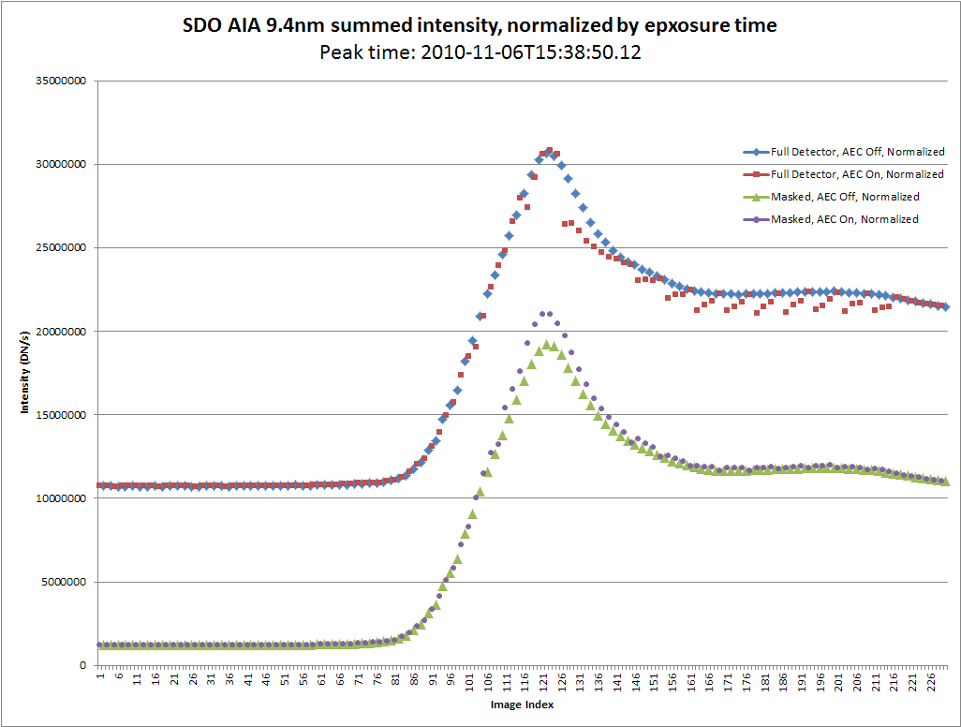
Effect of pixel saturation (major flares)
During major flare, 12 s cadence 94 Å AIA images alternate between default exposure time (often with saturated pixels) and Automatic Exposure Control (AEC), i.e., much shorter exposure time to avoid saturated pixels.
Comparing AEC (purple) and non-AEC (green) light curves in M5.4 flare 2010-11-06T15:38:50, we observe 10% saturation.
“AEC only“ light curve will avoid saturation, but requires importing images at much higher cadence (currently 2 minutes)

Slide 22
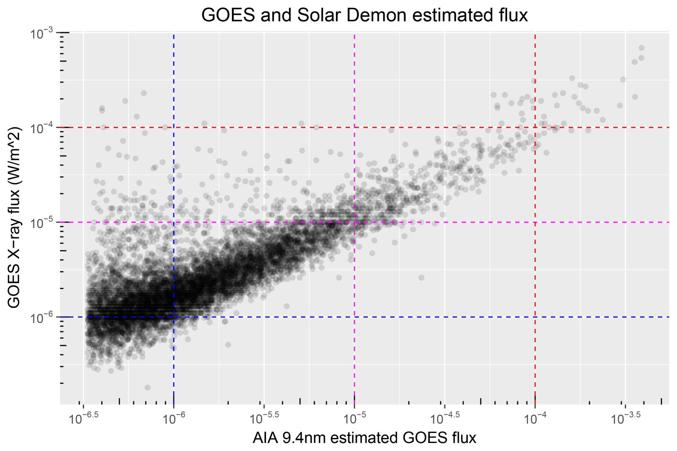
Effect of nonlinearity
To which extent is the Solar Demon flare intensity linear w.r.t. GOES X ray flux?
Linear relationship, but relatively large proportion of flares with high GOES X ray flux and low Solar Demon intensity.
Notes:
For every detected are, Solar Demon estimates the corresponding GOES (0.1-0.8 nm) X-ray flux, expressed in Wm^-2, as the total are intensity plus a correction factor in DN s􀀀1 (in 9.4 nm, normalized for exposure time) multiplied by 3.33 10^-10. The correction factor is the the number of saturated pixels multiplied by 25,000.

Slide 23
Future ideas
Employ high cadence (12 s) AIA data for Solar Demon flare detections
Removes effect of saturation in major flares
More accurate parameter estimates such as peak intensity
Investigate the effect of high cadence on the detection of faint, short duration flares
Perform a similar analysis on other flare datasets, e.g., background-subtracted GOES X ray flares
Compare power law and lognormal fits

Slide 24
Bootstrap convergence: power law for flare integrated brightness
Notes:
All values converge to a narrow range after 5000 iterations. This shows the bootstrapping process is robust.

Slide 25
Bootstrap convergence: lognormal for flare integrated brightness
Notes:
All values converge to a narrow range after 5000 iterations. This shows the bootstrapping process is robust.

