Slide 1
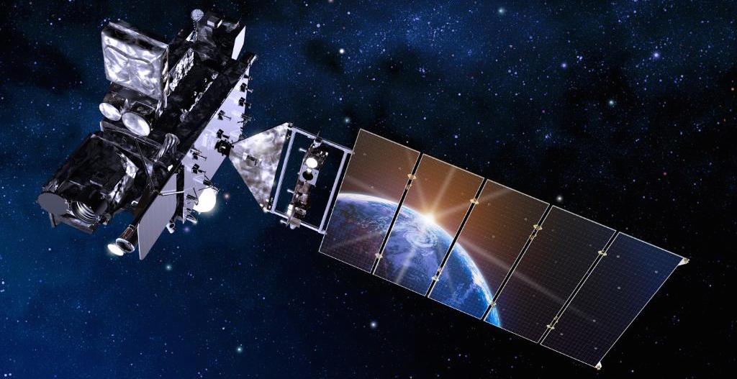
Solar EUV Irradiance Monitoring beyond SDO-EVE: GOES EXIS Preliminary Measurements and Validation
F.G. Eparvier, A.R. Jones, T.N. Woods, M. Snow, E.M.B. Thiemann, W.M. McClintock, D.L. Woodraska, R. Viereck, J. Machol, T. Eden, S. Mueller, and R. Meisner
eparvier@Colorado.edu

Slide 2
EUV and X-Ray Irradiance Sensors (EXIS)
NOAA requires the realtime monitoring of the solar irradiance variability that controls the variability of the terrestrial upper atmosphere (ionosphere and thermosphere). This requirement supports NOAA’s space weather operations and is implemented with two instruments:
XRS = X-Ray Sensor
XRS measures the solar soft x-ray irradiance in two bandpasses at 0.05-0.4 nm and 0.1-0.8 nm
On GOES manifest from beginning of program (~1978 on SMS)
all past and present instruments are ionization chambers with Be filters
XRS Purpose: Monitor solar flares (and help predict proton events) that can disrupt communications and degrade navigational accuracy
EUVS = Extreme UltraViolet Sensors
Through a combination of measurements and modeling, EUVS determines the solar EUV spectral irradiance in the 5 - 127 nm range
first included on GOES in 2006 (GOES-13, in on-orbit storage) as transmission grating spectrographs measuring 5 broad bandpasses
EUVS Purpose: Monitor solar variations that directly affect satellite drag / tracking and ionospheric changes, which impact communication and navigation operations

Slide 3
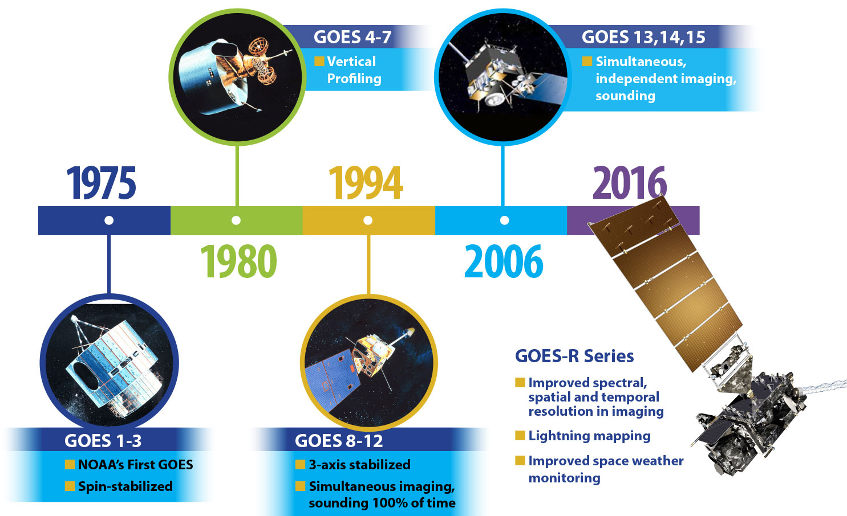
GOES: Part of NOAA for 43 Years
XRS on GOES from beginning
Broadband EUVS added with GOES-13
New EUV and X-Ray Irradiance Sensors (EXIS) with R Series

Slide 4
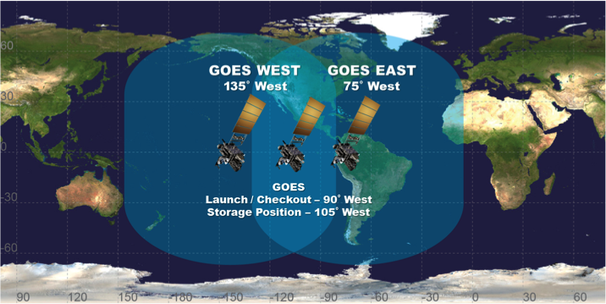
So Important They Fly More Than One

Slide 5
^Space
2009
EXIS
CDR
2010 SDO launch
Each of the GOES-R series has a 10 year mission lifetime.
The 4th (GOES-U) will launch no earlier than 2024.

Slide 6
EXIS Nursery at LASP
EXIS FM-4
GOES-U
To Launch in 2024?
To be GOES-19
As needed
In LASP High-Bay
To deliver in 2019?
EXIS FM-3
GOES-T
To Launch in 2020
To be GOES-18
On orbit storage
At LM on hold for ABI repairs
EXIS FM-2
GOES-S
Launched 3/1/18
Now GOES-17
To be GOES-WEST
In PLPT Phase
Operational 2019?
EXIS FM-1
GOES-R
Launched 11/19/16
Now GOES-16
Or GOES-EAST
In XV Phase
Operational 12/18?
Plus we’ve just been contracted to build an FM-5 as a “spare unit”.

Slide 7
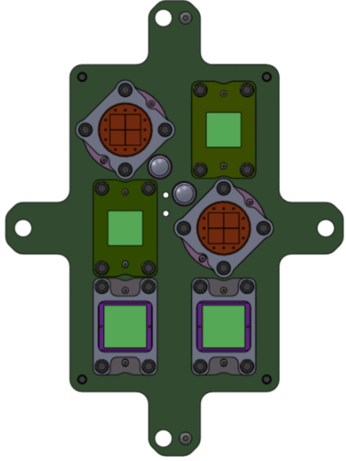
GOES-R XRS Overview
Each XRS channel (A & B) has:
Two photometers with different sized apertures for solar minimum and solar maximum/flaring conditions (Large overlap in both dynamic ranges adds redundancy in measurements)
Silicon photodiodes with Be filters (thicknesses of filters and diodes scaled to match previous XRS bandpasses)
Low-power, low-noise electrometers
XRS also has:
Dark channel for simultaneous background corrections
Improved calibration methodology
Improved measurement to irradiance conversion
A2:
Solar max/flare
λ = 0.05-0.4nm
A1:
Solar min
λ = 0.05-0.4 nm
B1:
Solar min
λ = 0.1-0.8 nm
B2:
Solar max/flare
λ = 0.1-0.8nm
Dark
Dark
Flare Location with XRS:
XRS-A and XRS-B solar max detectors are quadrant photodiodes giving the location of bright X-Ray flares

Slide 8
XRS Data Products
L1b:Measurements:
Irradiances: 0.05-0.4 and 0.1-0.8 nm bands at 1-sec
Note: requirements met with 3-sec median
Raw counts for each diode (1-sec)
Data flags
Pointing information (to pass on to higher level products)
L2 + Higher Level Products:
Flare classes (A, B, C, M, X) and magnitude
Flare event alerts (start, max, duration, magnitude)
Flare locations
Proton event alerts

Slide 9
Extreme Ultraviolet Sensor (EUVS)
Three channels to provide proxies for the emissions from the chromosphere (CH), transition region (TR), and corona (COR)
Measured proxies are used to model the full EUV range (5-115 nm and 121.6 nm)
MgII C/W key to internal EUVS degradation tracking method (and a NOAA required measurement)
Chan. | measured (nm) | Δλ (nm) | Integration Time (sec) | Optical Design
A | 25.6, 28.4, 30.4 | 0.6 | 1.0 | Spectrograph (grazing incidence) with foil filter and 24-element custom photodiode array
B | 117.5, 121.6, 133.5, 140.5 | 1.0 | 1.0 | Spectrograph with interference filter and 24-element custom photodiode array
C | 275-285 | 0.1 | 3.0 | Spectrograph with interference filter and 512-element photodiode array (MASCS)

Slide 10
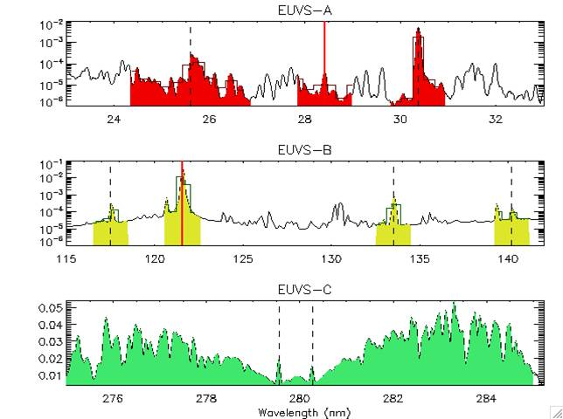
EUVS Measurements
Chromosphere:
Primary: MgII C/W (EUVS-C)
Redundant: CIII 117.5 nm and CII 133.5 nm (EUVS-B)
Transition Region:
Primary: Ly-alpha 121.6 nm (EUVS-B)
Redundant: SiIV/OIV 140.5 nm (EUVS-B), HeII 30.4 nm and HeII 25.6 nm (EUVS-A)
Corona:
Primary; FeXV 28.4 nm (EUVS-A)
Hot Coronal:
Primary: 0.1-0.8 nm (XRS)
Redundant: 0.05-0.4 nm (XRS)
Note: All measurements can be used in the EUVS model, but the “primary” ones are the minimum necessary to meet requirements.

Slide 11
EUVS Data Products
L1b Measurements:
Irradiances: in all the lines (at 1-sec and 30-sec)
Mg II Core-to-Wing Ratio (at 3-sec and 30-sec)
Measured Ratio
NOAA scaled Ratio
Wing values and core fit parameters
Raw counts for each diode on all channels
Data flags
L1b EUVS Model:
Model Irradiances: 5-115 nm in 5 nm bins, plus 5 nm bin around Ly-α
Proxies used (at 30-sec cadence)
L2 + Higher Level Products:
Minute and daily averages of lines, proxies, and spectra
EUV event alerts (start, max, duration, magnitude)
Daily averages of Irradiances and Proxies
Improved Flare Spectral Modeling

Slide 12
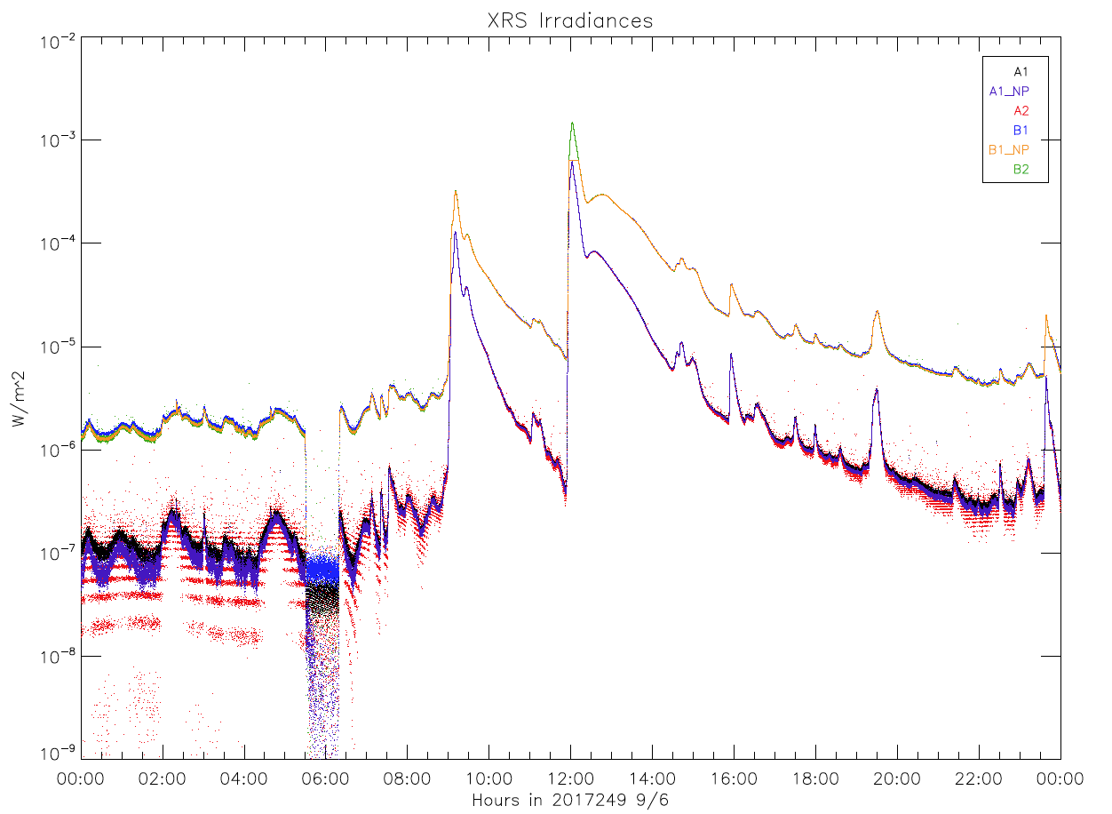
Preliminary GOES-16 XRS Data
a
September 6, 2017
XRS-B (Long)
Preliminary
XRS-A (Short)
Preliminary GOES-16 data, not for public or scientific use!!!

Slide 13
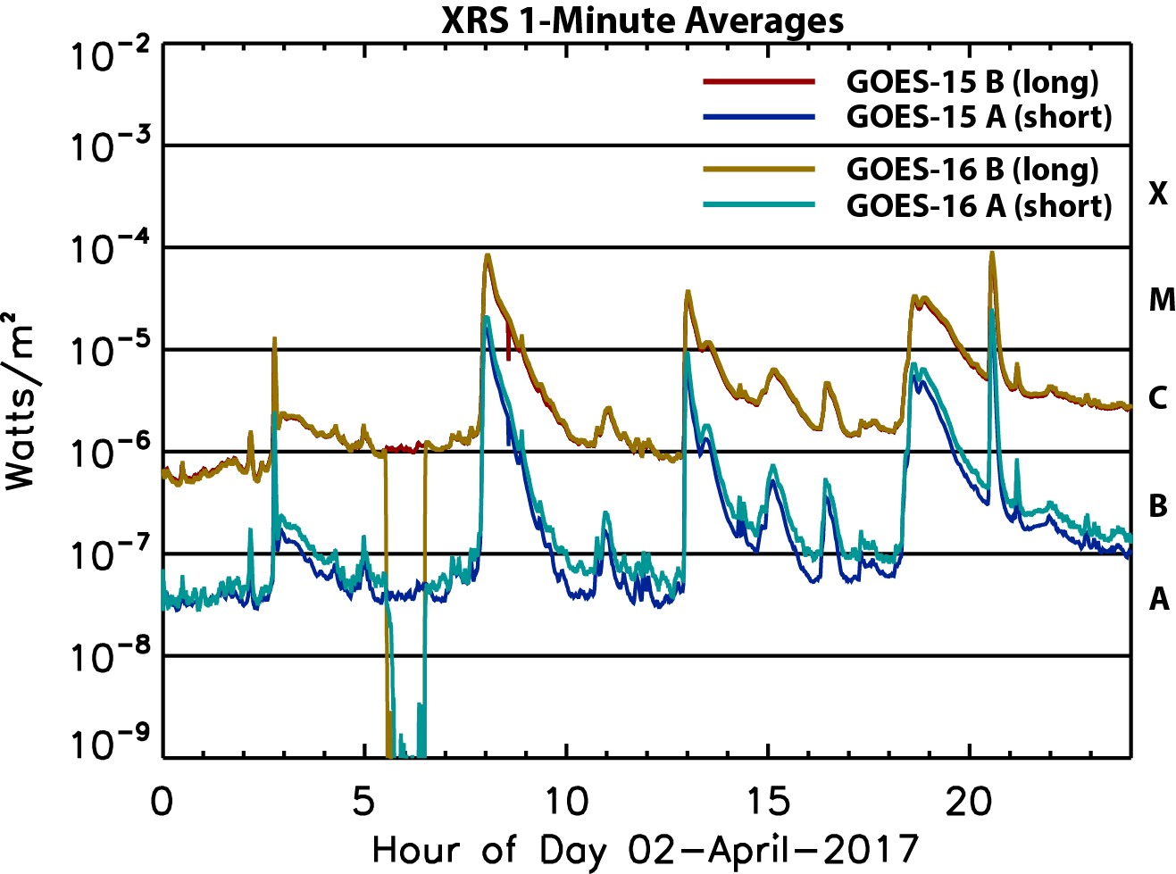
Preliminary GOES-16 XRS Data
XRS-B (Long)
Preliminary
XRS-A (Short)
Preliminary GOES-16 data, not for public or scientific use!!!

Slide 14
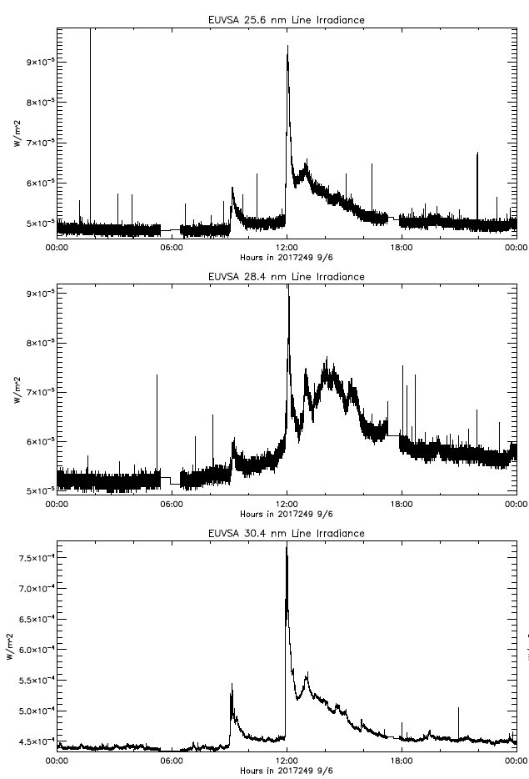
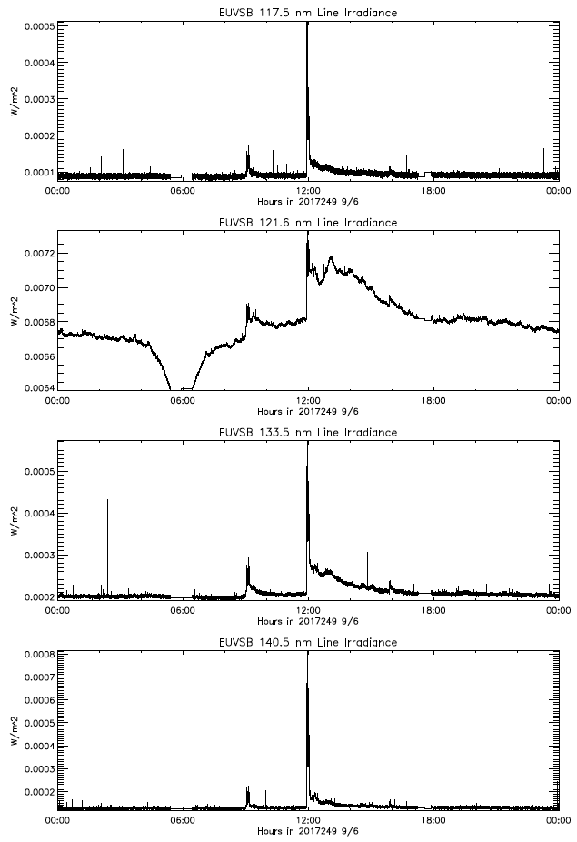
Preliminary GOES-16 EUVS-A & -B Data
a
a
September 6, 2017
September 6, 2017
25.6 nm
117.5 nm
121.5 nm
Preliminary
28.4 nm
133.5 nm
30.4 nm
140.5 nm
Preliminary GOES-16 data, not for public or scientific use!!!

Slide 15
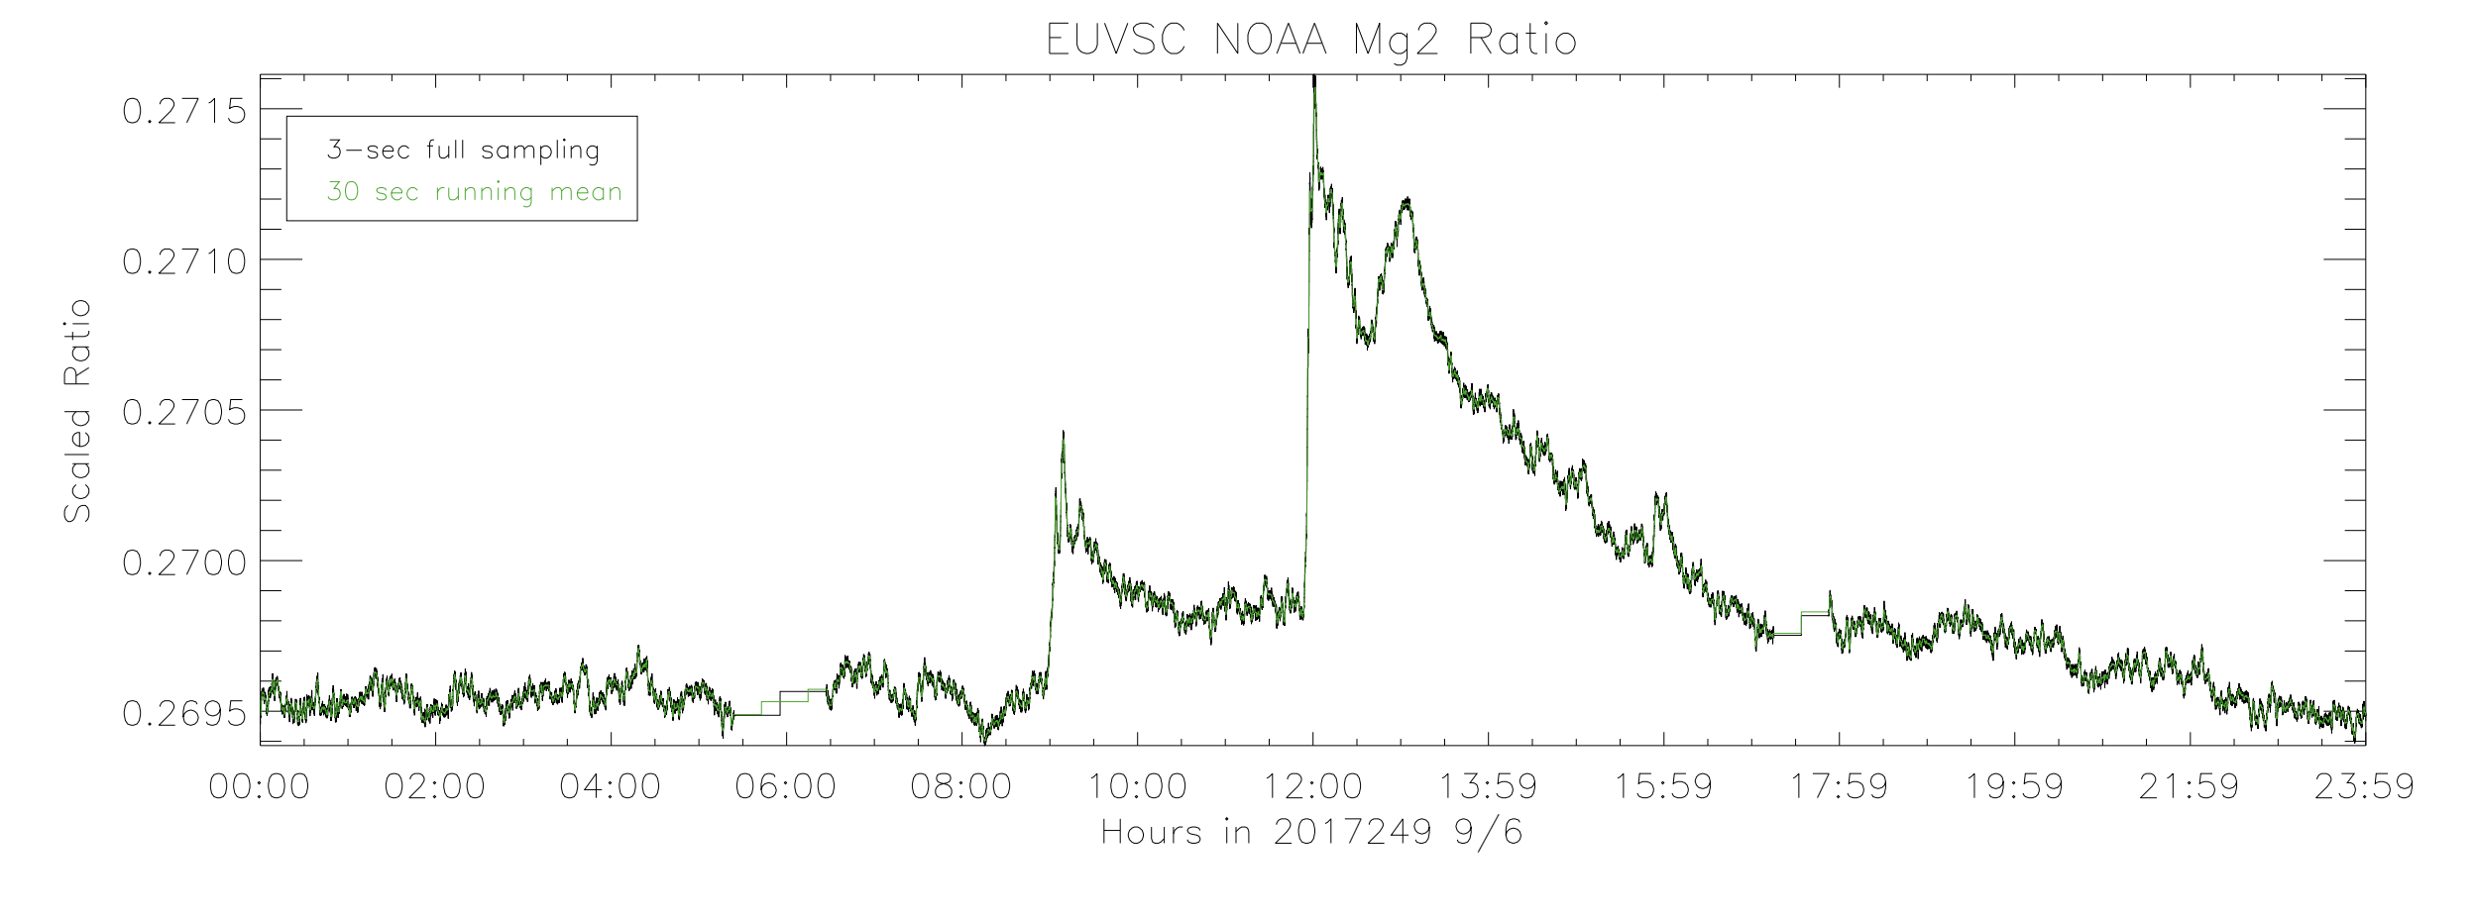
Preliminary GOES-16 EUVS-C Data
September 6, 2017
MgII C/W Index
Preliminary
Preliminary GOES-16 data, not for public or scientific use!!!

Slide 16
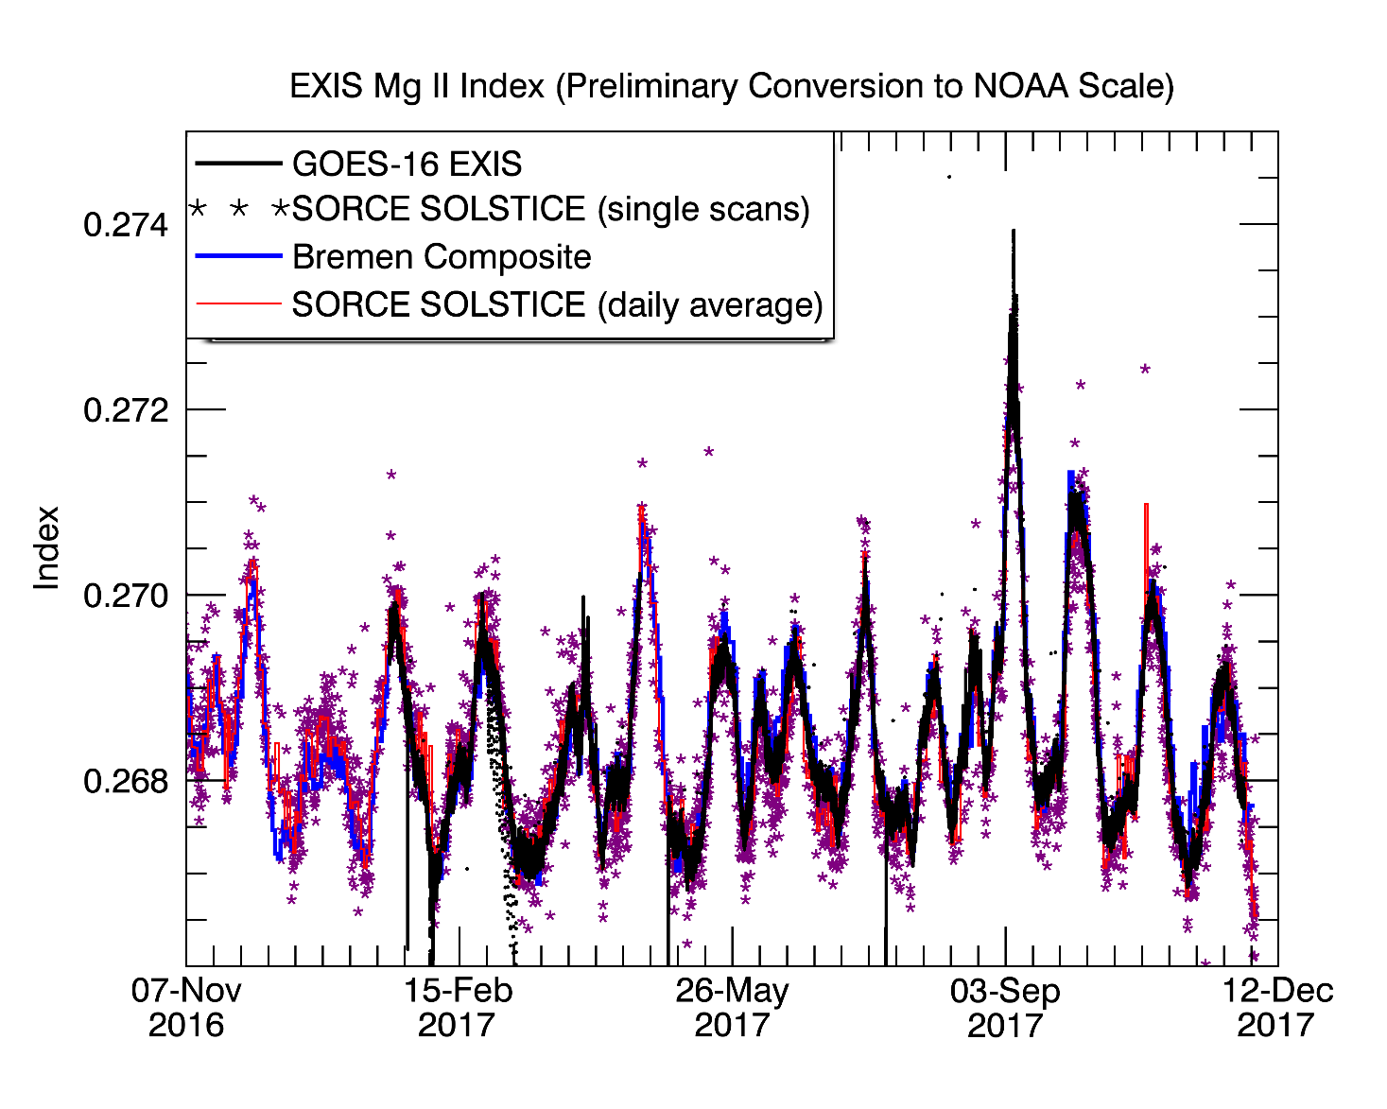
Preliminary GOES-16 EUVS-C Data
Preliminary
Preliminary GOES-16 data, not for public or scientific use!!!

Slide 17
Summary
EXIS provides:
Continuity of XRS measurements, but with larger dynamic range an other improvements
New EUVS with EUV/FUV line measurements and MgII index, plus full EUVS spectral model
Two EXIS on orbit now (GOES-16 and 17)
G16 data to be provisionally operational by end of year, with fully operation in 2019.
G17 data to follow
Future:
GOES-T to launch no earlier than 2020
GOES-U no earlier than 2024.
An EXIS will be operational until at least 2035

Slide 18
Data Availability
When the EXIS data becomes available, you will be able to get it at:
https://www.ngdc.noaa.gov/stp/satellite/goes-r.html

