Slide 1
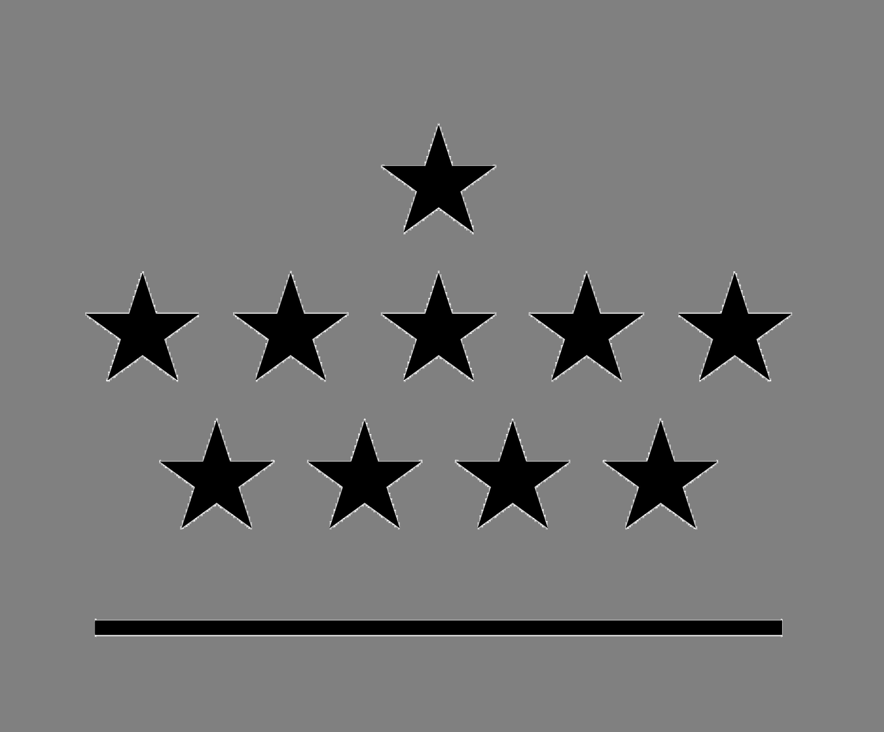
Three-dimensional structure of a coronal streamer observed by SOHO/LASCO and STEREO/COR2
Bieke Decraemer, Andrei Zhukov, Tom Van Doorsselaere
SDO Workshop, Ghent, Belgium, October 31, 2018
Solar Terrestrial Centre of Excellence – SIDC, Royal Observatory of Belgium, Belgium
Centre for mathematical Plasma Astrophysics – CmPA, KU Leuven, Belgium

Slide 2
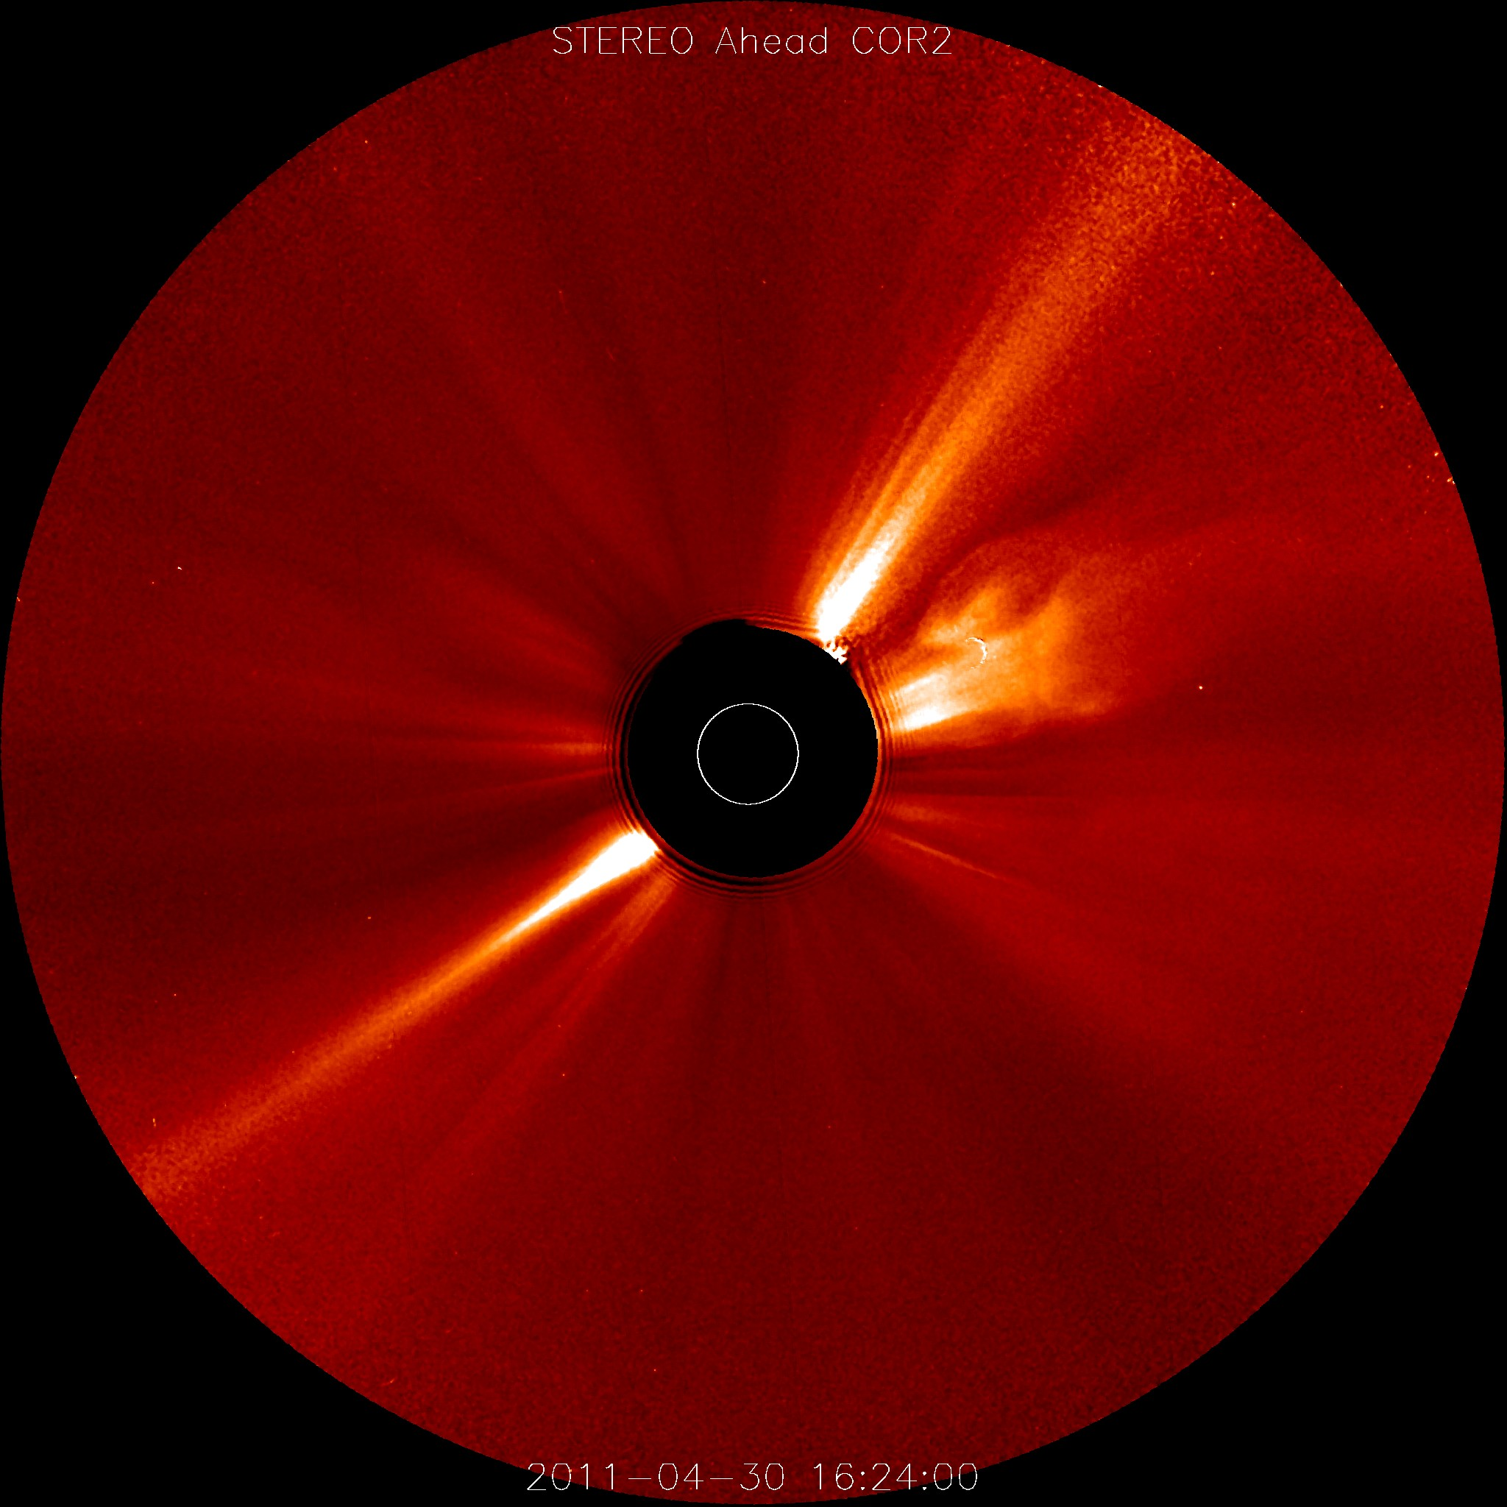
Introduction
Helmet streamers are a prominent manifestation of magnetic structures with current sheets in the Solar corona.
These large-scale structures are regions with high plasma density, overlying active regions and filament channels.
We investigate the 3D structure of coronal streamers, observed by white-light coronagraphs (SOHO/LASCO and STEREO/COR2).

Slide 3
Observations from different vantage points
The streamer used in this study was observed edge-on with COR2 onboard STEREO A on April 30, 2011.
The view of SOHO/LASCO at this moment corresponds to the face-on view of the same streamer.
At the time of observation STEREO A and Earth were separated by an angle of 91.415°.
Since this streamer is observed by two spacecraft nearly in quadrature, it is very well suited for 3D reconstructions.

Slide 4
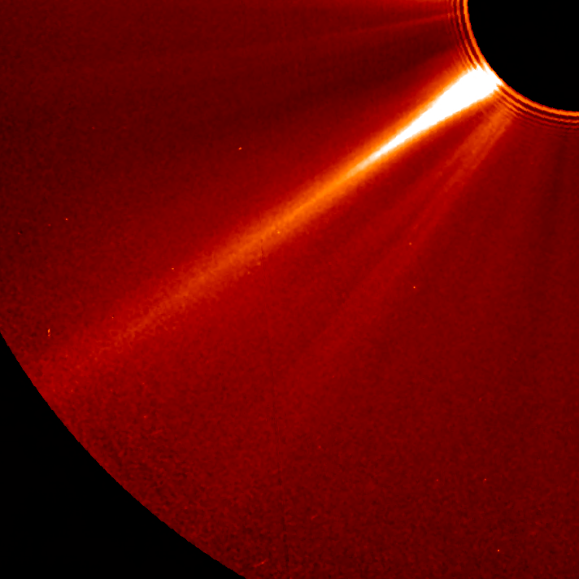
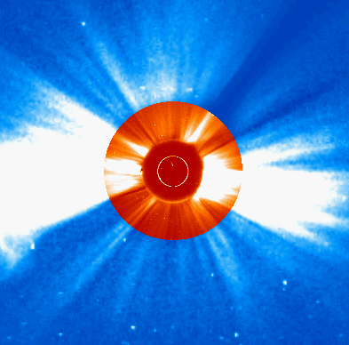
Observations from different vantage points
STEREO A / COR2
SOHO / LASCO C2 and C3

Slide 5
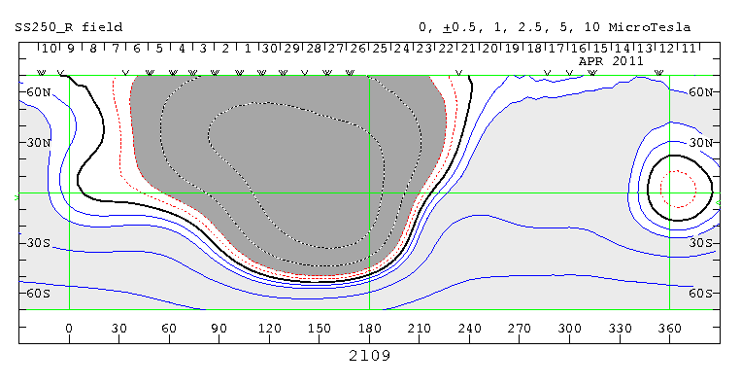
Identifying the streamer location
In the synoptic map the streamer structure spans about 40° at a latitude of -39° (the part curved towards the pole is due to the projection effect).
This corresponds to the part of the source surface magnetic neutral line (calculated on the base of the PFSS extrapolation of the WSO magnetogram) extending nearly parallel to the equator. This indicates that the streamer is centered around a current sheet in the corona.

Slide 6
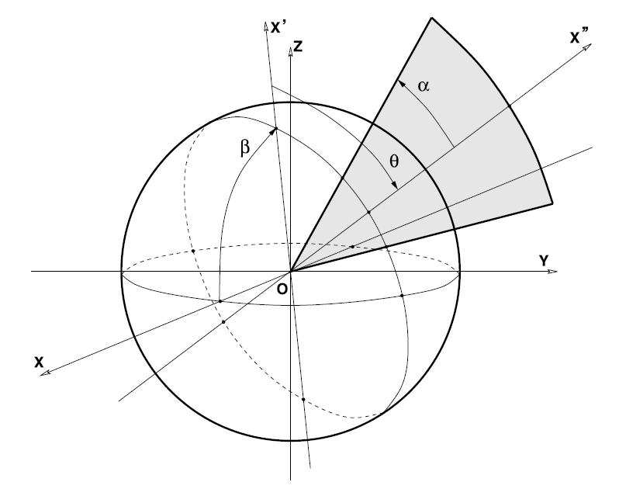
Model
We develop a forward model based on plausible assumptions about the 3D streamer structure, following the model proposed by Thernisien and Howard (ApJ, 2006)
The streamer is approximated with a plasma sheet, of which the electron density is given by
where r is the radial distance (in solar radii), α is the width angle in the plane of the slab and ξ is the angle between the line defined by a point in the corona and the Sun center to the central symmetry plane of the slab.
Figure from Thernisien and Howard (2006)

Slide 7
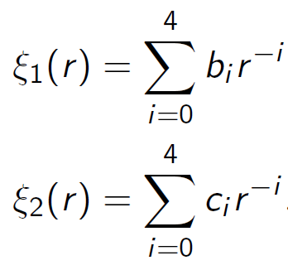
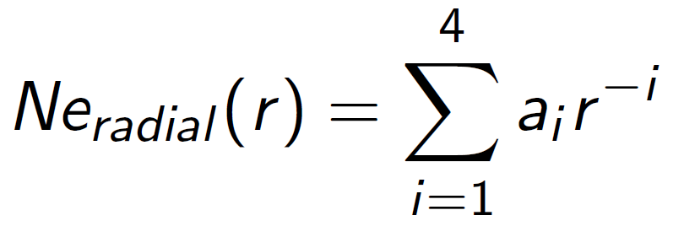
Model
First the shape function is fitted to the observations
Then the following radial function is used
The face-on modulation is expressed by putting in a normalized circular profile, taken from the face-on view of the slab.
We fit this model to the observations with a multivariate minimization technique on a $χ^{2}$ type criteria.

Slide 8
Results – ‘Shape’ fit
The shape function is first fitted to the observations. For this 10 observations across the edge-on streamer stalk are used simultaneously.
The brighter structure at the right of the streamer in the edge-on view must be excluded from the data, since it does not contribute to the streamer profile.
The overall shape of the fit matches the observations reasonably well.

Slide 9
Results – ‘Shape’ fit
The streamer axis is not orthogonal to the Solar surface. However, this is assumed in the definition of the shape function due to the symmetry in the ξ coordinate. This causes displacements of the streamer peak in the fits.
, moved

Slide 10
Results – Radial fit
Next we do a minimization procedure using one radial profile along the edge-on view and one circular profile along the face-on view to determine the still to be fitted parameters.
The radial profile of the modeled brightness is in good agreement with the observations

Slide 11
Results – Azimuthal fit
For the circular profile, the modulation at the center is quite nicely reproduced, while it smoothens towards the edges.
Even though we only use a single profile at one selected height, both profiles at 4 and 11 Solar radii are well reproduced. The assumption of quasi-radial structures in the face-on view is thus very reasonable.

Slide 12
Results – forward modeled views

Slide 13
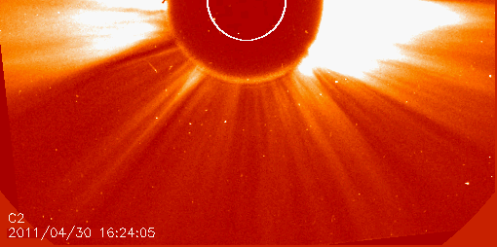
Comparison of model with observations

Slide 14
Conclusions and outlook
We developed a forward model based on plausible assumptions about the 3D streamer structure, which is optimized by fitting it to observational data taken by SOHO and STEREO A in quadrature.
Our model sheds light on the fine three-dimensional structure of the electron density distribution in coronal streamers.
Our model can reproduce the observations reasonably well, though it has some problems with the assumption that coronal streamers are purely radial features.
This density model can now be used as a background density model for the modelling of e.g. streamer wave events.

