Slide 1


Exploring The Solar Poles From The L1 Perspective
Matthew J West – Royal Observatory of Belgium
SDO Workshop – Ghent - 2018

Slide 2
What Do We Know About
The Poles So Far???
Notes:
So for those of you who are not familiar with Post-flare giant arches I thought I'd begin with a quick introduction.

Slide 3
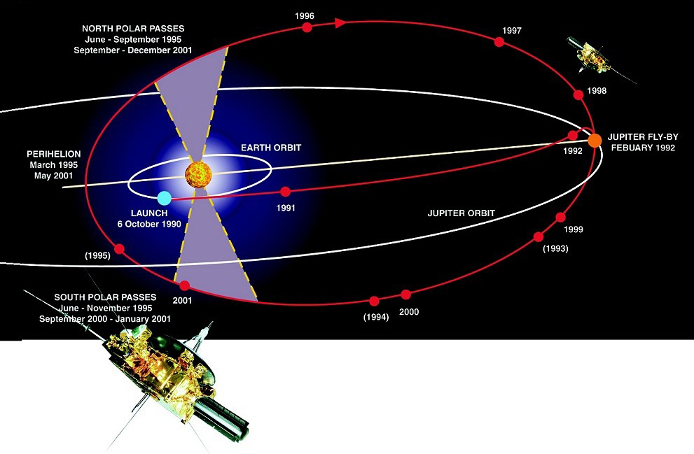
Exploring The Solar Poles From The L1 Perspective | Matthew J West – Royal Observatory of Belgium
Ulysses And The Poles
Courtesy of ESA

Slide 4
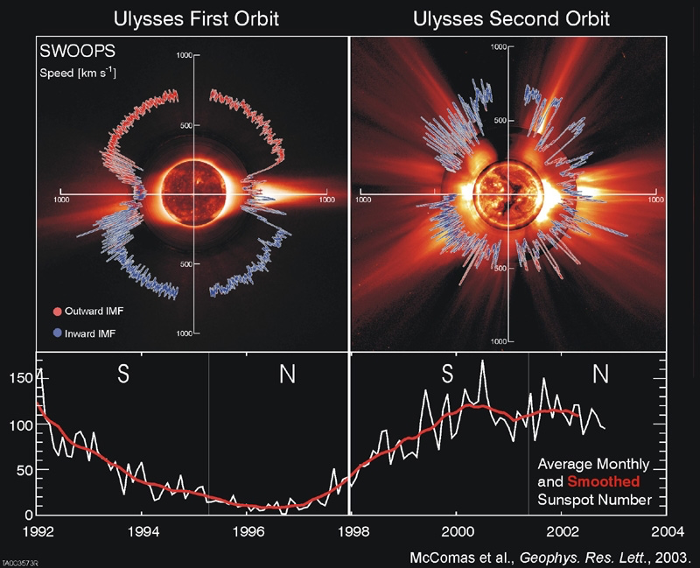
Exploring The Solar Poles From The L1 Perspective | Matthew J West – Royal Observatory of Belgium
Ulysses And The Poles
The solar poles are relatively unexplored regions of the solar atmosphere, this is due to a lack of satellites that have travelled over and through them.
The Ulysses mission (1990-2009) was the only mission to truly explore these regions.
Thanks to its orbit, Ulysses probed the Sun at a range of large of latitudes and traversed the southern and northern polar regions.
The mission included several instruments that measured the “in-situ” plasma properties, but alas did not include any imaging instruments.

Slide 5
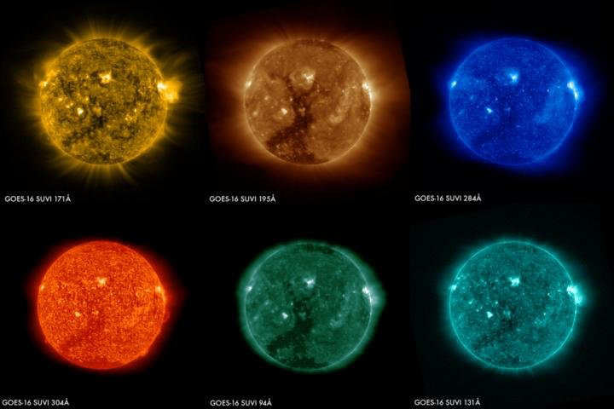
Exploring The Solar Poles From The L1 Perspective | Matthew J West – Royal Observatory of Belgium
The Poles From The Ecliptic
Portions of the solar poles can of course be observed with our current menagerie of solar observing instruments, such as SWAP, SUVI, AIA, EIT and EUVI, amongst others. However, these are mainly located around the ecliptic.
Courtesy of NOAA

Slide 6
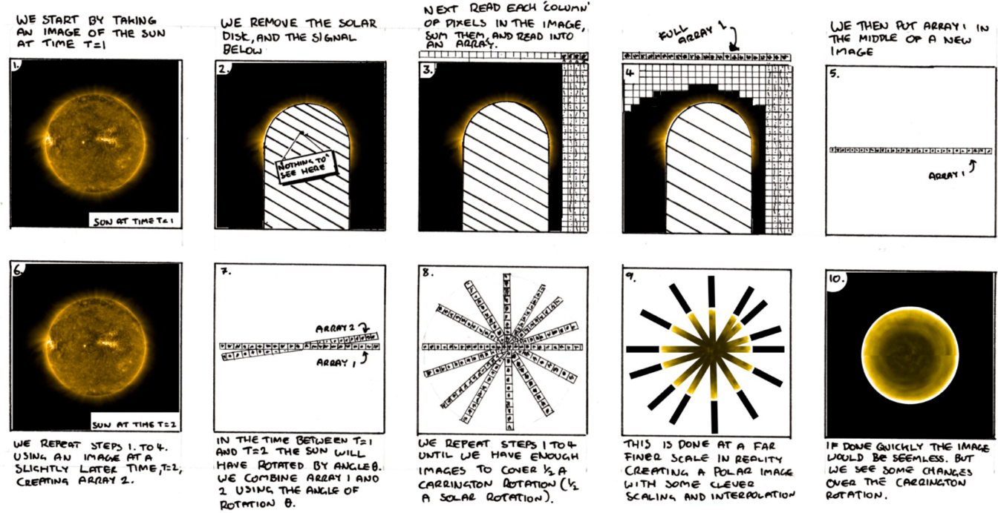
Exploring The Solar Poles From The L1 Perspective | Matthew J West – Royal Observatory of Belgium
Reconstructing The Poles
We can take advantage of the optically thin nature of the EUV observations to try and reconstruct what we might see in the polar regions.

Slide 7
Reconstructing The Poles
Notes:
So for those of you who are not familiar with Post-flare giant arches I thought I'd begin with a quick introduction.

Slide 8
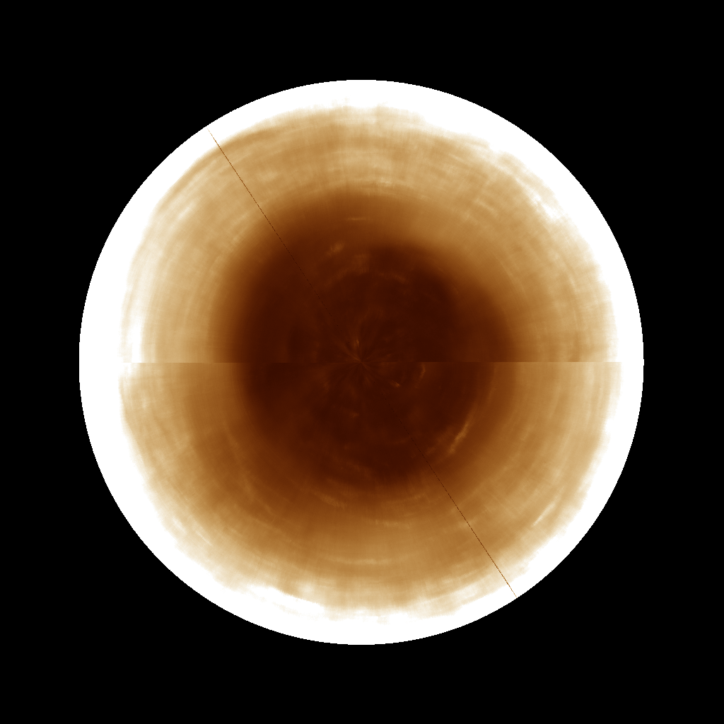
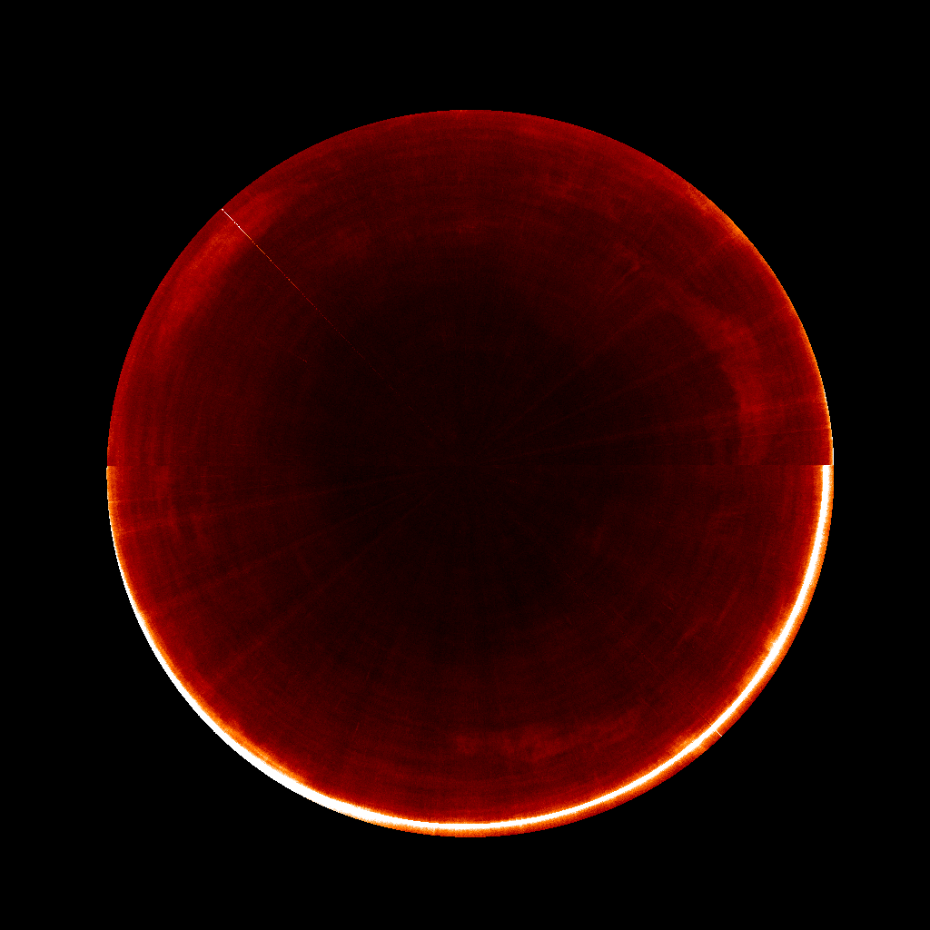
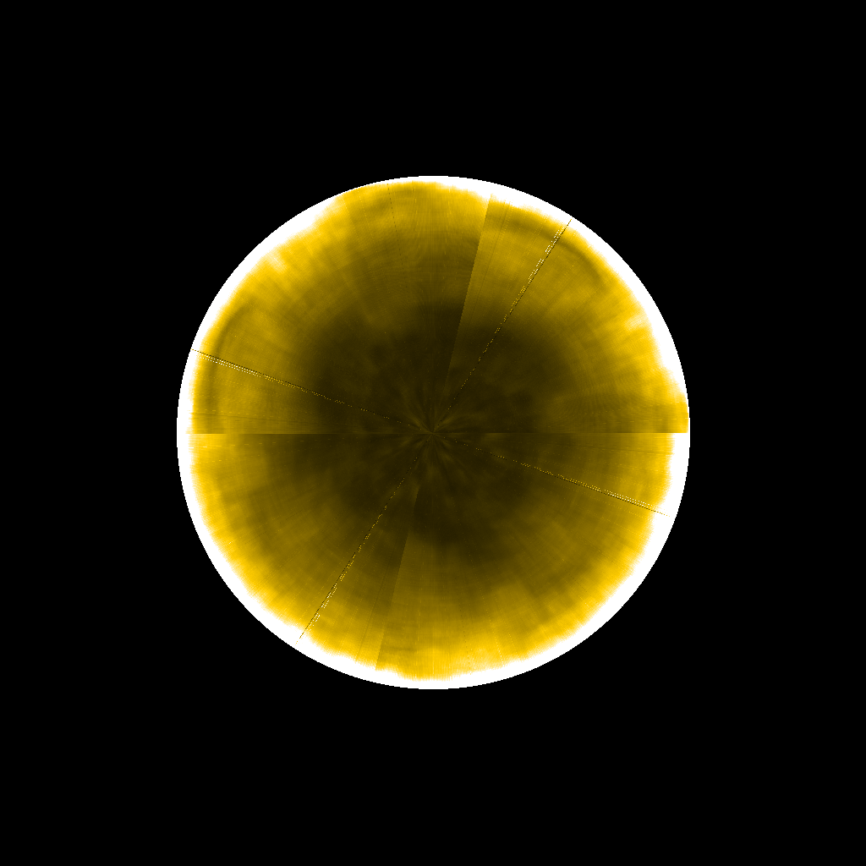
Exploring The Solar Poles From The L1 Perspective | Matthew J West – Royal Observatory of Belgium
Reconstructing The Poles
Basic polar reconstructions, using the techniques described in Figure 2, with AIA 193Å (left) 304Å (center) and SWAP 174Å (right).

Slide 9
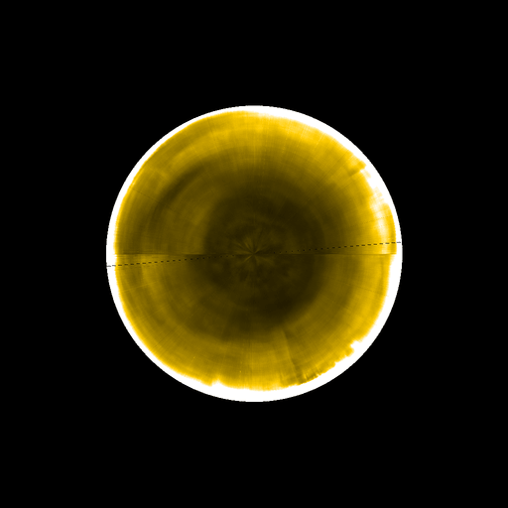
Exploring The Solar Poles From The L1 Perspective | Matthew J West – Royal Observatory of Belgium
Reconstructing The Poles

Slide 10
Exploring The Solar Poles From The L1 Perspective | Matthew J West – Royal Observatory of Belgium
Reconstructing The Poles
We are currently constructing polar images of the Northern solar pole on a daily basis, which can be found here:
proba2.oma.be/swap/data/polar_sun/SWAPpolarImageWithEdge/
and here:
proba2.oma.be/swap/data/polar_sun/SWAPpolarImageWithoutEdge/

Slide 11
What Needs To Be Done?
Notes:
So for those of you who are not familiar with Post-flare giant arches I thought I'd begin with a quick introduction.

Slide 12
Exploring The Solar Poles From The L1 Perspective | Matthew J West – Royal Observatory of Belgium
What Needs To Be Done?
Room for improvement - Over the coming months you can expect to see several improvements in the way the above images are generated. These will include:
The technique currently assumes that all the emission is coming from a single plane. This will be refined by using a single strip of pixels around the solar disk.
Back projection tomography will be implemented to more accurately reconstruct the pole following the techniques described in de Patoul. Sol Phys, 2011.

Slide 13
Exploring The Solar Poles From The L1 Perspective | Matthew J West – Royal Observatory of Belgium
What Needs To Be Done?
An improved radial filter and differential rotation algorithm will be applied to help improve the saturated limb contribution.
The line generated due to using half a Carrington rotation of images will be reduced using some smoothing and interpolation techniques.
Different wavelengths from the SDO/AIA and NOAA/SUVI mission will be used to see differing structures observed in different wavelengths and temperatures.

Slide 14
Why Are We Interested?
Notes:
So for those of you who are not familiar with Post-flare giant arches I thought I'd begin with a quick introduction.

Slide 15
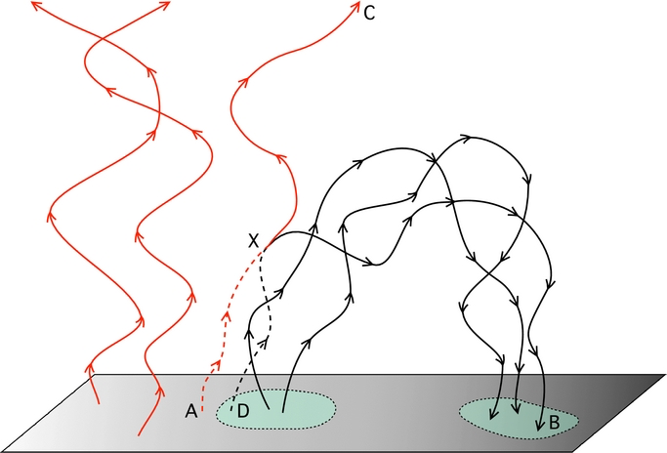
Exploring The Solar Poles From The L1 Perspective | Matthew J West – Royal Observatory of Belgium
Why Are We Interested?
There are still several open questions and areas of research concerning this region, these include:-
The study of the polar coronal holes and their boundaries, in particular studying the dynamics / processes occurring between the open and closed magnetic flux at the boundaries (e.g. interchange reconnection), and on a longer time-scale the formation of the polar coronal holes.
Rappazzo et al. APJL 2012

Slide 16
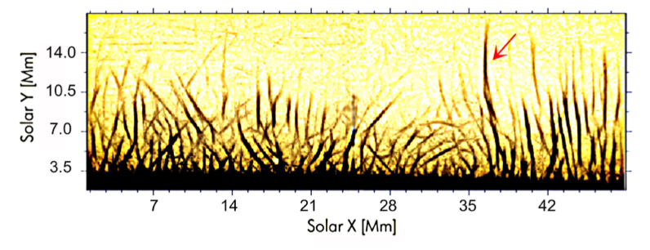
Exploring The Solar Poles From The L1 Perspective | Matthew J West – Royal Observatory of Belgium
Why Are We Interested?
Wave propagation in the polar regions has not been fully explored, especially Alfvén wave propagation. In particular, looking for further evidence of wave emergence from below (spicules) or waves generated by reconnection (brightenings) higher up in the region.
Ulysses revealed one pole of the Sun is cooler than the other. Studying this region may help reveal heating processes occurring in the regions.
Tavabi et al. A&A 2015

Slide 17

Exploring The Solar Poles From The L1 Perspective | Matthew J West – Royal Observatory of Belgium
Why Are We Interested?
On a larger-scale, global waves (Rossby-like) related to coronal hole boundaries.
Courtesy of McIntosh

